Slide 1


Slide 2
Books
“ Digital Design” By M. Morris Mano and Michael D.Ciletti
Logical Design and Application By Dr. Krishnanaik Vankdoth LAP LAMBERT Academic Publishing Dnfscland/Germany – 2014
Complementary Material “ Logic and Computer Design Fundamentals ” By M. Morris Mano & Charles R Kime.

Slide 3


Slide 4
Logic Design
    Deals with the basic concepts and tools used to design digital hardware consisting of logic circuits,
        Circuits to perform arithmetic operations (+, -, x, ÷)

Slide 5
Digital Signal : Decimal values are difficult to represent in electrical systems. It is easier to use two voltage values than ten.
Digital Signals have two basic states:
      1 (logic “high”, or H, or “on”)
      0 (logic “low”, or L, or “off”)
Digital values are in a binary format. Binary means 2 states.
A good example of binary is a light (only on or off)
on
off
Power switches have labels “1” for on and “0” for off.

Slide 6
Binary Digital Signal
An information variable represented by physical quantity.
For digital systems, the variable takes on discrete values.
  Two level, or binary values are the most prevalent values.
Binary values are represented abstractly by:
  Digits 0 and 1
  Words (symbols) False (F) and True (T)
  Words (symbols) Low (L) and High (H)
  And words On and Off
Binary values are represented by values or ranges of values of physical quantities.
V(t)
Logic 1
undefine
Logic 0
t
Binary digital signal

Slide 7

Decimal Number System
Base (also called radix) = 10
  10 digits { 0, 1, 2, 3, 4, 5, 6, 7, 8, 9 }
Digit Position
  Integer & fraction
Digit Weight
  Weight = (Base) ^{Position}
Magnitude
  Sum of “Digit x Weight”
Formal Notation
2
1
0
-1
-2
5
1
2
7
4
100
10
1
0.1
0.01
500
10
2
0.7
0.04
d₂*B²+d₁*B¹+d₀*B⁰+d₋₁*B⁻¹+d₋₂*B⁻²
(512.74)₁₀

Slide 8
Octal Number System
Base = 8
  8 digits { 0, 1, 2, 3, 4, 5, 6, 7 }
Weights
  Weight = (Base) ^{Position}
Magnitude
  Sum of “Digit x Weight”
Formal Notation
64
8
1
1/8
1/64
5
1
2
7
4
2
1
0
-1
-2
5 *8²+1 *8¹+2 *8⁰+7 *8⁻¹+4 *8⁻²
=(330.9375)₁₀
(512.74)₈

Slide 9
Binary Number System
Base = 2
  2 digits { 0, 1 }, called binary digits or “bits”
Weights
  Weight = (Base) ^{Position}
Magnitude
  Sum of “Bit x Weight”
Formal Notation
Groups of bits 4 bits = Nibble
8 bits = Byte
4
2
1
1/2
1/4
1
0
1
0
1
2
1
0
-1
-2
1 *2²+0 *2¹+1 *2⁰+0 *2⁻¹+1 *2⁻²
=(5.25)₁₀
(101.01)₂
1 0 1 1
1 1 0 0 0 1 0 1

Slide 10
Hexadecimal Number System
Base = 16
  16 digits { 0, 1, 2, 3, 4, 5, 6, 7, 8, 9, A, B, C, D, E, F }
Weights
  Weight = (Base) ^{Position}
Magnitude
  Sum of “Digit x Weight”
Formal Notation
256
16
1
1/16
1/256
1
E
5
7
A
2
1
0
-1
-2
1 *16²+14 *16¹+5 *16⁰+7 *16⁻¹+10 *16⁻²
=(485.4765625)₁₀
(1E5.7A)₁₆

Slide 11
The Power of 2
n | 2^{n}
0 | 2⁰=1
1 | 2¹=2
2 | 2²=4
3 | 2³=8
4 | 2⁴=16
5 | 2⁵=32
6 | 2⁶=64
7 | 2⁷=128
n | 2^{n}
8 | 2⁸=256
9 | 2⁹=512
10 | 2¹⁰=1024
11 | 2¹¹=2048
12 | 2¹²=4096
20 | 2²⁰=1M
30 | 2³⁰=1G
40 | 2⁴⁰=1T
Kilo
Mega
Giga
Tera

Slide 12
Addition
Decimal Addition
1
1
Carry
5
5
+
5
5
1
1
0
= Ten ≥ Base
➔ Subtract a Base

Slide 13
Binary Addition
Column Addition
1
1
1
1
1
1
1
1
1
1
0
1
= 61
= 23
+
1
0
1
1
1
1
0
1
0
1
0
0
= 84
≥ (2)₁₀

Slide 14
Binary Subtraction
Borrow a “Base” when needed
1
2
= (10)₂
0
2
2
0
0
2
1
0
0
1
1
0
1
= 77
= 23
−
1
0
1
1
1
0
1
1
0
1
1
0
= 54

Slide 15
Binary Multiplication
Bit by bit
1
0
1
1
1
x
1
0
1
0
0
0
0
0
0
1
0
1
1
1
0
0
0
0
0
1
0
1
1
1
1
1
1
0
0
1
1
0

Slide 16
Number Base Conversions
Evaluate Magnitude
Octal
(Base 8)
Evaluate Magnitude
Decimal
(Base 10)
Binary
(Base 2)
Hexadecimal
(Base 16)
Evaluate Magnitude

Slide 17
Decimal (Integer) to Binary Conversion
Divide the number by the ‘Base’ (=2)
Take the remainder (either 0 or 1) as a coefficient
Take the quotient and repeat the division
Example: (13)₁₀
Quotient
Remainder
Coefficient
13
/ 2 = 6
1 a₀ = 1
6
/ 2 = 3
0 a₁ = 0
3
/ 2 = 1
1 a₂ = 1
1
/ 2 = 0
1 a₃ = 1
Answer: (13)₁₀ = (a₃ a₂ a₁ a₀)₂ = (1101)₂
MSB LSB

Slide 18
Decimal (Fraction) to Binary Conversion
Multiply the number by the ‘Base’ (=2)
Take the integer (either 0 or 1) as a coefficient
Take the resultant fraction and repeat the division
Example: (0.625)₁₀
Integer
Fraction
Coefficient
0.625
* 2 = 1 . 25
a₋₁ = 1
0.25
* 2 = 0 . 5 a₋₂ = 0
0.5
* 2 = 1 . 0 a₋₃ = 1
Answer: (0.625)₁₀ = (0.a₋₁ a₋₂ a₋₃)₂ = (0.101)₂
MSB LSB

Slide 19
Decimal to Octal Conversion
Example: (175)₁₀
Quotient
Remainder
Coefficient
175
/ 8 = 21
7 a₀ = 7
21
/ 8 = 2
5 a₁ = 5
2
/ 8 = 0
2 a₂ = 2
Answer: (175)₁₀ = (a₂ a₁ a₀)₈ = (257)₈
Example: (0.3125)₁₀
Integer
Fraction
Coefficient
0.3125
* 8 = 2 . 5
a₋₁ = 2
0.5
* 8 = 4 . 0 a₋₂ = 4
Answer: (0.3125)₁₀ = (0.a₋₁ a₋₂ a₋₃)₈ = (0.24)₈

Slide 20
Binary − Octal Conversion
Octal | Binary
0 | 0 0 0
1 | 0 0 1
2 | 0 1 0
3 | 0 1 1
4 | 1 0 0
5 | 1 0 1
6 | 1 1 0
7 | 1 1 1
8 = 2³
Each group of 3 bits represents an octal digit
Example:
Assume Zeros
( 1 0 1 1 0 . 0 1 )₂
( 2 6 . 2 )₈
Works both ways (Binary to Octal & Octal to Binary)

Slide 21
Binary − Hexadecimal Conversion
Hex | Binary
0 | 0 0 0 0
1 | 0 0 0 1
2 | 0 0 1 0
3 | 0 0 1 1
4 | 0 1 0 0
5 | 0 1 0 1
6 | 0 1 1 0
7 | 0 1 1 1
8 | 1 0 0 0
9 | 1 0 0 1
A | 1 0 1 0
B | 1 0 1 1
C | 1 1 0 0
D | 1 1 0 1
E | 1 1 1 0
F | 1 1 1 1
16 = 2⁴
Each group of 4 bits represents a hexadecimal digit
Assume Zeros
Example:
( 1 0 1 1 0 . 0 1 )₂
( 1 6 . 4 )₁₆
Works both ways (Binary to Hex & Hex to Binary)

Slide 22
Octal − Hexadecimal Conversion
Convert to Binary as an intermediate step
Example:
( 2 6 . 2 )₈
Assume Zeros
Assume Zeros
( 0 1 0 1 1 0 . 0 1 0 )₂
( 1 6 . 4 )₁₆
Works both ways (Octal to Hex & Hex to Octal)

Slide 23
Decimal, Binary, Octal and Hexadecimal
Decimal | Binary | Octal | Hex
00 | 0000 | 00 | 0
01 | 0001 | 01 | 1
02 | 0010 | 02 | 2
03 | 0011 | 03 | 3
04 | 0100 | 04 | 4
05 | 0101 | 05 | 5
06 | 0110 | 06 | 6
07 | 0111 | 07 | 7
08 | 1000 | 10 | 8
09 | 1001 | 11 | 9
10 | 1010 | 12 | A
11 | 1011 | 13 | B
12 | 1100 | 14 | C
13 | 1101 | 15 | D
14 | 1110 | 16 | E
15 | 1111 | 17 | F

Slide 24
Complements
There are two types of complements for each base-r system: the radix complement and diminished radix complement.
Diminished Radix Complement - (r-1)’s Complement
  Given a number N in base r having n digits, the (r–1)’s complement of N is defined as:
  (r^{n} –1) – N
Example for 6-digit decimal numbers:
  9’s complement is (r^{n} – 1)–N = (10⁶–1)–N = 999999–N
  9’s complement of 546700 is 999999–546700 = 453299
Example for 7-digit binary numbers:
  1’s complement is (r^{n} – 1) – N = (2⁷–1)–N = 1111111–N
  1’s complement of 1011000 is 1111111–1011000 = 0100111
Observation:
  Subtraction from (r^{n} – 1) will never require a borrow
  Diminished radix complement can be computed digit-by-digit
  For binary: 1 – 0 = 1 and 1 – 1 = 0

Slide 25
Complements
1’s Complement (Diminished Radix Complement)
  All ‘0’s become ‘1’s
  All ‘1’s become ‘0’s
  Example (10110000)₂
  ⇨ (01001111)₂
  If you add a number and its 1’s complement …
1 0 1 1 0 0 0 0
+ 0 1 0 0 1 1 1 1
1 1 1 1 1 1 1 1

Slide 26
Complements
Radix Complement
Example: Base-10
Example: Base-2
The r's complement of an n-digit number N in base r is defined as
r^{n} – N for N ≠ 0. Comparing with the (r − 1) 's complement, we note that the r's complement is obtained by adding 1 to the (r − 1) 's complement, since r^{n} – N = [(r^{n} − 1) – N] + 1.
The 10's complement of 012398 is 987602
The 10's complement of 246700 is 753300
The 2's complement of 1101100 is 0010100
The 2's complement of 0110111 is 1001001

Slide 27
Complements
2’s Complement (Radix Complement)
  Take 1’s complement then add 1
  Toggle all bits to the left of the first ‘1’ from the right
  Example:
  Number:
  1’s Comp.:
OR
1 0 1 1 0 0 0 0
0 1 0 0 1 1 1 1
+ 1
1 0 1 1 0 0 0 0
0 1 0 1 0 0 0 0
0
1
0
1
0
0
0
0

Slide 28
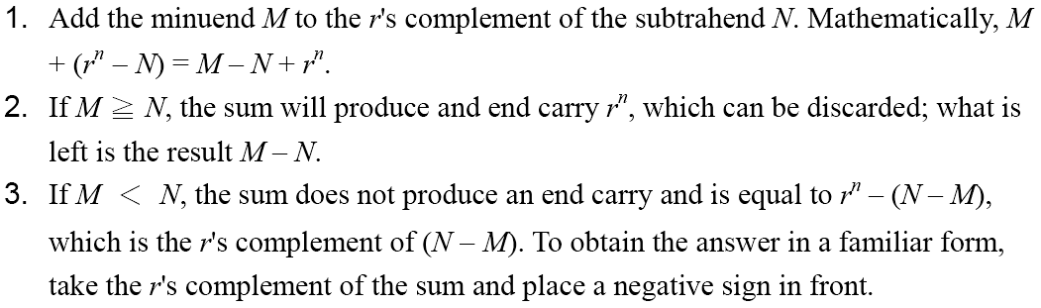
Complements
Subtraction with Complements
  The subtraction of two n-digit unsigned numbers M – N in base r can be done as follows:

Slide 29
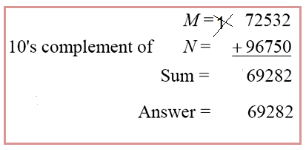
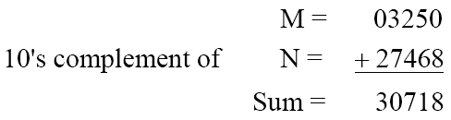
Complements
Example
  Using 10's complement, subtract 72532 – 3250.
Example
  Using 10's complement, subtract 3250 – 72532.
There is no end carry.
Therefore, the answer is – (10's complement of 30718) = − 69282.

Slide 30
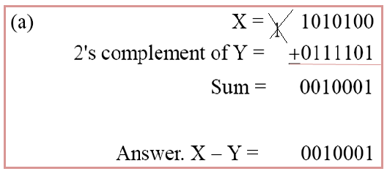
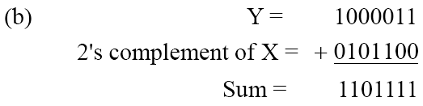
Complements
Example
  Given the two binary numbers X = 1010100 and Y = 1000011, perform the subtraction (a) X – Y ; and (b) Y − X, by using 2's complement.
There is no end carry. Therefore, the answer is Y – X = − (2's complement of 1101111) = − 0010001.

Slide 31
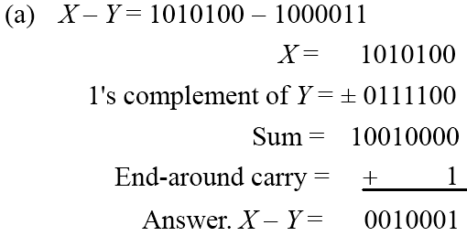
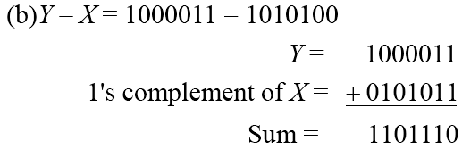
Complements
Subtraction of unsigned numbers can also be done by means of the (r − 1)'s complement. Remember that the (r − 1) 's complement is one less then the r's complement.
Example
  Repeat Example , but this time using 1's complement.
There is no end carry, Therefore, the answer is Y – X = − (1's complement of 1101110) = − 0010001.

Slide 32
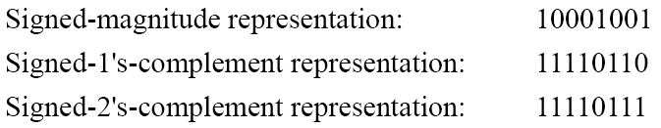
Signed Binary Numbers
To represent negative integers, we need a notation for negative values.
It is customary to represent the sign with a bit placed in the leftmost position of the number since binary digits.
The convention is to make the sign bit 0 for positive and 1 for negative.
Example:
Table 1.3 lists all possible four-bit signed binary numbers in the three representations.

Slide 33
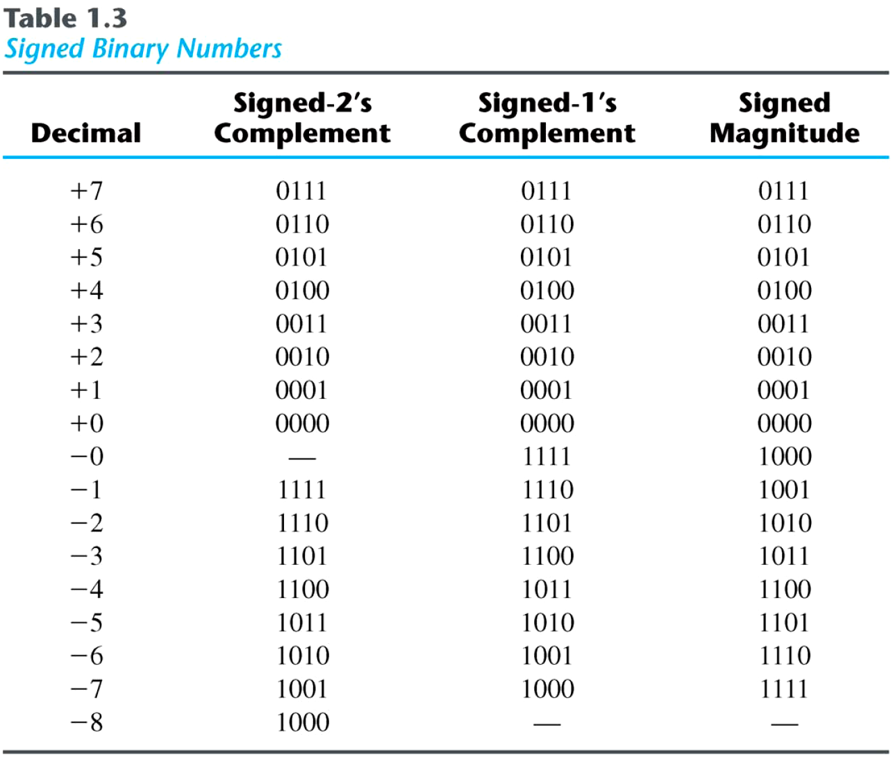
Signed Binary Numbers

Slide 34
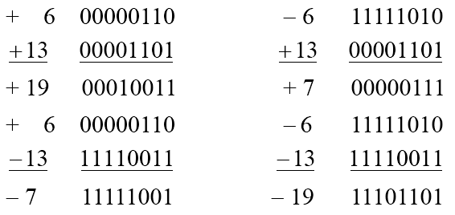
Signed Binary Numbers
Arithmetic addition
  The addition of two numbers in the signed-magnitude system follows the rules of ordinary arithmetic. If the signs are the same, we add the two magnitudes and give the sum the common sign. If the signs are different, we subtract the smaller magnitude from the larger and give the difference the sign if the larger magnitude.
  The addition of two signed binary numbers with negative numbers represented in signed-2's-complement form is obtained from the addition of the two numbers, including their sign bits.
  A carry out of the sign-bit position is discarded.
Example:

Slide 35
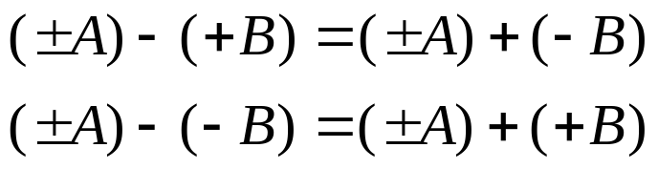
Signed Binary Numbers
Arithmetic Subtraction
  In 2’s-complement form:
Example:
Take the 2’s complement of the subtrahend (including the sign bit) and add it to the minuend (including sign bit).
A carry out of sign-bit position is discarded.
(− 6) − (− 13)
(11111010 − 11110011)
(11111010 + 00001101)
00000111 (+ 7)

