Slide 1
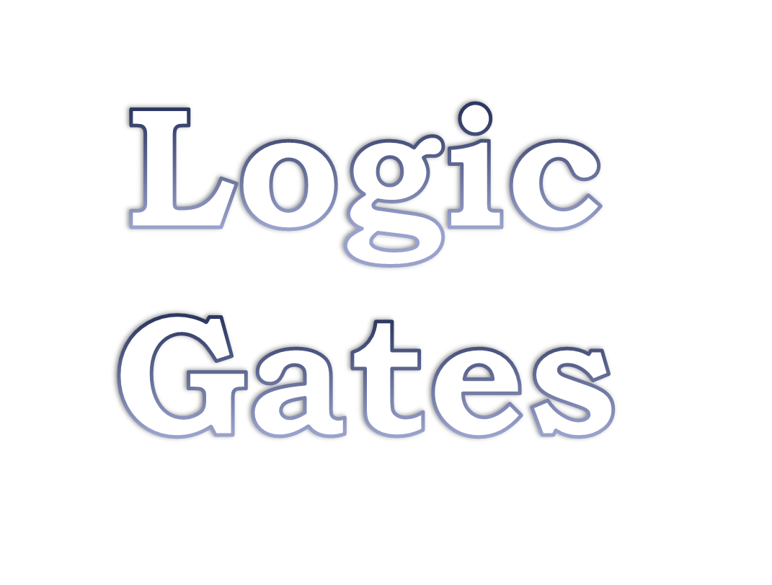

Slide 2
Logic Gates and Functions
  Introduction to Digital Logic Gates
    Truth table
    Symbol
    Universal Gates (NAND/NOR)
    XOR and XNOR Gates
  Logic Chips
  Logic Functions
    Logical Equivalence
    Standard Forms (SOP/POS)

Slide 3
Introduction to Digital Logic Basics
Hardware consists of a few simple building blocks
  These are called logic gates
    AND, OR, NOT, …
    NAND, NOR, XOR, …
Logic gates are built using transistors
    NOT gate can be implemented by a single transistor
    AND gate requires 3 transistors
Transistors are the fundamental devices
    Pentium consists of 3 million transistors
    Compaq Alpha consists of 9 million transistors
    Now we can build chips with more than 100 million transistors

Slide 4
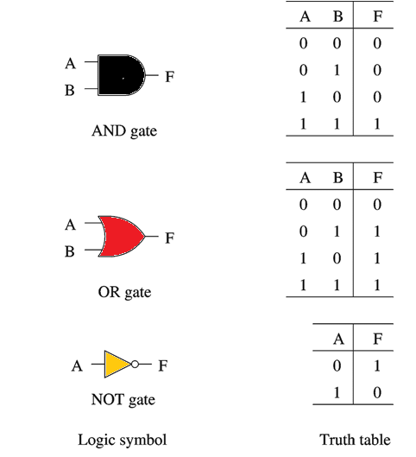
Basic Concepts
Simple gates
  AND
  OR
  NOT
Functionality can be expressed by a truth table
  A truth table lists output for each possible input combination
Precedence
  NOT > AND > OR
  F = A B + A B
  = (A (B)) + ((A) B)

Slide 5
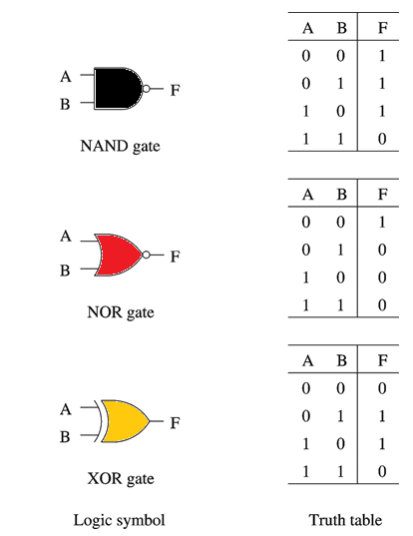
Basic Concepts (cont.)
Additional useful gates
  NAND
  NOR
  XOR
NAND = AND + NOT
NOR = OR + NOT
XOR implements exclusive-OR function
NAND and NOR gates require only 2 transistors
  AND and OR need 3 transistors!

Slide 6
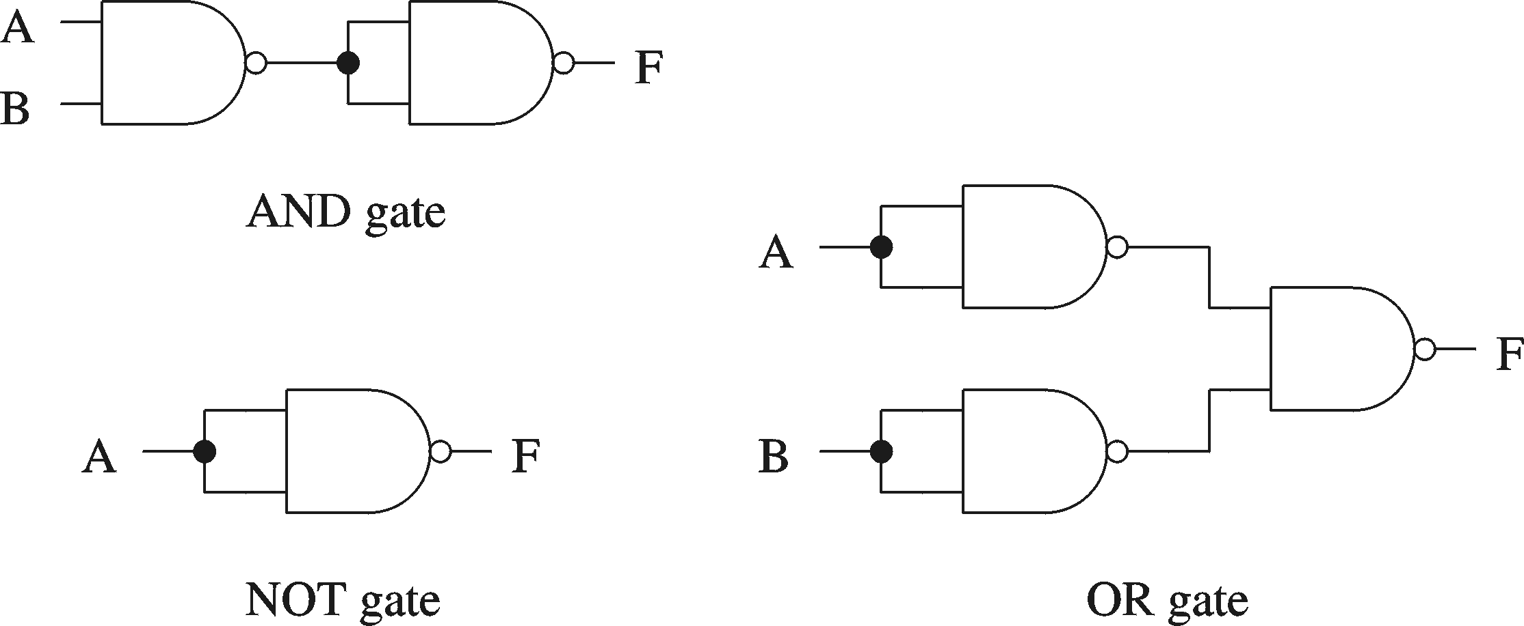
Basic Concepts (cont.)
Proving NAND gate is universal

Slide 7
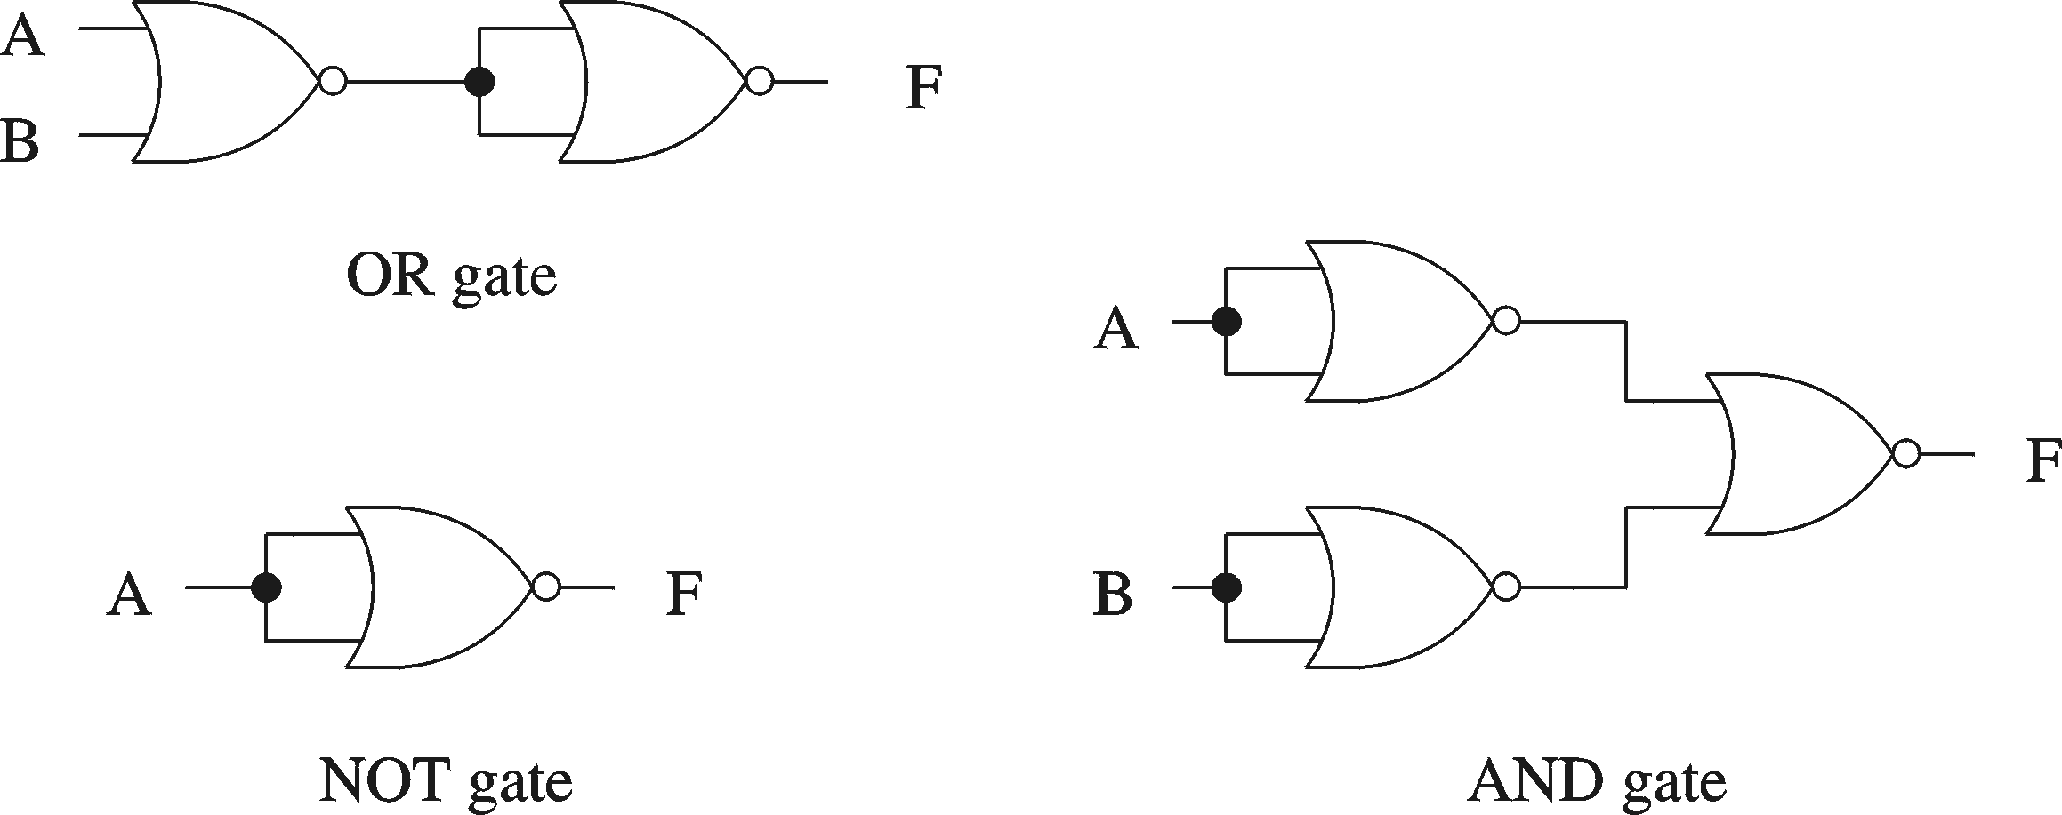
Basic Concepts (cont.)
Proving NOR gate is universal

Slide 8

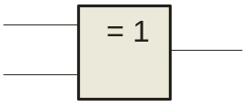
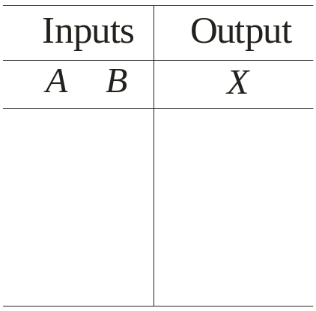
XOR and XNOR Gates
The XOR Gate
A
X
A
X
B
B
The XOR gate produces a HIGH output only when the inputs are at opposite logic levels. The truth table is
0 0
0 1
1 0
1 1
0
1
1
0
The XOR operation is written as X = AB + AB. Alternatively, it can be written with a circled plus sign between the variables as X = A + B.
Notes:
-XOR gate has only two inputs.

Slide 9
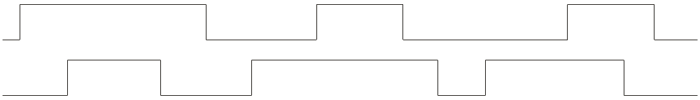
The XOR Gate
A
X
A
X
B
B
Example waveforms:
A
B
X
Notice that the XOR gate will produce a HIGH only when exactly one input is HIGH.

Slide 10

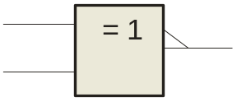
The XNOR Gate
A
X
A
X
B
B
The XNOR gate produces a HIGH output only when the inputs are at the same logic level. The truth table is
0 0
0 1
1 0
1 1
1
0
0
1
The XNOR operation can be shown as X = AB + AB.
Notes:
-XNOR gate has only two inputs.

Slide 11
The XNOR Gate
A
X
A
X
B
B
Example waveforms:
A
B
X
Notice that the XNOR gate will produce a HIGH when both inputs are the same. This makes it useful for comparison functions.

Slide 12
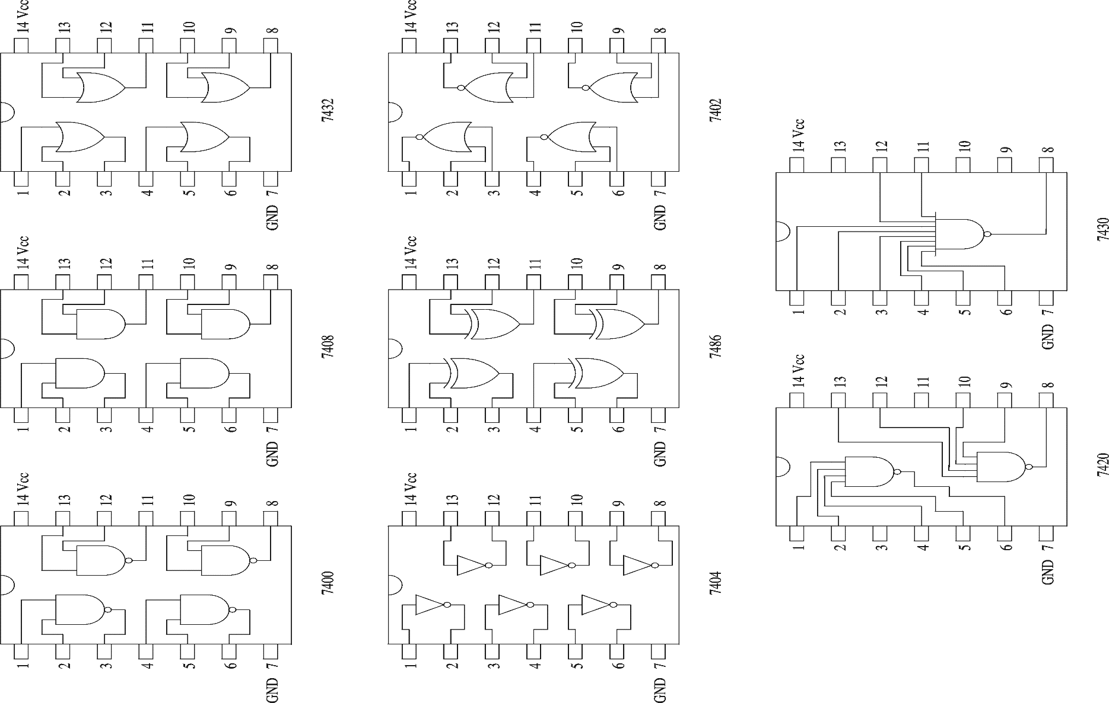
Logic Chips

Slide 13
Logic Chips (cont.)
Integration levels
  SSI (small scale integration)
    Introduced in late 1960s
    1-10 gates (previous examples)
  MSI (medium scale integration)
    Introduced in late 1960s
    10-100 gates
  LSI (large scale integration)
    Introduced in early 1970s
    100-10,000 gates
  VLSI (very large scale integration)
    Introduced in late 1970s
    More than 10,000 gates

Slide 14
Logic Functions
Number of functions
  With N logical variables, we can define
  2^{N} combination of inputs
  A function relates outputs to inputs
  Some of them are useful
    AND, NAND, NOR, XOR, …
  Some are not useful:
    Output is always 1
    Output is always 0

Slide 15
Logic Functions
Logical functions can be expressed in several ways:
  Truth table
  Logical expressions
  Graphical form
Example:
  Majority function
    Output is one whenever majority of inputs is 1
    We use 3-input majority function

Slide 16
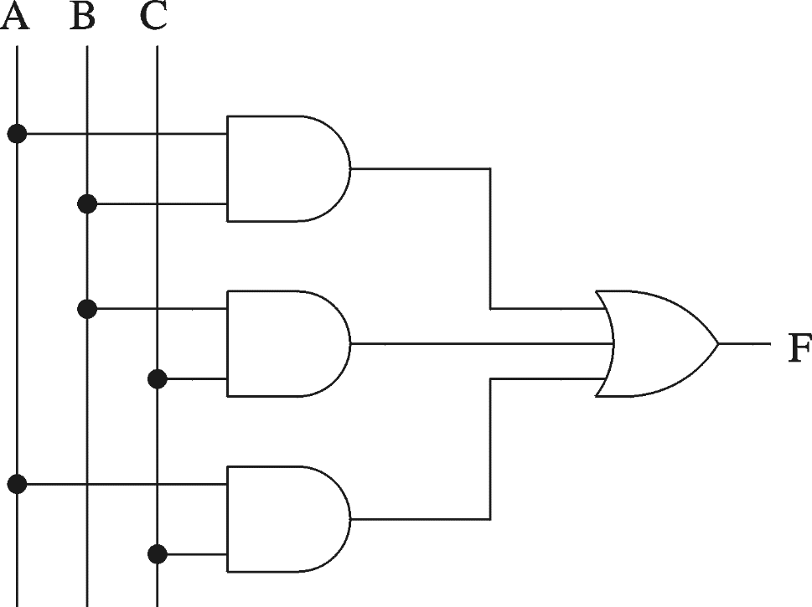
Logic Functions (cont.)
3-input majority function
A B C F
0 0 0 0
0 0 1 0
0 1 0 0
0 1 1 1
1 0 0 0
1 0 1 1
1 1 0 1
1 1 1 1
Logical expression form
F = A B + B C + A C

Slide 17
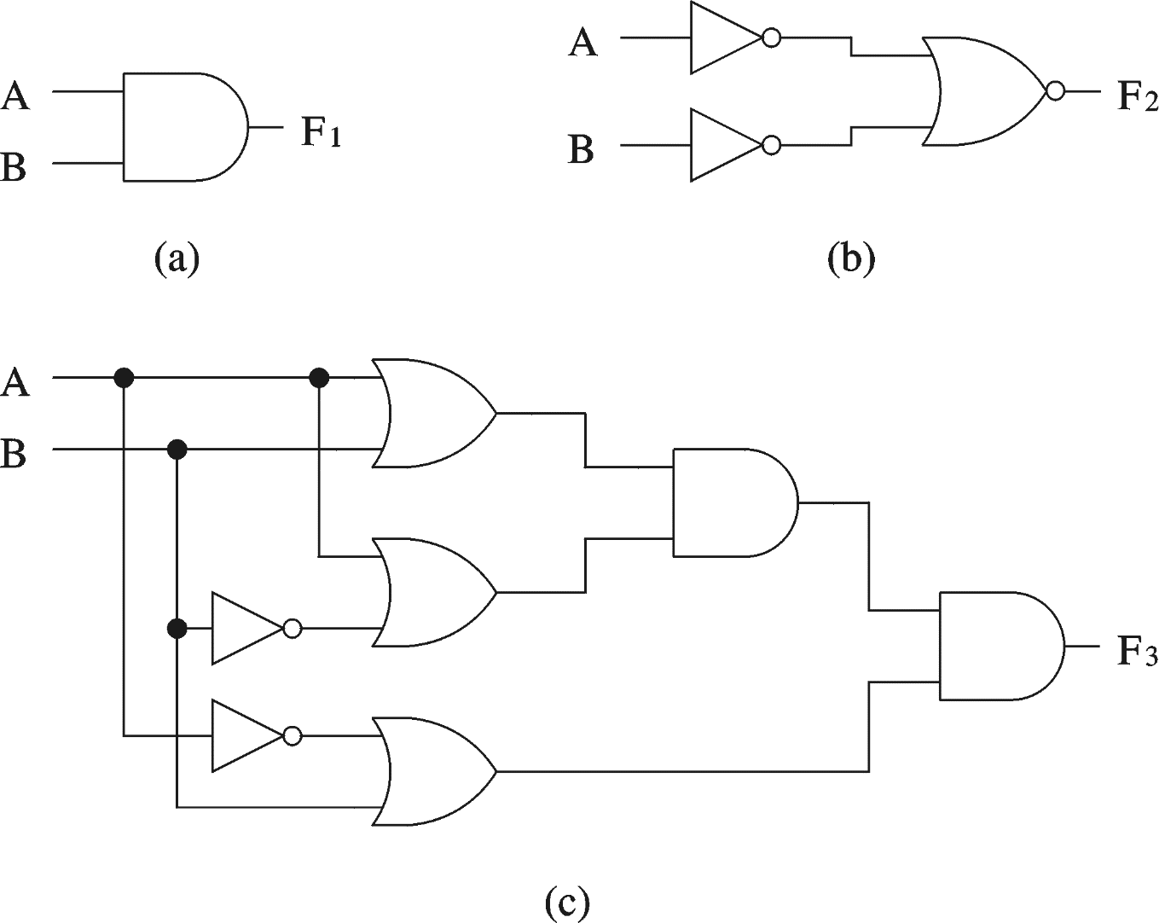
Logical Equivalence
All three circuits implement F = A B function

Slide 18
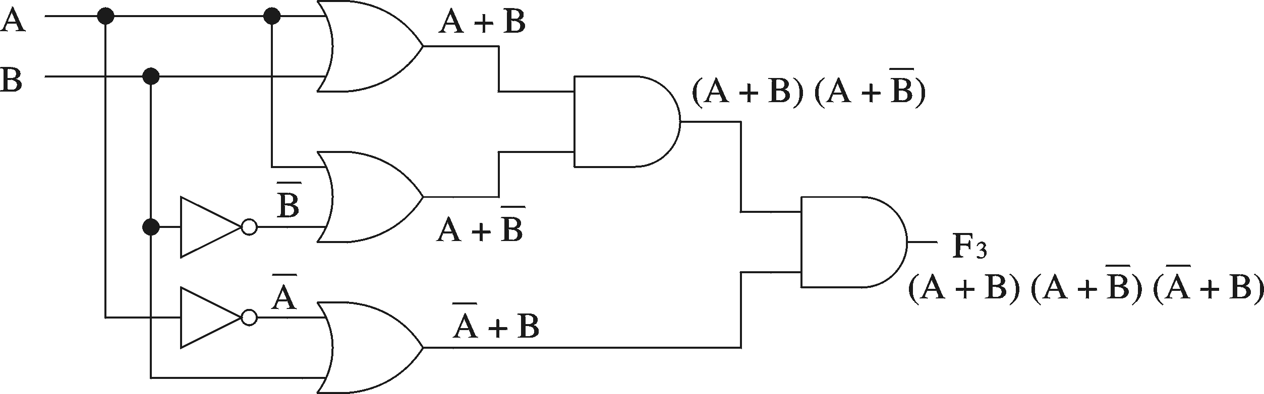
Logical Equivalence
Derivation of logical expression from a circuit
  Trace from the input to output
    Write down intermediate logical expressions along the path

Slide 19
Logical Equivalence (cont.)
Proving logical equivalence: Truth table method
  A B F1 = A B F3 = (A + B) (A + B) (A + B)
  0 0 0 0
  0 1 0 0
  1 0 0 0
  1 1 1 1

Slide 20
Standard Forms for
Boolean Expressions
Sum-of-Products (SOP)
  Derived from the Truth table for a function by considering those rows for which F = 1.
  The logical sum (OR) of product (AND) terms.
  Realized using an AND-OR circuit.
Product-of-Sums (POS)
  Derived from the Truth table for a function by considering those rows for which F = 0.
  The logical product (AND) of sum (OR) terms.
  Realized using an OR-AND circuit.

Slide 21
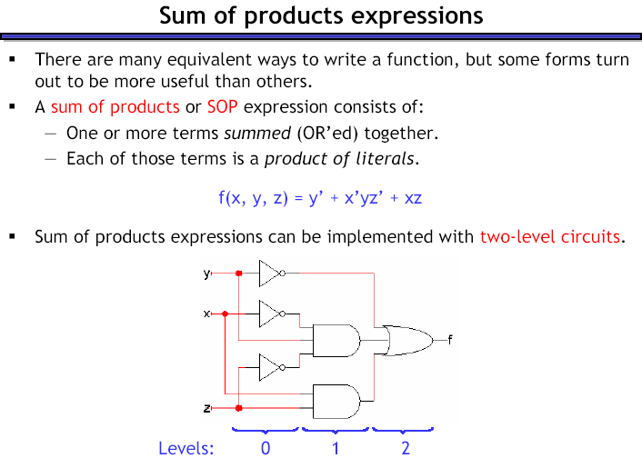
1

Slide 22
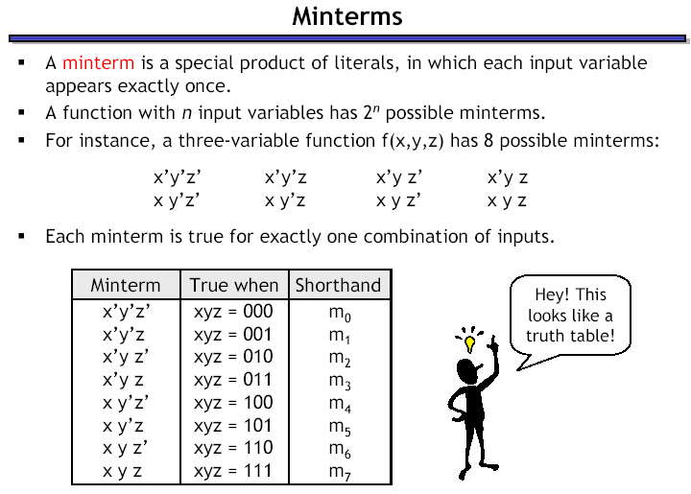

Slide 23




Minterms

Slide 24
Sum-of-Products
Any function F can be represented by a sum of minterms, where each minterm is ANDed with the corresponding value of the output for F.
  F = Σ (m_{i} . f_{i})
    where m_{i} is a minterm
    and f_{i} is the corresponding functional output
  Only the minterms for which f_{i} = 1 appear in the expression for function F.
  F = Σ (m_{i}) = Σ m(i)
Denotes the logical
sum operation
shorthand notation

Slide 25
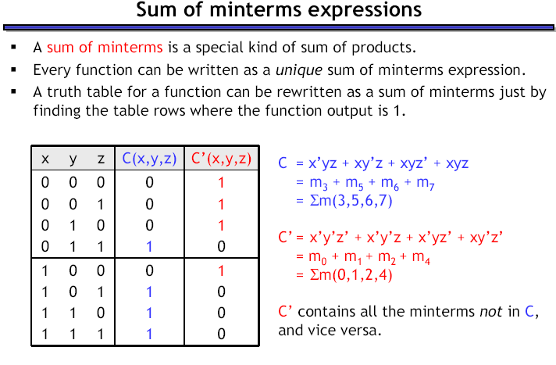

Slide 26
Sum-of-Products
Sum of minterms are a.k.a. Canonical Sum-of-Products
Synthesis process
  Determine the Canonical Sum-of-Products
  Use Boolean Algebra (and K-maps) to find an optimal, functionally equivalent, expression.

Slide 27
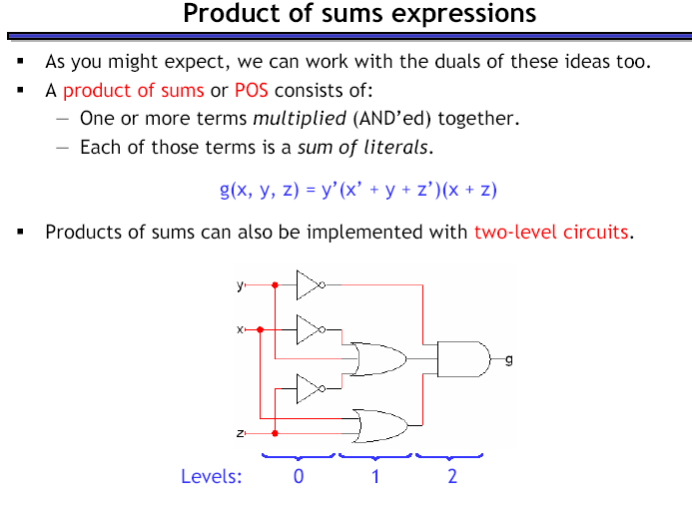
2

Slide 28
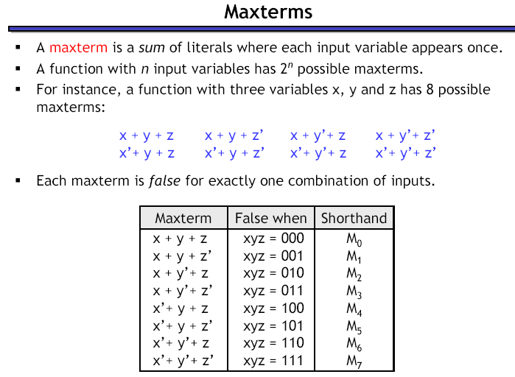

Slide 29
Maxterms

Slide 30
Product-of-Sums
Any function F can be represented by a product of Maxterms, where each Maxterm is ANDed with the complement of the corresponding value of the output for F.
  F = Π (M_{i} . f '_{i})
    where M_{i} is a Maxterm
    and f '_{i} is the complement of the corresponding functional output
  Only the Maxterms for which f_{i} = 0 appear in the expression for function F.
  F = Π (M_{i}) = Π M(i)
Denotes the logical
product operation
shorthand notation

Slide 31
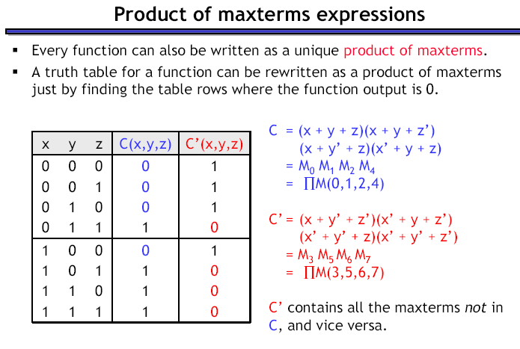

0
When the o/p is Zero
When the o/p is 1

Slide 32
Product-of-Sums
The Canonical Product-of-Sums for function F is the Product-of-Sums expression in which each sum term is a Maxterm.
Synthesis process
  Determine the Canonical Product-of-Sums
  Use Boolean Algebra (and K-maps) to find an optimal, functionally equivalent, expression.

