Slide 1


Slide 2
Sequential Logic
Introduction
Memory Elements
Pulse-Triggered Latch
  S-R Latch
  Gated S-R Latch
  Gated D Latch
Edge-Triggered Flip-flops
  S-R Flip-flop
  D Flip-flop
  J-K Flip-flop
  T Flip-flop
Asynchronous Inputs

Slide 3
Introduction
A sequential circuit consists of a feedback path, and employs some memory elements.
Combinational outputs
Memory outputs
Combinational logic
Memory elements
External inputs
Sequential circuit = Combinational logic + Memory Elements
Introduction

Slide 4
Introduction
There are two types of sequential circuits:
  synchronous: outputs change only at specific time
  asynchronous: outputs change at any time
Multivibrator: a class of sequential circuits. They can be:
  bistable (2 stable states)
  monostable or one-shot (1 stable state)
  astable (no stable state)
Bistable logic devices: latches and flip-flops.
Latches and flip-flops differ in the method used for changing their state.

Slide 5
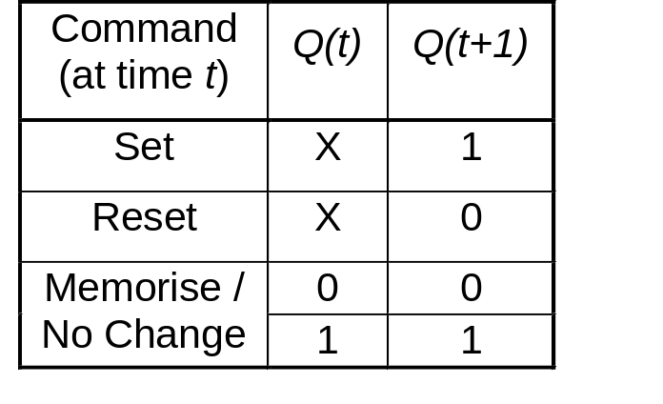
Memory Elements
Memory element: a device which can remember value indefinitely, or change value on command from its inputs.
Characteristic table:
Memory element
Q
command
stored value
Q(t): current state
Q(t+1) or Q⁺: next state
Memory Elements

Slide 6
Memory Elements
Memory element with clock. Flip-flops are memory elements that change state on clock signals.
Clock is usually a square wave.
Memory element
Q
command
stored value
clock
Positive pulses
Positive edges
Negative edges
Memory Elements

Slide 7
Memory Elements
Two types of triggering/activation:
  pulse-triggered
  edge-triggered
Pulse-triggered
  latches
  ON = 1, OFF = 0
Edge-triggered
  flip-flops
  positive edge-triggered (ON = from 0 to 1; OFF = other time)
  negative edge-triggered (ON = from 1 to 0; OFF = other time)
Memory Elements

Slide 8
S-R Latch
Complementary outputs: Q and Q'.
When Q is HIGH, the latch is in SET state.
When Q is LOW, the latch is in RESET state.
For active-HIGH input S-R latch (also known as NOR gate latch),
R=HIGH (and S=LOW)  RESET state
S=HIGH (and R=LOW)  SET state
both inputs LOW  no change
both inputs HIGH  Q and Q' both LOW (invalid)!
S-R Latch

Slide 9
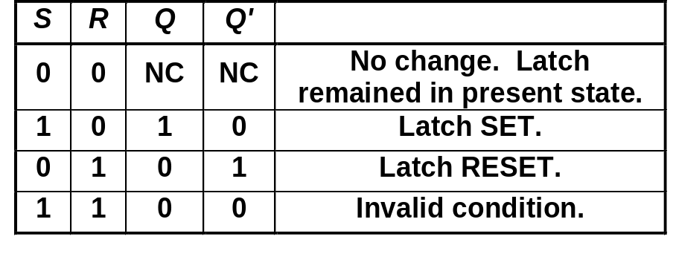
S-R Latch
Characteristics table for active-high input S-R latch:
S
R
Q
Q'

Slide 10
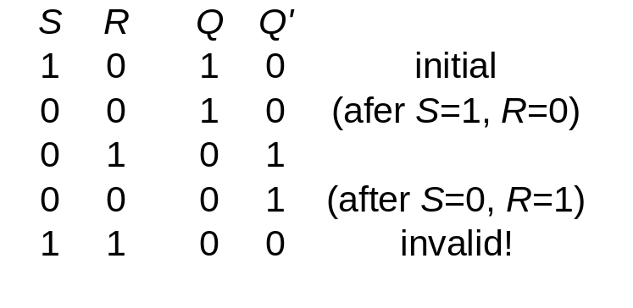
S-R Latch
Active-HIGH input S-R latch
1
0
1
0
0
R
1
1
0
0
Q
0
Q'
0
0
1
1
1
0
0
0
0
1
S

Slide 11
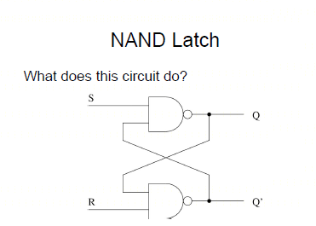

Slide 12
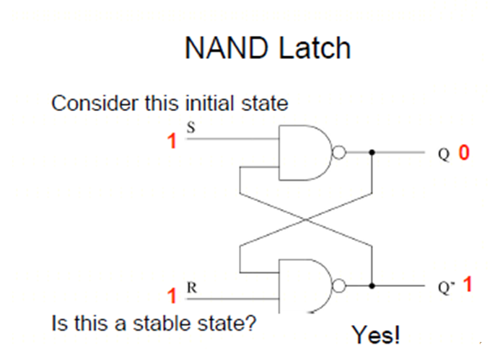

Slide 13
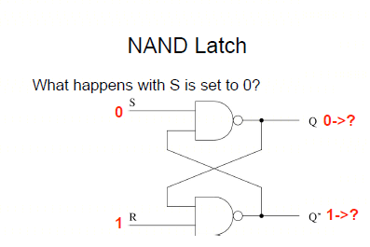

Slide 14
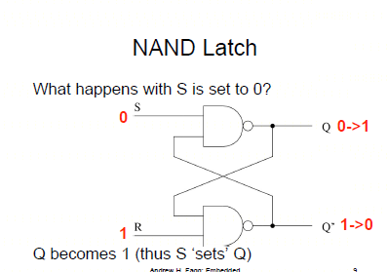

Slide 15
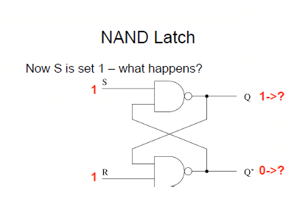

Slide 16
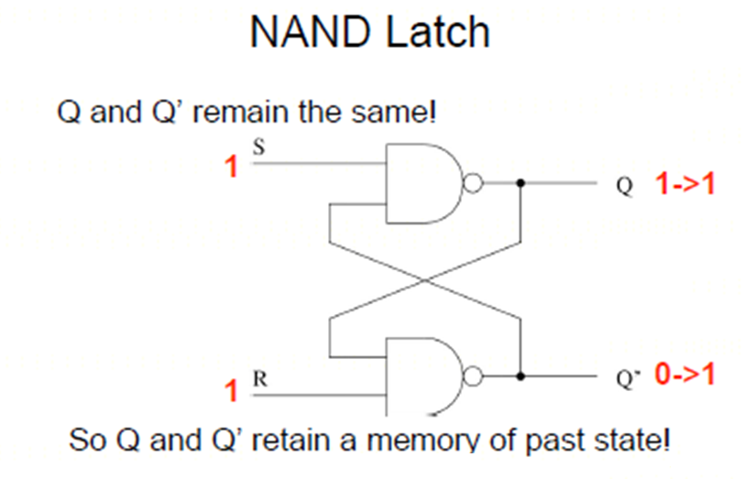

Slide 17
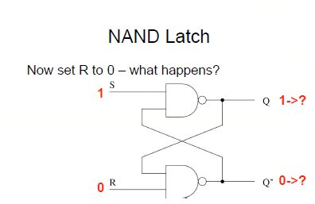

Slide 18
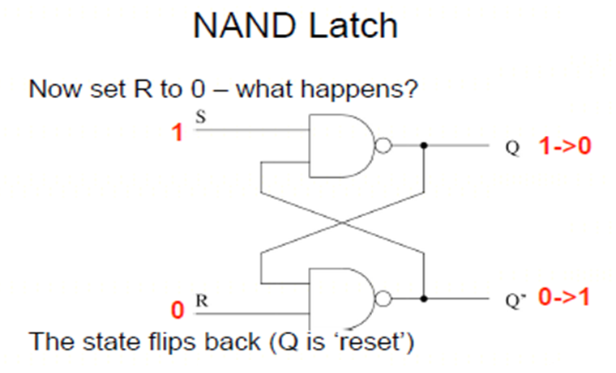

Slide 19
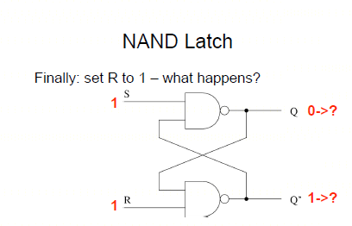

Slide 20
Gated D Latch
Make R input equal to S' → gated D latch.
D latch eliminates the undesirable condition of invalid state in the S-R latch.
D
Q
D
EN
Q
Q'
EN
Q'

Slide 21
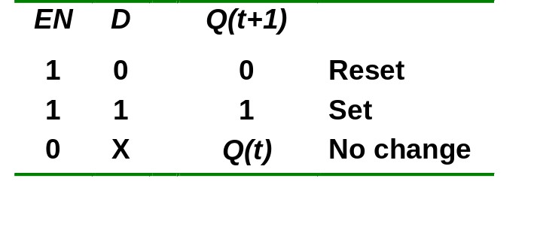
Gated D Latch
When EN is HIGH,
  D=HIGH → latch is SET
  D=LOW → latch is RESET
Hence when EN is HIGH, Q ‘follows’ the D (data) input.
Characteristic table:
When EN=1, Q(t+1) = D

Slide 22
Latch Circuits: Not Suitable
Latch circuits are not suitable in synchronous logic circuits.
When the enable signal is active, the excitation inputs are gated directly to the output Q. Thus, any change in the excitation input immediately causes a change in the latch output.
The problem is solved by using a special timing control signal called a clock to restrict the times at which the states of the memory elements may change.
This leads us to the edge-triggered memory elements called flip-flops.

Slide 23
Edge-Triggered Flip-flops
Flip-flops: synchronous bistable devices
Output changes state at a specified point on a triggering input called the clock.
Change state either at the positive edge (rising edge) or at the negative edge (falling edge) of the clock signal.
Clock signal
Positive edges
Negative edges

Slide 24
Edge-Triggered Flip-flops
S-R, D and J-K edge-triggered flip-flops. Note the “>” symbol at the clock input.
S
C
R
Q
Q'
D
C
Q
Q'
J
C
K
Q
Q'
Positive edge-triggered flip-flops
S
C
R
Q
Q'
D
C
Q
Q'
J
C
K
Q
Q'
Negative edge-triggered flip-flops

Slide 25
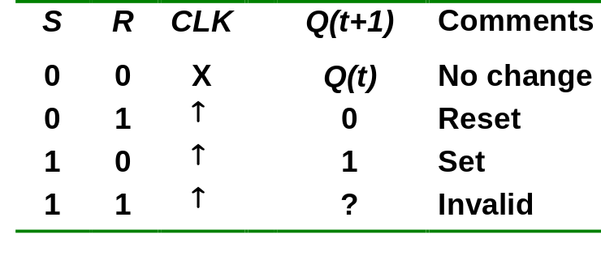
S-R Flip-flop
S-R flip-flop: on the triggering edge of the clock pulse,
  S=HIGH (and R=LOW)  SET state
  R=HIGH (and S=LOW)  RESET state
  both inputs LOW  no change
  both inputs HIGH  invalid
Characteristic table of positive edge-triggered S-R flip-flop:
X = irrelevant (“don’t care”)
↑ = clock transition LOW to HIGH

Slide 26
S-R Flip-flop
It comprises 3 parts:
  a basic NAND latch
  a pulse-steering circuit
  a pulse transition detector (or edge detector) circuit
The pulse transition detector detects a rising (or falling) edge and produces a very short-duration spike.

Slide 27
S-R Flip-flop
The pulse transition detector.
S
Q
Pulse transition detector
CLK
Q'
R
CLK'
CLK'
CLK
CLK*
CLK
CLK*
CLK
CLK
CLK'
CLK'
CLK*
CLK*
Positive-going transition
(rising edge)
Negative-going transition
(falling edge)

Slide 28
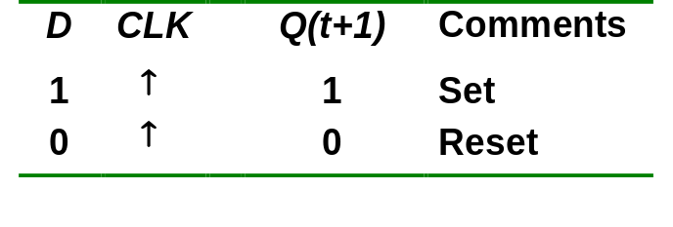
D Flip-flop
D flip-flop: single input D (data)
  D=HIGH  SET state
  D=LOW  RESET state
Q follows D at the clock edge.
Convert S-R flip-flop into a D flip-flop: add an inverter.
D
S
C
R
Q
Q'
CLK
↑ = clock transition LOW to HIGH
A positive edge-triggered D flip-flop formed with an S-R flip-flop.

Slide 29
J-K Flip-flop
J-K flip-flop: Q and Q' are fed back to the pulse-steering NAND gates.
No invalid state.
Include a toggle state.
  J=HIGH (and K=LOW)  SET state
  K=HIGH (and J=LOW)  RESET state
  both inputs LOW  no change
  both inputs HIGH  toggle

Slide 30
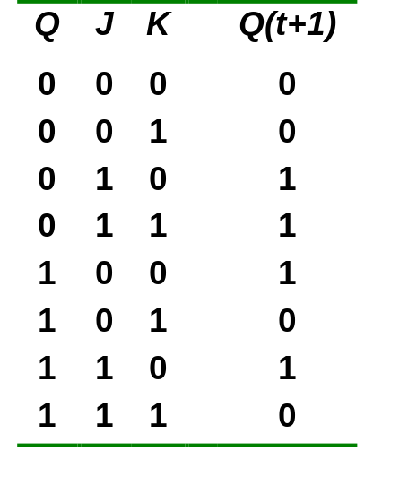
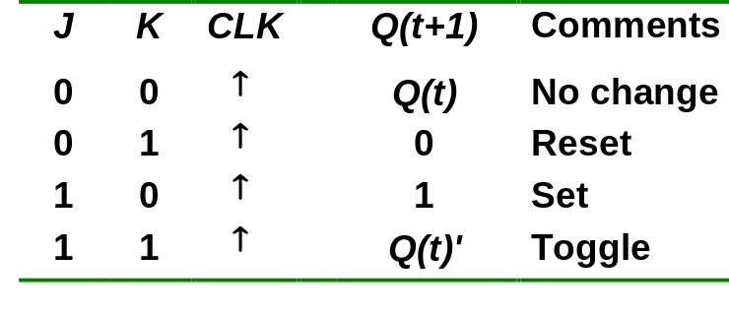
J-K Flip-flop
J-K flip-flop.
Characteristic table.
J
Q
Pulse transition detector
CLK
Q'
K
Q(t+1) = J.Q' + K'.Q

Slide 31
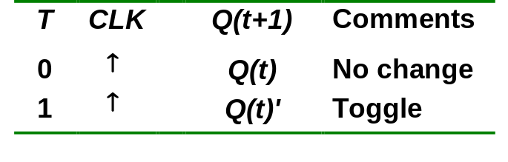
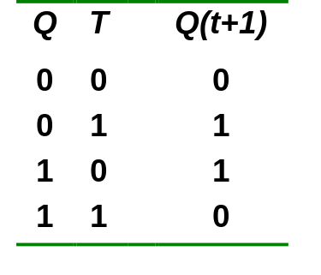
T Flip-flop
T flip-flop: single-input version of the J-K flip flop, formed by tying both inputs together.
Characteristic table.
T
T
Q
J
C
K
Q
Q'
Pulse transition detector
CLK
CLK
Q'
Q(t+1) = T.Q' + T'.Q

