Slide 1

Text Classification using Amazon SageMaker Capstone Project
This project presents a robust and efficient text classification system built using Amazon Web Services (AWS).

Slide 2

Project Team
Submitted To:
DEPI's Committee
Submitted By:
Abdullah Alsayed (21042655)
Mohamad Ashour (21002520)
Muhammed Tariq Aboseif (21025252)
Raafat Elrais (21000337)

Slide 3

Project Abstract
This project outlines the development and deployment of an end-to-end text classification system built using Amazon Web Services (AWS).

Slide 4
Project Overview
This project implements a comprehensive text classification system utilizing AWS services, with a specific focus on classifying BBC news articles into predefined categories. The project aims to design and deploy a machine learning model that can accurately categorize text data using AWS SageMaker, demonstrating the power of cloud-based machine learning for natural language processing tasks.
1
Objective
2
Scope
The primary objective is to design and deploy a machine learning model that accurately classifies text data into categories using AWS SageMaker, leveraging the scalability and efficiency of cloud-based machine learning.
The project scope encompasses data collection from BBC news articles, data preprocessing, feature extraction using AWS Comprehend, model training and optimization using AWS SageMaker's BlazingText algorithm, model deployment on a SageMaker endpoint, real-time inference using AWS Lambda, and continuous tracking and management of model versions using MLflow.

Slide 5

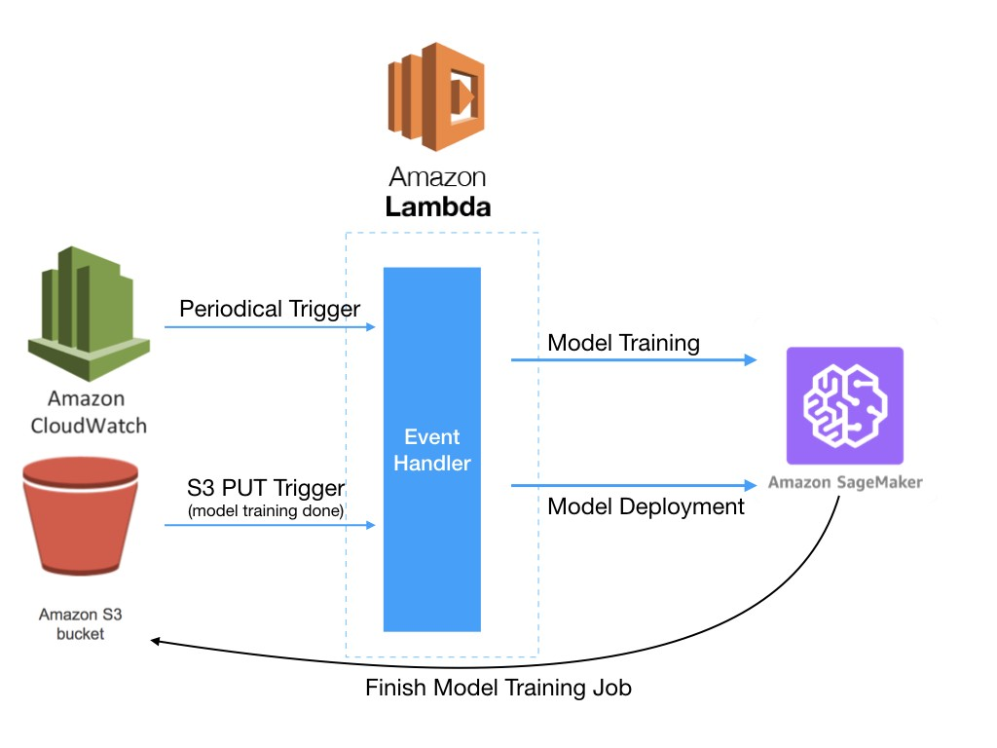





System Architecture
The system architecture for this project utilizes a carefully designed workflow, leveraging AWS services to build a scalable and efficient solution for text classification. The system encompasses data ingestion, preprocessing, feature extraction, model training, deployment, and real-time inference, all orchestrated through a series of interconnected AWS services.
Data Ingestion
BBC news articles are collected and stored in Amazon S3, serving as the
central data repository for the system.
Data Preprocessing
Data preprocessing tasks, such as cleaning, tokenization, and stemming, are performed using Python libraries like Pandas and NLTK, executed on Amazon EC2 instances or SageMaker Notebooks for efficient computation.
Feature Extraction
AWS Comprehend extracts valuable NLP features from the preprocessed data, such as
named entities, sentiment, and key phrases, further enriching the data for model training.
Model Training
The extracted features and preprocessed data are used to train a text classification model
using AWS SageMaker's BlazingText algorithm, leveraging its ability to handle large
datasets and achieve high accuracy.
Model Deployment
The trained model is deployed on an AWS SageMaker endpoint, making it
readily available for real-time inference requests.
Real-Time Inference
AWS Lambda handles real-time inference requests, leveraging the deployed
SageMaker model to classify incoming text data, providing a fast and efficient response.

Slide 6
Key AWS Services Utilized
The project leverages a suite of AWS services to build a comprehensive and robust text classification system, each service playing a crucial role in the overall workflow. These services are carefully chosen to ensure scalability, efficiency, and optimal performance.
Storage
Compute
Machine Learning
Amazon S3 serves as the central storage for datasets, models, and intermediate results, ensuring secure and reliable data management.
Amazon EC2 instances provide the necessary compute resources for data preprocessing, model development, and experimentation, offering flexible and scalable compute power.
Amazon SageMaker is the core service for training and deploying the text classification model, leveraging its advanced capabilities for machine learning model development and deployment.

Slide 7
Project Workflow
1
Week 1: Setup and Data Preparation
2
Week 2: Model Development
3
Week 3: Pipeline Integration
4
Week 4: Final Review and Presentation

Slide 8
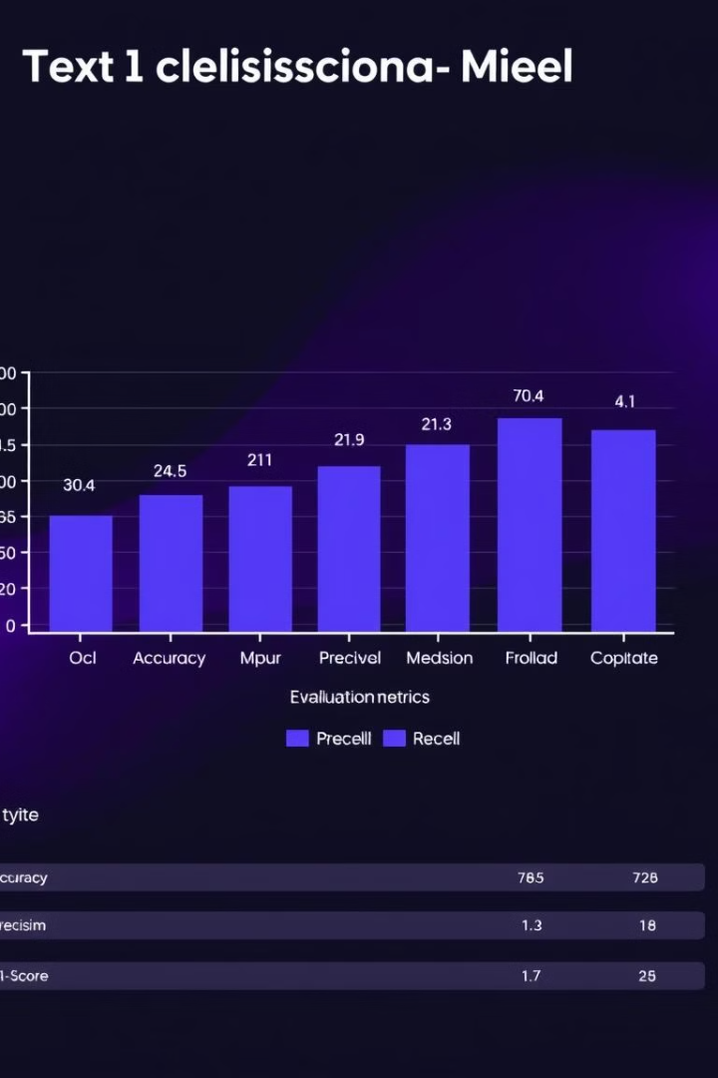




Model Evaluation
The text classification model's performance is evaluated using standard metrics like accuracy,
Accuracy
Measures the overall percentage of correctly classified instances.
Precision
Measures the proportion of correctly classified instances among those predicted as positive.
Recall
Measures the proportion of correctly classified instances among all actual positive instances.
F1-Score
Provides a balanced measure of precision and recall, useful for evaluating the model's overall performance.

Slide 9
AWS Services in Action
The project leverages a variety of AWS services, each playing a distinct role in building and deploying the text classification system, showcasing the power of AWS for machine learning tasks. The integration of these services ensures a robust, efficient, and scalable solution for real-time text analysis.
Setup S3 and EC2
Data Cleaning and Preprocessing
Amazon S3 is used for data storage, including uploading raw and cleaned BBC news articles. EC2 instances are launched as compute resources for data preprocessing tasks, providing the necessary computational power for data manipulation and preparation.
Data cleaning is performed using Pandas, removing duplicates and applying text preprocessing techniques such as stopword removal and lemmatization. This ensures clean and consistent data for machine learning algorithms, improving model performance and accuracy.
Model Training with Amazon SageMaker
NLP Feature Extraction with Amazon Comprehend
Amazon SageMaker is used to train the text classification model with XGBoost, utilizing its scalable, cloud-based infrastructure. The training and testing data are stored in S3 and then loaded into SageMaker for efficient model training and optimization.
AWS Comprehend is employed for entity recognition, sentiment analysis, and key phrase extraction from the dataset. These extracted NLP features are saved back to S3 for use in model training, enriching the data with valuable insights and improving the model's ability to understand and classify text.
Experiment Tracking and Model Deployment
Real-Time Inference with AWS Lambda
MLflow is used for experiment tracking, managing model versioning, and logging training results, ensuring reproducibility and efficient model management. The trained XGBoost model is logged and deployed via SageMaker for real-time inference, making it readily available for classification tasks.
A serverless inference endpoint is created using AWS Lambda, enabling real-time text classification requests to be processed via the deployed SageMaker model. This provides a fast and efficient way to classify text data in real time, without the need for managing servers.

Slide 10

Conclusion
The project successfully implements a scalable and robust text classification system using Amazon SageMaker and other AWS tools. The system demonstrates the power of AWS for building and deploying machine learning solutions, showcasing its capabilities for data storage, processing, training, deployment, and real-time inference. The project highlights the benefits of utilizing cloud-based services for machine learning tasks, enabling efficient development, deployment, and scalability of machine learning models.

