Slide 1


Gamma Scalping Trading Strategy
The University of Chicago
MS in Financial Mathematics
FINM 33150 - Quantitative Trading Strategies (Winter 2024)
Team: Nicholas Lee (ID: 12408152), Joey Recchia (ID: 12151786), Raafay Uqaily (ID: 12225382), Jesse Yan (ID: 12406982)

Slide 2
Executive Summary
We explore a potential edge in leveraging a model-free approach to calculating implied volatility from [Jiang & Tian]
We use this model-free implied volatility calculation in a gamma scalping trading strategy on SPY¹
Initiate positions by buying or shorting both at-the-money² calls³ and puts⁴ with ~30 days to expiration as a straddle
Position decisions are guided by our calculated model-free implied volatility versus the implied volatility derived from the Black-Scholes (B-S) model⁵
Positions are typically closed after a week before expiration to reduce risk
Stock positions are rebalanced daily to maintain risk-neutrality, enabling us to scalp profits throughout the strategy’s execution
Jiang, George J., and Yisong S. Tian. “The model-free implied volatility and its information content.” Review of Financial Studies, vol. 18, no. 4, 2005, pp. 1305–1342, https://doi.org/10.1093/rfs/hhi027.

Slide 3
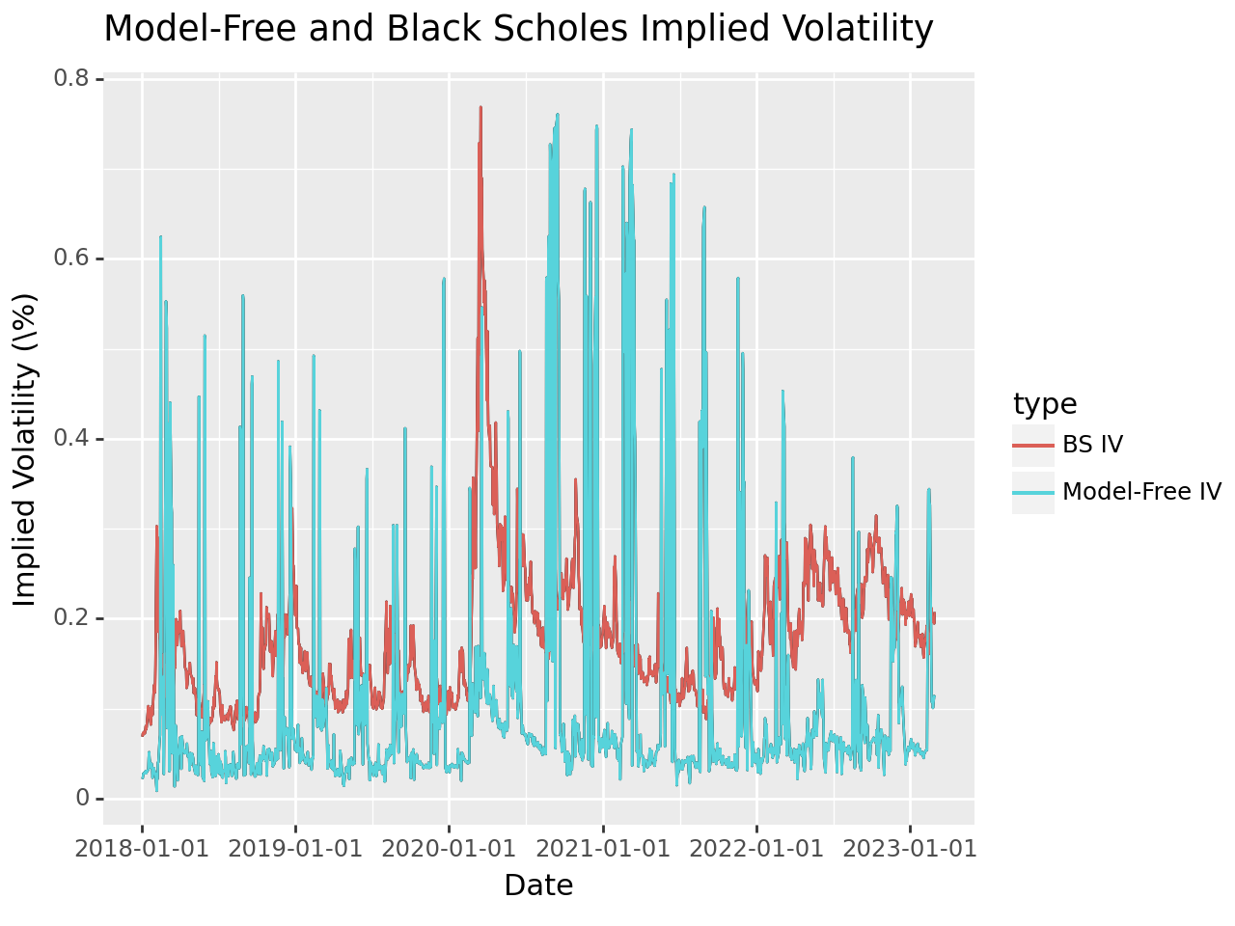
Implied Volatility
Implied volatility is a forecast of a likely movement in a security’s price
The model-free implied volatility computes implied volatility directly from the prices of options across different strikes and maturities, without depending on any specific model assumptions unlike B-S
The model-free implied volatility often disagrees with the B-S model values and is generally closer to the realized volatility
Figure 1. Time-series plot of the model-free and at-the-money B-S implied volatilities.

Slide 4
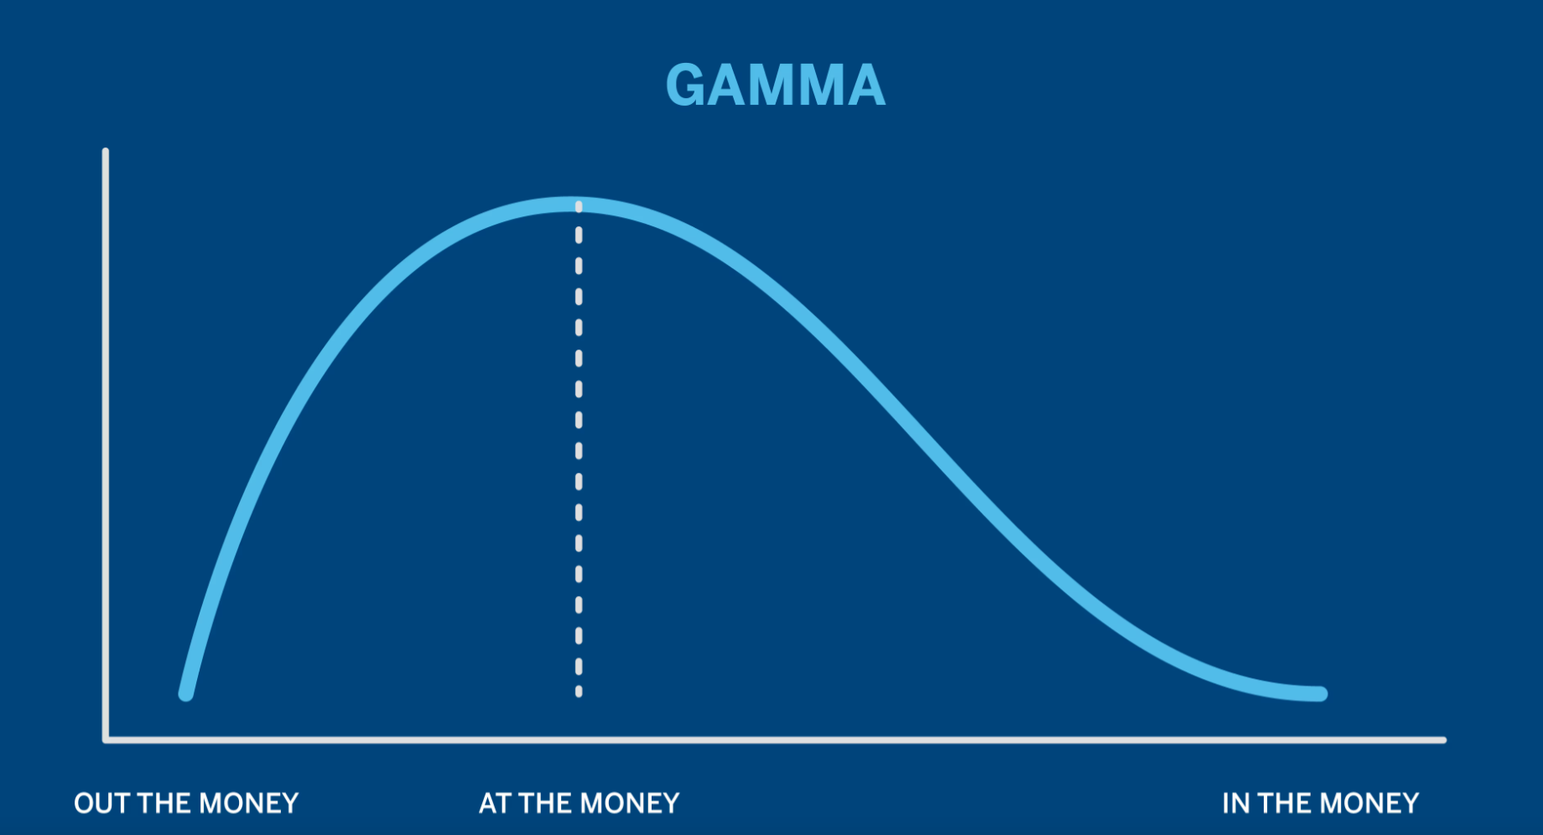
Gamma Scalping
Gamma measures the rate of change in an option's delta for a one-point change in the price of the underlying asset
Gamma scalping profits from short-term price movements in an asset by rebalancing positions to have a net-zero delta⁷ position (ie. neutral to movement in asset price) while only having exposure to gamma
Advantages include limited risk exposure to options’ time decay and high potential for returns
Figure 2. Sensitivity of gamma, noting that it is highest at-the-money.

Slide 5
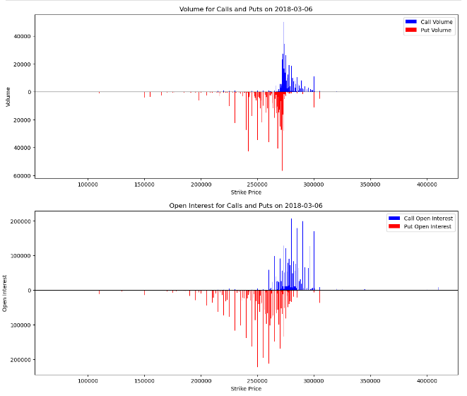
Backtesting Data
We selected the SPDR S&P 500 ETF Trust (SPY) for high liquidity in both the underlying and options markets, ensuring smooth entry and exit
We selected contracts for at-the-money call and put options with ~30 days to expiration for each trading day
We simulated our trading strategy from Jan 2018 to Feb 2023 to ensure our dataset reflects recent market dynamics and volatility patterns
Figure 3. Sample distribution of volume and open interest for calls and puts on 03-18-2018.

Slide 6
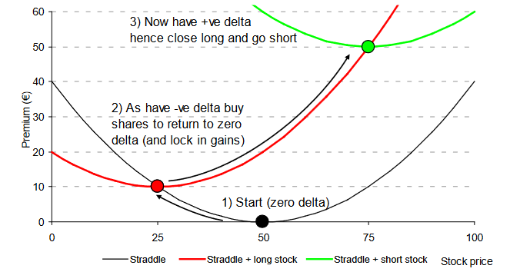
Strategy Implementation
Compare the B-S implied volatility to the model-free implied volatility to determine long or short entry position
Analyze whether to enter a delta-hedged straddle
A straddle⁷ reduces the required share count to initially delta-hedge and rebalance daily to maintain a zero-delta position, minimizing transaction costs
Exit each straddle after a 3-week holding period
Removes the need to delta-hedge against volatile market movements in the week preceding expiration while realizing most gamma-related profits
Figure 4. Visual representation of profiting from delta-hedging.

Slide 7
Backtesting Strategies
Assume $1MM initial capital with $9MM available margin (10x leverage) for a total of $10MM starting capital
Earn interest on unused initial capital (risk-free rate)
Pay interest on used margin (risk-free rate plus 25 basis points)
Test three trades on these delta-hedged straddles, which we open based on IV:
Strategy 1: Long-Short
Strategy 2: Long Only
Strategy 3: Short Only
Size each trade according to the difference between our calculated model-free IV and the listed B-S IV, but no trade will exceed 10% of starting capital
Assume 1 basis point in trading costs and pay interest to short shares
Risk-free rate plus 25 basis points
Margin will be used more like a short-term borrowing facility to ensure we have enough liquidity to enter into trades, rather than purely as a source of leverage

Slide 8
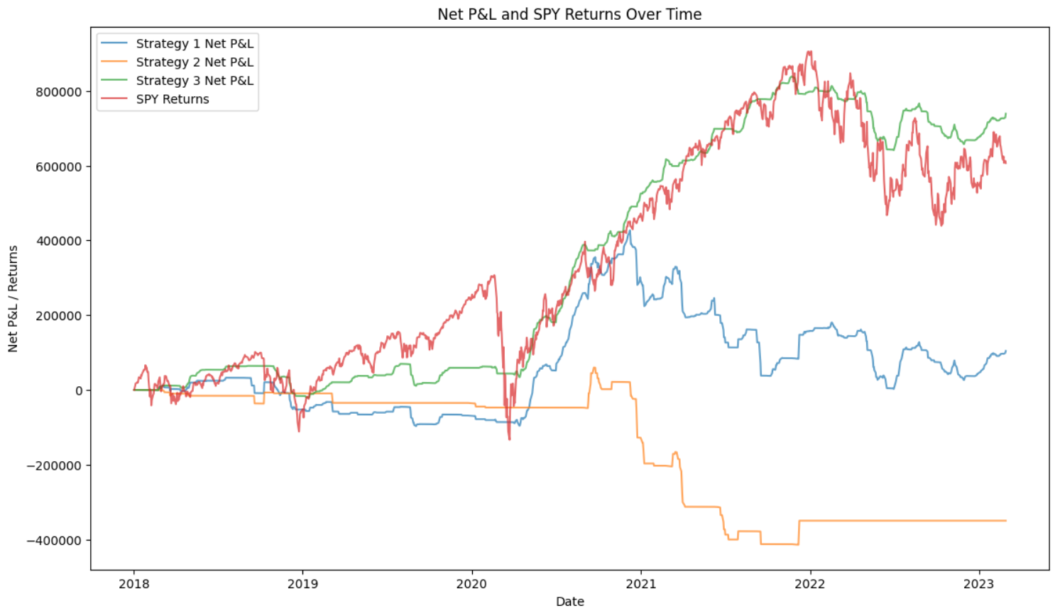
Strategy Returns
We regressed each strategy’s returns against SPY
As shown in the graph and the performance metrics, strategy 3 performed the best, almost mimicking SPY with significantly milder drops, whereas strategy 1 and 2 performed relatively poorly in comparison
Strategy 3 had a sharpe ratio of 0.76, an alpha of 0.06, and an information ratio of 0.39
Strategy | Ann. Return | Ann. Vol | Sharpe Ratio* | Information Ratio | Beta | Alpha | R-Squared
Strategy 1 (Long/Short) | 2.16% | 18.69% | 6.22% | 3.49% | 22.19% | 0.50% | 0.086
Strategy 2 (Long Only) | -7.12% | 13.81% | -58.80% | -42.15% | -28.55% | -2.98% | 0.3867
Strategy 3 (Short Only) | 11.59% | 13.85% | 76.42% | 38.68% | 54.78% | 5.67% | 0.3509
Figure 5. Graph of trading strategy returns versus the underlying (SPY)
Table 1. Key Performance metrics for all 3 trading strategies
* For simplicity, we assumed a risk-free rate of 1% when calculating excess returns

Slide 9
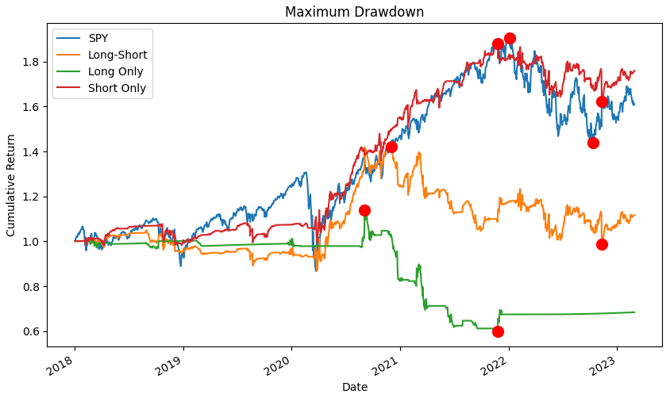
Risk and Capital
As we are a high-risk fund with a high risk-appetite, we will set up a stop-loss once we reach a maximum drawdown of 75%, upon which we would liquidate the fund
However, we did not have to implement this risk control in the backtest as we never had such a large maximum drawdown
The largest max drawdown occurred in the strategy 2, resulting in a drawdown of 48% and a position value of $597K
The best performing strategy had a drawdown of 14%
The amount of cash available to trade across all three trading strategies never fell below $2.46MM (~25% of starting capital, with leverage)
Figure 6. Graph showing maximum drawdown of each strategy versus SPY. Strategies long-short, long only, and short only are in orange, green, and red, respectively. SPY is in blue.

Slide 10
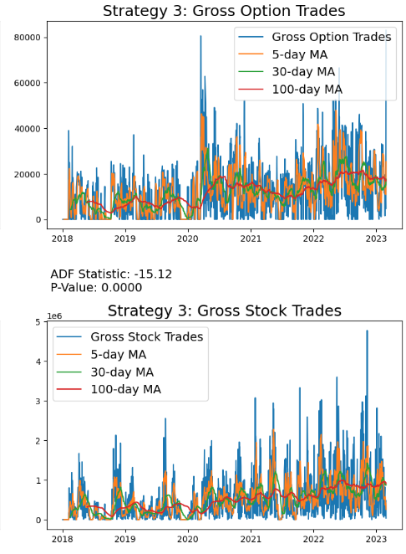
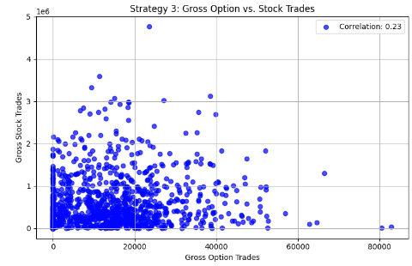
Analysis - Strategy 3
Strategy 3 had insignificant correlation with the Farma-French factors (Mkt, SMB, HML)
There was a slightly positive correlation (r=0.23) between gross options and stocks traded
Both gross options and stocks traded had a significant outcome for the test for non-stationarity
Figure 8. Moving averages of gross options and stocks traded for short-only strategy, and ADF test for non-stationarity results.
Figure 7. Scatterplot showing correlation between gross options and stocks traded.

Slide 11
Conclusion
Consistent with general knowledge, we found realized volatility to be lower than B-S IV.
Model-free IV was able to identify low volatility, but struggled to identify high volatility
Our fund will focus on short gamma based off of the backtest of these strategies
While the short-gamma strategy has beta, this is to be expected as SPY is its underlying. With this in mind, the beta of 0.55 can be considered low, especially when given a positive alpha and a modest Sharpe ratio of 0.76, which exceeds SPY’s Sharpe ratio (0.57-0.73) over the last 3-5 years ^{x}
^{X} https://finance.yahoo.com/quote/SPY/risk/?guccounter=1

Slide 12
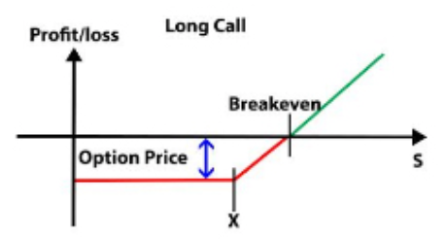
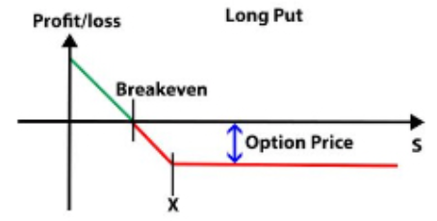
Appendix A: Options Basics
¹SPY: Refers to the SPDR S&P 500 ETF Trust, which is an exchange-traded fund that seeks to provide investment results that correspond to the price and yield performance of the S&P 500 Index.
²At-The-Money: When an option contact’s strike price is closest to the current market price of the underlying asset.
³Calls: Options contracts that grant the holder the right (but not the obligation) to buy an underlying asset at a specified price within a certain period of time.
⁴Puts: Options contracts that grant the holder the right (but not the obligation) to sell an underlying asset at a specified price within a certain period of time.
Figure 5. Payoff diagram for a call.
Figure 6. Payoff diagram for a put.

Slide 13
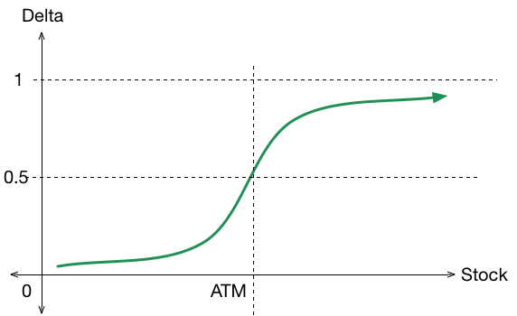
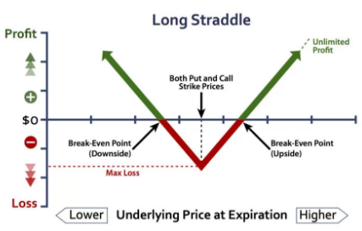
Appendix B: Options Basics
⁵Black-Scholes Model: A mathematical framework for pricing European-style put and call options based on the stock price, strike price, time until expiration, risk-free interest rate, and volatility of the stock.
⁶Delta: Measures the rate of change in an option's price relative to changes in the price of the underlying asset.
⁷Straddle: A combination of both a put and call option with the same strike price and expiry, entered on the same side (buy or short both).
Figure 7. Call delta vs stock price.
Figure 8. Payoff for a straddle.

