Slide 1

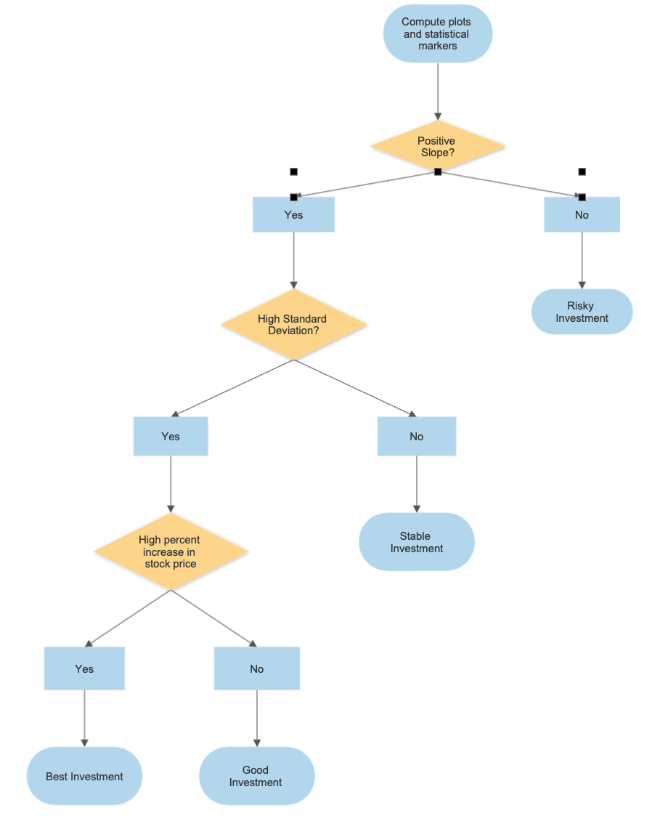
Analyzing Stock Market Trends using MATLAB
Andrew Dittmer, John Swanson, Riley Young, Raafay Uqaily
West Virginia University
Benjamin M. Statler College of Engineering and Mineral Resources
Freshman Engineering Program
ENGR-102-H04
Spring 2020
Mr. Brewster
Group 1
Introduction
Purpose: Identify the best / worst stock out of 22 companies
Problem: Effectively analyze data to determine the best investment
Earliest organized market was in Rome in 2 BC (Smith 10)
Crash of 1929 led to the Great Depression (Hur 1)
Stock market has provided around +10 % annual returns (U.S. SEC)
Prediction modeling and stock analysis methods help investors
Results and Figures
Discussion
Best Overall Company
Dominos due to steep positive slope and high standard deviation
Most Stable Company
GM due to having a positive slope and low standard deviation value
Riskiest Company to Invest In
Chipotle due to its fluctuations and high standard deviation value
Best Industries to Invest In
Fast Food Industry for risk taking investors
Beverage Industry for more conservative investors
Results
Plot Trends
Dominos - steep positive slope
General Motors - slightly positive slope
Chipotle - positive slope (fluctuations)
McDonald’s - positive slope
Table Facts
Dominos - high standard deviation; high positive % difference
General Motors - low standard deviation; low positive % difference
Chipotle - high standard deviation; fairly high % difference
McDonalds - low standard deviation; fairly high % difference
Methodology
MATLAB Code
Import excel data and compute statistical markers
Create tables and graphs
Data Analysis
Calculate percent difference using initial and final close price of each company
% Difference = ((final close price × 100) ÷ (initial close price))
Sort companies into appropriate industries
Determine most stable, risky, and best overall investment using the flowchart seen in Figure 1
Table 1. Companies of Interest Statistics
Conclusion
Goal of the project was met by suggesting investment recommendations
Best industry depends on the type of investment (Long-term or Short-term)
Future works include using P/E or PEG ratios to analyze market trends
Other industries like technology, healthcare, banking can be analyzed
Company | Standard Deviation Close ($) | Percent Difference Close Value
Dominos | $59.13 | +459.3%
General Motors | $3.79 | +105.5%
Chipotle | $127.99 | +130.2%
McDonalds | $26.51 | +168.1%
References
Hur, Johnson. “History of The Stock Market.” From The Beginning To Present Time, 4 Dec. 2018, bebusinessed.com/history/history-of-the-stock-market/. Accessed 20 Feb. 2020
Smith, B. Mark. A History of the Global Stock Market: from Ancient Rome to Silicon Valley. University Of Chicago Press, 2004. Accessed 21 Feb. 2020
U.S. Securities and Exchange Commission. “Saving and Investing - A Roadmap To Your Financial Security Through Saving and Investing.” SEC Emblem, www.investor.gov/additional-resources/general-resources/publications-research/publications/saving-investing-roadmap. Accessed 16 Feb. 2020
Figure 1. Decision Making Flowchart

