Slide 1
License Plate Recognition and Extraction (Using OpenCV4 and C++)
Raag Yatchu Maharjan ACE078BCT051

Slide 2
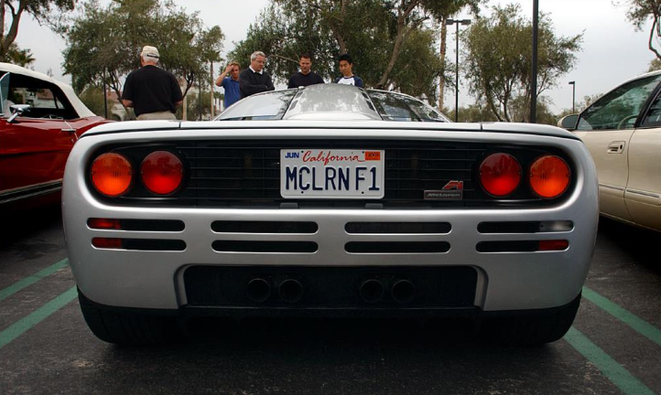
Steps and Functions With Images
“cv::Mat ogImage”
Our original Test Image without any changes
This image is sent to the “preproess()” function
To process the image into
-> A Grayscale image -> A Threshold Image

Slide 3
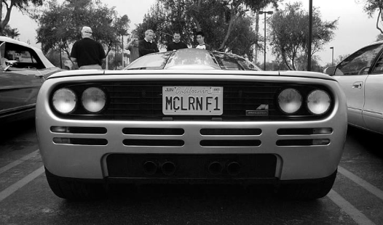
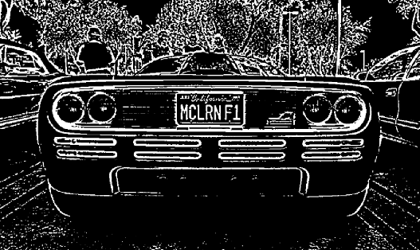
After Preprocessing
The grayscale image “imgGrayscale”
The threshold image “imgThresh”
The threshold image is then processed ny the “findPossibleCharsInScene()” function which analyses all the contour of the threshold image and counts up all the possible characters in the image.

Slide 4
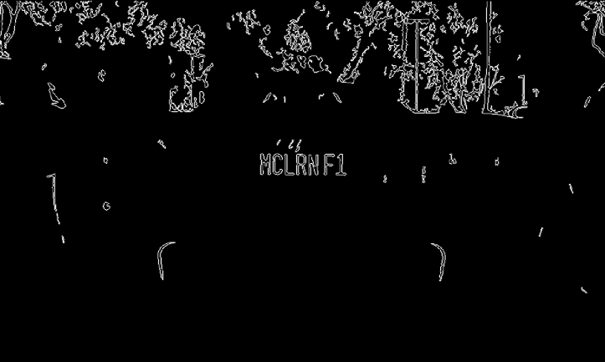
Then from a pre-trained cascade algorithm “classifications.xml” (The KNN Algorithm, references and acknowledgements to the person I took reference from at the end of the slide) “std::vector vectorOfPossibleCharsInScene” stores only the Machine Learned Contours.

Slide 5
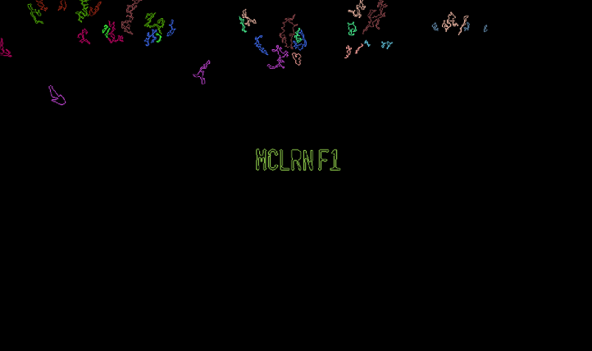
The vector data is then fed through the function ->
“std:: vector vectorOfVectorsOfMatchingChars = findVectorofVectorsOfMatchingChars()”
Which returns the value of all the vector contours found in the image.

Slide 6
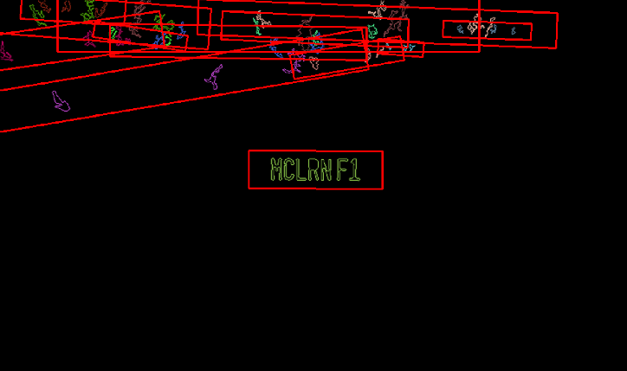
The function “extractPlates()” then takes the vectorOfPossiblePlates and then analyses them using a pretrained cascade classifier (Similar to the KNN algorithm) “images.xml” and checks for every possible plate in the image contour for extraction.

Slide 7
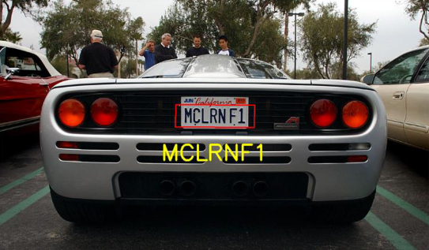

All the countours are then again preprocessed and all the above steps are recursively active until all the possible plates in the image is extracted.
Every recognized plate is taken into a list and then sorted descedingly from most number of characters recognized to least.
And assuming that the plate is the one with most number of recognized characters, the top most string is stored in “plateChars” , string type data in the class “plateHaru{};”

Slide 8
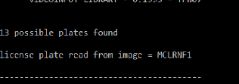
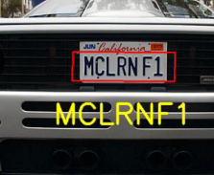
The Output
Finally after extraction and sorting, the string is accessed from the class and displayed.

Slide 9
Citations and Bibliography
Chris Damhs : Character Recognition Using OpenCV3(Python) and his KNN Algorithm and the cascade classifiers for KNN OpenCV4 . https://github.com/MicrocontrollersAndMore/OpenCV_3_License_Plate_Recognition_Python
OpenCV4 Documentations: https://docs.opencv.org/4.x/
For Image Processing and syntaxes C++
THANK YOU

