Slide 1
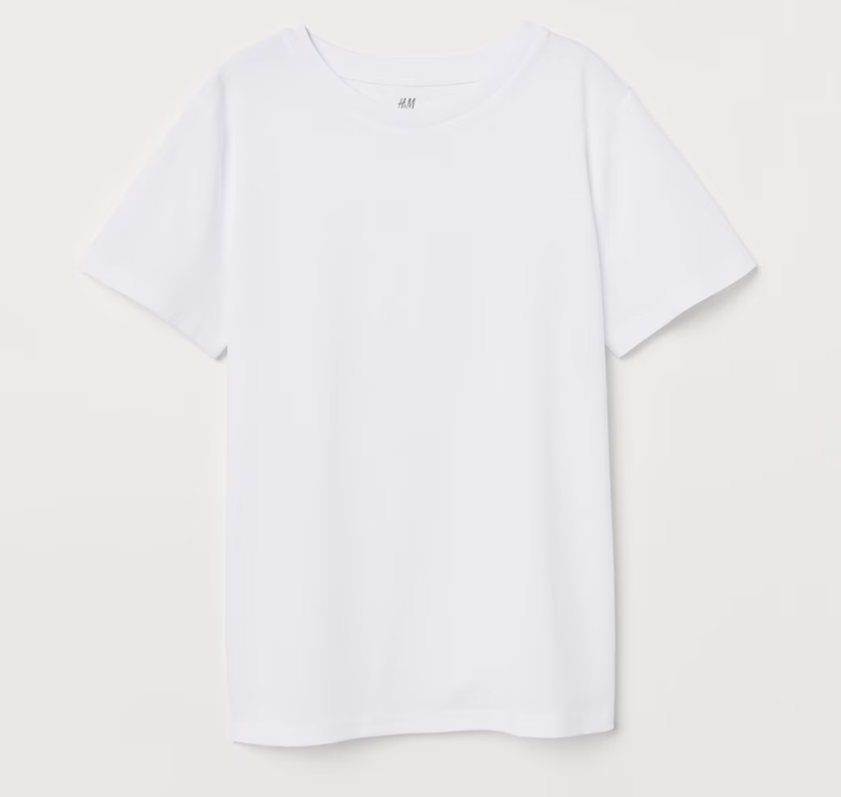

the Biorock Coral

Slide 2

the Biorock Coral

Slide 3
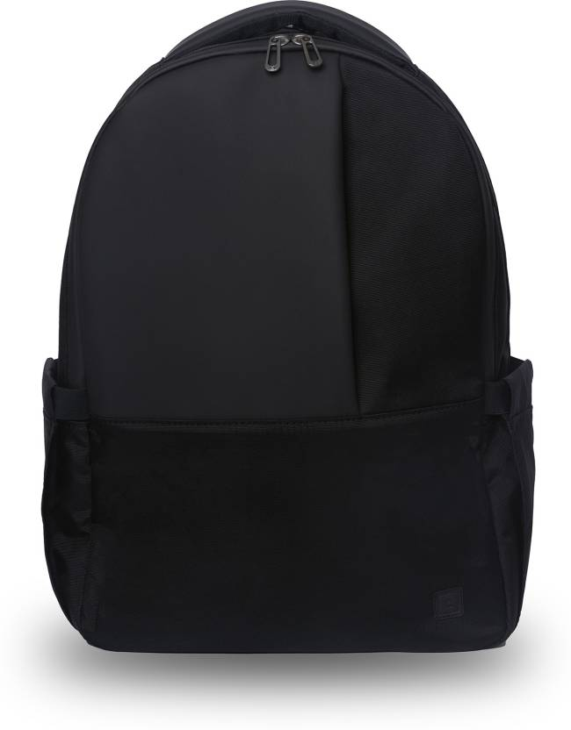
the Biorock Coral

Slide 4
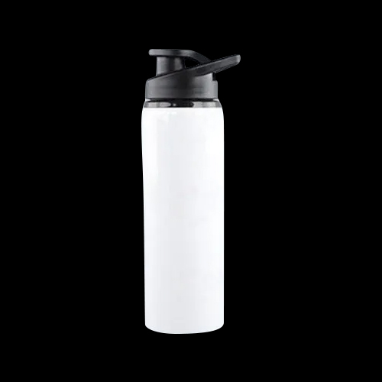
the Biorock Coral

Slide 5


the Biorock Coral

Slide 6
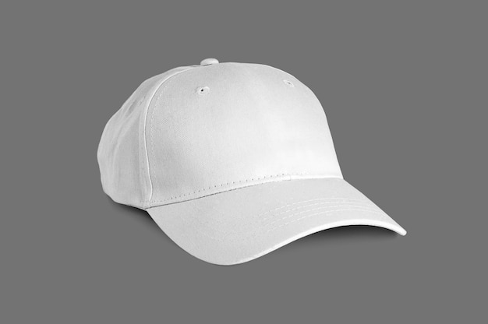
the Biorock Coral

Slide 7
