Slide 1

ENGINEERING EXPLORATION

Slide 2

WHAT IS ENGINEERING?
Engineering is the application of scientific and mathematical principles to design, develop, and improve products, systems, and technologies that solve real-world problems.
Examples: Bridges, Computers, Smartphones, Electric Vehicles, Medical Equipment
.

Slide 3
Difference Between Science and Engineering
Science | Engineering
Discovers how nature works | Applies scientific knowledge
Focuses on understanding | Focuses on solving problems
Answers "Why?" | Answers "How?"
Produces theories | Produces products and systems

Slide 4
Difference Between Scientist and Engineer
Scientist | Engineer
Conducts research | Designs solutions
Studies natural phenomena | Develops practical applications
Creates knowledge | Uses knowledge
Example: Physicist | Example: Software Engineer

Slide 5

Needs
Problem-solving ability
Computer and internet access
Knowledge of algorithms and data structures
Continuous learning
Programming skills
Wants
High-performance computers
Latest software tools
Career growth opportunities
Innovative projects
Good work-life balance

Slide 6
Various Engineering Disciplines and Role of CSE
Mechanical Engineering
Develops robotics, automation software, and CAD applications
Civil Engineering
Creates smart city systems and construction management software
Electrical Engineering
Designs smart grid monitoring and control systems
Biomedical Engineering
Creates healthcare applications, medical databases, and AI diagnostic systems
Aerospace Engineering
Develops flight simulation, navigation, and control software

Slide 7
Case Study;
Smart agriculture system;
A Smart Agriculture System combines different engineering disciplines to improve farming productivity and efficiency.
Agricultural Engineers develop modern farming techniques and irrigation methods.
Mechanical Engineers design tractors, harvesters, and automated farming equipment.
Electrical Engineers provide power systems for irrigation and farm machinery.
Electronics & Communication Engineers develop sensors to monitor soil moisture, temperature, and weather conditions.
Computer Science Engineers create mobile applications, IoT platforms, AI-based crop monitoring systems, and data analytics tools.

Slide 8
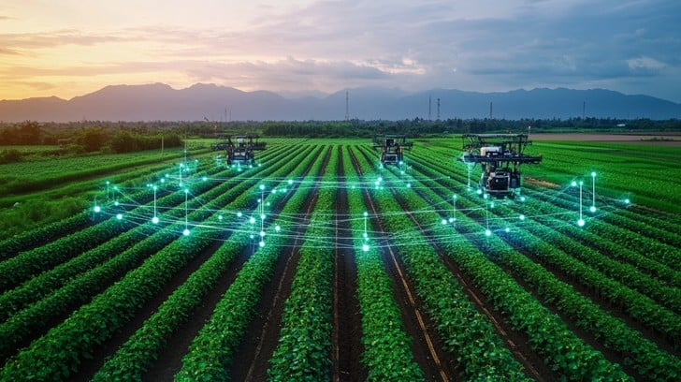
Role of Computer Science Engineering
Smart irrigation control
Crop disease prediction using AI
Weather forecasting applications
Farm management software
IoT-based soil and water monitoring
Drone data analysis for crop health

Slide 9
Misconception of about computer science engineer
Myth | Reality
CSE is only coding. | CSE includes AI, Cybersecurity, and Data Science.
CSE students work only in IT companies. | They work in many industries.
AI will replace programmers. | AI supports programmers, not replaces them.
CSE does not require mathematics. | Mathematics is important in CSE.

Slide 10
Skills Required for a Computer Science Engineer in the 21st Century
Programming Skills
Problem-Solving Ability
Communication Skills
Teamwork and Collaboration
Critical Thinking
Artificial Intelligence Knowledge
Cybersecurity Awareness
Continuous Learning

Slide 11


