Slide 1
Salary Prediction Model using Ensemble Learning
Random Forest + Gradient Boosting + Voting Regressor

Slide 2
OBJECTIVE :
Predict employee salary using features like Age, Gender, Education, Job Title, Years of Experience

Slide 3
Dataset Description
Features:
Age ,Working Hours, (numeric)
Gender, Education, Job Title , company size,Location(categorical)
Years of Experience ,certifications(numeric)
Salary (target)

Slide 4
Feature Engineering
Encode categorical features:
LabelEncoder for Gender, Education, Job Title
Scale numerical features:
StandardScaler applied to Age and Experience

Slide 5
Model Building
Train-test split: 80% train, 20% test (random_state=42)
Models used:
RandomForestRegressor
GradientBoostingRegressor
Final ensemble: VotingRegressor combining both

Slide 6
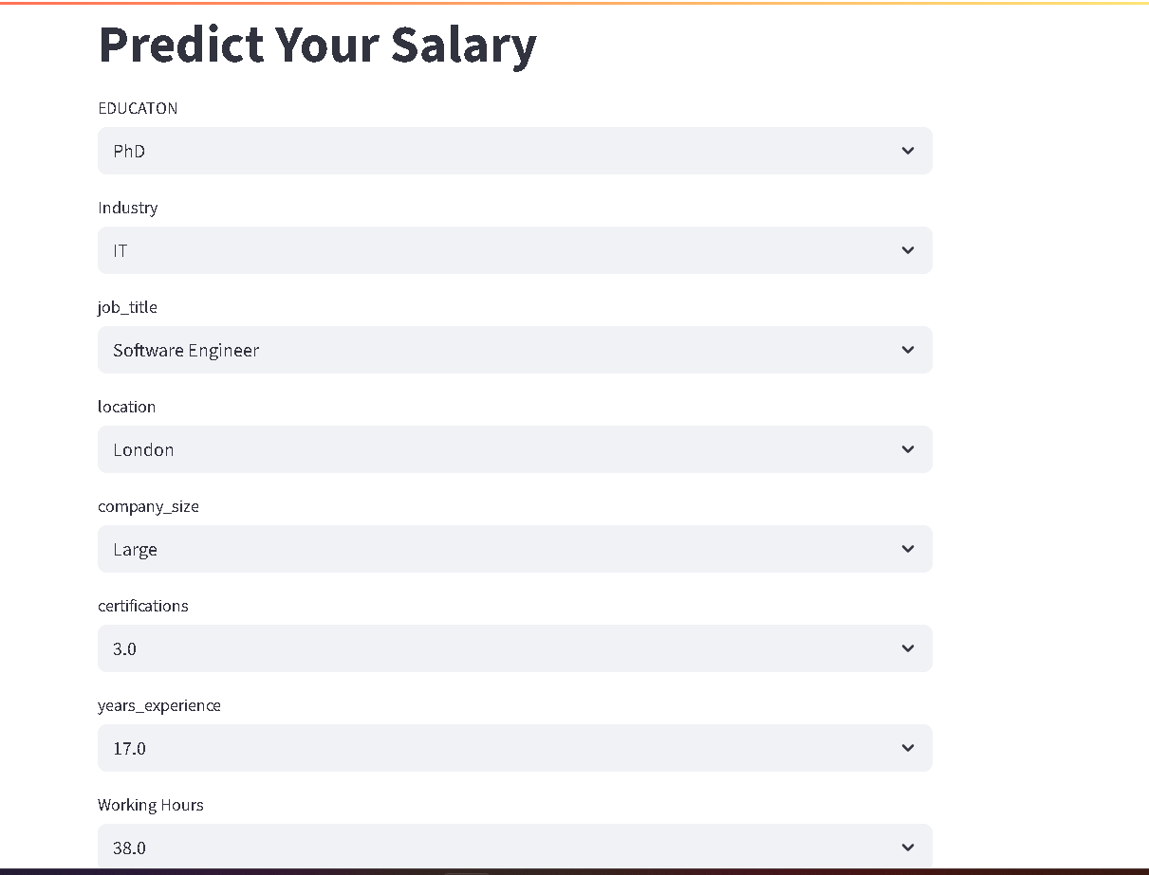
User Interface

Slide 7
Contact info:
Name : Ragini Goel
Contact number: 9368830361
Email : rg.raginigoel5@gmail.com
Demo :https://salaryprediction-dg33wig2agpnn4mq7hjf4h.streamlit.app/

