Slide 1
Customer Segmentation Project
RFM Analysis & Marketing Strategy

Slide 2
🎯 Objective
Segment customers based on Recency, Frequency, and Monetary (RFM) behavior.
Enable targeted marketing campaigns and personalized offers.
Improve engagement, retention, and revenue.

Slide 3
🔹 Methodology
1. Data Preparation:
- Cleaned transaction data.
- Calculated Recency, Frequency, Monetary (RFM).
2. Clustering:
- Standardized features.
- Applied K-Means clustering.
- Selected optimal clusters (Elbow/Silhouette).
3. Profiling:
- Analyzed average RFM values per cluster.
- Assigned business-friendly segment names.

Slide 4
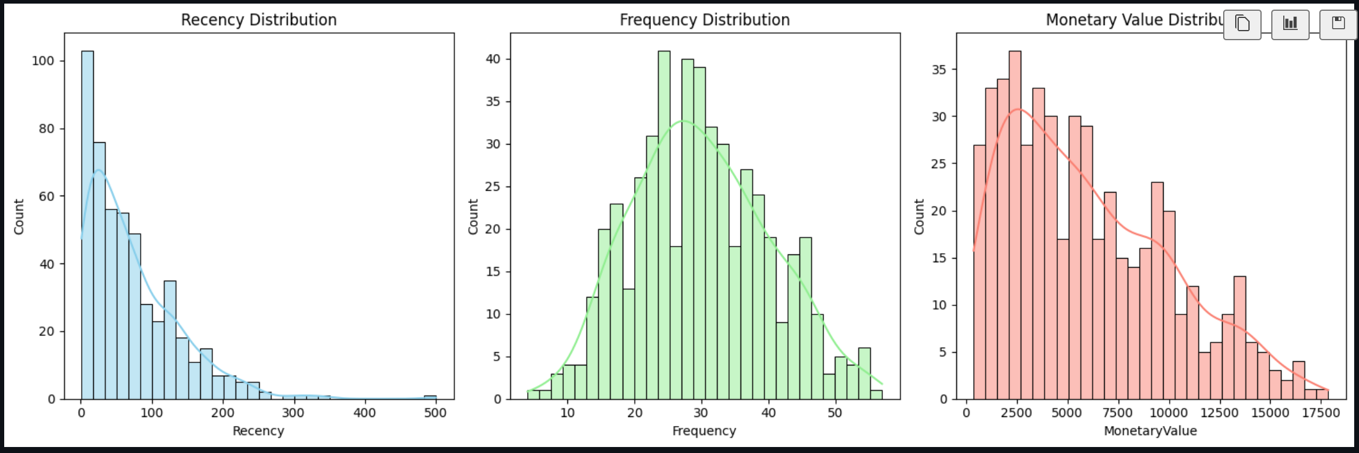
RFM Calculation

Slide 5
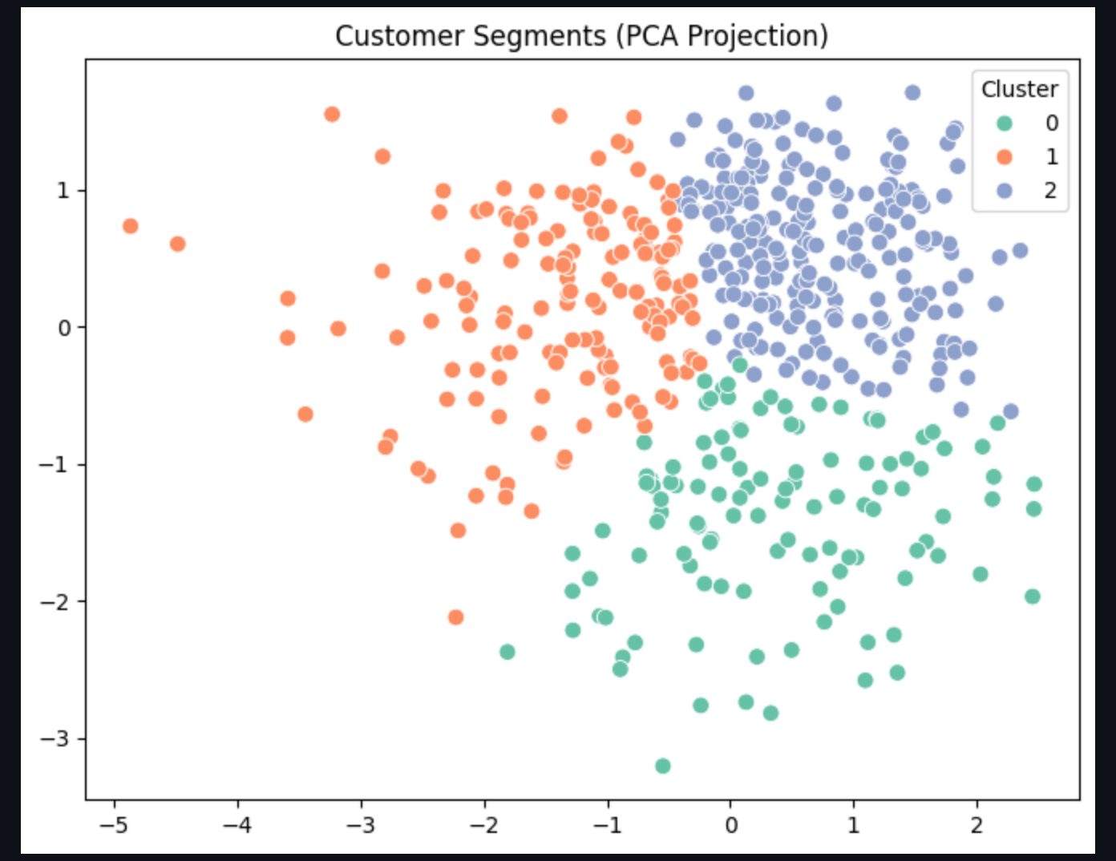
Clustering

Slide 6
Loyal High Spenders
- Recent buyers, frequent, high spend.
- VIP rewards, exclusive offers, referrals.

Slide 7
At-Risk Low Spenders
- Inactive for long, low frequency & spend.
- Win-back campaigns, discounts, re-engagement.

Slide 8
Potential Loyalists
- Moderate recency/frequency, growing spend.
- Loyalty programs, upselling, cross-selling.

Slide 9
New Customers
- Recent first-time/second-time buyers.
- Welcome offers, onboarding, education.

Slide 10
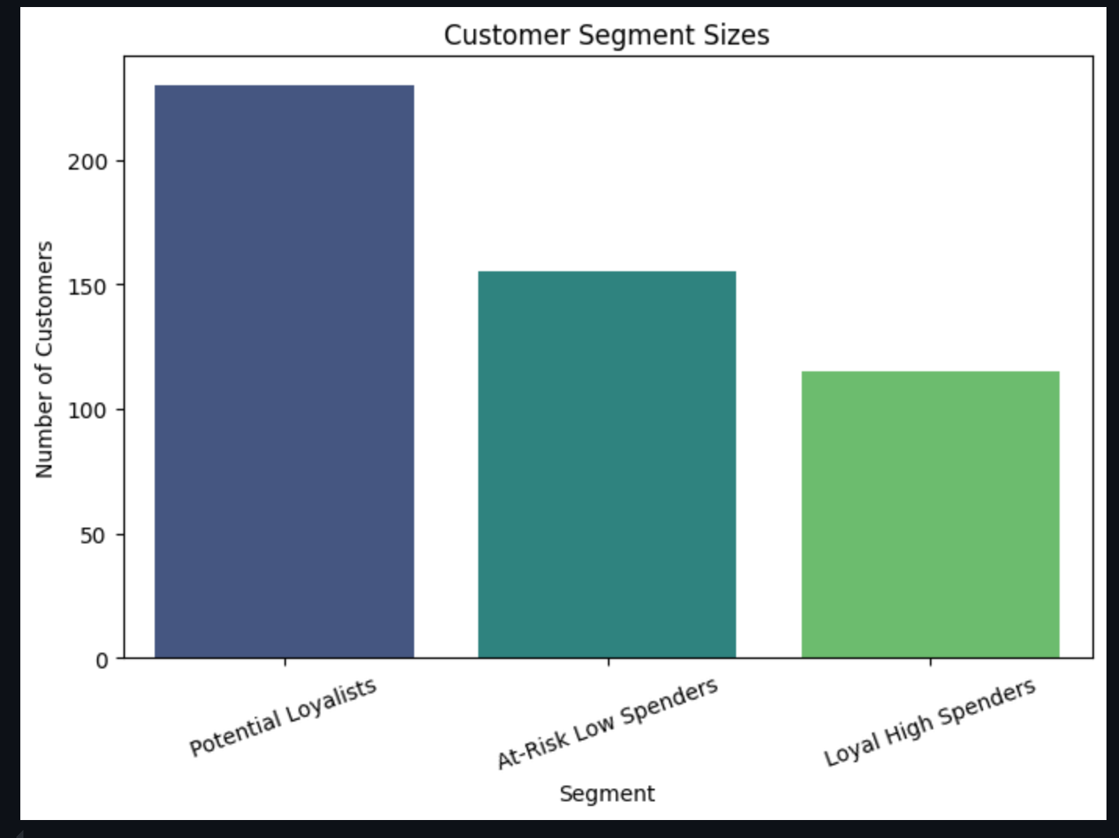
Customer Segments

Slide 11
🔹 Strategic Insights
- Focus on converting Potential Loyalists into Loyal High Spenders.
- Target At-Risk customers with win-back campaigns.
- Encourage New Customers with nurturing strategies.
- Prioritize Loyal High Spenders with VIP programs.

Slide 12
🔹 Conclusion
Segmentation revealed 4 distinct groups:
- Loyal High Spenders
- At-Risk Low Spenders
- Potential Loyalists
- New Customers
Tailored marketing strategies will boost retention, engagement, and customer lifetime value.

