Slide 1

Retail Sales Forecasting Project
Time Series Forecasting for Inventory & Financial Planning

Slide 2

Project Objective
Develop a time series forecasting model to predict monthly sales for the next 6 months, supporting inventory management, marketing strategies, and financial planning.

Slide 3
Data Description
- 4 years of monthly synthetic retail sales data (2020–2023)
- Variables:
• Date (monthly timestamps)
• SalesAmount (monthly sales)
• Promotion flag
• HolidayMonth flag
- Includes trend, seasonality, promotions, and holidays

Slide 4
Methodology
1. Data exploration and preprocessing
2. Feature engineering (Promotion & Holiday effects)
3. Model training and validation
• ARIMA
• SARIMA
• Exponential Smoothing
4. Model selection based on validation metrics
5. Forecast generation for 6 months ahead

Slide 5
Model Performance (Validation Set)
Model | MAE | RMSE | MAPE
ARIMA | 2427.400 | 2769.81 | 21.03
SARIMA | 1193.97 | 1534.42 | 9.37
Exponential Smoothing | 1046.96 | 1383.19 | 8.03
Best model selected based on lowest RMSE.
Exponential smoothing

Slide 6
6-Month Sales Forecast
Forecast (with 95% CI):
2024-01: 15966.66
2024-02: 15165.60
2024-03: 14360.76
2024-04: 12716.09
2024-05: 12023.30
2024-06: 9525.57

Slide 7
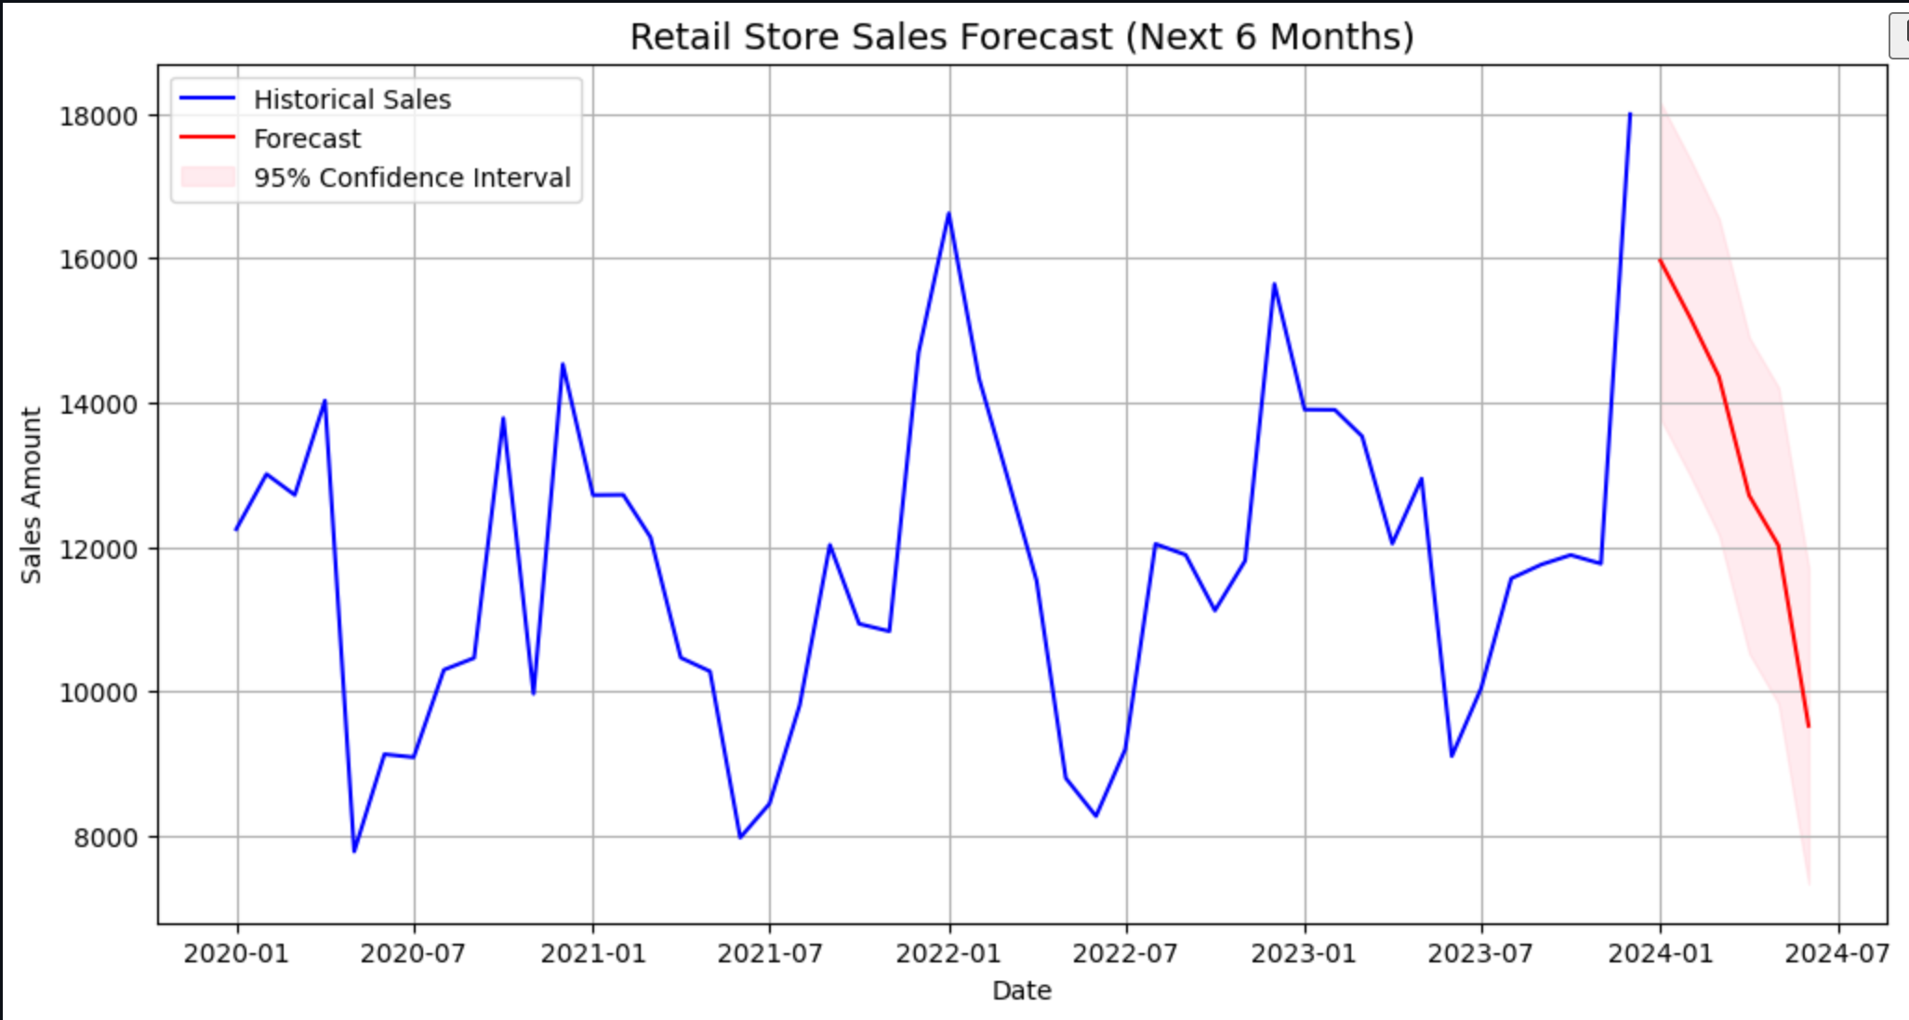
Visualization
Visualization shows historical sales in blue, forecast in red, and confidence intervals in shaded pink.

Slide 8
Business Insights
- Sales show strong upward trend with seasonal spikes in Q4
- Promotions and holidays significantly boost sales
- Forecast supports:
• Inventory planning
• Marketing campaigns
• Financial budgeting
Future work: Add external factors, explore ML models (LSTM/Transformers), and automate updates.

