Slide 1
Extracting and Processing PubMed Abstracts for NER and Question-Answering
NFO-B 643 Natural Language Processing and Text Mining for Biomedical Records and Reports
Guided by
Prof. Saptarshi Purkayastha Ph.D.
Director, Health Informatics
Associate Professor, Data Science, Health Informatics
Raajitha Muthyala

Slide 2
Introduction
This project aims to build an NLP pipeline that extracts abstracts from PubMed based on the keywords “social determinants of health” and “liver”. The extracted abstracts will be pre-processed, tokenized, and used to train a model to generate questions. After Named Entity Recognition (NER) will be applied to extract entities, which will then be standardized using UMLS (Unified Medical Language System). The questions are generated using entities. Finally, a QA system will be built which responds to user queries based on the learned entities.

Slide 3
Tasks
Abstract Extraction from PubMed using relevant keywords.
Preprocessing, Tokenization, NER
Question Generation from the Entities
Question-Answering based on recognized and standardized entities.
UMLS Standardization of these entities.

Slide 4
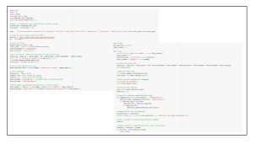
Abstract Extraction from PubMed using relevant keywords.
Objective: Extracted PubMed abstracts containing keywords "social determinants of health" and "liver" from the past 10 years.
Methodology:
Created an advanced query with filters for publication date range (2014–2024). Utilized PubMed's E-utilities API (esearch and efetch) for efficient data retrieval.
Steps Performed:
Generated a query URL for esearch and obtained the total abstract count. Used efetch in iterative loops to fetch abstracts in XML format, ensuring structured data collection. Extracted abstract texts using XML parsing and handled missing or malformed entries. Implemented delays between requests to comply with PubMed's usage policies.
Tools/Technologies Used: Python libraries: csv, urllib, re, xml.etree.ElementTree.
Output: Successfully downloaded 356 abstracts. Saved data in CSV format for easy access and further processing.

Slide 5
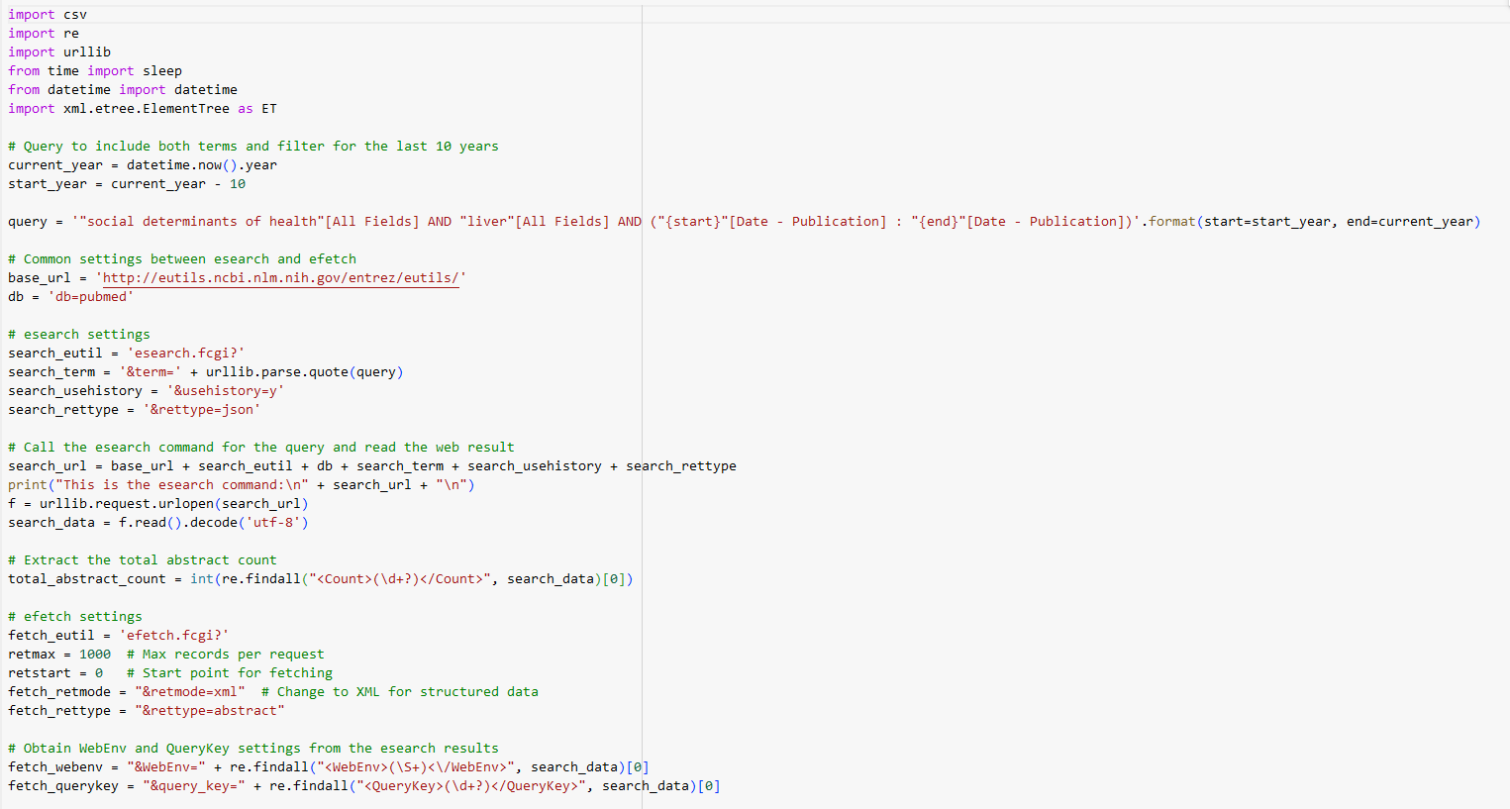
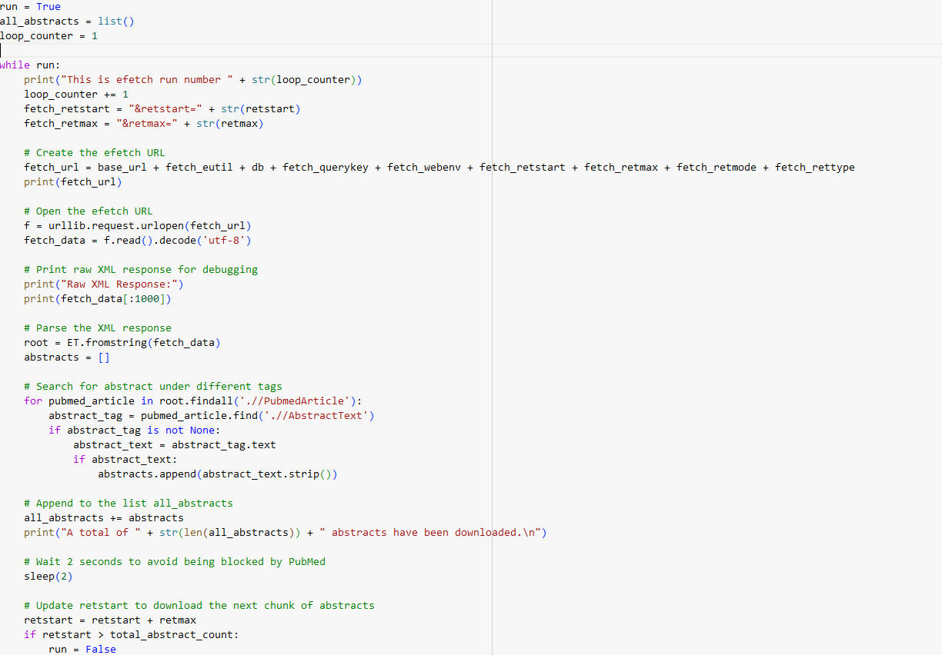

Slide 6
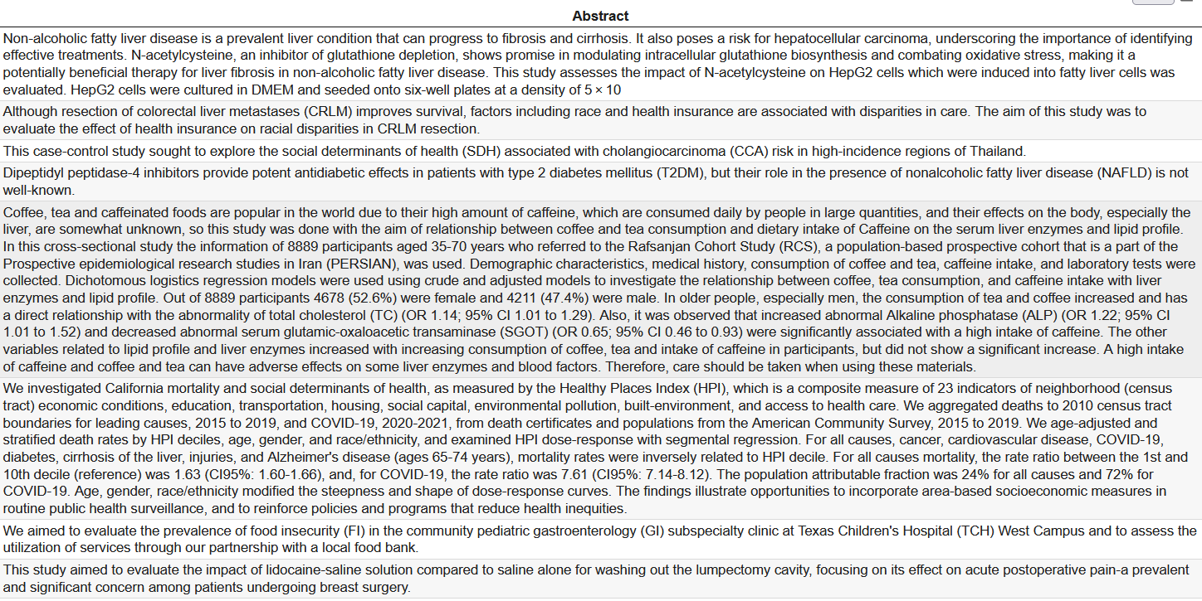

Slide 7
Data Preprocessing
Objective: Prepare extracted abstracts for Named Entity Recognition (NER) by cleaning and tokenizing the data.
Methodology: Step 1: Removed punctuation using regular expressions to standardize text.
Step 2: Eliminated common stopwords (e.g., "the," "is") using NLTK to focus on meaningful terms. Step 3: Tokenized the cleaned text using blaze999/Medical-NER AutoTokenizer from Hugging Face for medical-specific tokenization. Step 4: Converted tokens back to a readable string format for validation.
Tools/Technologies Used:Python libraries: pandas, nltk, re.
Transformer Model: blaze999/Medical-NER AutoTokenizer from Hugging Face.
Output: Cleaned and tokenized abstracts for structured analysis. Created a new dataset column, tokenized_abstract, for easy comparison and downstream tasks.

Slide 8
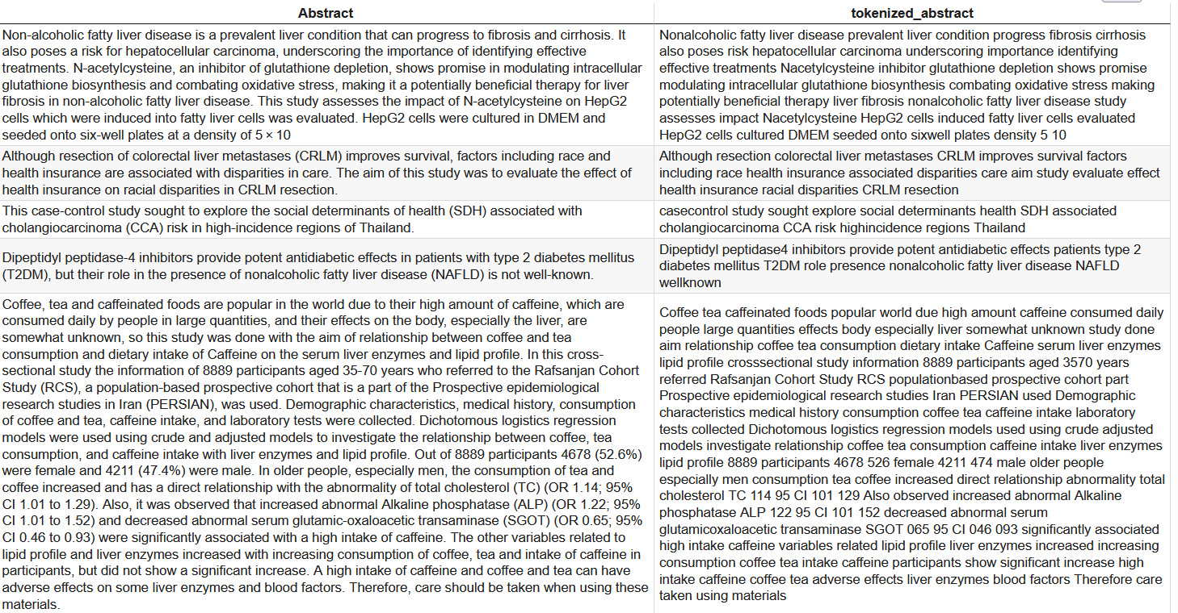

Slide 9
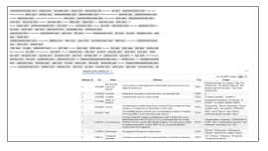
NER & UMLS Standardization
Objective: Identify medical entities in abstracts and map them to standardized Unified Medical Language System (UMLS) concepts for consistency and relevance.
Methodology: Utilized the en_core_sci_scibert NER model from SciSpacy for domain-specific entity recognition. Integrated UMLS Entity Linking with SciSpacy's linker to resolve abbreviations and map entities to UMLS concepts.
Steps Performed:
Processed tokenized abstracts with the NER model to identify entities.
Linked recognized entities to UMLS concepts, retrieving detailed
Flattened extracted entity details into a structured format for analysis. metadata.
Tools/Technologies Used:
SciSpacy Models: en_core_sci_scibert for NER.
Linking Tool: SciSpacy's UMLS Entity Linker.
Data Handling: pandas for organizing extracted data.
Output:
Generated a DataFrame with standardized UMLS entity details for each abstract.
Ensured high-quality entity resolution for downstream Question-Answer model training.
Extracted and standardized the following UMLS details:
Concept Unique Identifier (CUI)
Canonical Name
Definition
Semantic Types (TUIs)
Top aliases (up to 5).

Slide 10
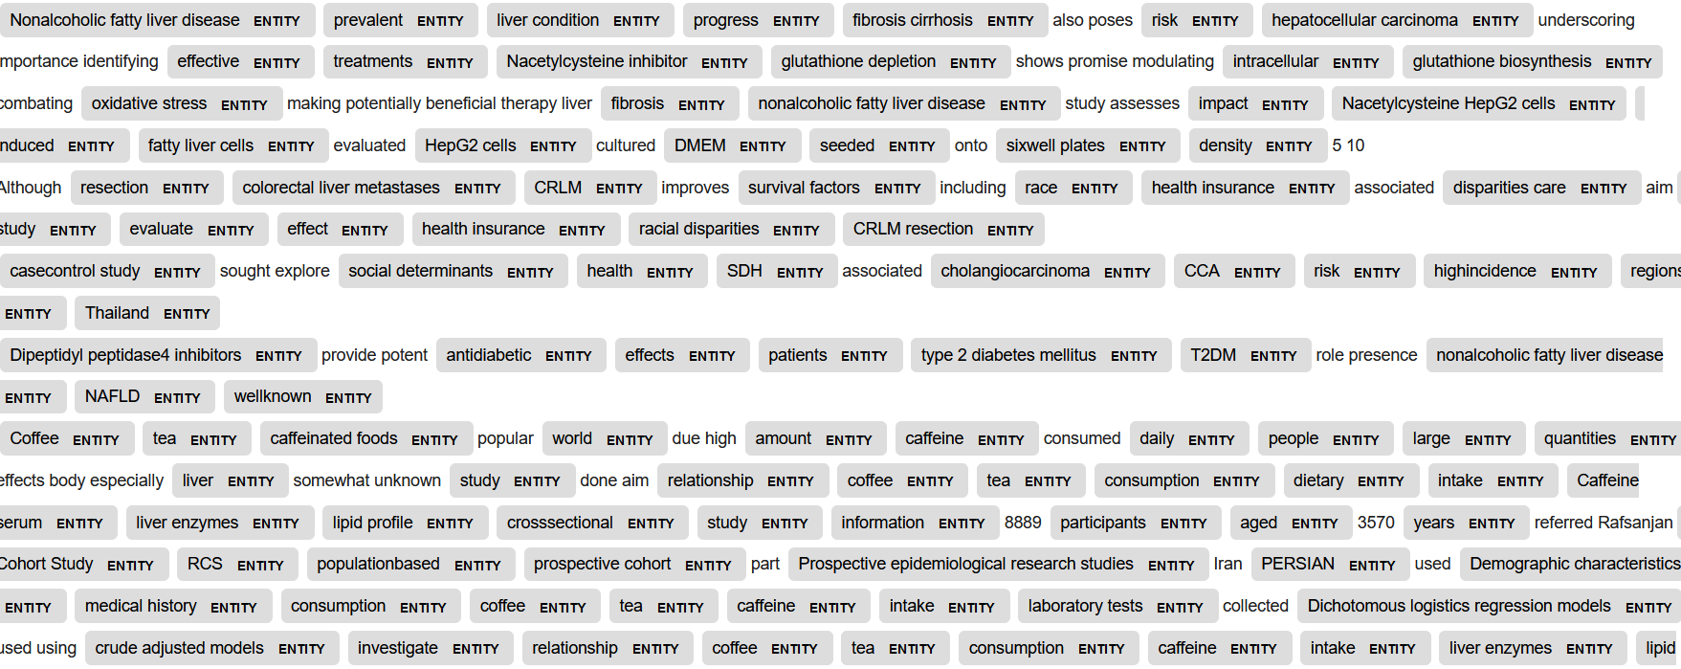
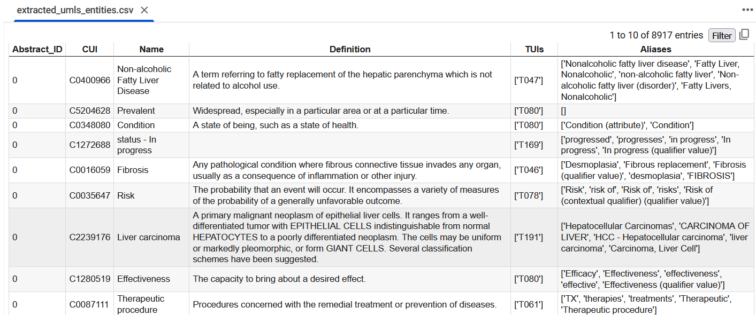

Slide 11
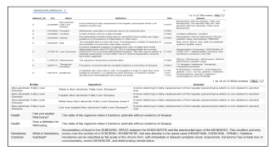
Question generation from Entities
Data Cleaning:
Converted alias strings to lists and removed invalid or missing definitions.
Ensured uniformity by joining aliases with a semicolon delimiter.
Question Generation:
What is {entity}?",
Explain {entity}.",
What does {entity} mean?",
Can you explain {entity}?",
Give a definition for {entity}.",
For Aliases;
What is {alias}?",
Explain {alias}.",
What does {alias} mean?",
Can you explain {alias}?",
Give a definition for {alias}."
Combined questions with corresponding UMLS definitions to form QA pairs.
Generated question-answer pairs in a structured DataFrame.

Slide 12
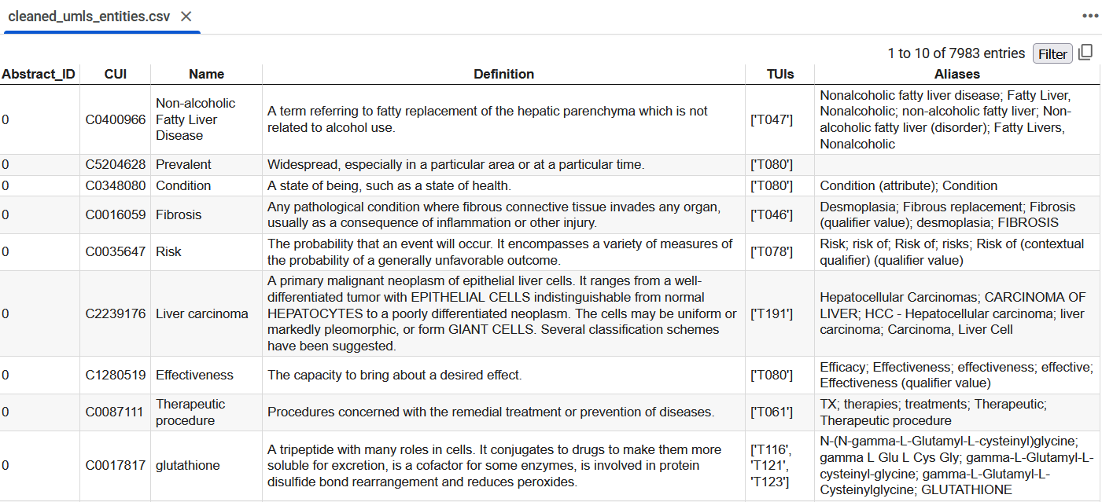
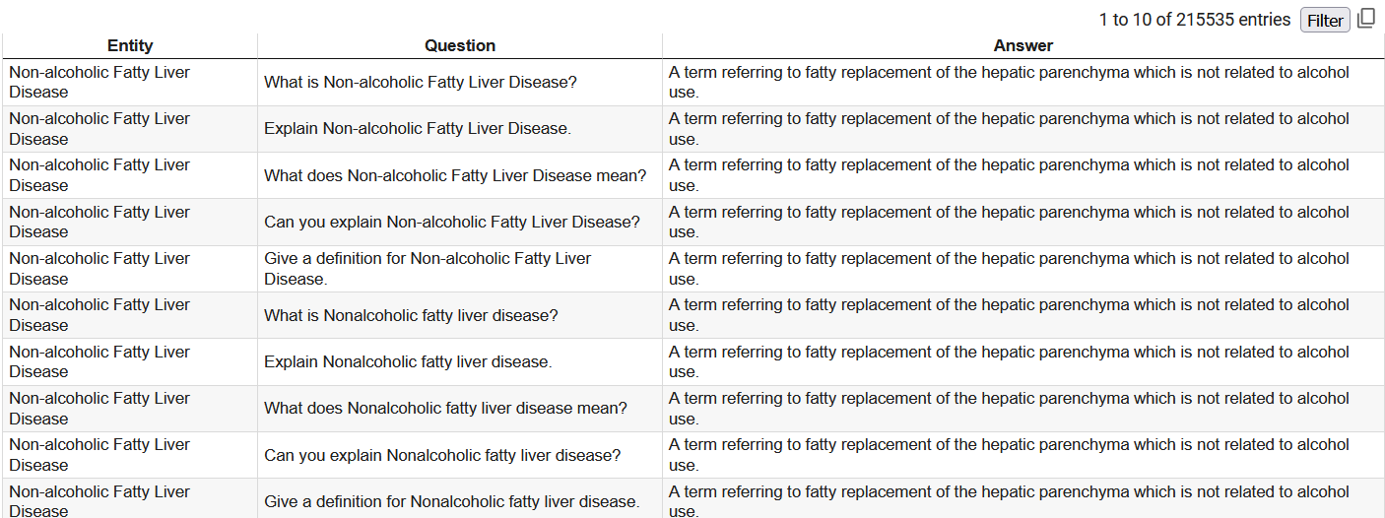
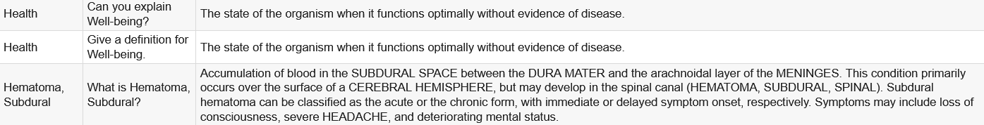

Slide 13
Training QA model-T5 Small
Converted the QA dataset into a Hugging Face Dataset format.
Split the data into training (80%) and testing (20%) subsets using train_test_split.
Chose T5-small as the pre-trained transformer model for sequence-to-sequence tasks.
Training Process: Fine-tuned the model with Seq2SeqTrainer using key parameters:
Learning Rate: 2e-5.
Batch Size: 4.
Number of Epochs: 3.
Evaluation Strategy: Per epoch.
Predicted answers generated in batches on the test set using the trained model.
Compared predictions to true answers for performance assessment.
Fine-tuned the QA model and tokenizer for domain-specific tasks.
Saved the model and tokenizer for deployment: ./fine_tuned_model

Slide 14
Streamlit Deployment
Used Streamlit to build a user-friendly interface for the QA model.
Designed the app to accept user-input questions and display model-generated answers.
Loaded the fine-tuned QA model and tokenizer from the saved directory (./fine_tuned_model).
Utilized Hugging Face's pipeline for seamless text-to-text generation
Allowed users to input questions through a text field.
Used localtunnel to make the app accessible via a public URL for testing.

Slide 15
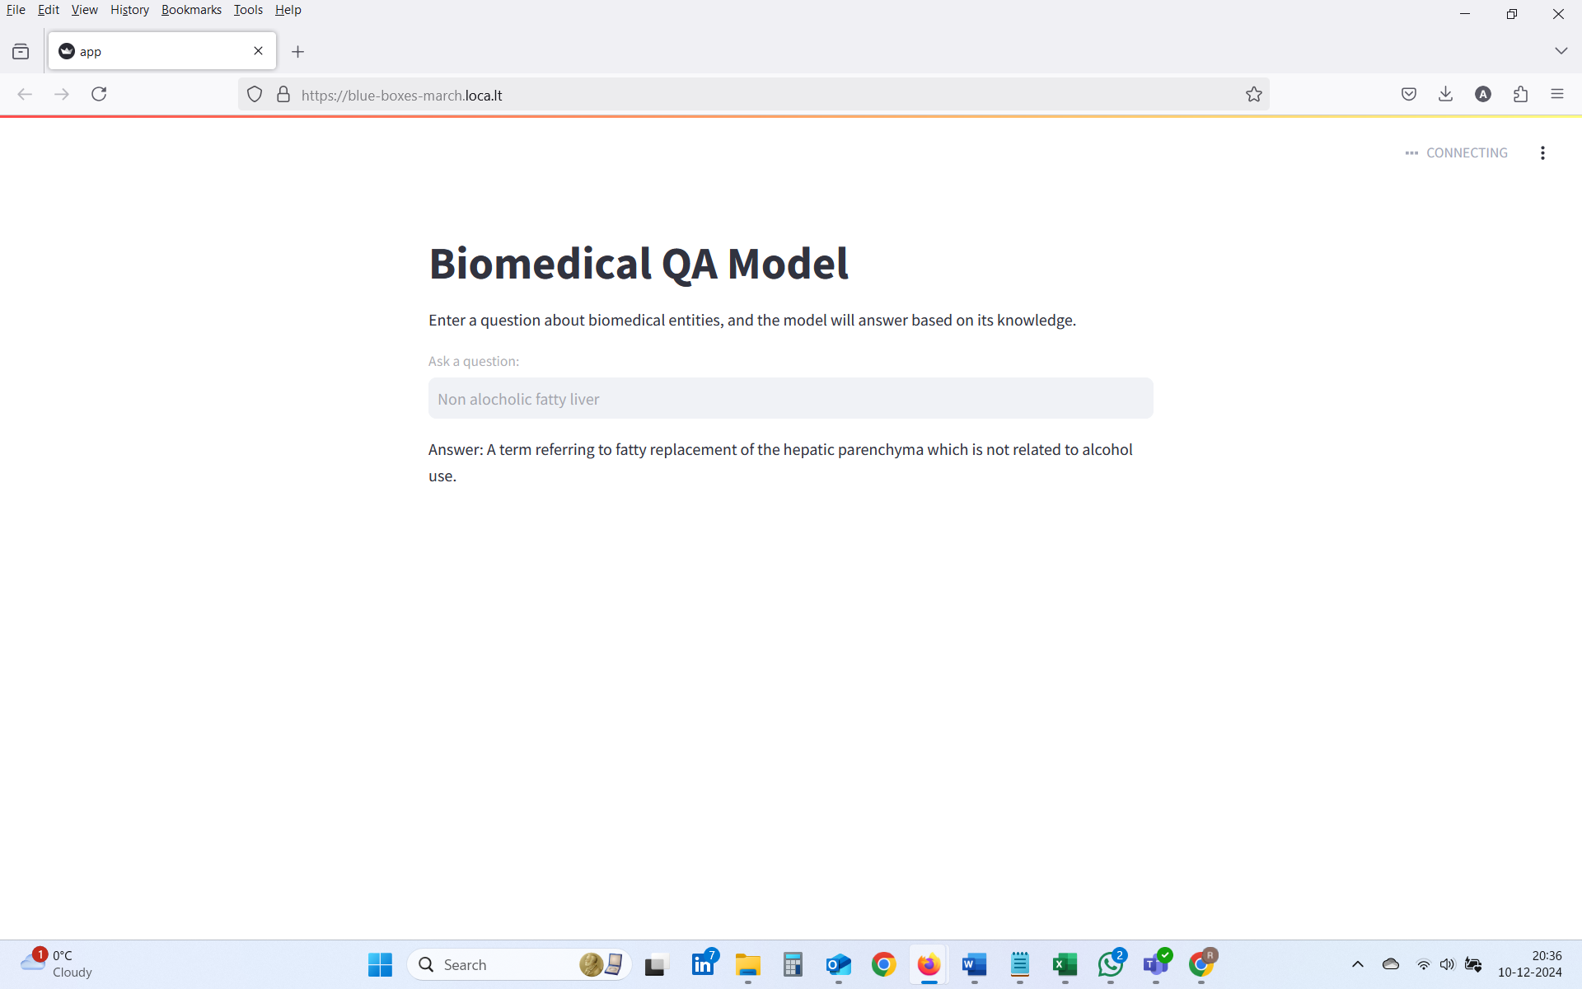

Slide 16
Evaluation
Exact Match (EM):
Measures the percentage of predictions that exactly match the true answers.
Result: 29.61%
F1 Score:
Evaluates the harmonic mean of precision and recall for token overlap.
Result: 52.57%
BLEU Score:
Measures the quality of predictions based on n-gram overlap with the true answers.
Result: 40.70%
ROUGE Scores:
Compares the overlap of sequences between predictions and true answers:
ROUGE-1 (Unigrams): Precision = 59.91%, Recall = 51.76%, F1 = 54.18%.
ROUGE-2 (Bigrams): Precision = 49.68%, Recall = 43.48%, F1 = 45.38%.
ROUGE-L (Longest Common Subsequence): Precision = 59.03%, Recall = 51.09%, F1 = 53.46%.

Slide 17
While the Exact Match score indicates room for improvement in precision, the F1 and ROUGE scores highlight the model's ability to capture relevant information effectively.
This project establishes a solid foundation for developing robust QA systems tailored to biomedical domains, paving the way for future enhancements

Slide 18


