Slide 1
Introduction to Computer Graphics

Slide 2
Books & Resources to follow
Khandaker Jannatul Ritu, Lecturer(CSE), BAIUST

Slide 3
Outlines of this lecture
Khandaker Jannatul Ritu, Lecturer(CSE), BAIUST

Slide 4
Introduction of Computer Graphics
Graphics are defined as any sketch or a drawing or a special network that pictorially represents some meaningful information. Computer Graphics is used where a set of images needs to be manipulated or the creation of the image in the form of pixels and is drawn on the computer.
To plot some points on a computer screen to make an image
Computer graphics involves technology to accept, process, transform and present information in a visual form that also concerns with producing images using a computer
The study of creating, manipulating, and using visual images in the computer
An art of drawing pictures, lines, charts etc. on computer screen by using programming is known as computer graphics. The activities involved in computer graphics are computations, creation and manipulation of data. The images are generated and manipulated by a rendering tool known as computer graphics.
In computer graphics objects are presented as a collection of discrete pixel elements.
Khandaker Jannatul Ritu, Lecturer(CSE), BAIUST

Slide 5
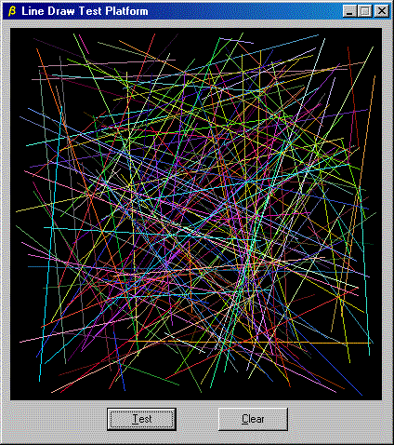
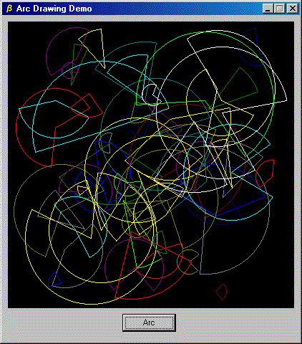
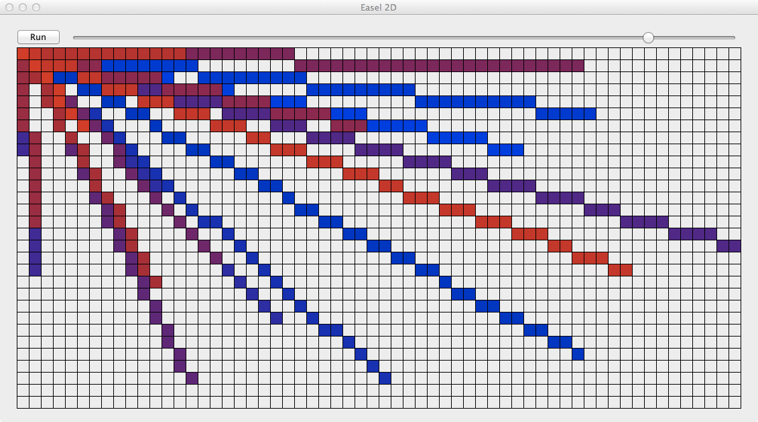
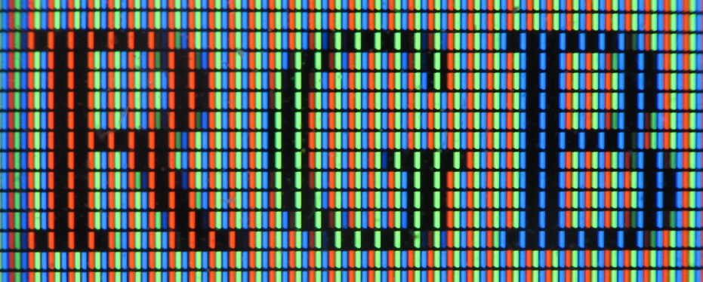
Computer Graphics refers to several things:
The manipulation and the representation of the image or the data in a graphical manner.
Various technology is required for the creation and manipulation.
Digital synthesis and its manipulation.
Khandaker Jannatul Ritu, Lecturer(CSE), BAIUST

Slide 6
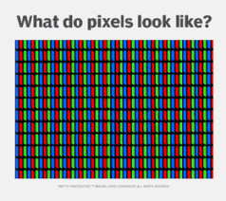
Pixel → smallest screen element
Graphics: computer generated by coding or drawn by you.
Image: scanned, captured, take photograph or an graphic file not generated by you.
Khandaker Jannatul Ritu, Lecturer(CSE), BAIUST

Slide 7
What is a Picture?
Picture — A drawing, painting, or artwork created on a computer.
What is a Photo?
Photo or photograph — Anything taken by a camera, digital camera, or photocopier.
What is an Image?
Image — Any visual object modified or altered by a computer or an imaginary object created using a computer. A picture that is store in some electronic form. Eg any picture file in your computer.

Slide 8
Types of Computer Graphics
Raster Graphics: In raster, graphics pixels are used for an image to be drawn. It is also known as a bitmap image in which a sequence of images is into smaller pixels. Basically, a bitmap indicates a large number of pixels together.
Vector Graphics: In vector graphics, mathematical formulae are used to draw different types of shapes, lines, objects, and so on.
Khandaker Jannatul Ritu, Lecturer(CSE), BAIUST

Slide 9
Computer graphics vs Image Processing
1. CG: generation of picture using computer
IP: technique to modify or interpret existing pictures
2. CG: synthesizes pictures from mathematical or geometrical models
IP: analyze pictures to derive description of objects appeared in the picture
3. CG: creation, storage, manipulation of images of objects
IP: handles image manipulation or interation.

Slide 10
Application of Computer Graphics
Computer graphics user interfaces GUIs
− A graphic, mouse-oriented paradigm which allows the user to interact with a computer.
Business presentation graphics − "A picture is worth a thousand words".
Cartography − Drawing maps.
Weather Maps − Real-time mapping, symbolic representations.
Satellite Imaging − Geodesic images.
Photo Enhancement − Sharpening blurred photos.
Medical imaging − MRIs, CAT scans, etc. - Non-invasive internal examination.
Engineering drawings − mechanical, electrical, civil, etc. - Replacing the blueprints of the past.
Khandaker Jannatul Ritu, Lecturer(CSE), BAIUST

Slide 11
Application of Computer Graphics
Typography − The use of character images in publishing - replacing the hard type of the past.
Architecture − Construction plans, exterior sketches - replacing the blueprints and hand drawings of the past.
Art − Computers provide a new medium for artists.
Training − Flight simulators, computer aided instruction, etc.
Entertainment − Movies and games.
Simulation and modeling − Replacing physical modeling and enactments
8. Visualization: It is used for visualization of scientists, engineers, medical personnel, business analysts for the study of a large amount of information.
9. Educational Software: Computer Graphics is used in the development of educational software for making computer-aided instruction.
10. Printing Technology: Computer Graphics is used for printing technology and textile design.
Khandaker Jannatul Ritu, Lecturer(CSE), BAIUST

Slide 12
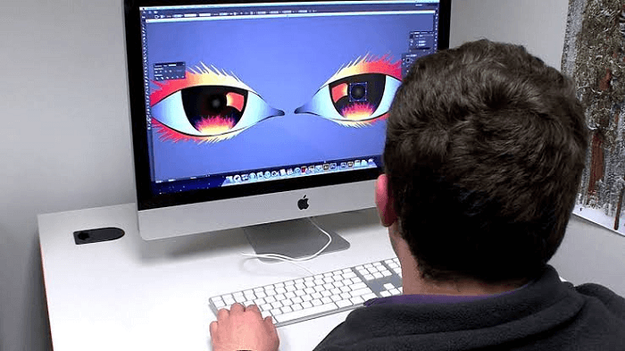
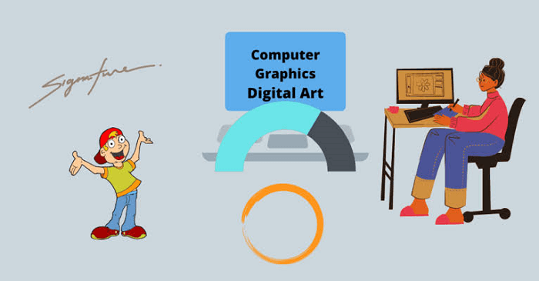
Khandaker Jannatul Ritu, Lecturer(CSE), BAIUST

Slide 13
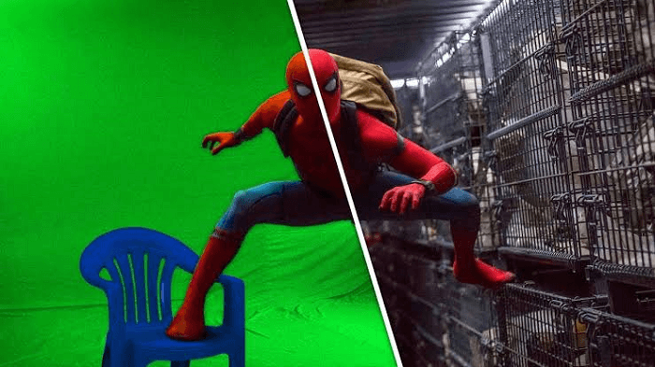
Khandaker Jannatul Ritu, Lecturer(CSE), BAIUST

Slide 14
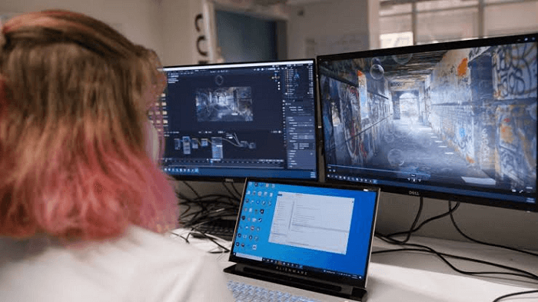
Khandaker Jannatul Ritu, Lecturer(CSE), BAIUST

Slide 15
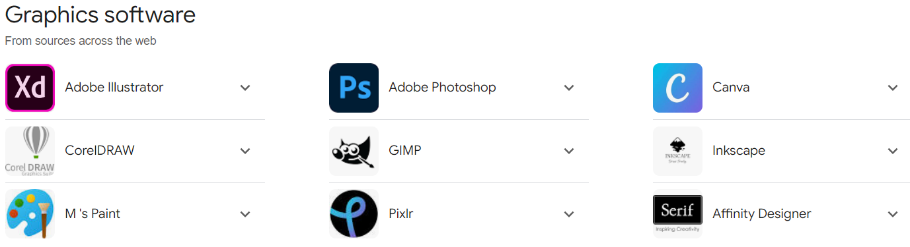
Khandaker Jannatul Ritu, Lecturer(CSE), BAIUST

Slide 16
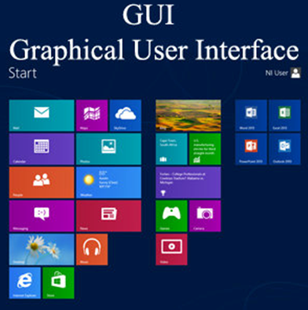
Khandaker Jannatul Ritu, Lecturer(CSE), BAIUST

Slide 17
Interactive and Passive Graphics
(a) Non-Interactive or Passive Computer Graphics:
In non-interactive computer graphics, the picture is produced on the monitor, and the user does not have any controlled over the image, i.e., the user cannot make any change in the rendered image. One example of its Titles shown on T.V.
Non-interactive Graphics involves only one-way communication between the computer and the user, User can see the produced image, and he cannot make any change in the image.
Khandaker Jannatul Ritu, Lecturer(CSE), BAIUST

Slide 18
(b) Interactive Computer Graphics:
In interactive Computer Graphics user have some controls over the picture, i.e., the user can make any change in the produced image. One example of it is the ping-pong game.
Interactive Computer Graphics require two-way communication between the computer and the user. A User can see the image and make any change by sending his command with an input device.
Khandaker Jannatul Ritu, Lecturer(CSE), BAIUST

Slide 19
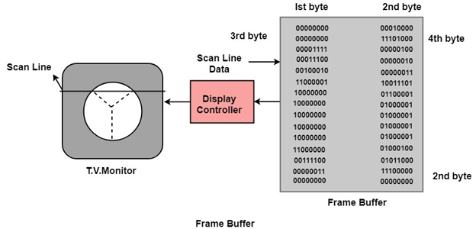
Working of Interactive Computer Graphics:
The modern graphics display is very simple in construction. It consists of three components:
Frame Buffer or Digital Memory
A Monitor likes a home T.V. set without the tuning and receiving electronics.
Display Controller or Video Controller: It passes the contents of the frame buffer to the monitor.
Frame Buffer: A digital frame buffer is large, contiguous piece of computer memory used to hold or map the image displayed on the screen.
Khandaker Jannatul Ritu, Lecturer(CSE), BAIUST

Slide 20
At a minimum, there is 1 memory bit for each pixel in the raster. This amount of memory is called a bit plane.
A 1024 x 1024 element requires 2²⁰ (2¹⁰=1024;2²⁰=1024 x 1024)sq.raster or 1,048,576 memory bits in a single bit plane.
The picture is built up in the frame buffer one bit at a time.
∵ A memory bit has only two states (binary 0 or 1), a single bit plane yields a black and white (monochrome display).
As frame buffer is a digital device write raster CRT is an analog device.
Khandaker Jannatul Ritu, Lecturer(CSE), BAIUST

Slide 21

Properties of Video Monitor:
1. Persistence: Persistence is the duration of phosphorescence. Different kinds of phosphors are available for use in CRT. Besides color, a major difference between phosphor in their persistence how they continue to emit light after the electron beam is removed.
2. Resolution: Use to describe the number of pixels that are used on display image.
3. Aspect Ratio: It is the ratio of width to its height. Its measure is unit in length or number of pixels.
Khandaker Jannatul Ritu, Lecturer(CSE), BAIUST

Slide 22
Khandaker Jannatul Ritu, Lecturer(CSE), BAIUST

Slide 23
Khandaker Jannatul Ritu, Lecturer(CSE), BAIUST

Slide 24
Khandaker Jannatul Ritu, Lecturer(CSE), BAIUST

Slide 25
Khandaker Jannatul Ritu, Lecturer(CSE), BAIUST

Slide 26
Khandaker Jannatul Ritu, Lecturer(CSE), BAIUST

Slide 27
Khandaker Jannatul Ritu, Lecturer(CSE), BAIUST

Slide 28
Khandaker Jannatul Ritu, Lecturer(CSE), BAIUST

Slide 29
Khandaker Jannatul Ritu, Lecturer(CSE), BAIUST

Slide 30
Khandaker Jannatul Ritu, Lecturer(CSE), BAIUST

Slide 31
Khandaker Jannatul Ritu, Lecturer(CSE), BAIUST

Slide 32
Khandaker Jannatul Ritu, Lecturer(CSE), BAIUST

Slide 33
Khandaker Jannatul Ritu, Lecturer(CSE), BAIUST

Slide 34
Khandaker Jannatul Ritu, Lecturer(CSE), BAIUST

Slide 35
Khandaker Jannatul Ritu, Lecturer(CSE), BAIUST

Slide 36
Khandaker Jannatul Ritu, Lecturer(CSE), BAIUST

Slide 37
Khandaker Jannatul Ritu, Lecturer(CSE), BAIUST

Slide 38
Khandaker Jannatul Ritu, Lecturer(CSE), BAIUST

Slide 39
Khandaker Jannatul Ritu, Lecturer(CSE), BAIUST

Slide 40
Khandaker Jannatul Ritu, Lecturer(CSE), BAIUST

Slide 41
Khandaker Jannatul Ritu, Lecturer(CSE), BAIUST

Slide 42
Khandaker Jannatul Ritu, Lecturer(CSE), BAIUST

Slide 43
Khandaker Jannatul Ritu, Lecturer(CSE), BAIUST

Slide 44
Khandaker Jannatul Ritu, Lecturer(CSE), BAIUST

Slide 45
Khandaker Jannatul Ritu, Lecturer(CSE), BAIUST

Slide 46
Khandaker Jannatul Ritu, Lecturer(CSE), BAIUST

Slide 47
Khandaker Jannatul Ritu, Lecturer(CSE), BAIUST

Slide 48
Khandaker Jannatul Ritu, Lecturer(CSE), BAIUST

Slide 49
Khandaker Jannatul Ritu, Lecturer(CSE), BAIUST

Slide 50
Khandaker Jannatul Ritu, Lecturer(CSE), BAIUST

