Slide 1
Internet and Web Programming
Module - 2
Dr S P Meenakshi
spmeenakshi@vit.ac.in
SCOPE

Slide 2
Module -2 Web designing
HTML5 Form elements
Input types and Media elements
CSS3 – Selectors
  Box Model
  Backgrounds and Borders
  Text Effects
  Animations
  Multiple Column Layout
User Interface

Slide 3
HTML
HTML stands for Hyper Text Markup Language
HTML is the standard markup language for creating Web pages
HTML describes the structure of a Web page
HTML consists of a series of elements
HTML elements tell the browser how to display the content
HTML elements label pieces of content such as "this is a heading", "this is a paragraph", "this is a link", etc.

Slide 4
A Simple HTML Document
<!DOCTYPE html>
<html>
<head>
<title>Page Title</title>
</head>
<body>
<h1>My First Heading</h1>
<p>My first paragraph.</p>
</body>
</html>

Slide 5
A Simple HTML Document
The <!DOCTYPE html> declaration defines that this document
is an HTML5 document
The <html> element is the root element of an HTML page
The <head> element contains meta information about the HTML page
The <title> element specifies a title for the HTML page
(which is shown in the browser's title bar or in the page's tab)
The <body> element defines the document's body, and is a container
for all the visible contents, such as headings, paragraphs, images, hyperlinks, tables, lists, etc.
The <h1> element defines a large heading (h1-h6)
The <p> element defines a paragraph

Slide 6
What is an HTML Element?
An HTML element is defined by a start tag, some content, and an end tag:
<tagname>Content goes here...</tagname>
The HTML element is everything from the start tag to the end tag:
<h1>My First Heading</h1>
<p>My first paragraph.</p>

Slide 7
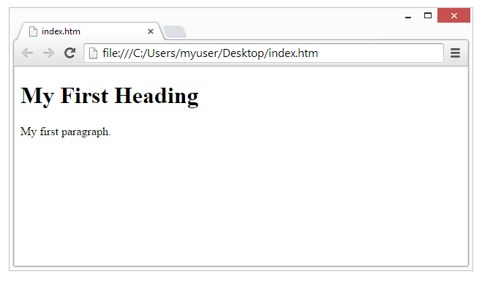
Web Browsers
The purpose of a web browser (Chrome, Edge, Firefox, Safari) is to read HTML documents and display them correctly.
A browser does not display the HTML tags, but uses them to determine how to display the document:

Slide 8
HTML Attributes
All HTML elements can have attributes
Attributes provide additional information about elements
Attributes are always specified in the start tag
Attributes usually come in name/value pairs like: name="value“
href attribute - <a> tag defines hyperlink reference, href attribute specifies the url
<a href="https://www.w3schools.com">Visit W3Schools</a>

Slide 9
HTML elements and attributes
<img> element used to embed an image in the html page, it does not have a closing tag
src,height,width,alt – attributes associated with <img>
<img src="img_girl.jpg“ alt="Girl with a jacket" width="500" height="600">
Html allows animated images also specified as .gif file in the src attribute
CSS width and height property and float property can be used with <img>
<p><img src="C:\Users\Admin\Pictures\robot1.JPG" alt=“ROBOT" style="float:left;width:42px;height:42px;">
The image will float to the left of the text.</p>
Other image elements are <map>, <area>, <picture>

Slide 10
HTML formatting elements
These elements are used to display the text in the specified form
<b> - Bold text - <b>This text is bold</b>
<strong> - Important text - <strong>This text is important!</strong>
<i> - Italic text - <i>This text is italic</i>
<em> - Emphasized text - <em>This text is emphasized</em>
<mark> - Marked text
<small> - Smaller text - <small>This is some smaller text.</small>
<del> - Deleted text - <p>My favorite color is <del>blue</del> <ins>red</ins>.</p>
<ins> - Inserted text
<sub> - Subscript text <p>This is <sub>subscripted</sub> text.</p>
<sup> - Superscript text

Slide 11
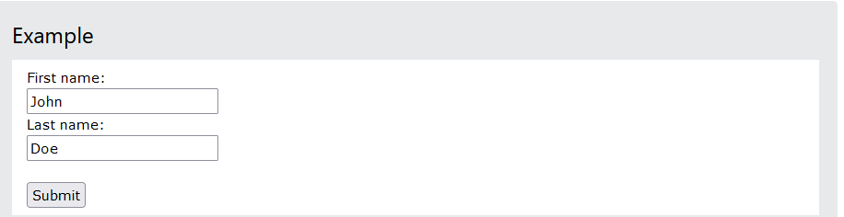
HTML5 Form element
An HTML form is used to collect user input. The user input is most often sent to a server for processing.
The <form> Element
The HTML <form> element is used to create html forms for user input
User input processing in the browser side is done using i.e., java scripts

Slide 12
Form element
<form>
.
form elements
.
</form>
The <form> element is a container for various input types like text fields, checkboxes, radio buttons, submit buttons

Slide 13
Input elements
The HTML <input> element is the most used form element
An <input> element can displayed in different forms based on type attribute
Type | Description
<input type="text"> | Displays a single-line text input field
<input type="radio"> | Displays a radio button (for selecting one of many choices)
<input type="checkbox"> | Displays a checkbox (for selecting zero or more of many choices)
<input type="submit"> | Displays a submit button (for submitting the form)
<input type="button"> | Displays a clickable button

Slide 14
Input type example - text
<form>
<label for="fname">First name:</label><br>
<input type="text" id="fname" name="fname"><br>
<label for="lname">Last name:</label><br>
<input type="text" id="lname" name="lname">
</form>
The label element defines label for form elements
It is useful for screen readers and those who have problem in clicking small regions
“for” attribute of label element is equal to the “id” attribute of input element.

Slide 15
Input type example - radio
<p>Choose your favorite Web language:</p>
<form>
<input type="radio" id="html" name="fav_language" value="HTML">
<label for="html">HTML</label><br>
<input type="radio" id="css" name="fav_language" value="CSS">
<label for="css">CSS</label><br>
<input type="radio" id="javascript" name="fav_language" value="JavaScript">
<label for="javascript">JavaScript</label>
</form>
Other attributes used in input element– id,name,value

Slide 16
Input type example -checkbox
<form>
<input type="checkbox" id="vehicle1" name="vehicle1" value="Bike">
<label for="vehicle1"> I have a bike</label><br>
<input type="checkbox" id="vehicle2" name="vehicle2" value="Car">
<label for="vehicle2"> I have a car</label><br>
<input type="checkbox" id="vehicle3" name="vehicle3" value="Boat">
<label for="vehicle3"> I have a boat</label>
</form>
Other attributes of input element used: id, name,value

Slide 17
Input type example - submit
Input type attribute submit will assign the form to form handler
Formhandler is the script in server side to process the submitted form
The form handler is specified in action attribute of the form element
<form action="/action_page.php">
<label for="fname">First name:</label><br>
<input type="text" id="fname" name="fname" value="John"><br>
<label for="lname">Last name:</label><br>
<input type="text" id="lname" name="lname" value="Doe"><br><br>
<input type="submit" value="Submit">
</form>
Along with attribute type submit, value attribute is used.

Slide 18
Form attributes
Form element attributes: id, method, novalidate
“Id” form attribute is used in input element to bind the form it belongs
Method attribute specifies : get/post
“novalidate” attribute specify that no form-data should be validated on submit
<form action="/action_page.php" id="form1“ method=“post” novalidate>
</form>
<label for="lname">Last name:</label>
<input type="text" id="lname" name="lname" form="form1">

Slide 19
Form attributes
Form attributes associated with other form elements
formenctype – specifies how the form-data should be encoded when submitted
  Used only for forms with post method, it overrides the encrypt attribute of form element
  Used with input type: submit, image
  <input type="submit" formenctype="multipart/form-data"
  value="Submit as Multipart/form-data">
formtarget – specifies a name or keyword that indicates where to display the response that is received after submitting the form
  It works with the input type: submit, image
  <input type="submit" formtarget="_blank" value="Submit to a new window/tab">
formnovalidate – specifies that an input element should not be validated when submitted
  It works with the input type submit
  <input type="submit" formnovalidate="formnovalidate"
  value="Submit without validation">

Slide 20
Get method
This method appends the form-data to the URL in name/value pairs
This method is useful for form submissions where a user want to bookmark the result
There is a limit to how much data you can place in a URL (varies between browsers), therefore, you cannot be sure that all of the form-data will be correctly transferred
Never use the "get" method to pass sensitive information! (password or other sensitive information will be visible in the browser's address bar)

Slide 21
Post method
This method sends the form-data as an HTTP post transaction
Form submissions with the "post" method cannot be bookmarked
The "post" method is more robust and secure than "get“
"post" does not have size limitations

Slide 22
Media elements
Media data – sound, music, video, movies, animations
To include the media data in web pages – media elements
Browser support for fonts, colors, multimedia is required
Multimedia elements stored in media files
Media file formats - .wav, .mp3, .mp4, .mpg, .wmv, .avi
MP4, WebM, Ogg video formats are supported by html
MP3, WAV, and Ogg audio are supported by the HTML standard

Slide 23
HTML video
<video> element is used to show a video on a web page
Attributes – height, witdth, controls, autoplay
Control attribute adds video controls like play, pause and volume
Autoplay - To play the video automatically
<source> element used along with <video> element to specify different video sources
The text specified between the <video> element tags will be displayed if browser support not available for the video formats
HTML DOM defines methods, properties and events for the video element

Slide 24
Example
<video width="320" height="240" controls>
<source src="movie.mp4" type="video/mp4">
<source src="movie.ogg" type="video/ogg">
Your browser does not support the video tag.
</video>
<video width="320" height="240" autoplay muted>

Slide 25
HTML -Audio
<audio> element - To play an audio file on a web page
Attributes – controls, autoplay, muted
Associated html elements <source>
Attributes of <source> element – src, type
Text between the <audio> tags used to display if the browser doesnot support the audio element
<audio controls autoplay muted>
<source src="horse.ogg" type="audio/ogg">
<source src="horse.mp3" type="audio/mpeg">
Your browser does not support the audio element.
</audio>

Slide 26
HTML – plug-ins
Used to improve the standard functionality of the browsers
Plug-ins designed to be used for different purposes
Browsers no longer supports java applets, Microsoft ActiveX controls and plug-ins
<object> element used to embed plug-ins like java applets in web pages including html page
<object width="100%" height="500px" data="snippet.html"></object>
To run Java applets
To display maps
To scan for viruses
To verify a bank id
To display Flash movies
To run Microsoft ActiveX controls

Slide 27
HTML - YouTube
To play video in html page
No Video format conversion related issues
To play your video on a web page using youtube
<iframe width="420" height="315"
src="https://www.youtube.com/embed/tgbNymZ7vqY">
</iframe>
Parameters like autoplay=1, mute=1 can be passed through url
Upload the video to YouTube
Take a note of the video id
Let the src attribute point to the video URL
Use the width and height attributes to specify the dimension of the player
Define an <iframe> element in your web page
Add any other parameters to the URL

Slide 28
CSS3
CSS3 – Selectors
  Box Model
  Backgrounds and Borders
  Text Effects
  Animations
  Multiple Column Layout
User Interface

Slide 29
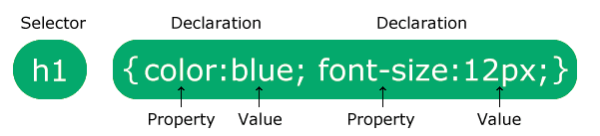
CSS3
CSS is the language we use to style an HTML document.
CSS describes how HTML elements should be displayed.
Each html element style is set using css syntax.
A CSS rule consists of a selector and a declaration block.
The selector points to the HTML element you want to style.
The declaration block contains one or more declarations separated by semicolons.
Each declaration includes a CSS property name and a value, separated by a colon.
Multiple CSS declarations are separated with semicolons, and declaration blocks are surrounded by curly braces.

Slide 30
Example – CSS3 styles
<head>
<style>
body {
background-color: lightblue;
}
h1 {
color: white;
text-align: center;
}
P{
font-family: “Verdana,Helvetica,Times New Roman, Serif,sans-serif,Arial” ; <! -- List of fonts to support fallback -->
font-size:20px;
}
</style>
</head>

Slide 31
CSS Selectors
CSS selectors are used to "find" (or select) the HTML elements you want to style.
We can divide CSS selectors into five categories:
  Simple selectors (select elements based on name, id, class)
  Combinator selectors (select elements based on a specific relationship between them)
  Pseudo-class selectors (select elements based on a certain state)
  Pseudo-elements selectors (select and style a part of an element)
  Attribute selectors (select elements based on an attribute or attribute value)
Element selector based on name
  p {
  text-align: center;
  color: red;
  }
Element selector based on id
  The id selector uses the id attribute of an HTML element
  The id of an element is unique within a page
  To select an element with a specific id, write a hash (#) character, followed by the id of the element.
  #para1 {
  text-align: center;
  color: red;
  }

Slide 32
CSS Selectors
Element selector based on class
  The class selector selects HTML elements with a specific class attribute.
  To select elements with a specific class, write a period (.) character, followed by the class name.
  .center {
  text-align: center;
  color: red;
  }
  We can also specify that only specific HTML elements should be affected by a class.
  p.center {
  text-align: center;
  color: red;
  }
The universal selector (*) selects all HTML elements on the page
  * {
  text-align: center;
  color: blue;
  }
The grouping selector selects all the HTML elements with the same style definitions.
  h1, h2, p {
  text-align: center;
  color: red;
  }

Slide 33
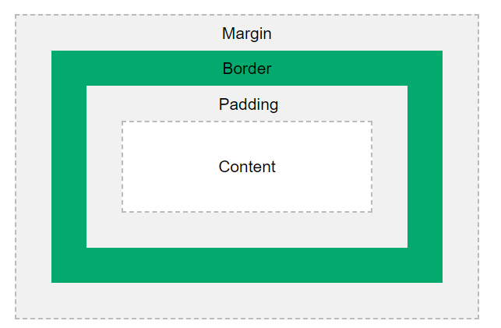
CSS - Boxmodel
All HTML elements can be considered as boxes.
In CSS, the term "box model" is used when talking about design and layout.
The CSS box model is essentially a box that wraps around every HTML element. It consists of: margins, borders, padding, and the actual content. The image below illustrates the box model:

Slide 34
CSS - Boxmodel
The box model allows us to add a border around elements, and to define space between elements.
  Content - The content of the box, where text and images appear
  Padding - Clears an area around the content. The padding is transparent
  Border - A border that goes around the padding and content
  Margin - Clears an area outside the border. The margin is transparent
  div {
  width: 300px;
  border: 15px solid green;
  padding: 50px;
  margin: 20px;
  }
  <div> To show the content using box model</div>

Slide 35
CSS Backgrounds
The CSS background properties are used to add background effects for elements.
background-color, background-image, background-repeat, background-attachment, background-position, background (short hand property)
Background-attachment – fixed/scroll
body {
background-color: lightblue;
background-image: url("paper.gif");
background-repeat: repeat-x;
background-position: right top;
background-attachment: scroll;
}
body {
background: #ffffff url("img_tree.png") no-repeat right top;
}

Slide 36
CSS Borders
The CSS border properties allow you to specify the style, width, and color of an element's border.
The border-style property specifies what kind of border to display
p.dotted {border-style: dotted;}
p.dashed {border-style: dashed;}
p.solid {border-style: solid;}
p.double {border-style: double;}
p.groove {border-style: groove;}
p.ridge {border-style: ridge;}
p.inset {border-style: inset;}
p.outset {border-style: outset;}
p.none {border-style: none;}
p.hidden {border-style: hidden;}
p.mix {border-style: dotted dashed solid double;}

Slide 37
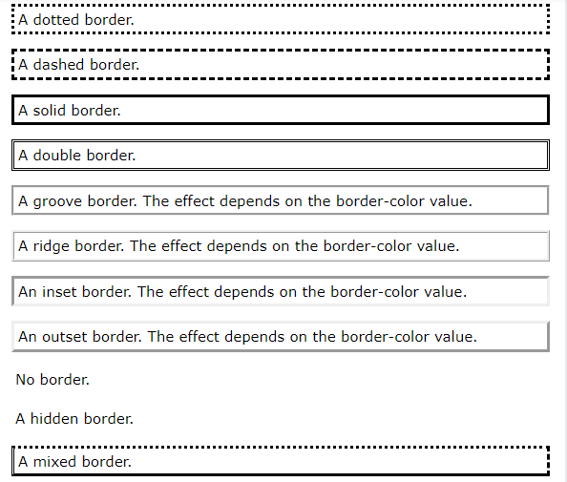
CSS Border style

Slide 38
CSS Border width, color
The border-witdth property specifies the width of the four borders
The border-color property specifies the color of the borders
There are also properties for specifying each of the borders (top, right, bottom, and left):
  p.one {
  border-style: solid;
  border-width: 5px 20px; /* 5px top and bottom, 20px on the sides */
  border-color: red green blue yellow; /* red top, green right, blue bottom and yellow left */
  }
  p {
  border-top-style: dotted;
  border-right-style: solid;
  border-bottom-style: dotted;
  border-left-style: solid;
  }
The border property is short hand property for border-width,border-style,border-color
  p {
  border: 5px solid red;
  }
The border-radius property used to have rounded border
  border-radius: 5px;

Slide 39
CSS – Text effects
Color property used to set the color of the text
The text-decoration property is used to set the decoration of the text like underline, overline,line-through
The text-align property is used to set the alignment of the text
The text-transform property is used to transform the text to uppercase or lowercase
The text-indent, letter-spacing, line-height, word-spacing, white-space are text spacing properties
The text-shadow used to include horizontal, vertical, blur and colored shadows to the text

Slide 40
CSS Text effects
  h1 {
  background-color: black;
  color: white;
text-align: center;
text-decoration: underline;
text-transform: uppercase;
text-indent: 50px;
letter-spacing: 5px;
line-height: 1.2;
word-spacing: 20px;
white-space: nowrap;
text-shadow: 20px 50px 5px red;
}

Slide 41
CSS text effect
Vertical-alignment is used to set the vertical alignment of an element
  img.a {
  vertical-align: baseline;
  }
The text-overflow property specifies how a overflowed text should be signalled to the user
p.test1 {
white-space: nowrap;
width: 200px;
border: 1px solid #000000;
overflow: hidden;
text-overflow: clip;
}
To display the overflow content when hovering over the element
div.test:hover {
overflow: visible;
}

Slide 42
CSS Text Effect (Cont.)
word-wrap property to wrap the long text line to next line
p {
word-wrap: break-word;
}
word-break property for breaking the words, writing-mode for laying the text horizonally or vertically
p{
word-break:break-all;
writing-mode:vertical-rl;
}

Slide 43
CSS animations
Without using javascript or flash, animation of html elements is allowed using CSS
An animation lets an element gradually change from one style to another.
CSS properties can be changed as many times as we want.
To use CSS animation, keyframes for the animation should be specified first.
Keyframes hold the styles the element will have at certain times.
CSS style is specified inside @keyframes rule and included in a html element using animation-name css property

Slide 44
CSS Animations
@keyframes example1{
from {background-color: red;}
to { background-color:blue;} }
div {
width:300px; height:300px; background-color:red;
position:relative;
animation-name:example1;
animation-time:4s; }
Positions – static, relative, fixed, absolute, sticky
Other postion properties – top,right,bottom,left,center

Slide 45
CSS animations
Many style changes can be specified using different percentages of animation time
@keyframes example1{
0% {background-color:blue; left:0px;top:0px;}
50% {background-color:red;left:200px; top:0px;}
75% {background-color:green;left:200px; top:200px}
100% {background-color:yellow;}left:0px;top:0px}
}
animation-delay property delays the start of the animation
animation-iteration-count repeats the animation
animation-direction property with values normal, reverse, alternate, alternate-reverse used to change the animation direction
Animation-timing-function property with values ease, linear, ease-in, ease-out, ease-in-out, cubic-bezier(n,n,n,n) specifies the animation speed variations

Slide 46
CSS animations
Div {
animation-name: example1;
animation-duration:5s;
animation-delay:2s;
position=relative;
animation-direction:alternate;
animation-iteration-count:infinite;
animation-direction:reverse;
animation-timing-function:linear;
}

Slide 47
CSS animation
@keyframes animation2{
0% { background-color:red;float:left;}
25% {background-color:blue;float:right;}
50% {background-color:lightblue;float:left;}
75% {background-color:green;float:right;}
100% {background-color:yellow;float:left;}
}
img {
width:100px;
height:100px;
animation-name:animation2;
animation-duration:10s;
animation-delay:2s;
animation-direction:normal;
animation-iteration-count:infinite;
animation-direction:reverse;
}
<img src="https://www.w3schools.com/images/w3schools_logo_436_2.png" alt="w3 image">

Slide 48
CSS multicolumns
It provides definition for multicolumn of texts like in news paper
column-count property specifies the number of columns the page should be divided
column-gap property specifies the gap between two columns
column-rule-style property specifies the style of the rule
column-rule-width property specifies the rule width of the column
column-rule-color property specifies the color of the rule between columns
column-span property specifies that how many columns the element span across
column-width property specifies width of the column
Column-fill property with the values auto, balanced specifies how to fill the column, balanced or not

Slide 49
CSS multicolumns
div {
width:600px;
height:600px;
background-color:lightblue;
//column-count:3;
column-gap:10px;
column-rule-style:solid;
column-rule-width:5px;
column-rule-color:red;
column-width:100px;
column-fill:auto;
}
h1 {
column-span:all;
}

Slide 50
User Interface
Provide interface for the users to interact.
Input elements to take the input
Event handlers to process the input
Output elements to display the output
Designs using background properties, boxmodel, borders, multicolumn
Enhanced appealing using animations, texteffects

