Slide 1

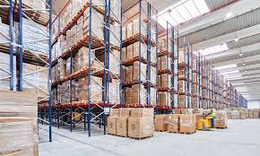
Optimizing Northwind: Recovering $88.8K in At-Risk Revenue
Strategic insights to improve profitability for a global wholesale food distributor

Slide 2
OVERVIEW
Project Scope
Mission
Focus Areas
Goal
Analyze Northwind's digital store data to generate actionable insights for the board
Product pricing, customer segmentation, and logistics performance
Drive strategic decisions to boost profitability and operational efficiency

Slide 3




Three Research Questions
01
02
Product Portfolio & Pricing
Customer Segmentation
Which categories drive profit vs. drain margins through excessive discounting?
Who are our most valuable customers and which regions show declining sales?
03
Logistics & Talent
Where are fulfillment bottlenecks and who are our top sales performers?

Slide 4
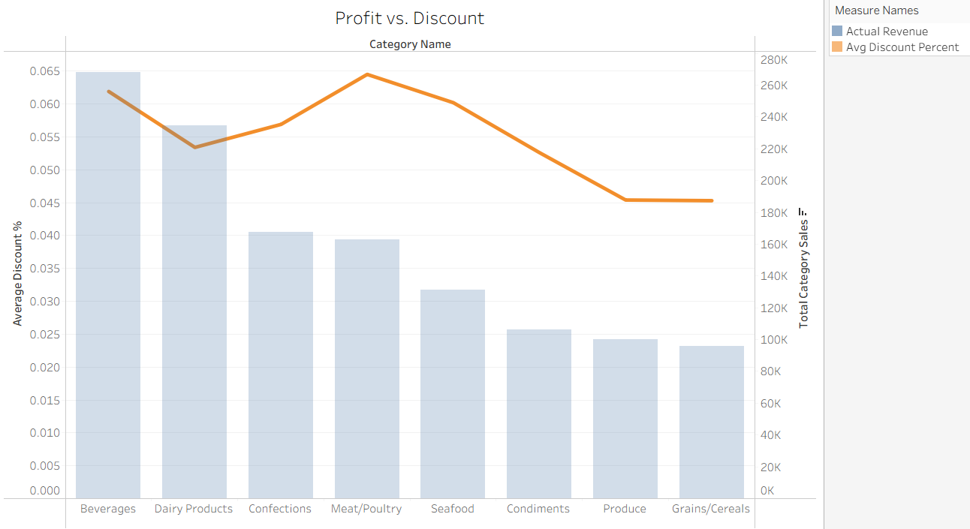

The Discount Trap
Critical Finding
Meat/Poultry has the highest discount rate (6.45%) but $45K less profit than Beverages. We're giving away margin on premium items.
Beverages proves discounts can work: 6.19% discount drives volume while maintaining top profit position.

Slide 5
Meat Category Deep Dive
(The "Good, Bad, & Ugly“)
$46
10%
$2
Thüringer Rostbratwurst
Mishi Kobe Niku
Tourtière
Profit per unit—occupying valuable warehouse space with minimal return
Profit per unit—the category anchor generating $34K total with healthy margins
Highest discount on luxury item—unnecessarily eroding profit on premium inventory

Slide 6
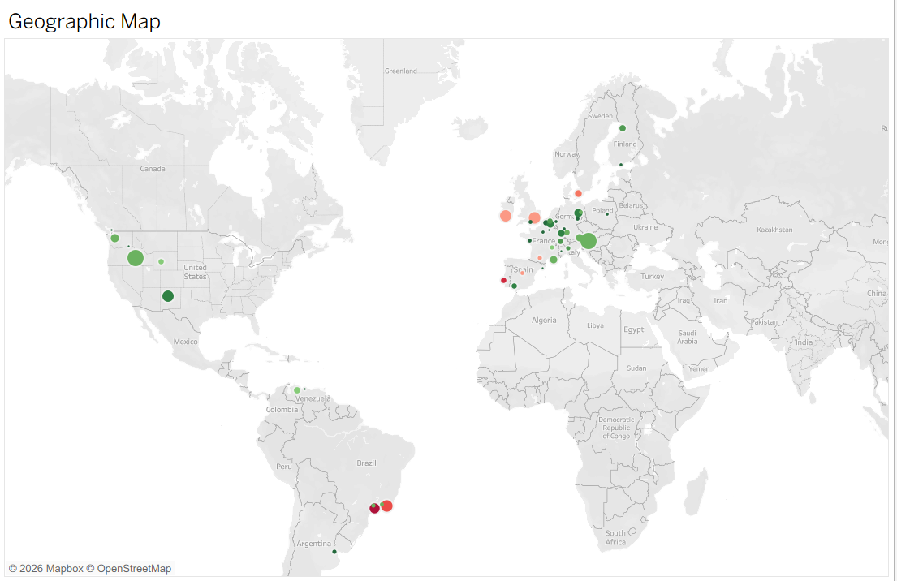

Customer Value Concentration
Top Revenue Drivers
Three customers generate over $100K each in lifetime value:
QUICK-Stop (Germany): $110K, 6.92% discount
Ernst Handel (Austria): $105K, 6.81% discount
Save-a-lot Markets (USA): $104K, 8.28% discount
Geographic strongholds: Western Europe, North America, and emerging Brazil market

Slide 7
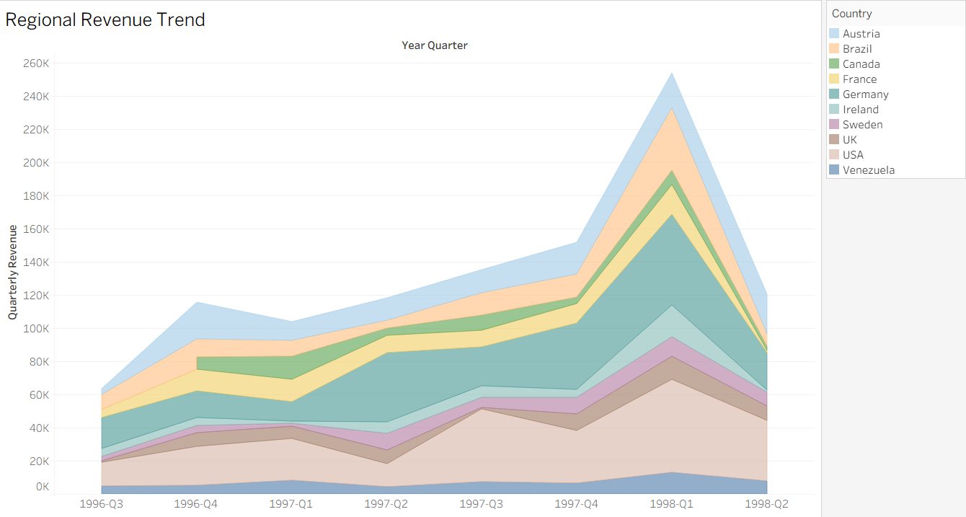
Revenue Trends & Warning Signs
1
1998-Q1 Peak
Massive revenue spike across all regions—investigate and replicate this success formula
2
1998-Q2 Decline
Sharp downturn following peak—systemic slowdown requiring immediate VIP outreach

Slide 8
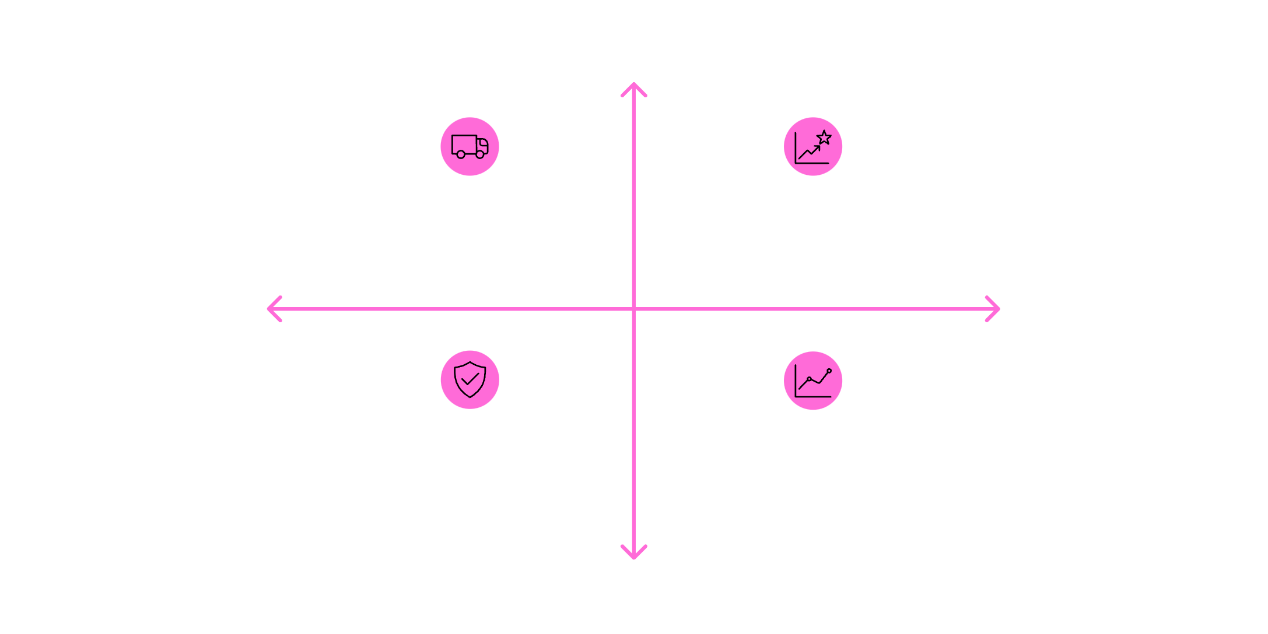
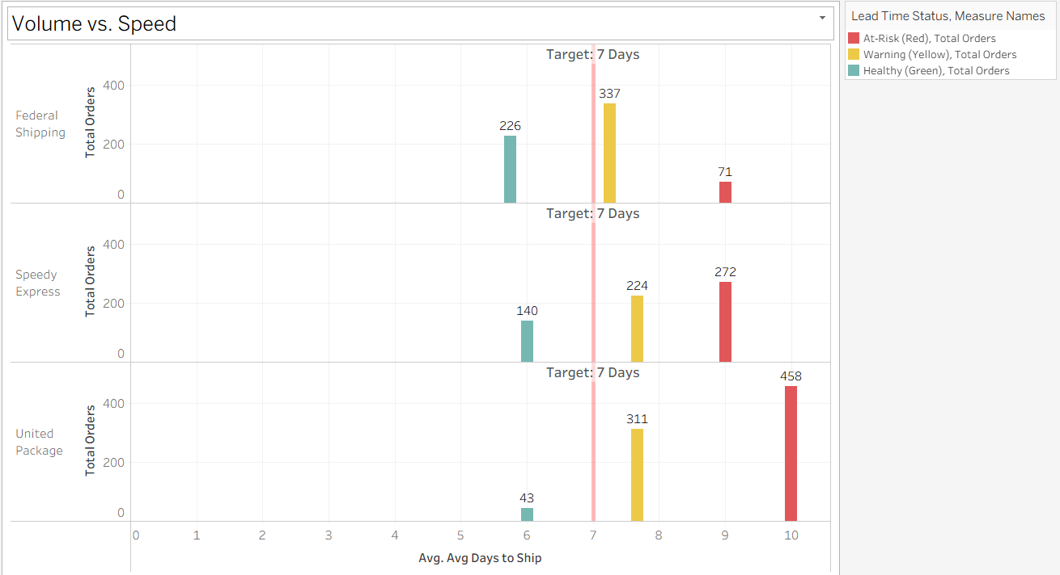




High Reliability
The Shipping Crisis
Federal Shipping — 6 days, 337 orders
Speedy Express — 9 days, moderate volume
Slower Transit
Faster Transit
Opportunity — Shift volume to faster shippers
United Package — 13 days, 458 orders
Low Reliability
Critical Bottleneck
United Package delivers 458 orders at 10-day lead time- our largest volume through our slowest shipper.
Federal Shipping proves reliability: 337 orders in 7.25 days with another 226 in 5.75 days.
$88.8K revenue at risk (7.2%) from delays exceeding 9 days.

Slide 9
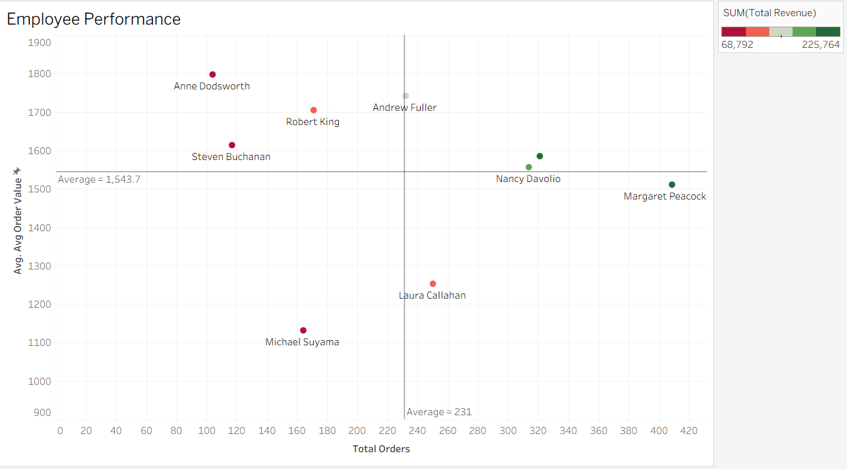
Sales Talent Matrix
Revenue Stars
Premium Closers
Operational Engines
Janet Leverling & Nancy Davolio: High volume + high AOV. Use as training models.
Anne Dodsworth & Robert King: $1,800+ AOV. Assign to whale customers and star products.
Laura Callahan: 250+ orders but lower AOV. Needs cross-selling and upselling training.

Slide 10




Strategic Recommendations
Protect Margins
Fix Logistics
Cap Meat/Poultry discounts at 5.5%. Freeze luxury item discounts (Mishi Kobe Niku).
Route orders over $1,800 AOV to Federal Shipping. Renegotiate United Package contract.
Retain VIPs
Replicate Success
Launch outreach program for top 10 customers. Address Q2 revenue decline immediately.
Investigate 1998-Q1 spike factors. Apply learnings to upcoming quarters.

