Slide 1
The chronicles of Higher Education
CAPSTONE PROJECT
Professor: Dr. Yan, Fujian
Mentor: Jimmy Aschkar
Presenters Name
Raasikh Naveed

Slide 2
Introduction
Many students apply to numerous universities, hoping to increase their chances of getting into their dream school.
Universities have specific enrolment criteria, admitting some students directly while placing others on a waiting list.

Slide 3
Objective
In recent years, the number of university applicants has increased, raising the likelihood of gaining admission through the waitlist.
This project aims to collect data from R1 universities over the past five years and analyze trends in the number of students offered from the waitlist.

Slide 4

Data Collection
Data was collected from the past five years for R1 universities concerning the required variables.
Out of 147 universities, 57 had records containing all the required information, although some entries had missing values that can be addressed in data processing steps.
Meanwhile, 63 universities did not disclose their waiting list information, and 27 universities had missing information for at least three years.

Slide 5
Dataset
The original dataset consisted of 147 rows and 3 columns, detailing all the R1 universities for which data should be collected.
The new dataset has 287 rows and 5 columns
Years | First time First-year applicants | The number of applicants offered a place on the waiting list | The number of students who accepted a place on the waiting list | The number of students admitted from the waiting list

Slide 6
Initial Goals
Percentage of the total applicant pool offered a place on the waiting list.
Percentage of applicants who accepted a place on the waiting list.
Percentage of applicants admitted from the waiting list.
Analyze the data to determine if there was an increase in the number of students offered a place on the waiting list, and those accepted from the waitlist, for 2020 compared to 2019

Slide 7
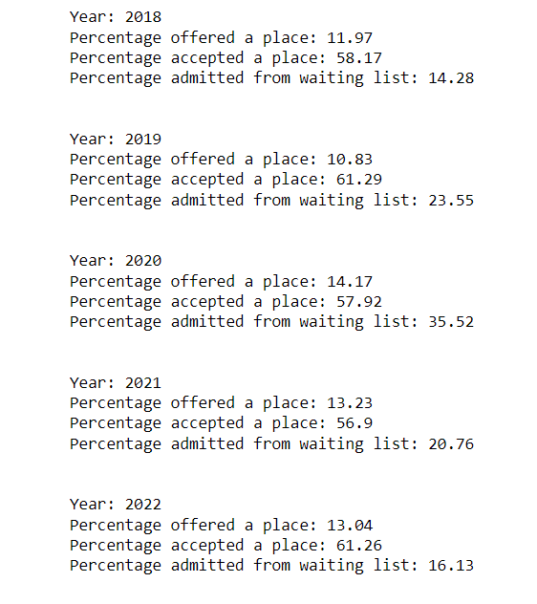
Results
Percentage of applicants admitted from the waiting list.
2018: 14.28
2019: 23.55
2020: 35.52
2021: 20.76
2022: 16.13

Slide 8
Analysis
Total Students Offered a Place on the Waiting List:
2019: 243,036
2020: 314,788
Increase: 71,752
Percent Increase: 22.8%
Total Students Admitted from the Waiting List:
2019: 25,374
2020: 56,577
Increase: 31,203
Percent Increase: 55.1%

Slide 9
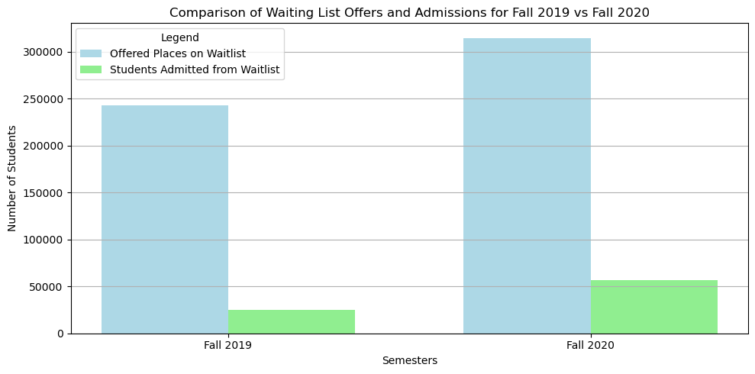
Graph

Slide 10
Reasons for this Increase
The COVID-19 pandemic led to increased uncertainty regarding admissions and enrolment.
Universities faced under-enrollment due to students deferring admission, choosing gap years, or attending closer to home.
This resulted in a larger reliance on waitlists to fill gaps caused by these fluctuations, leading to more students being offered, accepting, and ultimately admitted from the waitlist.

Slide 11
Classification
Initial approach: Linear regression to understand variable relationships and make predictions.
Strategy: Train model on first 4 years, predict 5th year, then forecast future
Goal: Establish credibility for 4-year future predictions
Challenge: Statistically insignificant values yielded poor indications
Attempt: Explored various classification techniques without success

Slide 12
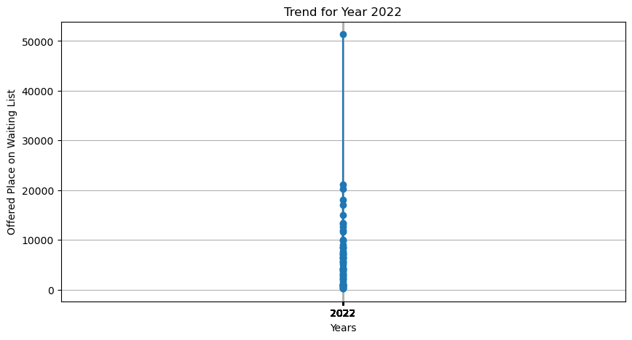
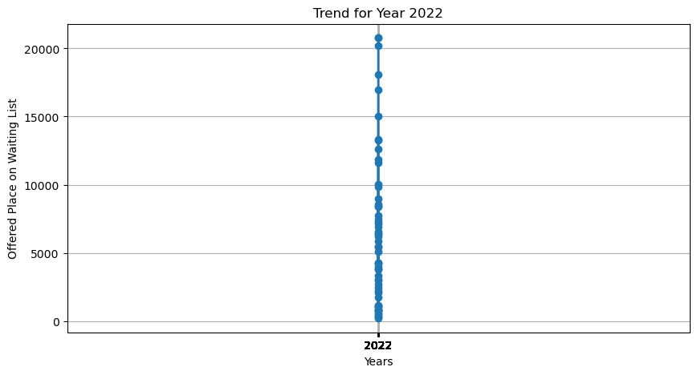
Analysis
Capping the max value so the outlier doesn’t affect our final value.
Used 99% percentile.
Before After

Slide 13
LSTM
The implemented LSTM (Long-Short-Term Memory) model is a type of recurrent neural network (RNN) specifically designed to handle sequential data.
Short-Term Memory: Learns immediate trends in the yearly data.
Long-Term Memory: Captures long-term patterns.
This is important as it helps in:
Predicting the next value in a sequence.
Handling data with non-linear dependencies.

Slide 14
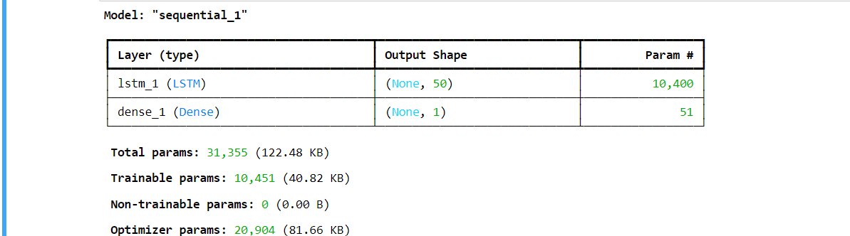
LSTM model
Initial run: Used uncorrected data resulted in poor performance
Improved approach: Applied necessary data corrections significantly improved results
The name sequential is because it uses keras sequential API

Slide 15
Evaluation and Results
Previously we were training the first 4 years and using the final year for testing. This didn’t help
Next approach was training the first 3 years and then testing for 2 years we got significantly better results.
Iterated with different epoch and batch size to get best results.
We ran our model for 100 epochs and batch size of 64
Actual value for 2022: 5456
Predicted value for 2022: 5484.5

Slide 16
Results
The loss decreases significantly, from 0.0927 in epoch 1 to around 0.029 by epoch 83.
This shows that the model is learning and adjusting weights well over time. It indicates that the LSTM is able to capture patterns in the data and gradually improve its predictions.
Predicting for the next four years
Predicted value for 2023: 5484.5234375
Predicted value for 2024: 5290.125
Predicted value for 2025: 5140.3701171875
Predicted value for 2026: 4992.00927734375

Slide 17
Insights
Reduction in student demand post-pandemic.
Hypothesis
Some of the external factors such as demographic shifts, fewer high school graduates, or changes in the economic environment affecting university admissions.
Universities are becoming more efficient with their admissions process, possibly admitting a more predictable number of students in the regular admissions cycle.

Slide 18
Contd…
The COVID-19 pandemic caused significant uncertainty in admissions in 2020, leading to a sharp increase in waitlist activity as universities were unsure how many admitted students would enroll. But now universities are returning to pre-pandemic levels of predictability in admissions, meaning they rely less on waitlists to fill spots.
The evolution of external and internal factors might be the key reason for this decline in trend.

Slide 19
Arima Model
ARIMA is a time-series model for forecasting and analyzing linear trends in stationary data. Before applying ARIMA, we must choose the optimal parameters p, d, and q.
p (Autoregressive Order):
Represents the number of lagged observations included in the model.
d (Differencing Order):
Indicates the number of times the data needs to be differenced to make it stationary.
q (Moving Average Order):
Refers to the number of lagged forecast errors used to predict the current value.

Slide 20
ADF test
We start by checking whether our dataset is stationary using the Augmented Dickey-Fuller Test, where the null hypothesis states that the data is not stationary.
In this case, the ADF statistic is -7.45, and the p-value is 5.63 * 10^(-11), indicating that the data is stationary. Since the p-value is significantly low, we reject the null hypothesis, which means that d = 0.

Slide 21
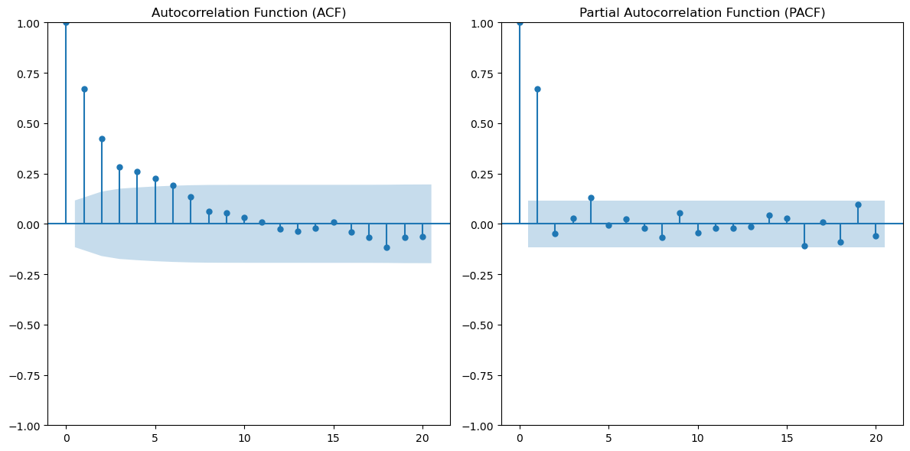
ACF and PACF
q=5 and p E [1,3]

Slide 22
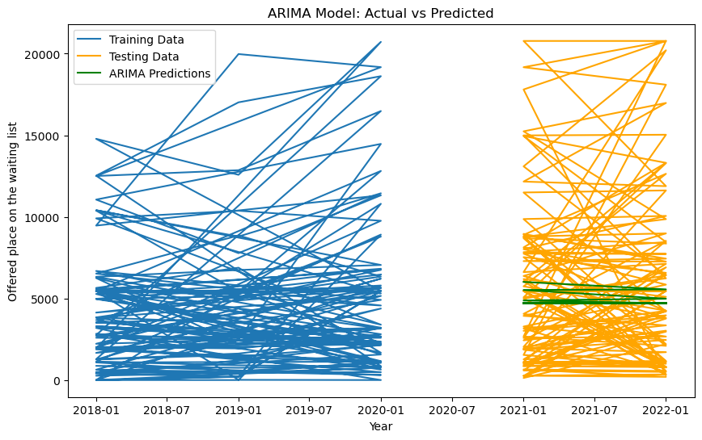
ARIMA Model Results
We trained the model on the data for the first three years and tested it on the subsequent two years.
Results: The model exhibited high Mean Squared Error (MSE) and Mean Absolute Error (MAE), indicating that the predictions failed to capture the variability in the test data.
The predictions were overly smooth and could not handle the non-linear trends present in the dataset.

Slide 23
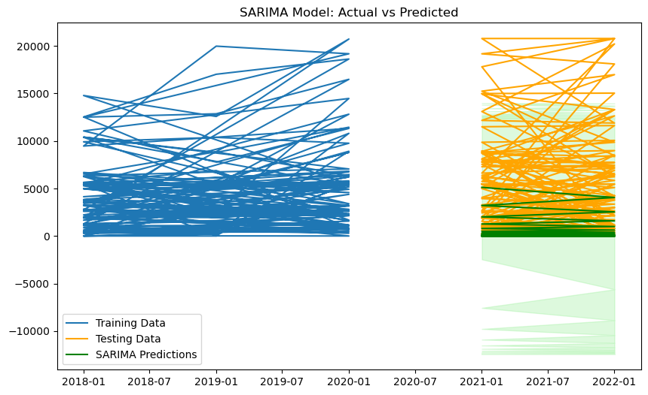
SARIMA
Similar to ARIMA, SARIMA produces smoother predictions that fail to capture the high variability in the testing data

Slide 24
Steps that can help Students Choose the Right University
One of the key factors that can assist students in making informed decisions about universities is understanding the specific courses and programs offered.
Having clarity on the courses provided by different universities allows students to better align their preferences and career goals with the institution's offerings.
Universities often design their majors and programs with unique approaches tailored to specific domains.

Slide 25
Contd..
By exploring the structure, focus, and specializations within the programs, students can identify which universities offer the most suitable courses for their academic and professional aspirations.
This insight not only helps students choose universities that match their interests but also empowers them to make well-informed decisions about their future.

Slide 26
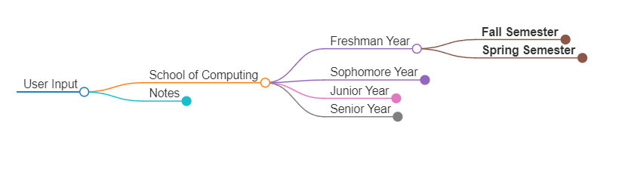
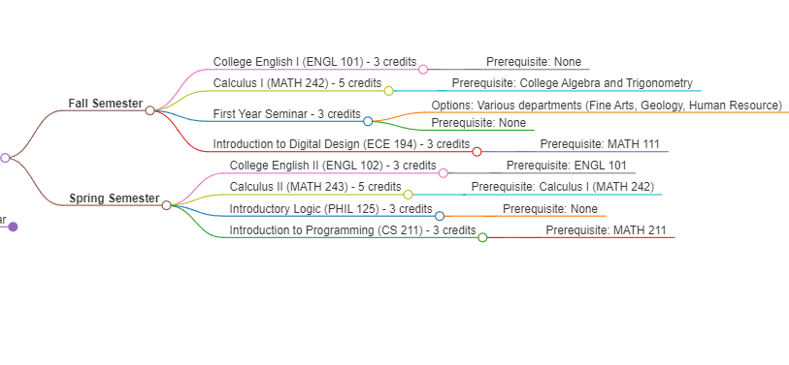
Prototype for the user

Slide 27
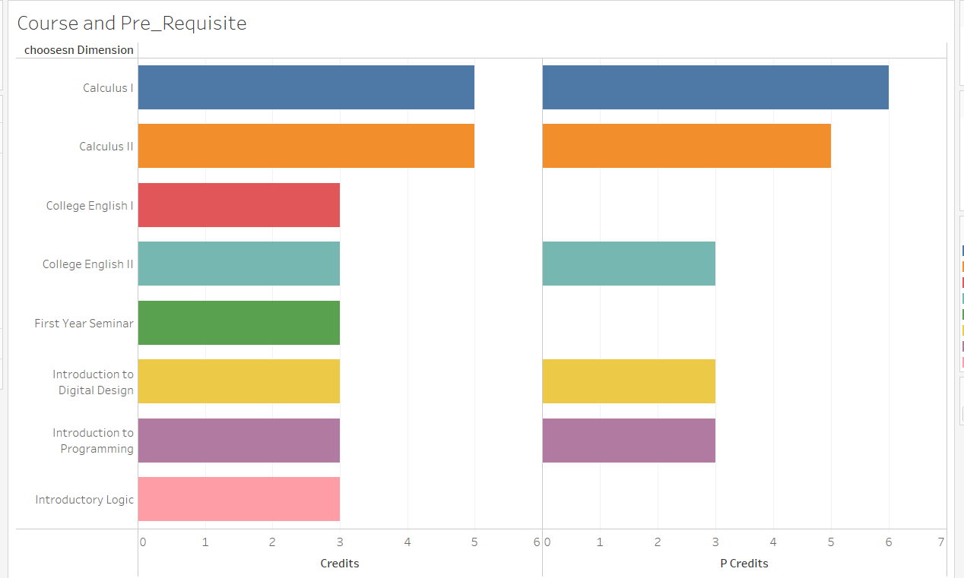
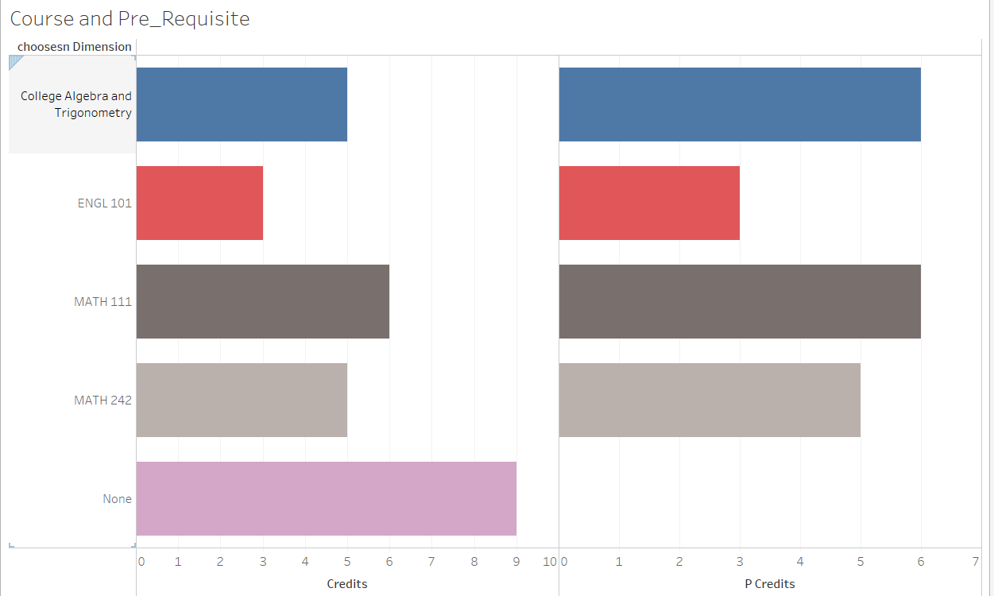
Dashboards

Slide 28
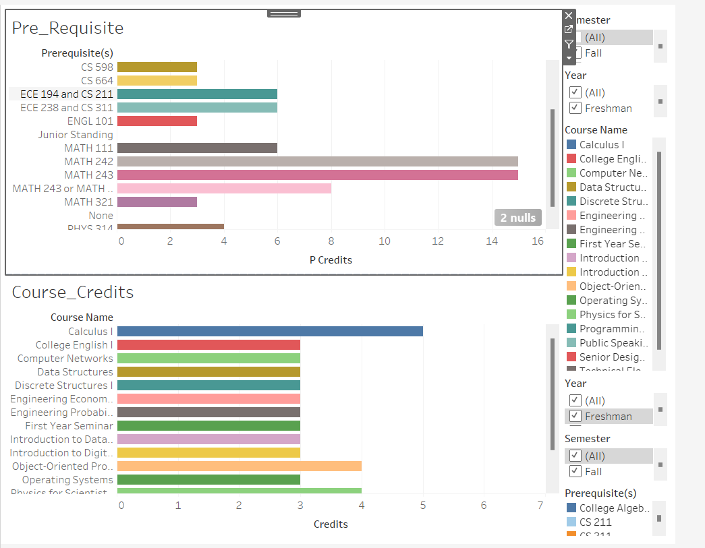
Dashboard

Slide 29
Universities Being Transparent
The increase or decrease in waitlist admissions is a critical phenomenon influenced by various factors, including:
Departments within Universities: The selection of students from the waitlist often depends significantly on the specific departments within universities.
Expansion of Departments: Universities expanding certain departments may admit more students from their waitlists to accommodate increased capacity or to fill positions in newly funded programs.
Budget Constraints: Budget cuts or reduced funding in specific departments can lead to fewer admissions, resulting in a corresponding decrease in waitlist offers for those programs.

Slide 30
Example of R1 univeristies
University of Michigan:
The expansion of engineering and computer science programs has led to the strategic use of waitlists to ensure diverse and qualified cohorts.
University of California, Berkeley:
Budget cuts to humanities departments led to fewer spots and limited movement on those programs’ waitlists, while STEM programs saw increased offers.
Carnegie Mellon University:
A strong focus on computer science and AI resulted in higher waitlist pull rates for those departments to keep pace with industry trends and demand.

Slide 31
Conclusion
This project provides a comprehensive analysis of trends in university waitlist admissions over the past five years, focusing on the impact of the COVID-19 pandemic.
The data revealed a sharp increase in waitlist activity during 2020, driven by enrollment uncertainties and the pandemic's influence on student decisions.
However, the subsequent years show a return to pre-pandemic patterns, indicating improved predictability in university admissions processes

Slide 32
Conclusion
It highlights the importance of transparent university data and offers actionable insights for universities and prospective students.
Universities can optimize their admissions strategies, while students can make more informed choices based on program-specific trends.
This analysis underscores the evolving dynamics of university admissions and sets the stage for more data-driven decision-making in higher education.

Slide 33
Thank you
Any questions

Slide 34
References
https://www.michigandaily.com/news/academics/students-discuss-frustrations-long-waitlists-upper-level-computer-science-classes/
https://edsource.org/2024/budget-cuts-begin-to-surface-at-california-state-university/718699
https://ai.cmu.edu/

