Slide 1


Insta Caption
Raasil | Francesco | Keyan

Slide 2
Problem
Instagram has 800 million users and 95 million posts are posted per day. One problem that Instagram users face is coming up with clever captions for their posts. Valuable time is wasted coming up with the perfect caption.
800 million Instagram users
95 million Instagram posts per day
10-20 minutes wasted on a caption

Slide 3



Market Potential
Instagram Users
Brands
Instagram
Instagram users waste valuable time on trying to think of good captions
Insta Caption saves time and provides quality captions that relate to the content
Aids social media teams in coming up with captions
Advertisements need quality captions to catch users attentions
Insta Caption helps with inspiration
Instagram (Owned by Facebook Inc) could integrate this feature into the app
Users don’t need to have a separate app just for captions

Slide 4




Customer Aspirations
Current functionality allows users to submit a picture to the app and select a variety of categories that they want to aim their caption towards. Using Microsoft Azure’s computer vision, the picture is analyzed and connects back to a database of captions that relate to the features of the picture
Caption provided based on features of photo
Music lyric captions that relate to photo
Famous quote captions that relate to photo
Pun-filled captions that relate to photo

Slide 5

Functionality
Expected users
‘s to success
Focus on simple UI
Focus on highschool/university students and market towards them
Keep in contact with Instagram
800k
800k
Triple users mirroring growth of other utility apps (instasize)
600k
500k
400k
Capture market share of highschool/undergraduate students in Ontario
200k
120k
01/03/2018 - MVP Launch at Queen’s University, Beta Version
EOY – Launch on Appstore with full functionality after successful beta testing
Year 2 – Expand caption database and other improvements
EOY 3 – Hope Instagram buys us out and integrates into app
Timeline

Slide 6

Growth Strategy
USD
600k
revenue
800k
cost of revenue
400k
200k
other expenses
300k
Assumptions
Free app with ads
$1 to remove ads, 20% of users
$5 to get better captions, 10$ of users
Expenses = Salary, Marketing, Improvements
300k
300k
200k
200k
140k
100k
80k
30k
01/03/2018 - MVP Launch at Queen’s University, Beta Version
EOY – Launch on Appstore with full functionality after successful beta testing
Year 2 – Expand caption database and other improvements
EOY 3 – Hope Instagram buys us out and integrates into app

Slide 7
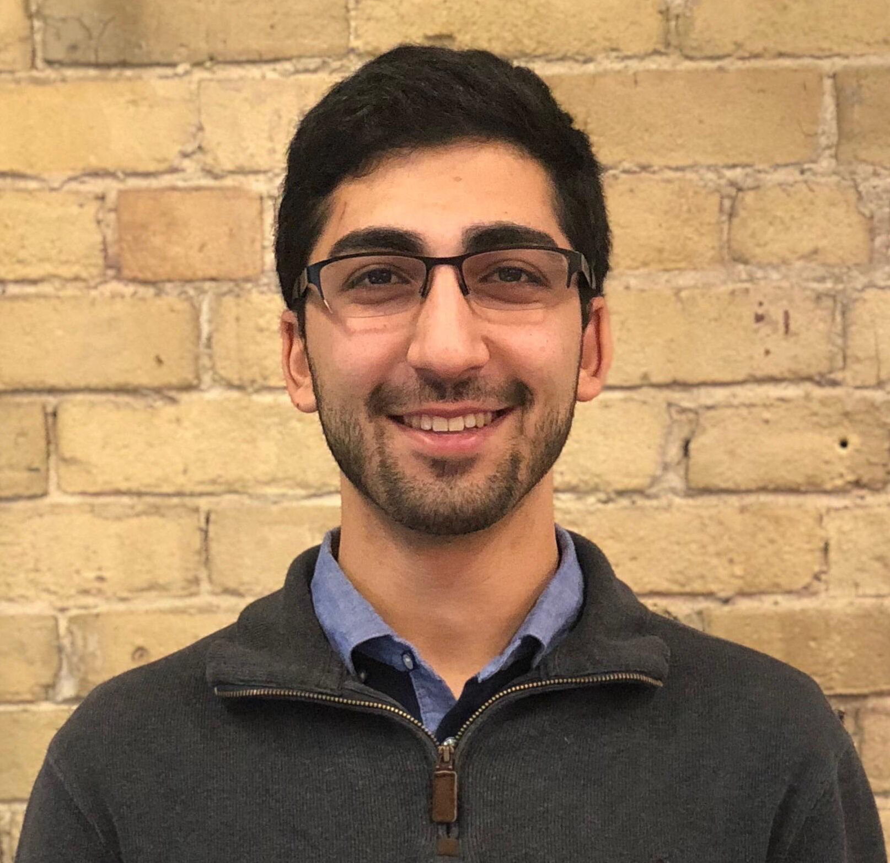
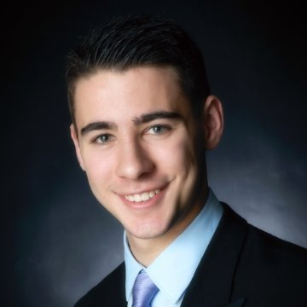
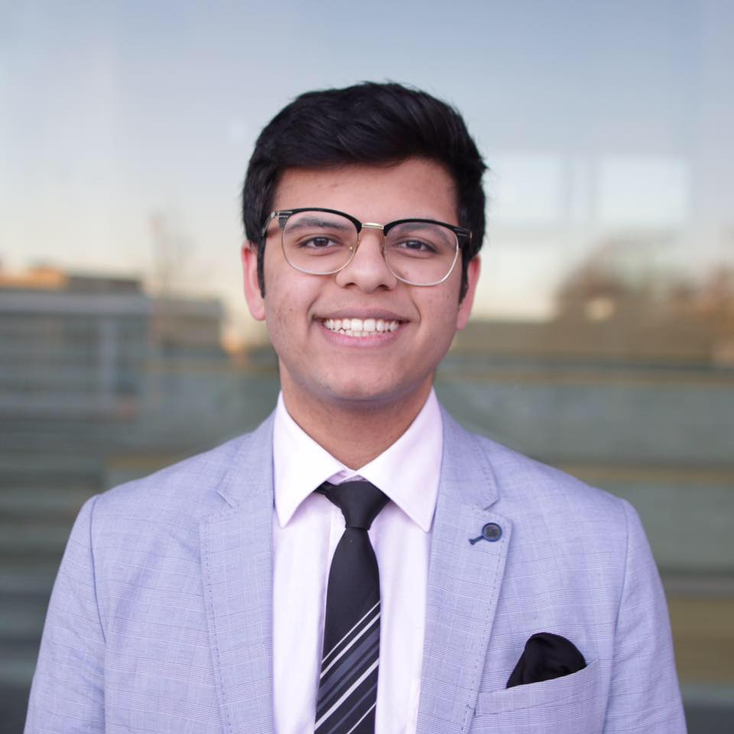
Team
Francesco Virga
Engineering Physics (Computing Stream)
Queen’s University
Raasil Khan
Psychology + Computing Student
Queen’s University
Keyan Fayaz
Computing Student
Queen’s University

