Slide 1
TRAMMO TRADING TECHNOLOGY
AI Use Case Overview
Decision Support Platform for Commodity Trading
How AI-augmented optimisation transforms real-time trading decisions across NH3 Domestic Barge, NH3 International, Sulphur, and Petcoke.
NH3 Domestic Barge
NH3 International
Sulphur International
Petcoke
Confidential — Internal Use Only | February 2026

Slide 2
Agenda
1
Problem Statement Overview
The challenges of manual commodity trading decisions
2
Use-Case Example
Set-the-Scene · Architectural Overview
3
Online Demo
Live walkthrough of the Trading Desk platform
4
Questions
Open discussion
5
Break-Out Session
Discover product managers’ use-case scenarios
Trammo | AI Use Case Overview
Confidential

Slide 3
SECTION 1
Problem Statement Overview
Why commodity traders need AI-augmented decision support
Trammo | AI Use Case Overview
Confidential

Slide 4
THE CHALLENGE
Manual Trading Decisions Are Slow, Fragmented & Risky
10+ Data Sources
THE SOLUTION
River gauges, weather, locks, market prices, freight rates, terminal inventory, fleet, capital, vessels, tides — all checked manually.
AI-Augmented Trading Desk
20 Variables
Traders mentally juggle 20 interdependent variables across environmental, operational, and commercial dimensions.
✓ Continuously ingests all 10+ data sources automatically
✓ Applies contract obligations via AI clause extraction
✓ Runs LP optimisation to find profit-maximising allocation
Contract Complexity
✓ Monte Carlo (1,000 scenarios) for risk-adjusted confidence
Active contracts impose price fixes, volume floors/caps, and penalty clauses that must be respected in every decision.
✓ AI-generated analyst notes explain every recommendation
✓ Auto-runner triggers re-optimisation on material changes
✓ Decision latency reduced from hours to seconds
Decision Latency
Assembling the data picture, checking contracts, and running spreadsheet scenarios takes hours — by which time conditions have changed.
Trammo | AI Use Case Overview
Confidential

Slide 5
SECTION 2
Use-Case Example
Set-the-Scene · Architectural Overview
Trammo | AI Use Case Overview
Confidential

Slide 6
SET THE SCENE
NH3 Domestic Barge — A Typical Trading Morning
It’s 7:00 AM. Overnight, river stage at Baton Rouge dropped 2 ft, lock delays doubled to 12 hours, and NOLA ammonia prices jumped $8/ton. Two active contracts have take-or-pay obligations expiring this week. The trader needs to decide: which terminals to load, which routes to run, and how many barges to commit — right now.
River Stage
Lock Delays
NOLA NH3 Price
Meredosia Inv.
Available Barges
Working Capital
22.5 ft (↓ 2 ft)
12.0 hrs (↑ 6 hrs)
$348/t (↑ $8)
8,200 t
14
$3.2M
USGS Baton Rouge
USACE Lower Miss.
Argus/ICIS
Insight TMS
Fleet TMS
SAP S/4HANA
WHAT THE PLATFORM DOES IN SECONDS:
1
Detects material changes
2
Reads active contracts
3
Runs Monte Carlo
4
Delivers recommendation
Auto-runner flags river + lock + price deltas
AI extracts take-or-pay and penalty clauses
1,000 scenarios with current conditions
"Strong Go on Meredosia→StL at 2,100 MT"
Trammo | AI Use Case Overview
Confidential

Slide 7
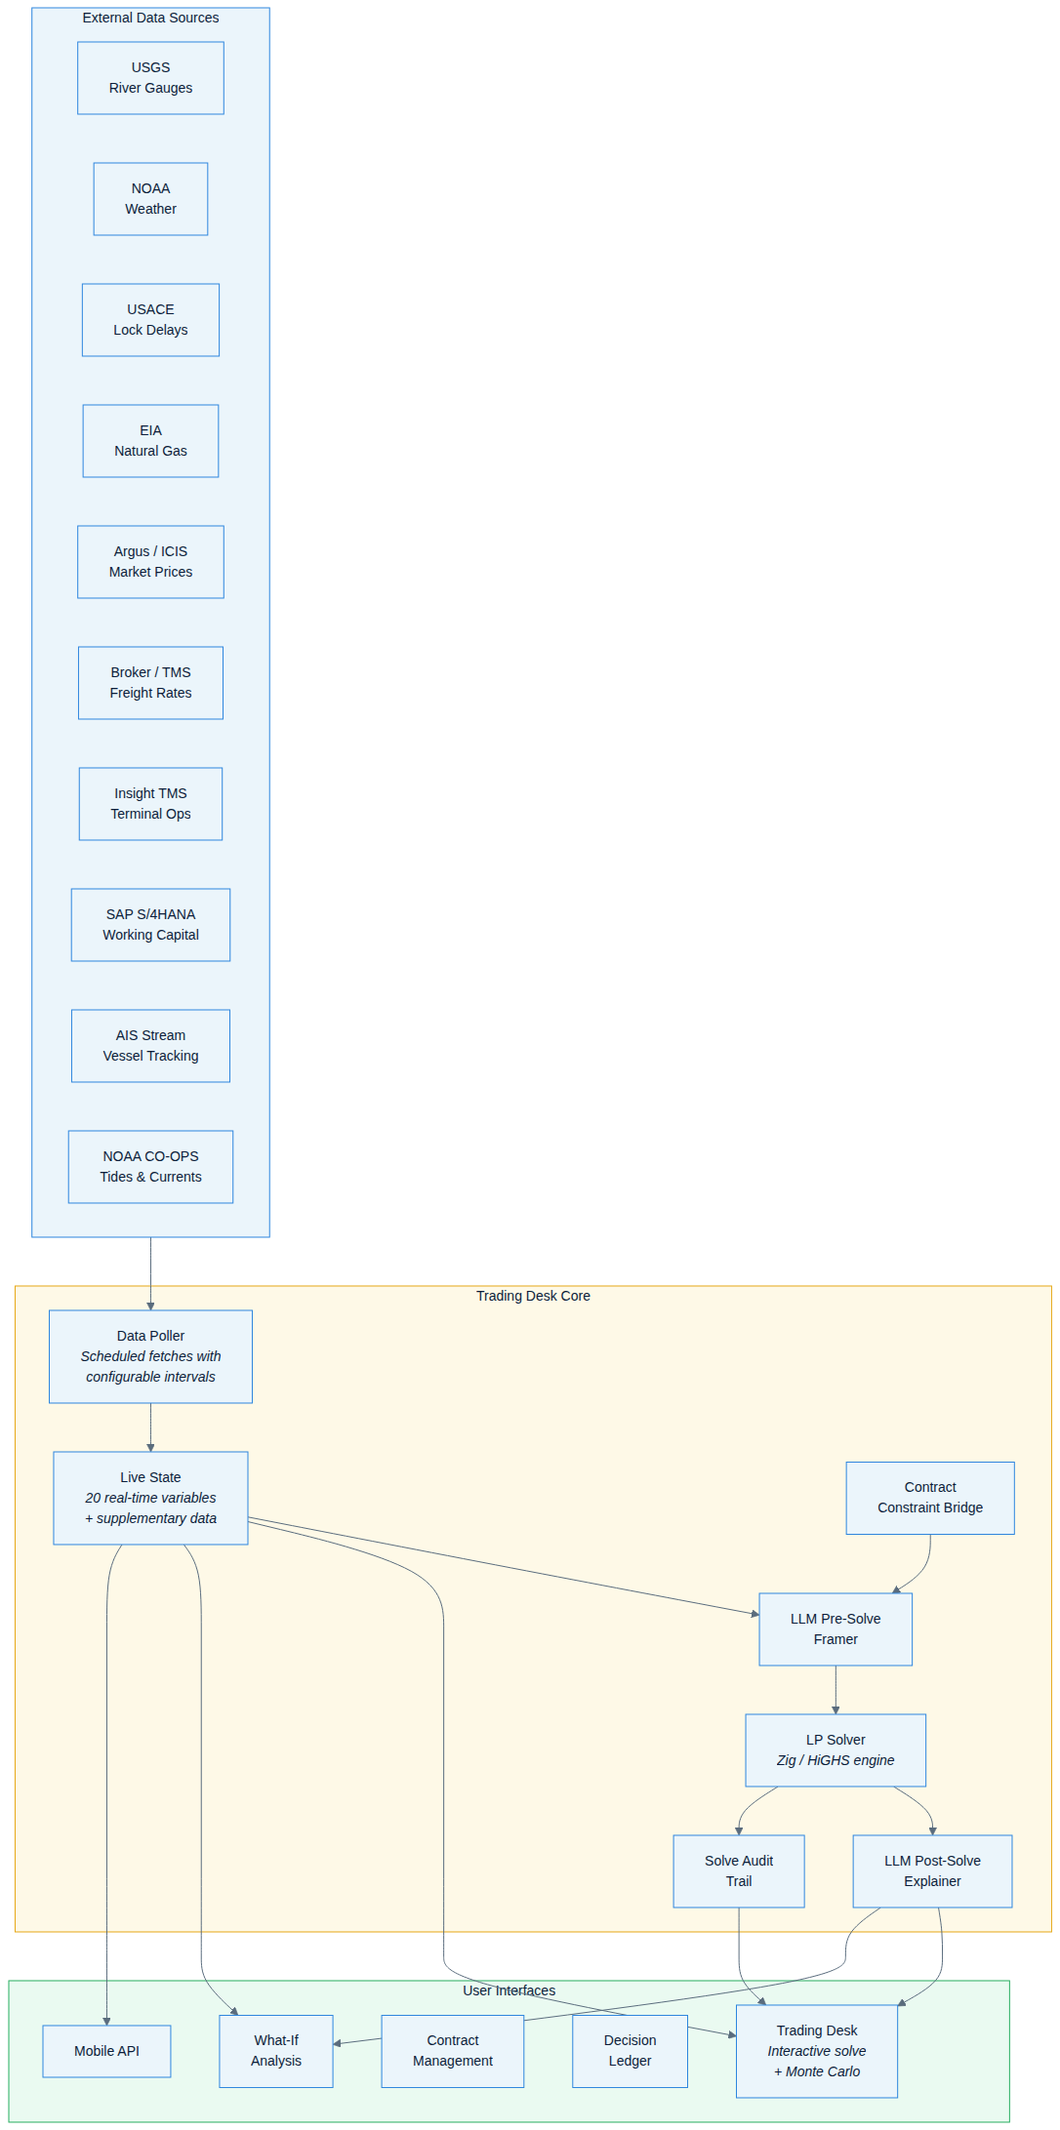
ARCHITECTURAL OVERVIEW
System Overview
Trammo | AI Use Case Overview
Confidential

Slide 8
ARCHITECTURAL OVERVIEW
10+ External Data Sources → 20 Solver Variables
20 SOLVER VARIABLES
Environmental
USGS River Gauges, NOAA Weather, USACE Lock Status
Environment (6 vars)
river_stage, lock_hrs, temp_f, wind_mph, vis_mi, precip_in
Operational
Insight TMS, Fleet TMS, SAP S/4HANA
Operations (5 vars)
Commercial
inv_mer, inv_nio, mer_outage, nio_outage, barge_count
Argus/ICIS Markets, Broker Freight, EIA Nat Gas
Commercial (9 vars)
Supplementary
nola_buy, sell_stl, sell_mem, fr_mer_stl, fr_mer_mem, fr_nio_stl, fr_nio_mem, nat_gas, working_cap
AIS Vessel Tracking, NOAA Tides & Currents
Every solve packs all 20 variables into a compact 160-byte binary and sends it to the Zig/HiGHS solver engine.
Trammo | AI Use Case Overview
Confidential

Slide 9
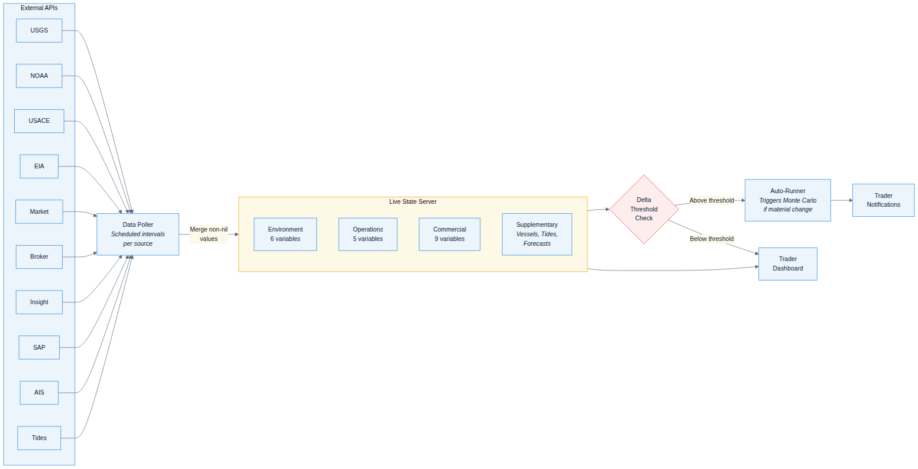
ARCHITECTURAL OVERVIEW
Data Ingestion & Live State
Trammo | AI Use Case Overview
Confidential

Slide 10
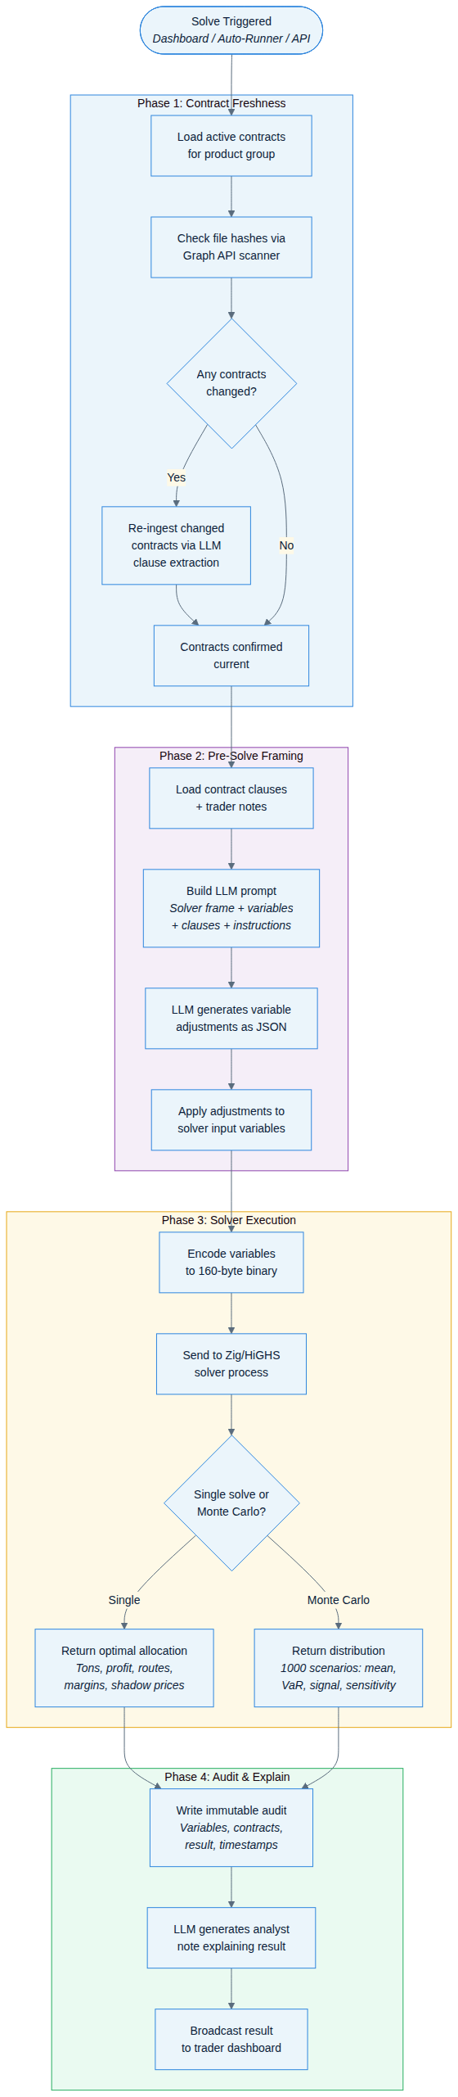
ARCHITECTURAL OVERVIEW
The 4-Phase Solve Pipeline
Trammo | AI Use Case Overview
Confidential

Slide 11
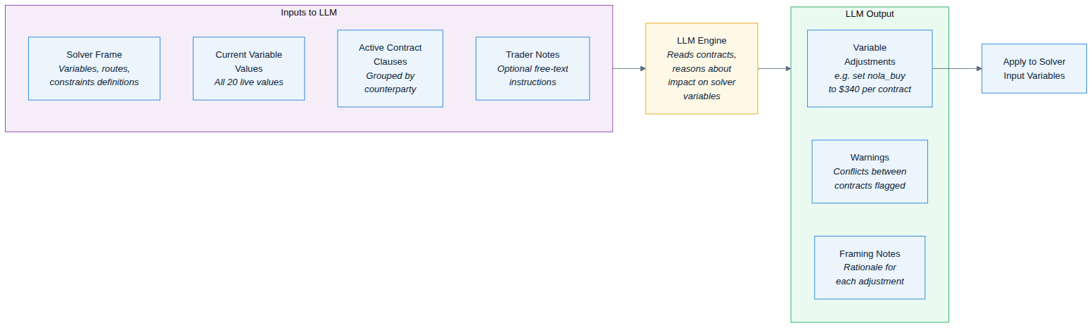
ARCHITECTURAL OVERVIEW
Pre-Solve: LLM Contract Framing
AI reads active contracts and adjusts solver variables to respect price fixes, take-or-pay volumes, and penalty clauses.
Trammo | AI Use Case Overview
Confidential

Slide 12
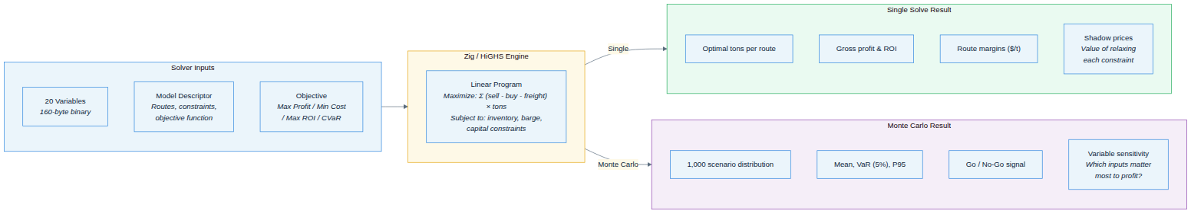
ARCHITECTURAL OVERVIEW
The Solver Engine — LP + Monte Carlo
High-performance Zig/HiGHS linear-programming solver. Single solve for optimal allocation; Monte Carlo (1,000 scenarios) for risk-adjusted confidence signals.
Trammo | AI Use Case Overview
Confidential

Slide 13
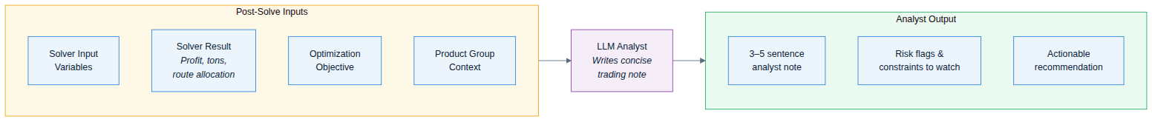
ARCHITECTURAL OVERVIEW
Post-Solve: AI Analyst Explanation
After the solver returns, AI writes a concise analyst note:
“The solver favors Meredosia-to-StL at 2,100 MT, capturing a $40/t margin. Memphis allocation limited by barge availability (shadow price: $12.50/barge).”
Trammo | AI Use Case Overview
Confidential

Slide 14
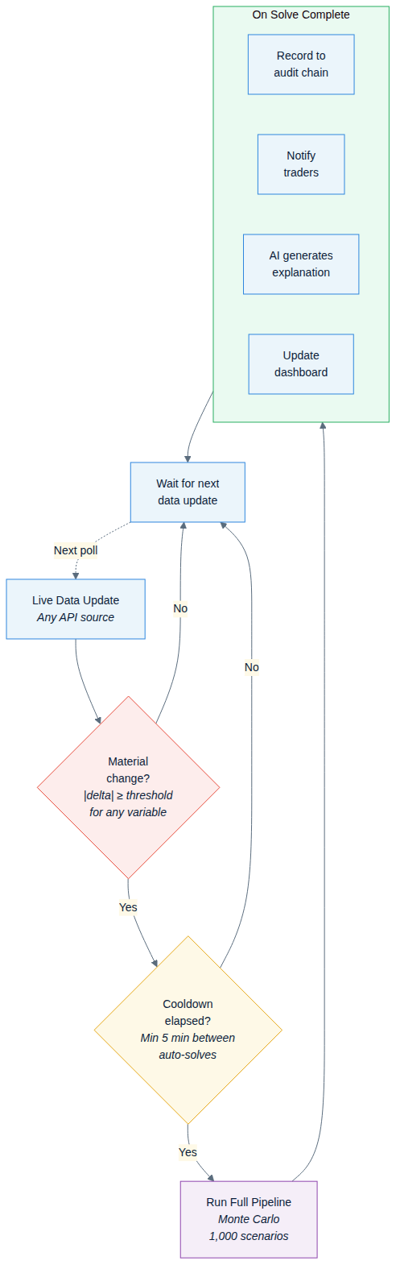
ARCHITECTURAL OVERVIEW
Auto-Runner: Continuous Monitoring
When live data changes materially, the auto-runner triggers Monte Carlo, notifies traders, and records the result on an immutable audit chain.
Trammo | AI Use Case Overview
Confidential

Slide 15
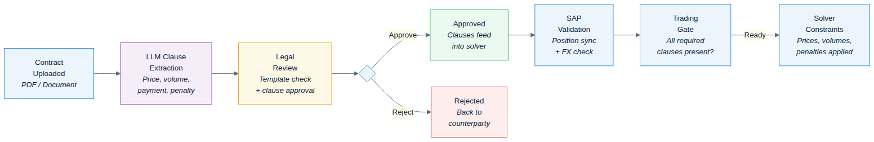
ARCHITECTURAL OVERVIEW
Contract Lifecycle
Upload → AI clause extraction → Legal review → SAP validation → Trading gate → Solver constraints.
Trammo | AI Use Case Overview
Confidential

Slide 16
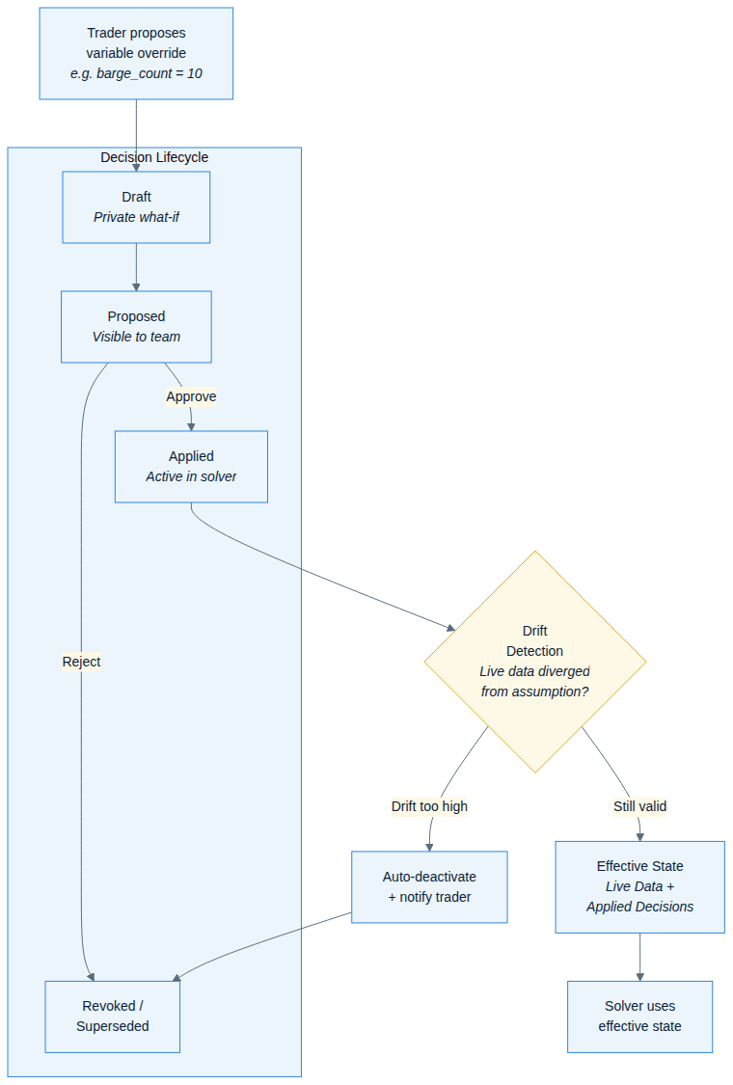
ARCHITECTURAL OVERVIEW
Trader Decision Ledger
Trammo | AI Use Case Overview
Confidential

Slide 17
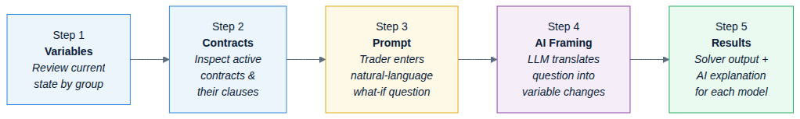
ARCHITECTURAL OVERVIEW
What-If Analysis Workflow
5-step wizard: Variables → Contracts → Natural-language prompt → AI framing → Solver results with explanation.
Trammo | AI Use Case Overview
Confidential

Slide 18
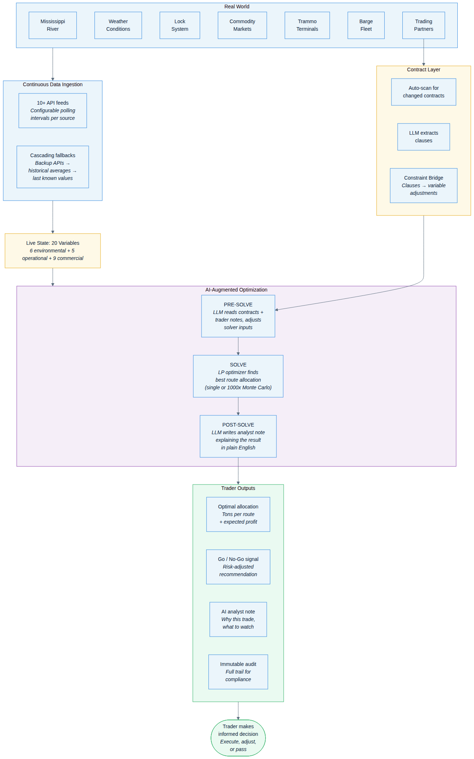
ARCHITECTURAL OVERVIEW
End-to-End: From Raw Data to Trading Decision
Trammo | AI Use Case Overview
Confidential

Slide 19
SECTION 3
Online Demo
Live walkthrough of the Trading Desk platform
http://localhost:4111
Trammo | AI Use Case Overview
Confidential

Slide 20
DEMO — WHAT-IF SCENARIOS
Copy & Paste Prompts for the Live Demo
Enter these into the What-If prompt box to demonstrate AI-framed scenario analysis:
① River Drop + Lock Surge
What if river stage drops to 7 feet and lock delays increase to 24 hours? Which contracts can still operate and what happens to the Koch demurrage exposure?
② NOLA Price Spike
What if NOLA ammonia prices jump to $380/MT? Does the CF Industries $365 cap still hold and can we meet the Mosaic $415 floor at St. Louis?
③ Barge Shortage
What if we lose 3 barges and only have 2 available? Can we still meet the Simplot quarterly minimum of 6,750 MT across both destinations?
④ Terminal Outage
What if Meredosia terminal goes into unplanned outage? How do we reroute the Mosaic St. Louis and Simplot deliveries from Geismar?
⑤ Working Capital Squeeze
What if working capital drops to $2.5M? The CF Industries LC alone requires $4M — which contracts do we prioritize and what’s the profit impact?
⑥ Combined Stress Test
What if lock delays double to 24 hours, we lose 2 barges, and NOLA price rises to $360? Run a Monte Carlo — is this still a go across the portfolio?
Trammo | AI Use Case Overview
Confidential

Slide 21
SECTION 4
Questions
Open discussion
Trammo | AI Use Case Overview
Confidential

Slide 22
SECTION 5
Break-Out Session
Discover product managers’ use-case scenarios
• What trading decisions does your team make daily?
• Which data sources do you currently check manually?
• Where are the biggest bottlenecks in your workflow?
• What would “real-time optimisation” look like for your product?
Trammo | AI Use Case Overview
Confidential

