Slide 1
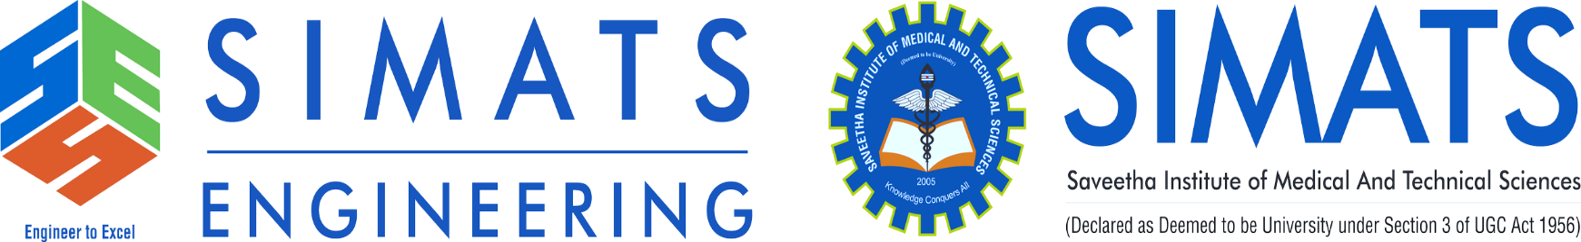

AI CHATBOT USING NLP
CSA1714- ARTIFICIAL INTELLIGENCE
GUIDED BY : DR NAGARAJAN BABU
PRESENTED BY: R. RUPA SREE(192472122)

Slide 2

INTRODUCTION
A chatbot is a computer program that talks with people using text or voice.
NLP (Natural Language Processing) helps computers understand human language.
An NLP chatbot can understand the meaning of a sentence, not just fixed words.
Today, chatbots are used in websites, apps, and customer support all over the world.
Hi! How can I help you today?
I need my exam schedule
Sure! Your exams start on 10th Nov.

Slide 3


PROBLEM STATEMENT
Human staff cannot answer questions 24 hours a day.
Users often wait a long time to get a reply.
Old chatbots only understand fixed keywords, not full sentences.
This gives wrong or no answers when users type in a different way.
We need a system that truly understands what the user is asking.
Long Wait Times
Keyword-based bots also fail on complex questions, causing user frustration.

Slide 4



OBJECTIVES
Understand Language
Detect Intent
Fast Replies
Better Experience
Build a chatbot that understands natural human language.
Correctly find out what the user really wants.
Give quick and accurate answers to users.
Improve overall user experience and satisfaction.

Slide 5


EXISTING SYSTEM
Most old chatbots are rule-based and use fixed keywords.
They cannot understand different sentence styles or spelling mistakes.
They do not learn from past conversations.
They can only answer a small, fixed list of questions.
Rule-Based Chatbot
"Book ticket" works, but "I want to book a ticket please" fails
No understanding of meaning, only exact words
Cannot handle spelling errors or slang

Slide 6


PROPOSED SYSTEM
Uses NLP to understand the real meaning of user text.
Automatically detects the user's intent, even with new sentence styles.
Uses machine learning to keep improving over time.
Gives smart, relevant, and human-like answers.
NLP-Based Chatbot
"I want to book a ticket please" is understood correctly
Understands meaning, not just exact words
Handles spelling errors, slang, and new phrasing

Slide 7




SYSTEM ARCHITECTURE
User
Text Input
NLP Processing
Intent Detection
Response
The response cycles back to the user, who can continue the conversation.

Slide 8







TOOLS & PLATFORMS
TECHNOLOGIES USED
Python
NLTK / spaCy
TensorFlow / PyTorch
Main programming language for AI and NLP.
Popular libraries used for NLP tasks.
Frameworks for machine learning models.
Flask / Django
Rasa / Dialogflow
Web / App Interface
Used to build the chatbot's web backend.
Ready-made chatbot development platforms.
Where users chat with the bot.

Slide 9
CHATBOT EXAMPLE
College Help Bot
What is the last date to pay fees?
The last date to pay fees is 15th September.
Can I pay it online?
Yes, you can pay fees online on the college portal.
A student asks about fees, and the chatbot instantly gives the correct answer
by understanding the question — this is NLP in action.

Slide 10

WHY IT HELPS
ADVANTAGES
Available 24/7
Saves Time & Cost
Handles Many Users
Consistent Answers
Easy to Use
Answers users anytime, day or night.
Reduces the need for extra staff.
Talks to many people at the same time.
Gives the same correct answer every time.
Simple chat interface for everyone.

Slide 11

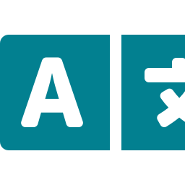


FUTURE SCOPE
Multiple Languages
Voice-Based Chat
Deep Learning
More Platforms
Support for many regional and global languages.
Let users talk to the bot using voice.
Better understanding using advanced AI models.
Connect with WhatsApp, apps, and more.

Slide 12
CONCLUSION
An AI chatbot using NLP can understand and reply to users like a human.
It saves time for both users and organizations.
It performs much better than old, rule-based systems.
It has many real-life uses in support, banking, health, and education.
16

Slide 13
THANKYOU!

