Slide 1
Decode Gaming Behavior Using SQL
By Rajkumar Pandey
Notes:
Hello everyone , Welcome to another presentation of this internship journey.
This is again a short presentation on my second SQL project in this internship and the topic is Decode Gaming Behavior using SQL.
My name is Rajkumar Pandey and I will walk you through the presentation where we will discuss the objective of project, tools and technologies used, Insights derived and steps performed for gaming analysis.

Slide 2
Introduction :
The "Decode Gaming Behavior" project is an exhilarating challenge of exploring and understanding the intricate dynamics of player behavior within the gaming industry.
We will be leveraging cutting-edge data analysis tools, like – SQL, Excel to deep dive into player actions, preferences, and the factors that influence their gaming experience, all with the aim of empowering game developers, publishers, and stakeholders to make informed decisions and optimize gaming experiences.
We will work with a database containing total 5 tables related to customer’s information and game level details.
Notes:
Lets start with a brief introduction about the project.
Decode Gaming Behavior is another dynamic project where we will get a chance to deal with a vast gaming dataset and we will be using data analysis tools like – SQL and Excel to uncover hidden patterns, derive useful insights that has the potential to shape the future of gaming experiences.
We have been provided with a Database that contains a total of 2 tables. We will discuss these tables in next slide.

Slide 3
Database Description:
Player_Details: Contains player information, including player_id, player_name, L1_status, L2_status, L1_code, L2_code.
Level_Details: Contains game level information, including product_id, device_id, start_time, stages_crossed, level, difficulty, kill_count, headshots_count, score and lives_earned.
Notes:
The first table in our Database is Player_Details table. It contains player information like – player id, player L1 status, L2 status, L1 code etc.
The second table is level_details table that contain level details like- device id, start time, stages crossed, level, difficulty, kill count etc.

Slide 4
Project Overview :
Objective of a project titled “Decode Gaming Behavior" is to leverage SQL (Structured Query Language) to unlock the secrets hidden in vast volumes of gaming data, shedding light on player preferences, in-game interactions, and driving factors that can shape the future of the gaming industry.
SQL is a powerful tool for managing and querying large datasets, making it an ideal choice for gaming data analysis. The key objectives of this project include:
Data Cleaning
Data Transformation
Data Manipulation
Finding key performance metrics
Player analysis
Player Behavior analysis
Tools and Technologies Used:
Microsoft SSMS (SQL server management studio)
Microsoft Excel
Notes:
Now lets cover an overview of the project.
While doing this project we have used SQL as an analysis tool to extract valuable insights, patterns and knowledge from gaming data. The key steps that we have performed in this project while doing the analysis include –
Data Cleaning
Data Transformation
Data Manipulation
Identifying key performance metrics
Player analysis
Two main tools that are used in this project are – Microsoft SQL Server and Microsoft Excel.

Slide 5
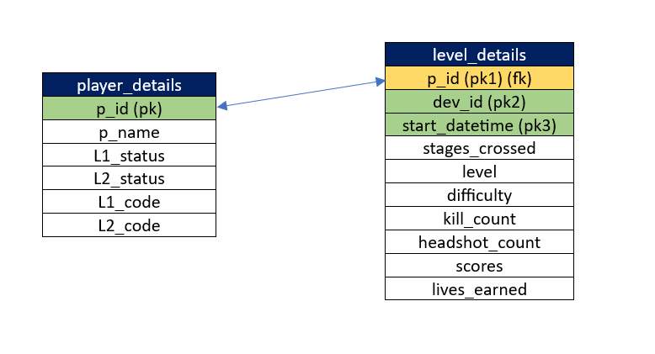
Database Schema:
Notes:
This diagram represents the Database schema of the data that is provided to us.
Each block represents a table and all its related fields.
The arrow between fields of different table indicates the relationship between the them.
The field in green are the primary keys of the tables and the field in yellow are the foreign key of the tables.

Slide 6
SQL Queries Used:
Below are few SQL commands, functions and clauses that were used to write SQL queries for analyzing gaming data:
ALTER Command: The ALTER TABLE command is used to modify an existing table's structure. You can add, modify, or delete columns, change data types, and apply constraints.
Sample Queries: 1. Adding primary key constraint on group of columns of a table
alter table level_details add primary key(P_ID,Dev_id,start_datetime);
2. changing the datatype of a column and defining it as not null
alter table level_details
alter column dev_id varchar(10) not null;
CTE: A Common Table Expression (CTE) in SQL is a named temporary result set that you can reference within a SELECT, INSERT, UPDATE, or DELETE statement. They can be thought of as a way to create a "subquery" that can be referenced multiple times within a main query.
Notes:
Now the upcoming slides show various types of SQL commands, clauses and functions that we have used in writing the SQL queries for the project.
We have used alter command, common table expressions, windows function and stored procedures.

Slide 7
Sample Query: Find Top 3 score based on each dev_id and rank them in increasing order using Row_Number. Display difficulty as well.
with rankedscores as (
select dev_id, difficulty, score,
row_number() over (partition by dev_id, difficulty order by score asc) as scorerank
from level_details
)
select dev_id, difficulty, score
from rankedscores
where scorerank >= 3
order by scorerank desc;
WINDOW function: Window functions are particularly useful for tasks like ranking, aggregation, and cumulative calculations. They are applied to a "window" of rows defined by an OVER() clause, allowing you to perform calculations on a specific subset of rows without collapsing the result set.
Sample Query: For each player and date, how many kill_count played so far by the player. That is, the total number of games played by the player until that date.
select
p_id, start_datetime, kill_count,
sum(kill_count) over (partition by p_id order by start_datetime) as total_kill_count
from
level_details;

Slide 8
PROCEDURES: In SQL, a procedure is a named collection of SQL statements that are grouped together into a single unit for execution. Procedures are used to perform specific tasks or operations, and they offer several advantages, including code reusability, modularity, and security.
Sample Query: Create a stored procedure to find top n headshots_count based on each dev_id and Rank them in increasing order using Row_Number. Display difficulty as well.
-- create the stored procedure
create procedure gettopnheadshotscount
@topn int
as
begin
-- common table expression (cte) to rank headshots_count
with rankedheadshots as (
select dev_id, difficulty, headshots_count,
row_number() over (partition by dev_id, difficulty order by headshots_count asc) as headshotsrank
from level_details
)
-- select the top n headshots_count for each dev_id and display the difficulty
select dev_id, difficulty, headshots_count
from rankedheadshots
where headshotsrank <= @topn
order by dev_id, difficulty, headshotsrank;
end;

Slide 9
Analysis and Insights:
Number of players at level 1 are greater than number of players at level 2 for medium difficulty level.
Player with player id 483 has maximum kill count for medium difficulty level.
For players at level 2 and using zm series device total crossed stages at different difficulties level are - Difficult = 46, Medium = 35, Low = 15.
There are total 10 devices. About 80% of the devices have started on 12-Oct-22 and rest started on 11-Oct-22.
Highest score for different difficulty levels are - For difficult = 235, For Low = 380, For Medium = 120.
9870 is the highest score which is made by player with player id 224 and device id bd_013.
There are 22 players who have scored more than 50% of the avg score scored by sum of scores for each player_id.
Notes:
This slide represents the Analysis and Insights that were discovered during the project.
Read 3-4 insights from the slide .

Slide 10
Conclusion:
The project “Decode Gaming Behavior" has been a journey of exploration, analysis, and discovery.
Through the effective utilization of SQL (Structured Query Language) and a comprehensive data analysis approach, we have successfully transformed gaming data into valuable insights that hold the potential to drive strategic decisions and optimize gaming experiences.
Throughout this project, we have achieved the following key milestones:
Data Cleaning
Data Transformation
Data Manipulation
Finding key performance metrics
Player analysis
Player Behavior analysis
This project helped us to leverage our SQL skills in driving valuable insights from sales data.
As we conclude this project, we recognize that the gaming industry is ever-evolving, driven by the dynamic nature of player behavior. Our insights are not an endpoint but a launchpad for future innovations. The gaming landscape will continue to change, and staying at the forefront of these changes is essential for success.
Notes:
Finally in the conclusion I will say, that we have successfully met the objective of the project.
We have effectively utilized SQL and data analysis approach to discover insights from gaming data. This project has helped us to leverage our SQL skills and use it to make strategic decisions.
We have successfully performed steps like –
Data cleaning
Data Transformation
Data Manipulation
Identifying KPIs
Player analysis.
With all these steps being successfully performed objective of the project is met. With this I will like to end my presentation. Thankyou.

