Slide 1
Uncover Insights From Real Sales Data Using SQL
By Rajkumar Pandey
Notes:
Hello everyone , Welcome to my presentation.
This is a short presentation on my first SQL project in this internship and the topic is Uncover Insights From Real Sales Data Using SQL
My name is rajkumar pandey and I will walk you through the presentation where we will discuss the objective of project, tools and technologies used, Insights derived and steps performed for analysis.

Slide 2
Introduction :
The "Uncover Insights from Real Sales Data" project is a dynamic initiative aimed at harnessing the power of data analytics to transform raw sales data into valuable, actionable insights.
We will be leveraging cutting-edge data analysis tools, like – SQL, Excel etc to uncover hidden patterns, trends, and opportunities within sales data that can drive strategic decisions, optimize performance, and enhance overall business outcomes.
We will work with a database containing total 5 tables related to customer’s information, product details, PIN code details, delivery person details and order details.
Notes:
Lets start with a brief introduction about the project.
Uncover Insights from real sales data is a dynamic project where we will get a chance to deal with a large sales dataset and we will be using data analysis tools like – SQL and Excel to uncover hidden patterns, derive useful insights that will help in business growth.
We have been provided with a Sales Database that contains a total of 5 tables. We will discuss these tables in next slide.

Slide 3
Database Description:
Customers: Contains customer information, including cust_id, first_name, last_name, email, phone, primary_pincode, gender, dob, joining_date.
Products: Contains product information, including product_id, product_name, brand, category, procurement_cost_per_unit, mrp.
Pincode: Contains pincode-related information, including the pincode, city and state.
Delivery Person: Contains information about delivery personnel, including delivery_person_id, name, joining_date, pincode
Orders: Contains order details, including order_id, order_type, cust_id, order_date, delivery_date, tot_units, displayed_selling_price_per_unit, total_amount_paid, product_id, delivery_person_id, payment_type, delivery_pincode
Notes:
The first table in our Database is Customer table. It contains customer information like – customer id, name, phone no, gender etc.
The second table is Product table that contain product details like- product id, name, brand, mrp etc.
Third one is the Pincode table which contains pincode related information like - city, state, and pincode.
Fourth one is the Delivery person table which contain information about the delivery person like – id, name, date of joining etc.
Fifth and most important is the Orders table which contain information related to orders like – id, type, delivery date, price, amount paid and much more.

Slide 4
Project Overview :
Objective of a project titled "Uncover Insights from Real Sales Data" is to leverage SQL (Structured Query Language) to extract valuable insights, patterns, and knowledge from real sales data.
SQL is a powerful tool for managing and querying large datasets, making it an ideal choice for data analysis in sales. The key objectives of this project include:
Data exploration
Data Transformation
Finding key performance metrics
Customer analysis
Product analysis
Market segmentation
Tools and Technologies Used:
Microsoft SSMS (SQL server management studio)
Microsoft Excel
Notes:
Now lets cover an overview of the project.
While doing this project we have used SQL as an analysis tool to extract valuable insights, patterns and knowledge from sales data. The key steps that we have performed in this project while doing the analysis include –
Data Exploration
Data Transformation
Identifying key performance metrics
Customer and Product analysis
Two main tools that are used in this project are – Microsoft SQL Server and Microsoft Excel.

Slide 5
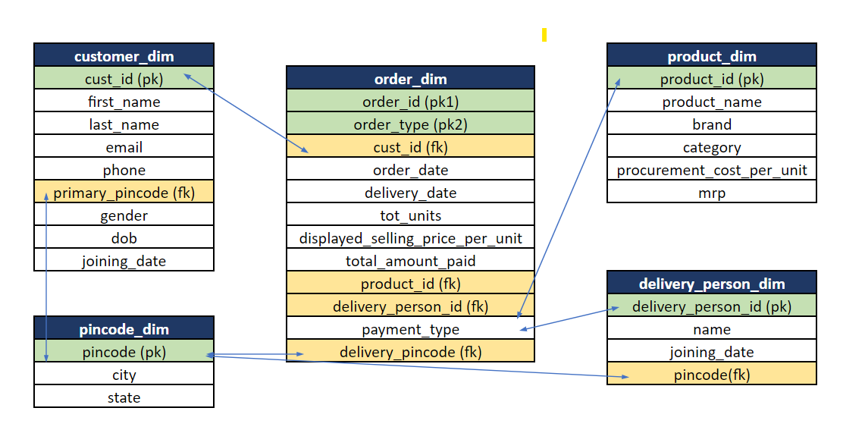
Database Schema:
Notes:
This diagram represents the Database schema of the data that is provided to us.
Each block represents a table and all its related fields.
The arrow between fields of different table indicates the relationship between the them.
The field in green are the primary keys of those tables and the field in yellow are the foreign key of the tables.

Slide 6
SQL Queries Used:
Below are few SQL commands, functions and clauses that were used to write SQL queries for analyzing sales data:
SELECT Statement: The SELECT statement is used to retrieve data from one or more tables.
Sample Query: How many customers do not have dob information available ?
select COUNT(*) dob from customers
where dob IS NULL;
Where Clause: The WHERE clause is used to filter records based on a specified condition.
Sample Query: Print product name and mrp for product which have more than 50000 mrp?
select product_name,mrp from products
where mrp>50000;
GROUP BY Clause: The GROUP BY clause is used to group rows that have the same values into summary rows, often used with aggregate functions.
Sample Query: How many delivery person are there in each pincode?
select count(*) as deli_person,pincode
from delivery_person
group by pincode;
Notes:
Now the upcoming slides show various types of SQL commands, clauses and functions that we have used in writing the SQL queries for the project.
We have used select statements, where clause, group by clause, joins and aggregate functions.

Slide 7
ORDER BY clause: The ORDER BY clause is used to sort the result set in ascending or descending order based on one or more columns.
Sample Query: How many total orders were there in each month and how many of them were returned? Add a column for return rate too.
select
month (order_date) as order_month,
count(*) as total_orders,
sum(case when order_type = 'return' then 1 else 0 end) as total_returned_orders,
(100.0 * sum(case when order_type = 'returned' then 1 else 0 end)) / count(*) as return_rate
from
orders
group by
month (order_date)
order by
order_month;
HAVING clause: The HAVING clause is used to filter the result set after the GROUP BY operation based on a specified condition.
Sample Query: Which pincode has average amount paid more than 150,000? Take only 'buy' order types .
select delivery_pincode
from orders
where order_type = 'buy'
group by delivery_pincode
having avg(total_amount_paid) > 150000;

Slide 8
JOINS: SQL supports various types of joins (INNER JOIN, LEFT JOIN, RIGHT JOIN, FULL OUTER JOIN) to combine rows from two or more tables based on a related column.
Sample Query: How many distinct customers are there in each state?
select
p.state,
count(distinct c.cust_id) as distinct_customers
from
customers as c
left join
pincode as p
on
c.primary_pincode = p.pincode
group by
p.state;
Aggregate Functions: SQL provides aggregate functions like SUM, AVG, COUNT, MIN, and MAX for performing calculations on sets of values.
Sample Query: For each Pin code, print the count of orders, sum of total amount paid, average amount paid, maximum amount paid, minimum amount paid for the transactions which were paid by 'cash'. Take only 'buy' order types .

Slide 9

select
delivery_pincode,
count(*) as order_count,
sum(total_amount_paid) as total_amount_paid ,
avg(total_amount_paid) as average_amount_paid,
max(total_amount_paid) as max_amount_paid,
min(total_amount_paid) as min_amount_paid
from
orders
where
order_type = 'buy' and payment_type = 'cash'
group by
delivery_pincode;

Slide 10
Analysis and Insights:
Out of total 6 pin code, pin code- 400001 has maximum number of delivery persons i.e., 4 and pin code- 700001 has second maximum number of delivery person i.e., 2. All other pin codes have only 1 delivery person.
The costliest products in the product list are laptops from HP and Dell as their cost is greater than Rs 50,000.
Delivery person - Simon Williams with delivery id - 1000002 has delivered the highest number of orders i.e., 10 and the total amount for all the orders delivered by him is 76801.
There are 8 customers whose email is a Gmail account.
Only one pin code i.e., 110001 (New Delhi) has an average paid amount greater than Rs.1,50,000.
In the 5th month (May) we have the maximum number of orders, which is 125 and the total returned order in this month is 8. We can say the return rate of orders in each month is very low, as the number of orders returned is very small compared to the order purchased.
There are 2 brands HP and Dell. Dell has sold a total of 502 units out of which 21 units were returned. HP has sold a total of 498 units out of which 29 units were returned.
Notes:
This slide represents the Analysis and Insights that were discovered during the project.
Read 3-4 insights from the slide .

Slide 11
Percentage-wise pen drive has made the highest profit as the profit percentage is highest for it. In case of absolute profit, it is laptop that has made highest profit.
For small products like - pen drive and mouse, profit is in boom i.e., more than 100%.
Dell brand has a higher profit percentage than HP brand.
In November and December there are zero buy orders for all the delivery people.

Slide 12
Conclusion:
The project "Uncover Insights from Real Sales Data" has been a journey of exploration, analysis, and discovery.
Through the effective utilization of SQL (Structured Query Language) and a comprehensive data analysis approach, we have successfully transformed raw sales data into valuable insights that hold the potential to drive strategic decisions, optimize performance, and enhance overall business outcomes.
Throughout this project, we have achieved the following key milestones:
Data exploration
Data Transformation
Finding key performance metrics
Customer analysis
Product analysis
This project helped us to leverage our SQL skills in driving valuable insights from sales data.
The insights derived from this endeavor have the potential to make inform strategic decisions, drive growth, and improve the bottom line. We now stand equipped with the knowledge and understanding necessary to leverage data as a powerful asset in our ongoing pursuit of business excellence.
Notes:
Finally in the conclusion I will say, that we have successfully met the objective of the project.
As we have effectively utilized SQL and data analysis approach to discover insights from sales data. The project has helped us to leverage our SQL skills and use it to make strategic decisions.
We have successfully performed steps like –
Data exploration
Data Transformation
Identifying KPIs
Customer and Product analysis.
As the objective of the project is met. With this I will like to end my presentation. Thankyou.

