Slide 1
European Rail vs. Air Travel: An Efficiency & Connectivity Analysis
Sara Milla, Adam Domoslawski, Rafael Mohr, Noah Weidenhaupt, Kyzer Gerez

Slide 2
Research Questions
How do rail travel times compare to air travel times between major European cities?
Are there routes where high-speed rail leads to shorter journey times than air travel?
What percentage of routes are faster to travel by train than by flight?
How can estimates of travel time to and from airports and train stations be included for a door-to-door comparison?
Which cities are the best and worst connected by travel time?

Slide 3
Data Sources & Acquisition Strategy
Shifted from static historical datasets to API-driven collection for modern relevance
Sources:
Cities: Simplemaps (Filtered to EU27 mainland, >500k residents)
Rail: Deutsche Bahn API (Routes & Stations) & OpenStreetMap (Infrastructure/HSR tagging)
Air: Jonty/Airline-Route-Data (sourced from FlightsFrom.com)

Slide 4
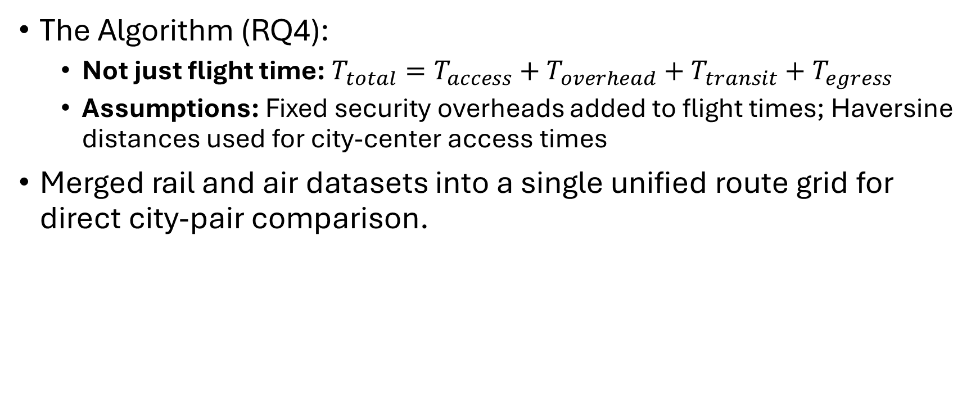
Methodology & The "Door-to-Door" Model
The Algorithm (RQ4):
Not just flight time: $T_{total}=T_{access}+T_{overhead}+T_{transit}+T_{egress}$
Assumptions: Fixed security overheads added to flight times; Haversine distances used for city-center access times
Merged rail and air datasets into a single unified route grid for direct city-pair comparison.

Slide 5
Key Insight 1 – The Dominance of Air
Air travel maintains a significant door-to-door advantage on 94.72% of routes
The average rail disadvantage is approximately 400 minutes on medium-to-long range corridors

Slide 6
Key Insight 2 – The Rail Niche
Rail competitiveness is confined to a niche subset of short-distance corridors under 500km
High-Speed Rail is the primary driver where trains win
Takeaway: Development must prioritize high-speed utilization on medium-range corridors to challenge the current air dominance

Slide 7
Key Insight 3 – Connectivity Hubs (Best vs. Worst)
Best Connected: Frankfurt.
Reason: "Dual-modality advantage" serving as both a major HSR and Air hub
Worst Connected: Genoa (Avg travel time: 689 mins).
Reason: "Significant modality gap"—30 out of 42 routes lack an air segment, forcing reliance on slower rail
Interesting: Athens outperforms Genoa despite geographic isolation due to strong air links

Slide 8
Sources

Slide 9
Work Division
Kyzer: Railway infrastructure data processing, RQs 2, 3, 4, 5, 6
Noah: City data processing, Methodology development, Notebook structure, RQs 1, 3, 5, 6
Rafael: Merging train route data, integrating train data into submission, file aggregation
Adam: Train station and train route data acquisition
Sara: Air route data acquisition/preprocessing, RQ4 analysis, Management Summary

