Slide 1
Bespins
Yash, Huzaifa, and Rabaa

Slide 2
Functional Requirements
Ability to take online payments
Displaying Job Postings
Maintainable “Simple Backend”

Slide 3
Non-functional Requirements
Efficient navigation
Decent simple design
Functional mobile design
Economical
Searchable (SEO)
Quick responses

Slide 4
User’s Story
https://landofooo.storiesonboard.com/m/bespins

Slide 5
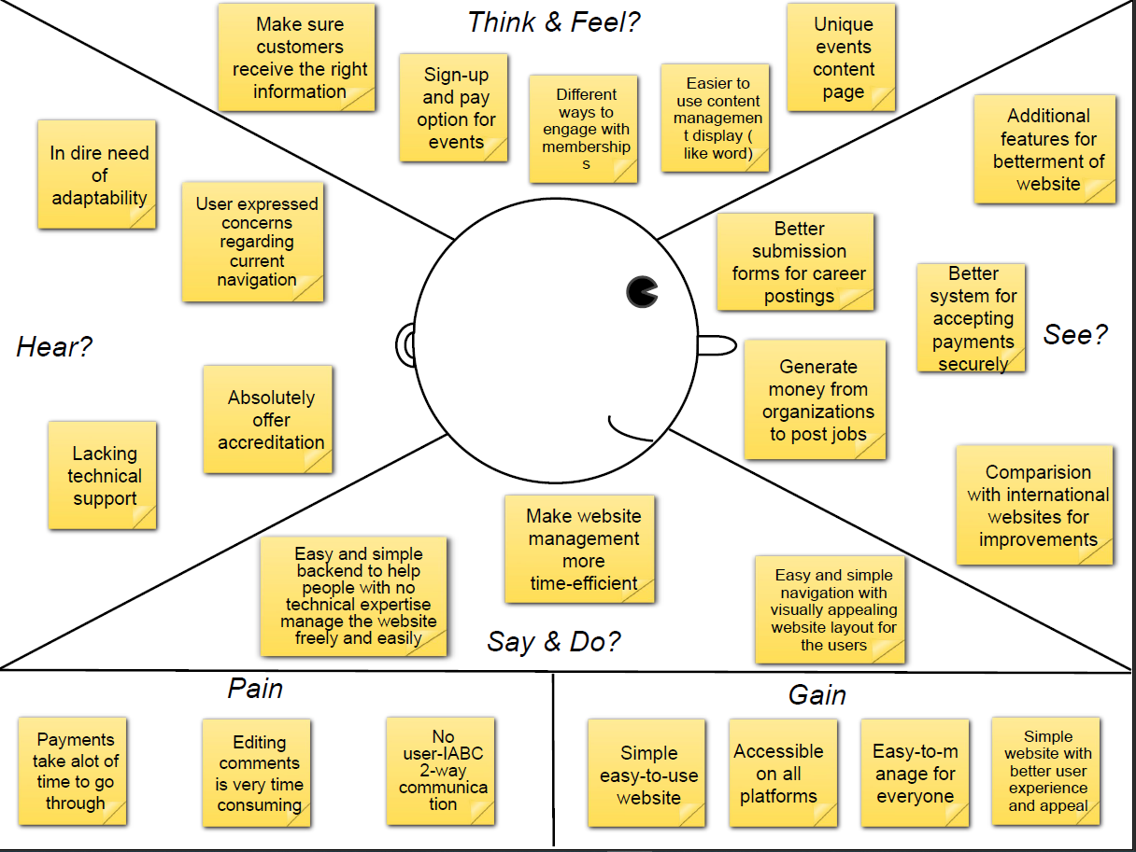

Slide 6
Affinity Diagram
User Experience
Utility
Maintenance
Simple/good Backend Design
Good UI design(easy to traverse)
Choice of Payment Methods
Security of the website/information
Theme Choices/Dark Mode
Metric Tracking
Sign Up Option
Should be easily scaleable/added to
Easy to update information
Search Function
Customisable for members
Information is appropriately sectioned
Sensible Mobile design
Avoid duplicated information
Minimise load times
Information Delivery
Scheduling information
Information storage/SQL/wordpress
Ablity to 'rollback' website
Job Listings

