Slide 1
SOS APP
Bugs - Rabaa, Renz, Li
Notes:
Li

Slide 2
Status Description
Current status: yellow — there are still gray areas with the project idea (difficulty in deciding on an emergency scenario to focus on that would make overall sense for our MVP)
Plan to get back to a green status: Apply insights from this morning's meeting with Dr. Morgan to our proposed ideas.
Li: Research; Documentation(Wiki, GitHub); site map; empathy map; Lo-Fi
Renz: Research; Documentation(Wiki, GitHub); site map; empathy map; Lo-Fi
Rabaa:Research; Documentation(Wiki, GitHub); site map; empathy map; Lo-Fi;
Notes:
Li, Renz and Rabba

Slide 3
Project issues
Sensors sending false positives causing the application to call 911
Sending as much amount of the available information to 911
Notes:
Rabaa

Slide 4
Project changes
The project main idea was not changed. We are focus on scenarios we must achieve. Such as the main functionality we must have.
Notes:
Li

Slide 5
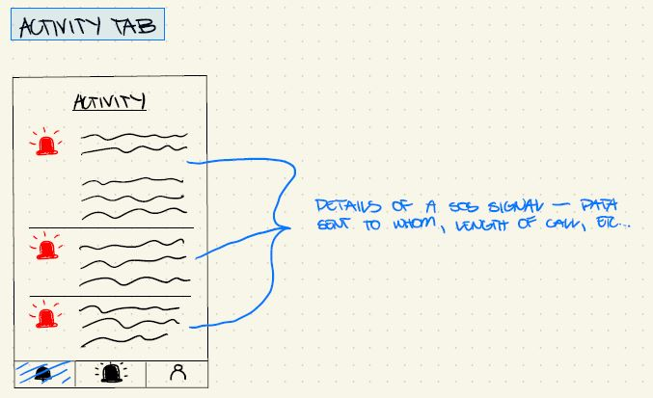
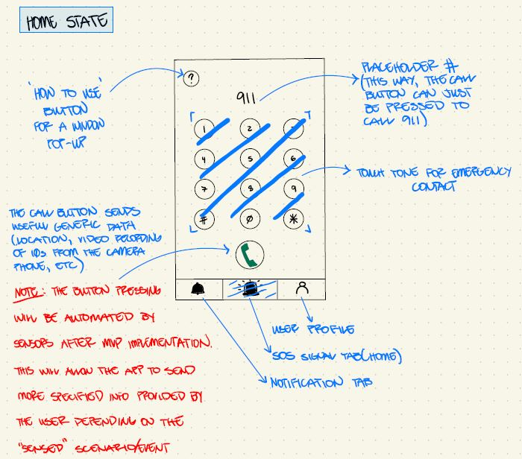
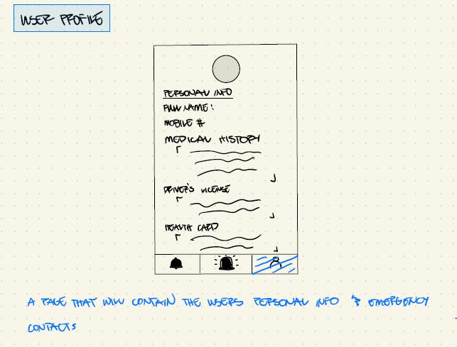
Documentation overview and/or project demo
MVP Lo-Fi Prototype Proposal for Dr. Morgan
Notes:
Renz

Slide 6
Next up
Decide on one scenario (medical, fire, etc) that would make overall sense for a MVP
Applying insights from our meeting earlier with Dr. Morgan about our Lo-Fi prototype
Lo-Fi usability testing through clickable wireframe
Create a Hi-Fi prototype
Notes:
Renz

Slide 7
Team Reflection
Does the team feel "on track"? (reiterate the above colour status)
We are currently yellow status due to difficulties in deciding on a emergency scenario that would make overall sense for a MVP.
What progress does the team particularly feel good (great) about?
We feel good about our individual ability to contribute ideas and then finding ways to combine all of them together into one idea.
What barriers (if any) does the team feel are a current impediment to success?
Not really a barrier, making sure the application doesn’t call 911 due to a false positive.
What help (if any) does the team require to move positively forward?
Our weekly meetings set with Dr. Morgan for general guidance of our work/progress will help our team move positively forward
What questions or concerns does the team have (if any)?
As of now, the difference in our time zones do not really affect us. It may or may not become a concern once the course work this semester gets more demanding.
Notes:
Li

