Slide 1
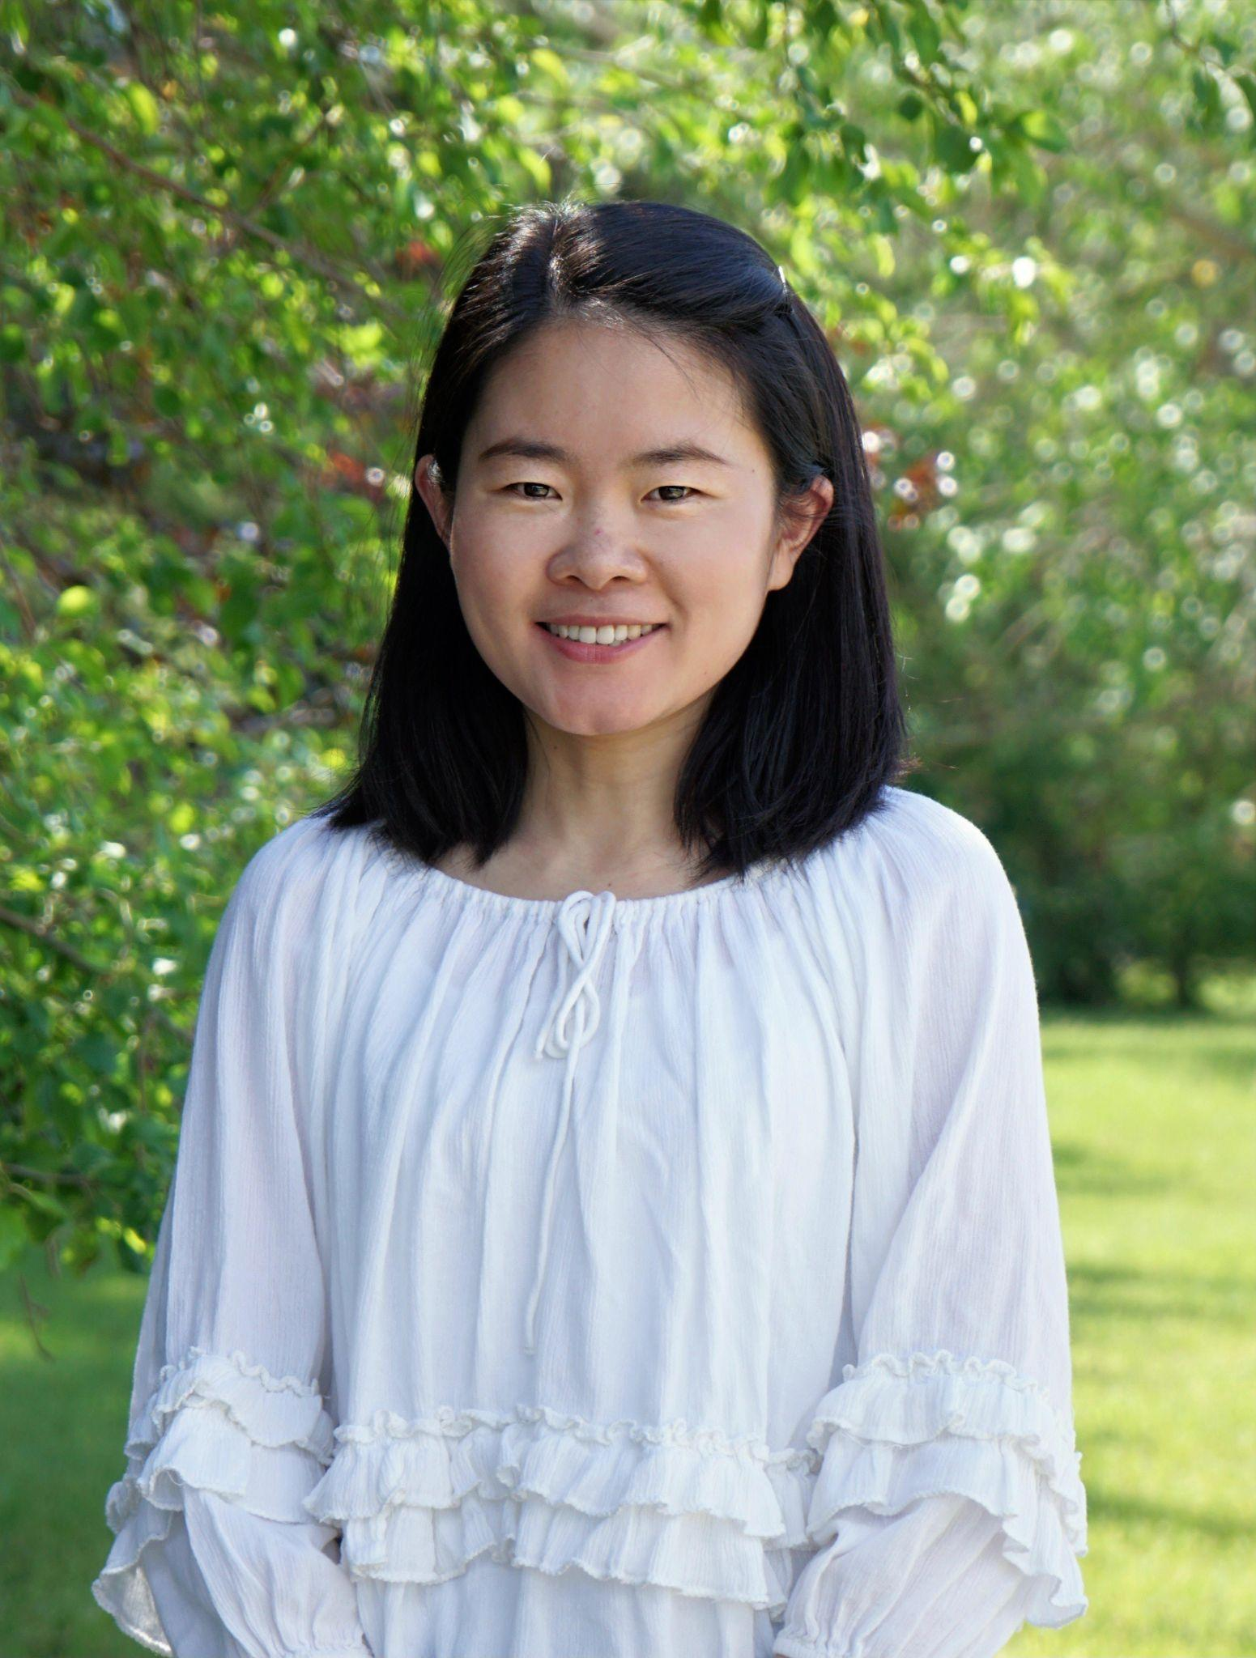
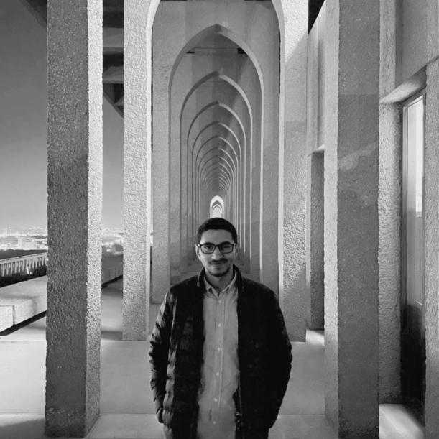
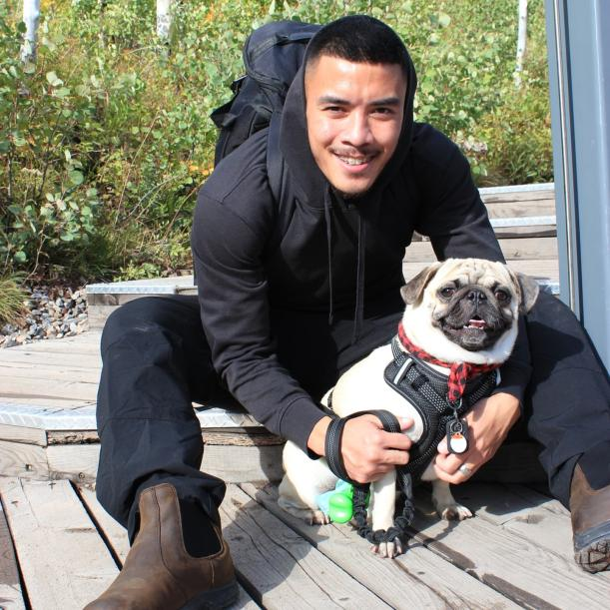
Capstone Project Vlog#2
SOS Application
by Team Bugs
Li Pan
Abdelrahman Rabba
Renz Rivero

Slide 2

SOS APP
Vlog #2
Abdelrahman Rabaa, Li Pan, Renz Rivero

Slide 3
Project Blurb
A 911 call made a little efficient by specifying distress calls into different “scenario” buttons
MVP: Will be for a medical scenario button as most calls that go to 911 are identified “medical in nature” according to our discussion Mr. John Lietch, a previous RCMP professional
Will aim to utilize the next generation 911 (NG911) infrastructure
Notes:
Renz
A 911 call made a little more efficient by specifying distress calls into different "scenario" buttons. As for our MVP, this scenario button will be a medical scenario for this is the case for most calls according to our discussion with John Leitch, a previous RCMP professional. With the information provided by Mr. Lietch, we now know that it will not be impossible to skip the step where the user calls 911 and have to answer for their current scenario whether it is medical, fire, etc. The user must go through that process. What is possible is to then send text messages, images, videos, location, and any other relevant information after this process through the upcoming next generation 911 (NG911) infrastructure but this won’t be possible until 2024, which is the estimated time for NG911 to be implemented. So, this is a feature that our app should easily extend to. In the meantime, the innovation that comes with our app comes in the form of having the relevant information for specific distress calls in the app for support workers to use. These are the main objectives of our project. Make it possible for app to easily extend and use the upcoming NG911 infrastructure to send relevant information as fast as possible to the other end of the 911 call … and hold these relevant information from different scenarios in the form of logs for support workers to use

Slide 4
Project Activity
Renz: Lofi; Initialized project using Flutter with a navigation bar system as well as set up the skeleton for the home page with a loading indicator
Li : Lofi; Icon; Make the placeholder profile page with the basic signup information requirement.
Rabaa: Lofi; Coded the “Activities page” front end, implementation of the call function, stakeholders analysis and story map.
Notes:
Renz
From September 10 up until now, October the 15th, the due date of this vlogs, we had been researching about what can be implemented and had been designing accordingly. In terms of my contribution, I had helped with the LoFi prototype as well as finalize it, started our project on Flutter with a bottom navigation bar system (not the best implementation), as well as set up the skeleton of our SOS (Home page) with a loading effect.
Li: Design User interface. Make the placeholder profile page with the basic signup information requirement.
Rabaa. Coded the “Activities page” front end, implementation of the call function, stakeholders analysis and story map.

Slide 5
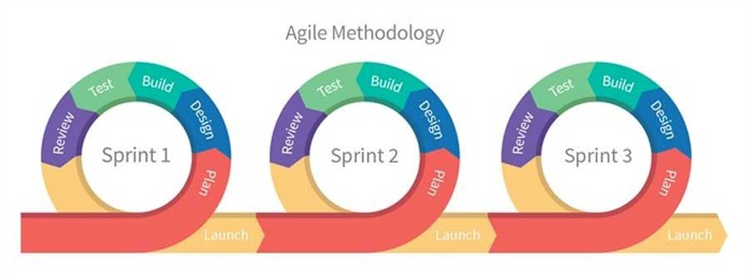
Status Description
Our project's current status is Green. We are focusing on the medical emergency scenario MVP by using an agile design process.
Notes:
Li

Slide 6
Project Issues
Minimal issues
We are balancing our work between design and coding
Notes:
Rabaa

Slide 7
Project Changes
Considering Next Generation 911
Notes:
Rabba

Slide 8
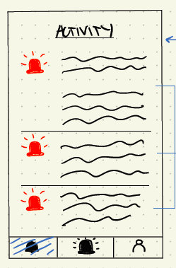
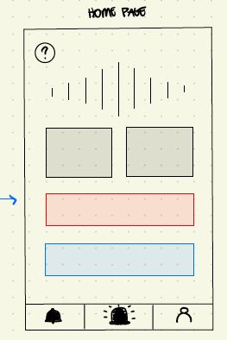
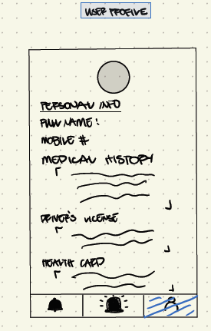
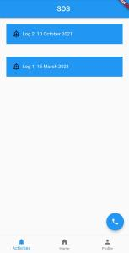
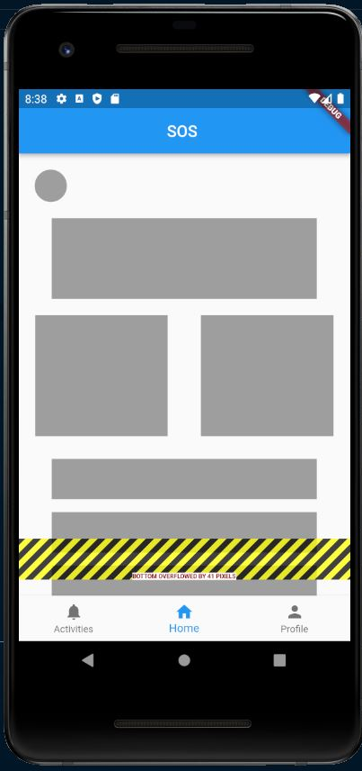
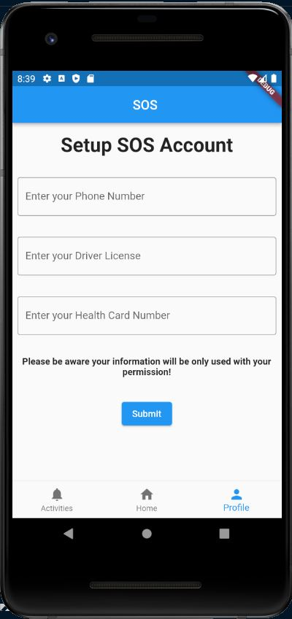
Demo
Notes:
Rabba

Slide 9

Demo
Notes:
Rabba

Slide 10
Next up
Refactor (Yikes) our page implementations as they are stateless as of now and work in a way that they just cover up one another
Will have to implement some sort of state machine
Slowly replace the placeholders in each page with actual implementations of how they are supposed to be (actual texts, buttons, etc)
Notes:
Renz
As of now, we have concerns with our page implementations. Everything looks nice but they are stateless and pretty much just cover up each other. Basically, not having states for each page. The plan to make this better is to clearly refactor the code so that it is state based and will likely implement some kind of a state machine design pattern.
Other than that, we will slowly replace the placeholders in each page with actual implementations of how they are supposed be such as actual texts, buttons, etc

Slide 11
Does the team feel "on track"? (reiterate the above colour status)
Our team feels our current progress is on track to succeed. We implement an agile design process to improve our App’s functionality and reliability. The App’s main function has been achieved.
What progress does the team particularly feel good (great) about?
We feel good that we have a clear plan to forward our project. Our mentor gave us clear goals of what we should achieve each week.
What barriers (if any) does the team feel are a current impediment to success?
There are no barriers in our way currently, but we want to keep the balance between our design idea and the implementation process.
What help (if any) does the team require to move positively forward?
Our weekly meetings with Dr. Morgan helps us greatly. Also, the officer from The RCMP gives us lots of good suggestions to keep our team moving positively forward.
What questions or concerns does the team have (if any)?
We are concerned that it could take too much time to implement the agile design process that we are designing and developing simultaneously.
Notes:
Li

Slide 12
Thank you!

