Slide 1

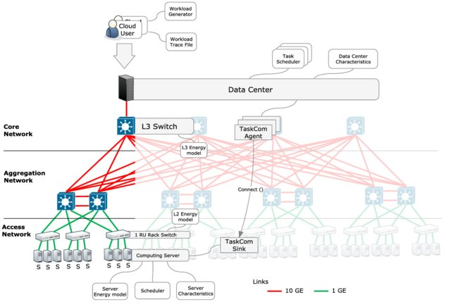
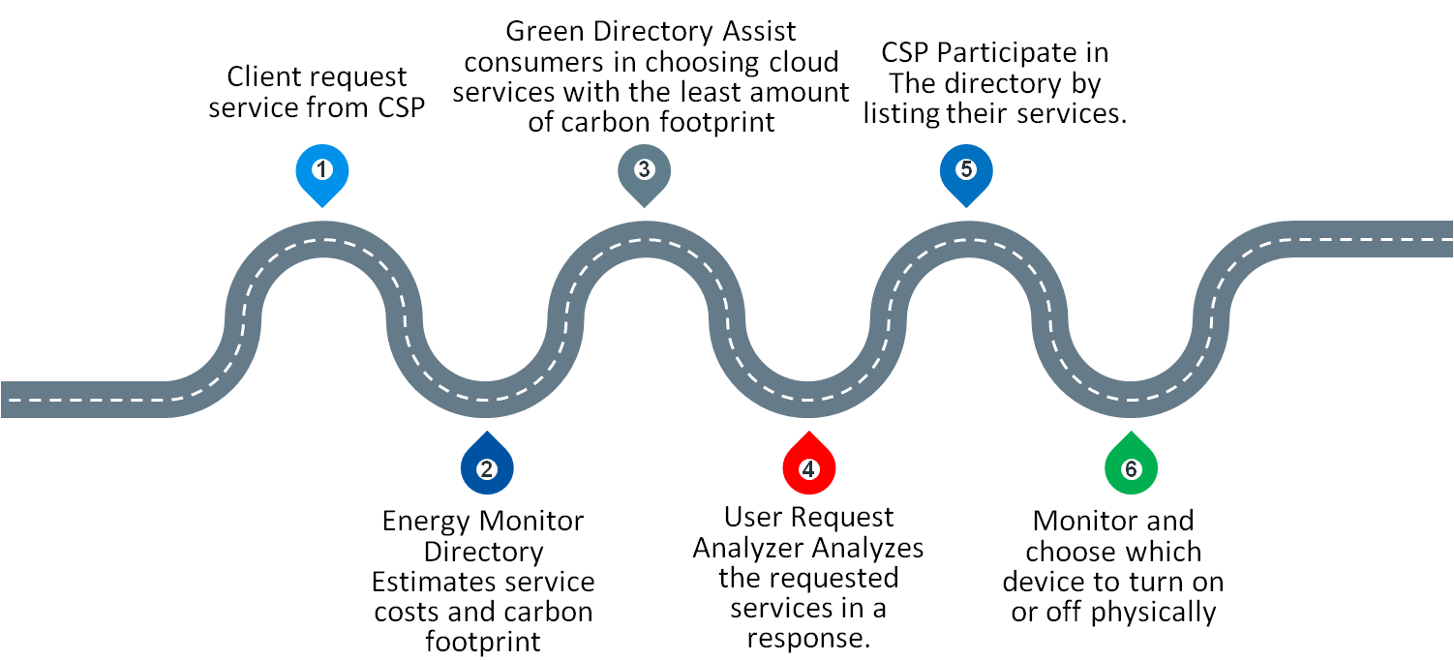
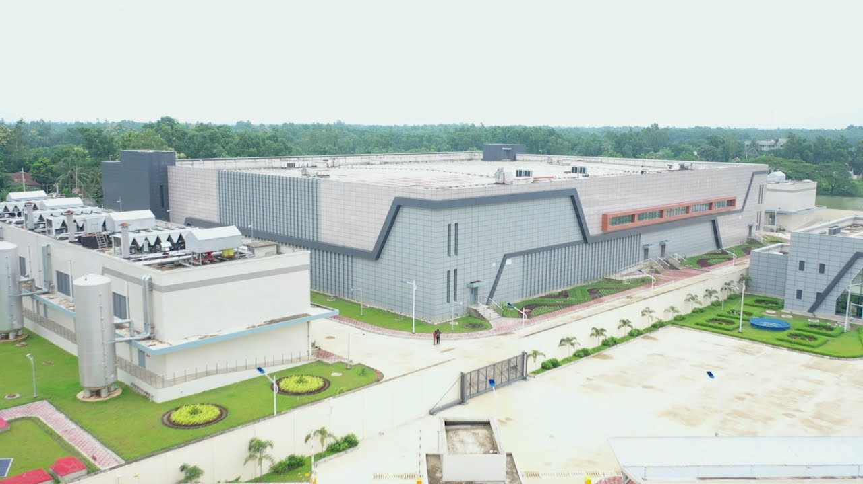
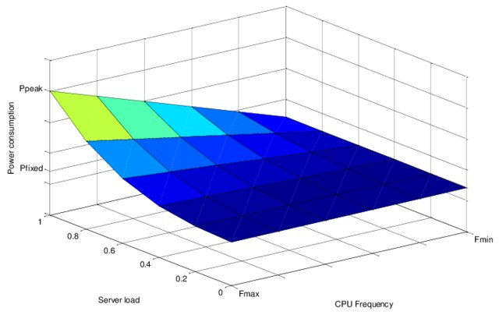
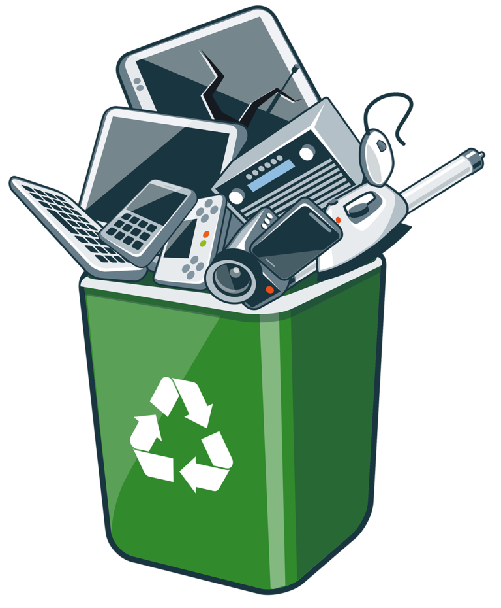
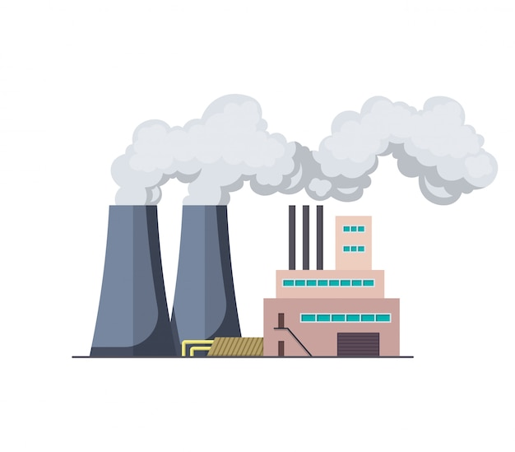
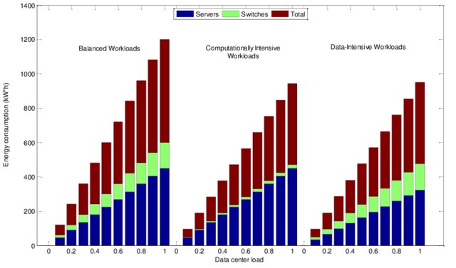

Obstacles to implementing sustainable computing in Bangladesh and
approach to being sustainable through green cloud computing methodology
Rabab Khan Rongon, Krishna Das
IUBAT - International University of Business Agriculture and Technology
Abstract
Methods and Materials
Our earth is facing serious difficulties related to excessive energy usage, global warming, and other environmental issues.
Solution of this problem is using environmentally friendly technology and to reduce carbon footprint from the environment.
Many developing countries like Bangladesh are taking proper initiatives to implement sustainable and green computing in their country.
A green cloud computing framework is proposed to practice sustainable study in data center in Bangladesh.
This study represents the barriers to implementing green and sustainable computing in Bangladesh and suggest some techniques to become sustainable in computing.
Fig. 1 presents the structure of the GreenCloud extension mapped onto the three-tier
Introduction
National data center of Bangladesh
Located in Bangabandhu Hi-Tech City
World 7th largest data center
Having 22000 TB storage capacity.
The key component needed to power this technical
apparatus is electricity.
When coal or oil is used to produce energy, carbon
dioxide and other pollutants are released into the
environment.
Fig: 1
Discussion
The figure 2 presents the server power
consumption model implemented in
GreenCloud.
The curve is built for a typical server
running on Intel Xeon processor.
It consumes 301 W of energy with around
130 W allocated for peak CPU power
consumption and around 171 W
allocated for other peripheral devices.
The scheduling depends on the server load level and operating frequency, and aims at capturing the effects of both of the DVFS and DPM techniques.
The recommended green Cloud framework will be created in a way that will enable it to monitor the total amount of energy used by the data centers of cloud service providers.
This encourages cloud service providers to make their products "Sustainable" so they can provide the subscriber the solutions with the lowest energy demand.
For every CSP, the green mediator may be developed at the base of the cloud infrastructure.
To maintain the cloud computing platform sustainable and environmentally and effective in terms of CO₂ emissions, the proposed framework’s first objective is to establish a set of secure methodologies for continuously measuring the service energy usage in cloud sites.
A significant amount of carbon footprint generates due to high energy consumption of data center and the presence of hazardous materials in e-waste, or electronic trash.
Fig: 2
Results
Fig. 3 presents data center energy consumption comparison for different types of user
workloads: balanced, computationally intensive, and data-intensive workloads. Balanced
workloads consume the most as the consumptions of both servers and switches become
proportional to the offered load of the system.
Conclusions
In datacenter, a significant number of processors and resources are used, which generates a lot of heat.
Deploying green cloud computing technologies might contribute to CO2 emissions reduction
Sustainable computing in cloud computing illustrates how vital it is to protect the environment.
The resources and machinery employed in cloud computing are utilized effectively by sustainable cloud computing.
It is important to make efforts so that technology sets an example by reducing its energy consumption in data centers of Bangladesh.
The adoption of green cloud computing framework will eventually occur across all cloud fields, benefiting both us and the environment of our country.
Fig. 3. Data center energy consumption for different types of workloads.
Contact
References
Rabab Khan Rongon
IUBAT- International University of Business Agriculture and Technology
Email: rababrongon@gmail.com
Phone: 01760533424
“Barriers to Implement Green ICT in Bangladesh: A Study on Organizations. "International Journal of Computer Applications, 2018
“AN INVESTIGATION INTO THE APPLICABILITY OF GREEN IT CONCEPTS INTO GREEN IS.” International Journal of Application or Innovation in Engineering & Management, 2014
J., Henretig. “Reduce CO2 Emissions with UC Tools.” Microsoft News and Resources, 2011
“Greening the Cloud: A Load Balancing Mechanism to Optimize Cloud Computing Networks.” Journal of Management Information Systems, 2022
“A Green Proactive Orchestration Architecture for Cloud Resources.”International Journal of Computers and Applications, 2019
“The Impacts of Cloud Computing Architecture on Cloud Service Performance.” Journal of Computer Information Systems, 2020
“Harnessing Green IT: Principles and Practices.” IT Professional, 2008

