Slide 1
TensorFlow 2.0 Tutorial
Topic3: Data Input Pipeline

Slide 2
Recap
We load all the data on to CPU memory at once.
How about?
When data are too large to fit in memory.
Online data augmentation.

Slide 3
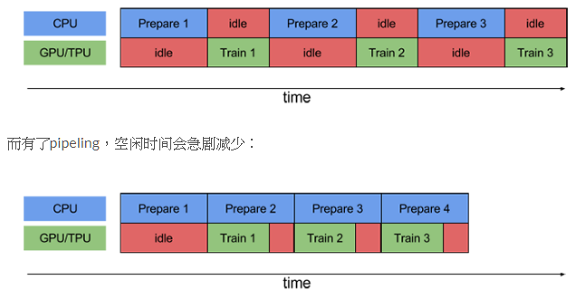
Data Input Pipeline
Therefore, we need a data generator that can:
Read data from disk to memory (in an online fashion)
Shuffle the data
Apply random augmentation to each sample
Batch the samples
ETL process (Extract Transform Load)

Slide 4
Code
Data generator on cats vs. dogs dataset

Slide 5
tf.data.Dataset
Make the dataset:
tf.data.Dataset.from_tensor_slices()
Apply a function to each sample:
tf.data.Dataset.map()
Use tf.data.experimental.AUTOTUNE to let TensorFlow autotune the degree of parallelism.

Slide 6
Code
Data generator on simulation dataset
Shuffling
Batching
Prefetching

Slide 7
Code
Data generator on cats vs. dogs dataset
Online data augmentation
Apply arbitrary Python logic https://imgaug.readthedocs.io/en/latest/

Slide 8
tf.data.Dataset functions
Shuffling: shuffle(), buffer size as big as possible
Batching: batch()
Prefetching: prefetch(), with AUTOTUNE
Perform function: map(), with AUTOTUNE
Arbitrary python function:
tf.py_function(func, inp, Tout)
inp: list of input tensors
Tout: TUPLE of types of output tensors

Slide 9
Code
Full example: cats vs. dogs
Manual train/validation split
Cache data onto memory

Slide 10
Code
Load .mat file
Paired image augmentation

Slide 11
Summary
Make the dataset from path:
tf.data.Dataset.from_tensor_slices()
Apply a function to each sample (load, augmentation)
tf.data.Dataset.map()
Arbitrary Python function:
tf.py_function()
Add Dataset settings:
cache() -> shuffle() -> batch() -> prefetch() -> repeat()
Remember to unit test your data generator on small amount of data first!!

Slide 12
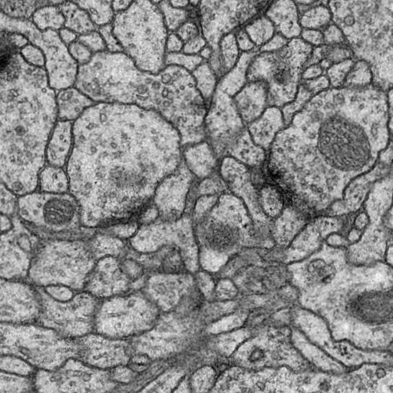
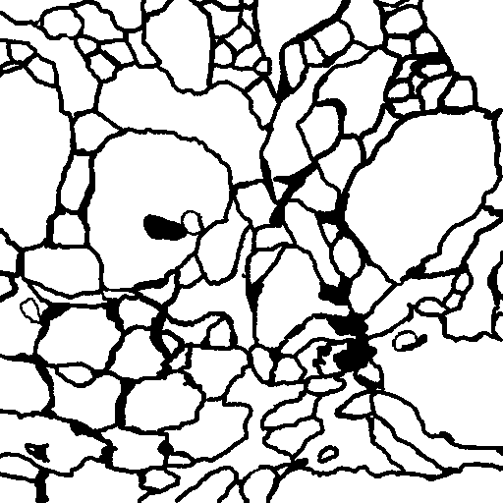
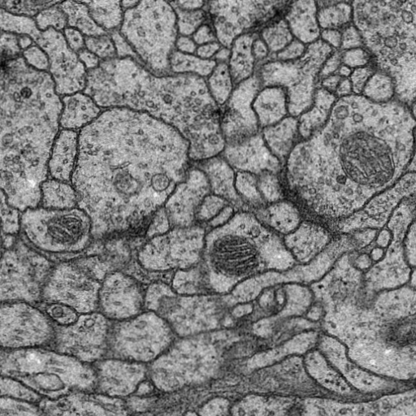
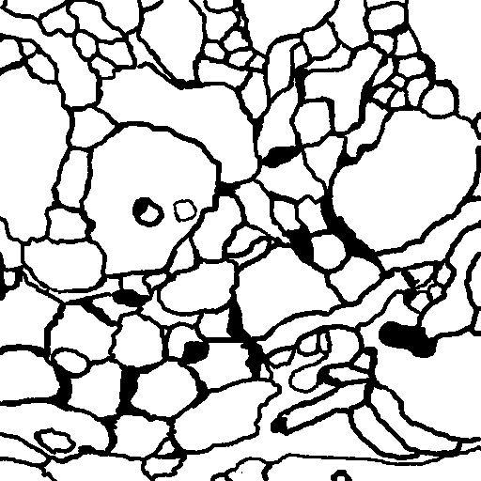
Practice exercises
Make a data generator for cell membrane segmentation (2D EM segmentation challenge). https://drive.google.com/file/d/1mEBOddY9MVPNYxmmzioHHcQPI2ej35IS/view?usp=sharing
You can try different methods for image augmentation, e.g. numpy, cv2, etc … Elastic Transformation

