Slide 1
TensorFlow 2.0 Tutorial

Slide 2
Package
TensorFlow 2.0
pip install tensorflow / pip install tensorflow-gpu (This would install the 2.0 now)
Eager execution by default
Keras
tf.keras (I would use this throughout the whole lesson to be clear)
TensorFlow 1.0
session.run() (Run if you see this!!)

Slide 3
Deep learning pipeline
Build model
Sequential model / Functional API
Initialize all the parameters
Load data
Data loading pipeline
Preprocess / Data augmentation
Train model
Define loss function
Calculate gradient
Apply optimizer
Deploy model

Slide 4
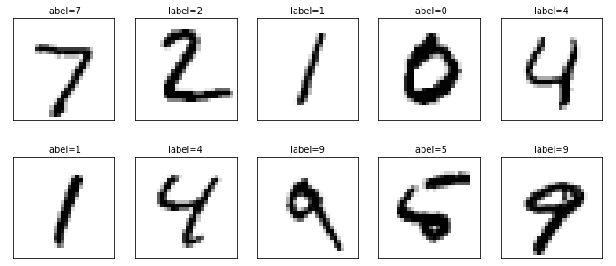

MNIST Dataset (Image Classification)
Input is an image: $X_{W×H}$
Output is a one-hot vector: $y_{C}$ (C: class count)
Loss: cross-entropy
Metric: accuracy

Slide 5
Code
MNIST image classification example

Slide 6
Load data
For now, we use the example dataset under tf.keras.datasets
There is much more example dataset under another package, called TensorFlow Dataset (tfds): https://www.tensorflow.org/datasets
By doing so, we load all the data onto the memory at once.
We use up 70000*28*28*1 = 54.88 MB of memory. (uint8)

Slide 7
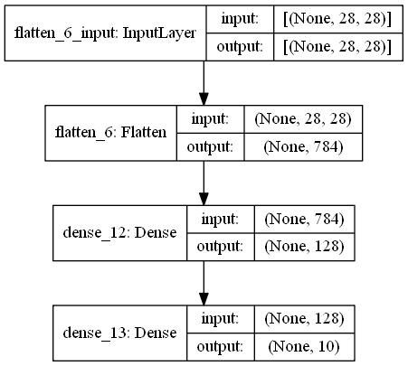
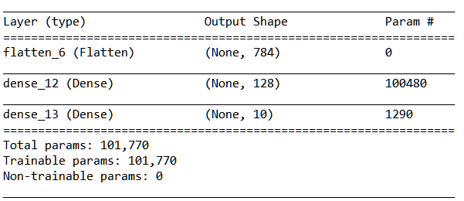
Sequential API
Build the model by stacking a series of layer blocks.
tf.keras.Sequential()

Slide 8
Compile the model
For now, we let TensorFlow take care of all the mess when training!
model.compile() defines optimizer and loss
model.train() takes care of gradient calculation and batching
“categorical_crossentropy” vs. “sparse_categorical_crossentropy”

Slide 9
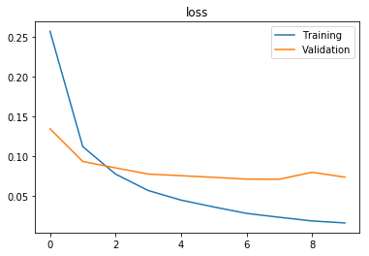
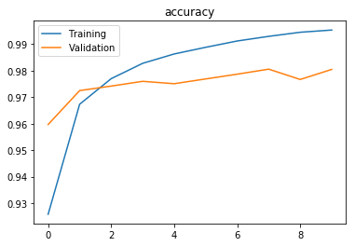
Plot Training Progress
Why validation is always a little better at the start?

Slide 10
Code
Add convolution layers to MNIST example

Slide 11
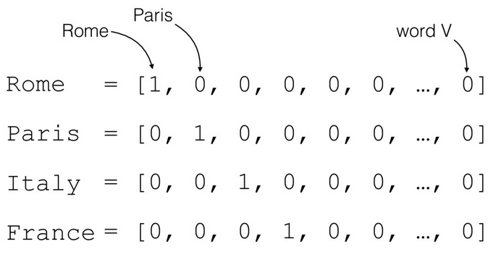
Optional Topics – Text Classification
Different data needs different kind of preprocessing/augmentation.
For a sequence of text – one-hot encoding

Slide 12
Code
IMDB text classification example

Slide 13
Practice exercises
Repeat the same pipeline using tf.keras.datasets.cifar10
https://aidea-web.tw/topic/a49e3f76-69c9-4a4a-bcfc-c882840b3f27
You might want to resize the image smaller so that all data can fit onto memory
A very simple CNN would work.

