Slide 1
TensorFlow 2.0 Tutorial
Topic2: Build models using TensorFlow Keras functional API

Slide 2
Recap
Problems with tf.keras.utils.plot_model()
conda install -c https://conda.binstar.org/t/TOKEN/j14r pydot
conda install -c https://conda.binstar.org/t/TOKEN/j14r graphviz
Build sequential models using tf.keras.Sequential()

Slide 3
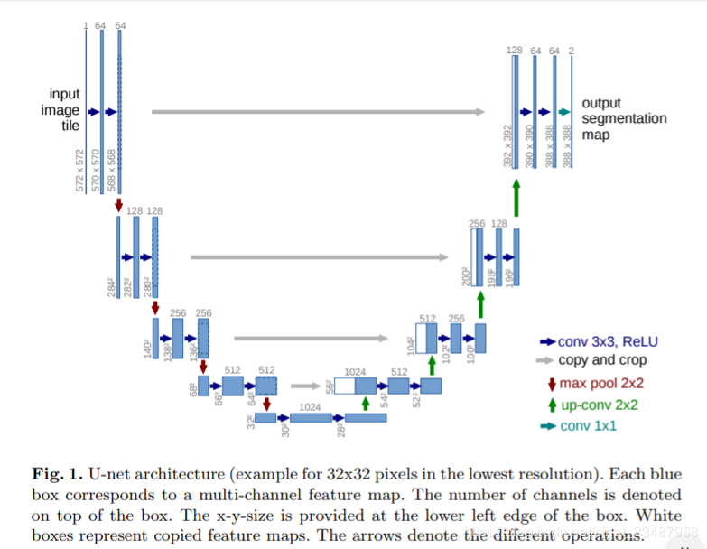
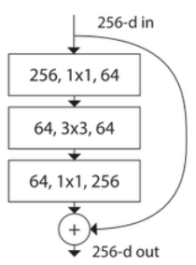
Models
Many models are not sequential.
Many problems do not have one single input or output

Slide 4
Code
Simple ResNet model for image classification with 10 categories.
Skip connection

Slide 5
TensorFlow Keras Functional API
Specify the input tensor and its shape
tf.keras.Input(shape=(___), batch_size=None)
None means that batch size can be defined later (most of the time we want to let the data generator control the batch size)
Define how the input tensor passes through each layer
Let TensorFlow knows the input and output
tf.keras.Model(inputs=[input_tensor], outputs=[output_tensor])
[ ] can be omitted

Slide 6
Code
Model with shared layers and weightings
The model takes in two sequences of texts and predicts whether the comments are from the same person.
Inputs:
Two padded sequences (256, ) (256, )
Outputs
(1, )

Slide 7
Code
Model with sub-models and multiple outputs
The model takes in two images of different size and classify it into 10 categories and predict whether it is the same viewpoint.
Inputs:
Two images (30, 30, 3), (60, 60, 3)
Outputs
(10, ), (1, )

Slide 8
TensorFlow Keras Functional API
Layers can be called as an instance, and their weightings are shared
shared_embedding = layers.Embedding(5000, 15)
Models is also callable, and their weighting are shared.
out = feature_extractor(image)
Note that we cannot use model.predict() here (since it is a tensor execution)
Multiple outputs need to specify multiple loss functions and their weightings
loss={'category': 'sparse_categorical_crossentropy',
'viewpoint': 'binary_crossentropy’},
loss_weights=[1., 0.2]

Slide 9
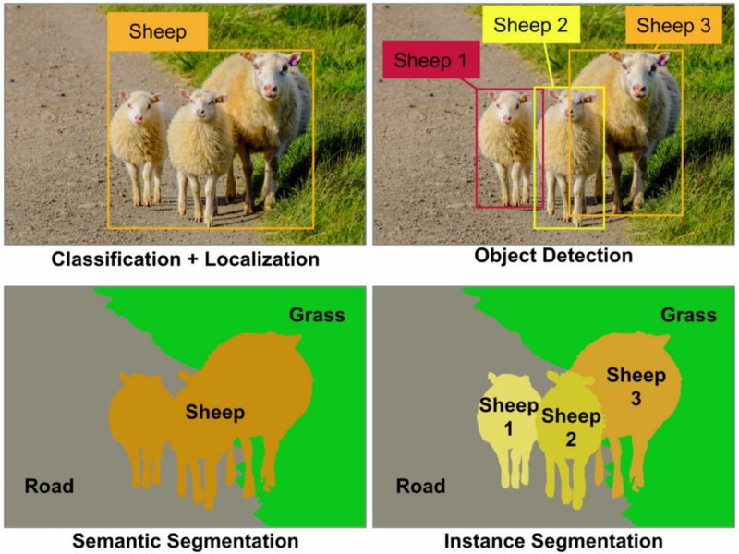
Code
U-Net: Convolutional Networks for Biomedical Image Segmentation. 2015. Citation: 9960.
Image as both input and output

Slide 10
Lambda Layer
Easy customizable layer object to let you perform your own operation.
Custom operation, e.g. linear transformation
Custom loss function.

Slide 11
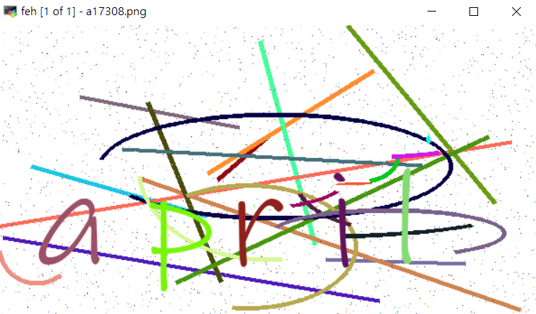
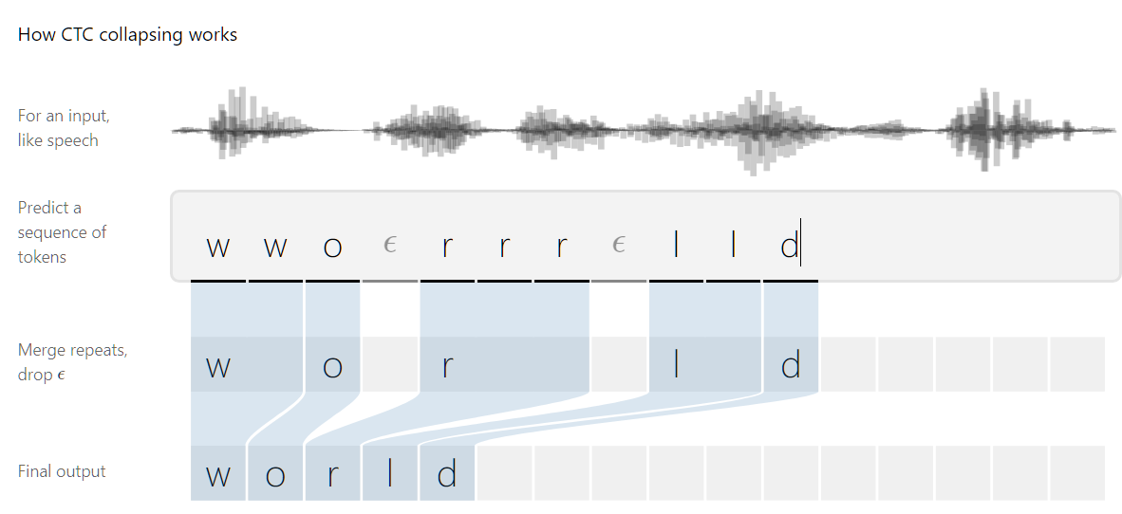
Code
Captcha recognition
Input is an image, output a sequence of characters

Slide 12
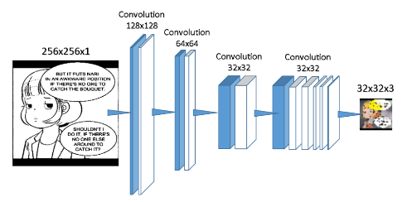
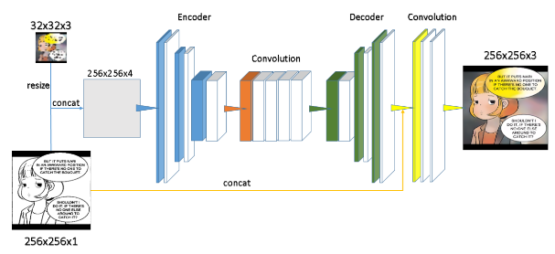
Practice exercises
Build the low resolution colorizer and plot the model architecture
Repeat (1) on the polishing network
See the supplementary material section for detailed network architecture: https://github.com/Rabbit1010/Speech-Bubble-Aware-Automatic-Comic-Colorization/blob/master/Final_report.pdf
Can only be built using functional API
This can be built using tf.keras.Sequentia()

