Slide 1



Fewer is More: A Deep Graph Metric Learning
Perspective Using Fewer Proxies
Yuehua Zhu¹, Muli Yang¹, Cheng Deng¹, and Wei Liu²
¹Xidian University
²Tencent AI Lab
Notes:
Hi, this is Yuehua Zhu from XiDian university in China. In this paper, we focus on a novel deep metric learning method.

Slide 2
Overview
Notes:
The core idea of deep metric learning is to learn an embedding space, where the embedded vectors of similar samples are close, while those of dissimilar ones are far away from each other. Considering that graphs are good at modeling global data affinity, we propose to characterize neighbor relationships among samples with graphs.

Slide 3
Overview
Notes:
Recall that the idea behind graph-based label propagation in semi-supervised learning is to infer unknown labels with the help of neighbor relationships captured in graph or manifold structure. On the contrary, we seek to leverage known labels to adjust the neighbor relationships with the proposed reverse label propagation algorithm.

Slide 4
Overview
Notes:
This algorithm forces the data points to satisfy the above-mentioned distance constraint in the embedding space.

Slide 5
Overview
Triplet
Notes:
Learning such an embedding space is challenging due to large intra-class variations and subtle inter-class differences. Traditional methods such as contrastive loss and triplet loss, rely on pairs or triplets constructed from samples in a mini-batch, but they empirically suffer from the sampling issue. These methods often select hard samples from a subset (mini-batch) of the whole training dataset, failing to characterize the global geometry of the embedding space precisely.

Slide 6
Overview
Proxy-NCA
Notes:
Another type of proxy-based and classification-based methods address such a sampling issue with a global consideration. For instance, ProxyNCA assigns a trainable reference point to each class, namely proxy, and enforces each raw data point to be close to its relevant positive proxy and far away from the other negative proxies. During training, all the proxies are kept in the memory, therefore avoiding the sampling issue over different mini-batches.
However, those proxy-based and classification-based methods equally treat each raw data point by calculating with either all reference points or class-specific parameters in classification layers, hence failing to capture the most discriminative relationships among raw data points. In addition, what follows is expensive computational consumption when many classes are involved.

Slide 7
Overview
ProxyGML
Notes:
In order to address the above challenges, our method adaptively compares each sample with the most informative proxies, and efficiently captures both global and local similarity relationships among raw samples.

Slide 8
Proposed ProxyGML
Proxy-based deep Graph Metric Learning
y
...
Label
Positive mask S^{pos}
...
...
...
...
Top-k
...
..
Similarity graph S
Predictions
Ground truths
Input
Subgraphs W
in a mini-batch
Predictive
outputs Z
Relation-guided
graph construction
Reverse label propagation
Classification loss
Samples：
class 1
class 2
class 3
class 1
class 2
class 3
Proxies：
Notes:
In general, we propose a proxy-based deep metric learning approach from the perspective of graph classification. It can also be regarded as a novel deep metric learning loss.

Slide 9
Proposed ProxyGML
Proxy-based deep Graph Metric Learning
y
...
Label
Positive mask S^{pos}
...
...
...
...
Top-k
...
..
Similarity graph S
Predictions
Ground truths
Input
Subgraphs W
in a mini-batch
Predictive
outputs Z
Relation-guided
graph construction
Reverse label propagation
Classification loss
Samples：
class 1
class 2
class 3
class 1
class 2
class 3
Proxies：
Notes:
We first use multiple global proxies to collectively approximate original data points for each class and build a directed similarity graph between mini-batch samples and all proxies.
Second, we design an efficient positive mask to ensure that the positive proxies of each sample can be selected.
Third, after constructing k-nearest neighbor (k-NN) sub-graphs, all positive proxies for each sample are selected under the guidance of the positive mask, and the remaining negative proxies in each sub-graph can be regarded as hard proxies for each sample.
Fourth, these sub-graphs immediately serve for the proposed reverse label propagation, during which the label information of proxy nodes will be passed to sample nodes to encode each sample's predictive output.
Lastly, all samples will be classified under the supervision of their ground-truth labels.

Slide 10
Proposed ProxyGML
(a)
Notes:
The following slides show the changes in manifold structure during the process of subgraph classification.

Slide 11
Proposed ProxyGML
(a)
(b)

Slide 12
Proposed ProxyGML
(a)
(b)
(c)

Slide 13
Proposed ProxyGML
(a)
(b)
(c)

Slide 14
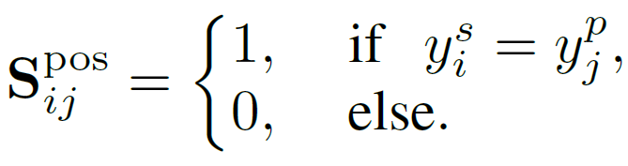
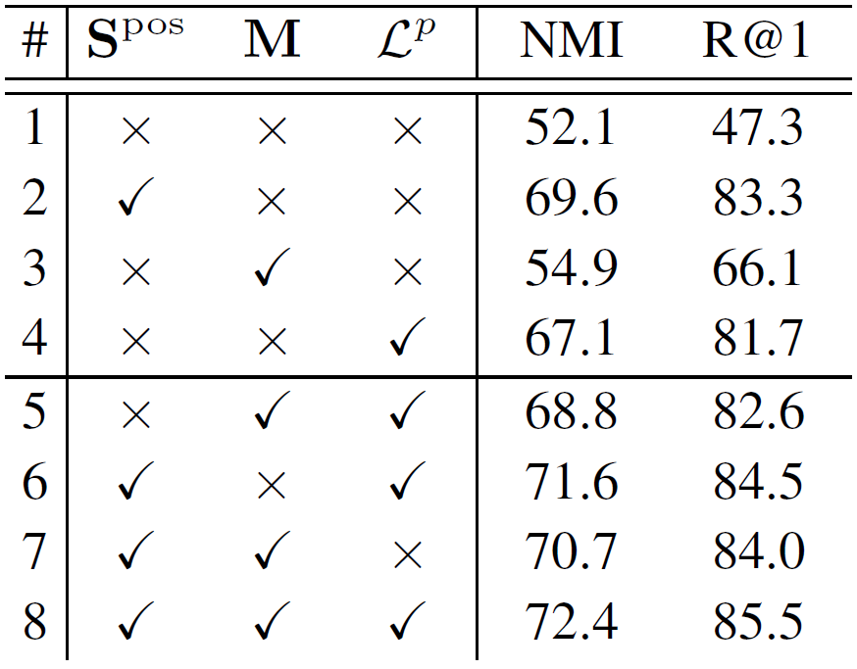
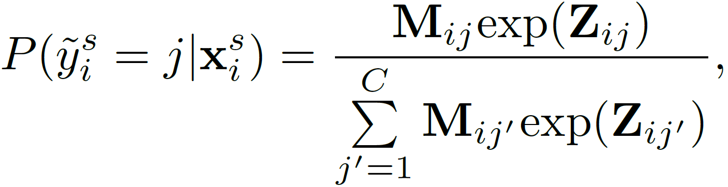
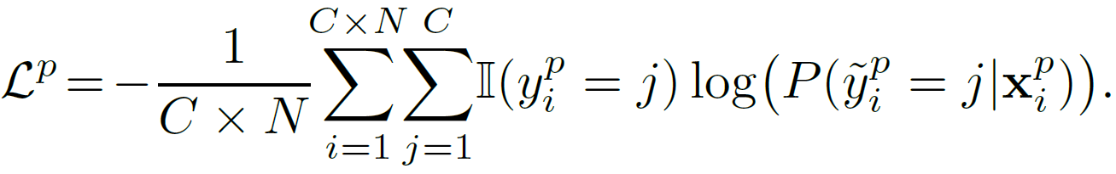
Experiments
Ablation study of three
proposed modules
Notes:
The experiments demonstrate the superiority of our ProxyGML over state-of-the-art methods in terms of both effectiveness and efficiency.
ProxyGML consists of three modules, including positive mask, mask SoftMax and regularizer.
Specifically, the positive mask can be regarded as a “soft” constraint on proxies, which makes similar proxies mutually close by encouraging proxies to be close to their relevant samples.
The mask SoftMax encodes the subgraph predictions more precisely.
The regularizer is a “hard” constraint on the proxies to ensure that similar proxies are close to each other while dissimilar ones are far apart. As demonstrated in this Table, each proposed module contributes to the overall performance of our ProxyGML.

Slide 15
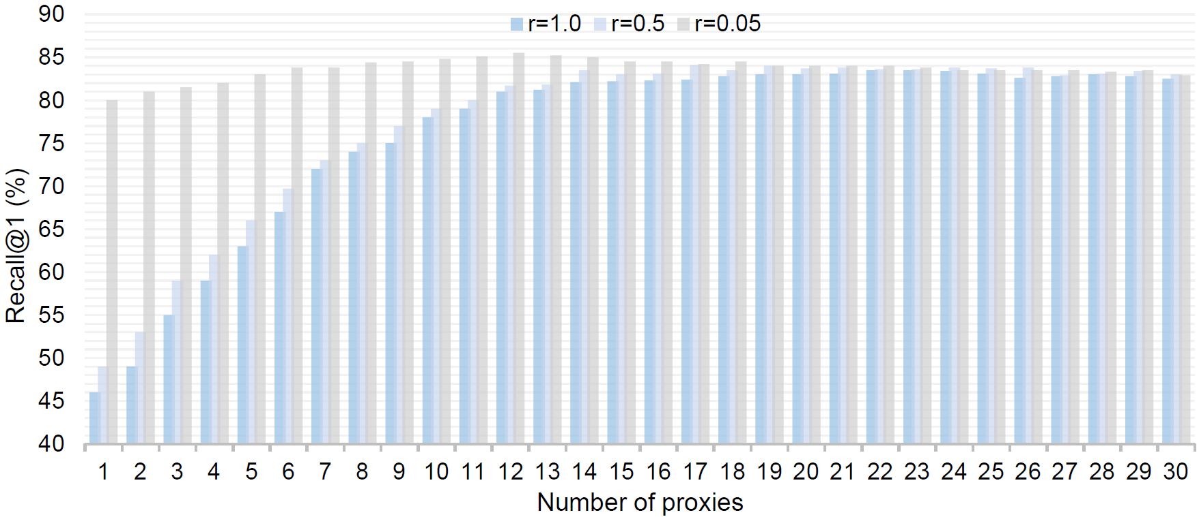
Experiments
Ablation study of N under three different r
(N means the number of proxies assigned to each class )
Notes:
We also investigate the impact of the number of selected proxies, which is actually controlled by N and r. Specifically, N means the number of proxies assigned to each class

Slide 16
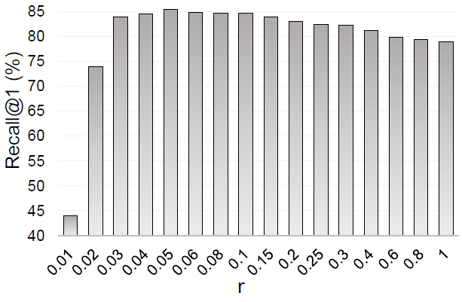
Experiments
Ablation study of r
( implies the scale of the graph)
r
Notes:
and r means the scale of the graph.

Slide 17
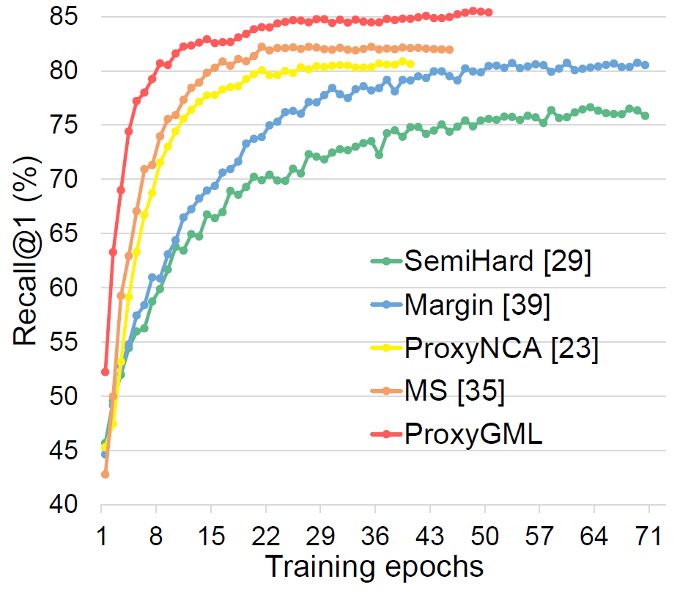
Experiments
Training convergence curve of image retrieval task on the Cars196 dataset
Notes:
ProxyGML converges faster with better performance as shown in the training convergence curve.

Slide 18
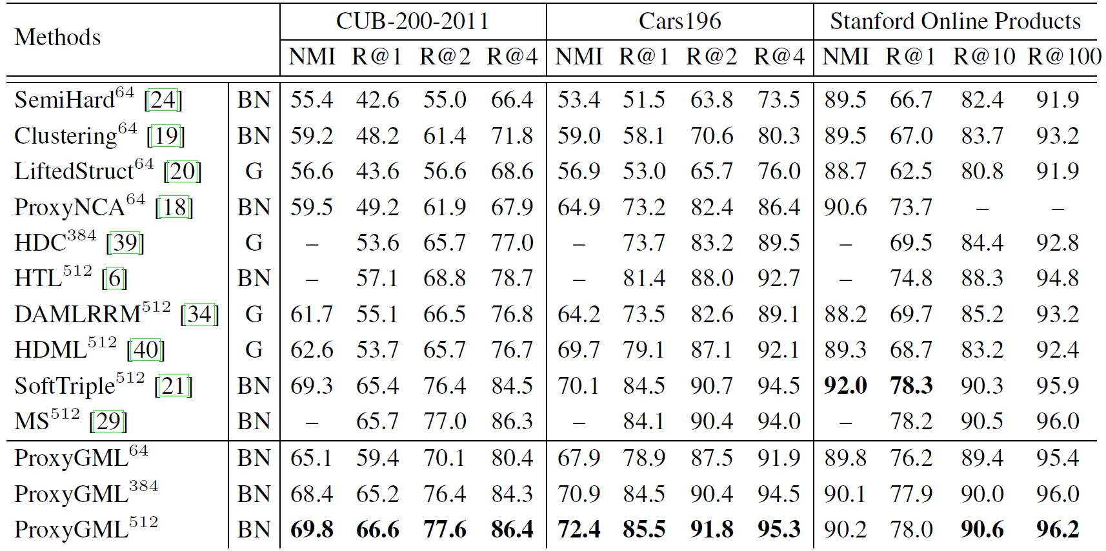
Experiments
Comparison with SOTAs
Notes:
And our method generally outperforms the state-of-the-art methods on three widely-used benchmarks: CUB-200-2011, Cars196, and Stanford Online Products.

Slide 19

Fewer is More: A Deep Graph Metric Learning
Perspective Using Fewer Proxies
Fewer is more!
Fewer proxies yield more efficacy!
Feel free to contact us via
yhzhu.vip@gmail.com
Code is released at https://github.com/YuehuaZhu/ProxyGML
Notes:
Fewer is more! That means in this work that fewer proxies yield more efficacy! Thank you for your watching!

