Slide 1
Popcorn
STAT571B Project
Spring 2016
Jimmy Thornton & Ken Youens-Clark

Slide 2
Design
Factorial

Slide 3
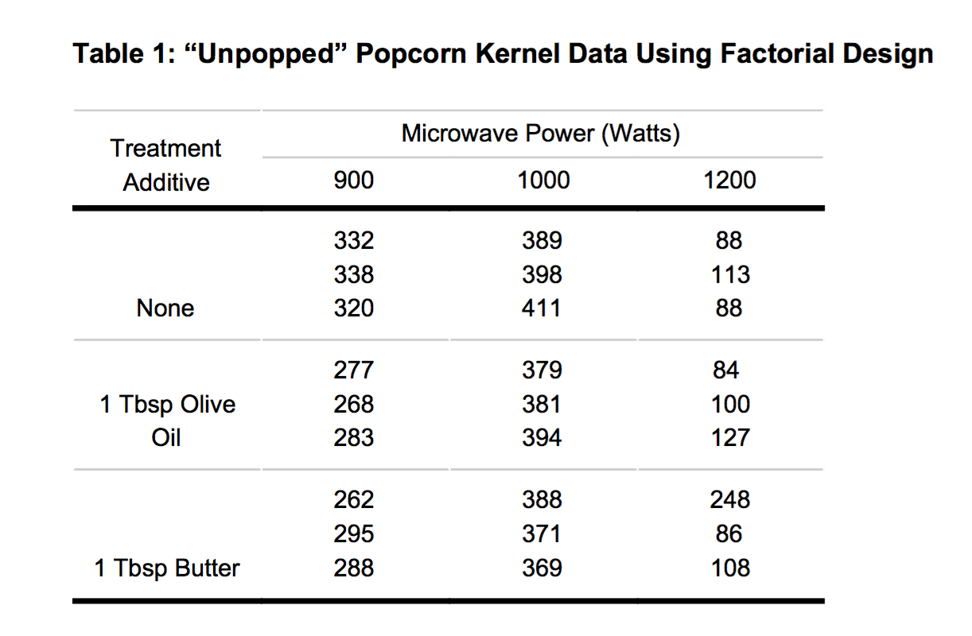
Data

Slide 4
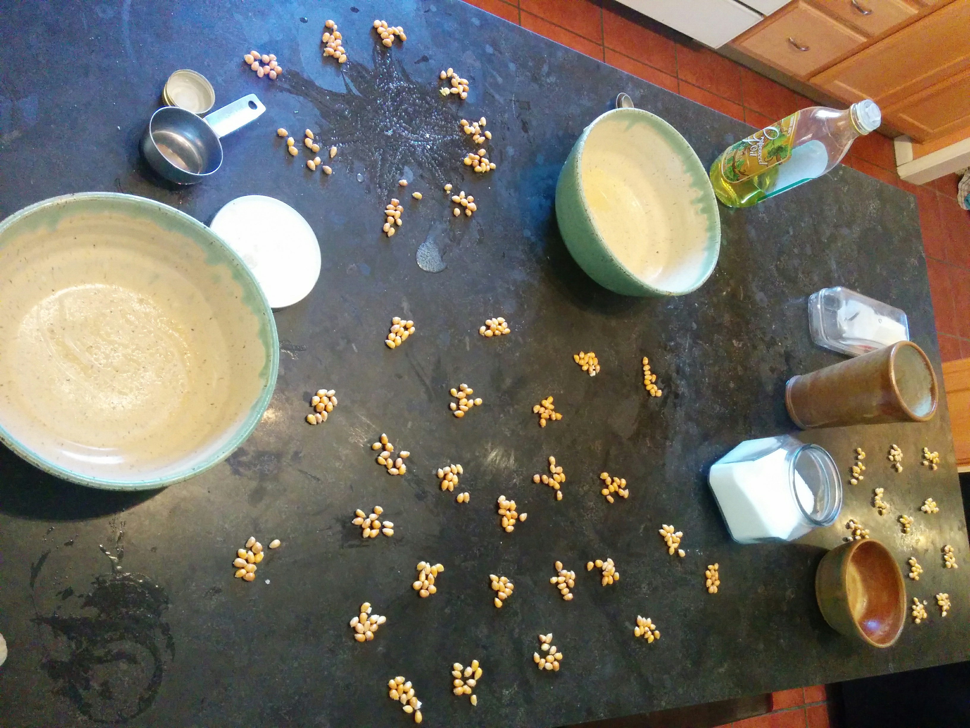
Counting

