Slide 1

Microwave Popcorn
STAT571B Project
Spring 2016
Jimmy Thornton & Ken Youens-Clark

Slide 2
Design
RCBD

Slide 3
Microwaves
1200W was ~1yo; newest, highest power, best performance
Older, less powerful had much worse outcomes
All ovens used a turntable

Slide 4
Potential Errors
Differences in ¼ cup ~ 400 kernels
Do older ovens work properly/can we trust wattage?

Slide 5
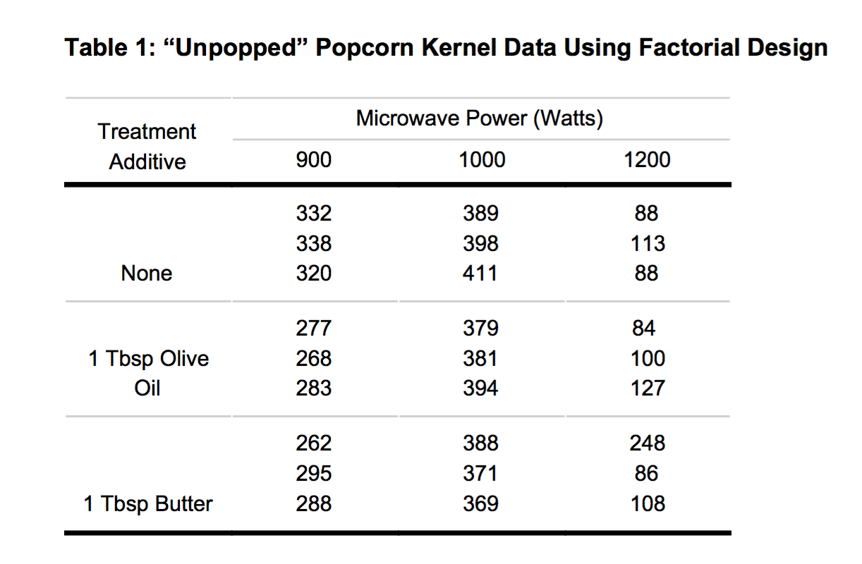
Data

Slide 6
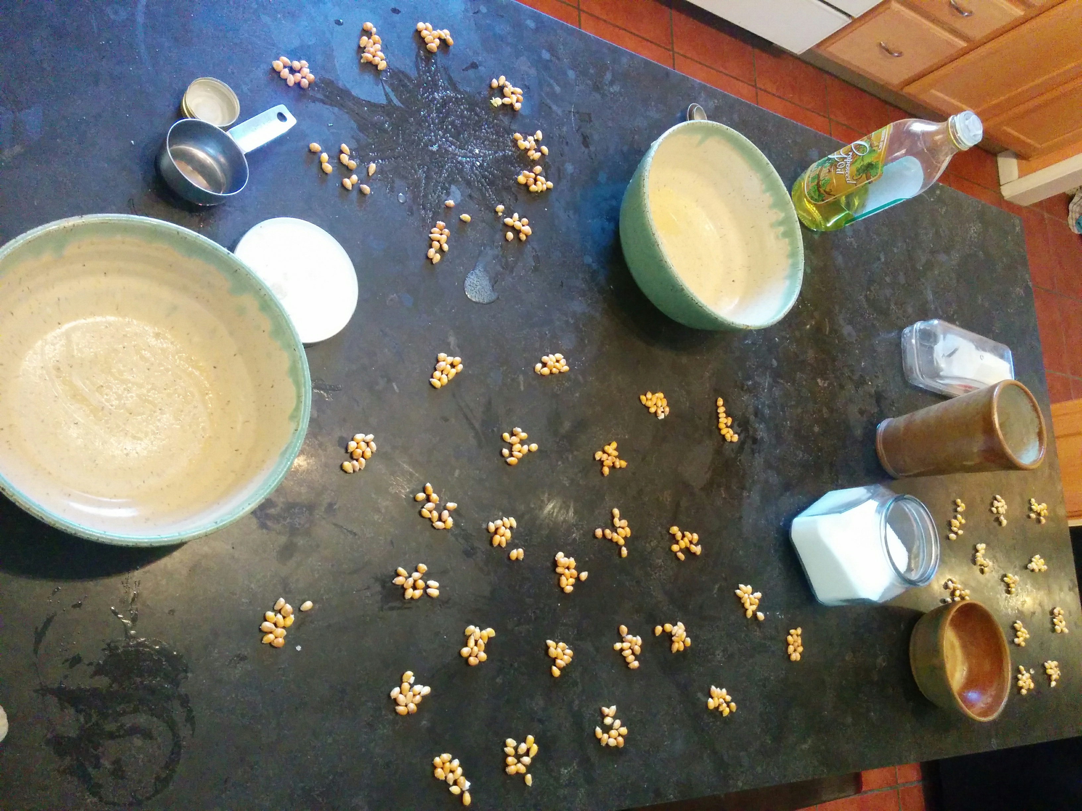
Counting

Slide 7
Calculations
unpopped = c(332,338,320,389,398,411,88,113,88,277,268,
283,379,381,394,84,100,127,262,295,288,388,371,369,248,86,108)
additive = c(rep("none", 9), rep("olive", 9), rep("butter", 9))
power = rep(c(rep("900", 3), rep("1000", 3), rep("1200", 3)), 3)
dat = data.frame(additives, power, unpopped)
mod = aov(unpopped ~ additive * power, dat)
options(show.signif.stars=FALSE)
summary(mod)
Df Sum Sq Mean Sq F value Pr(>F)
additive 2 1948 974 0.793 0.465
power 2 342184 171092 139.311 3.22e-13
Residuals 22 27019 1228

Slide 8
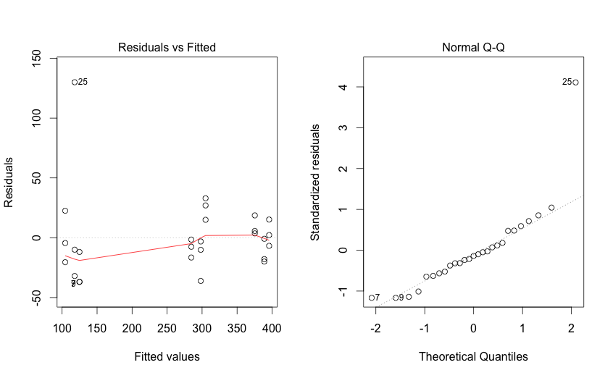
Normality

Slide 9
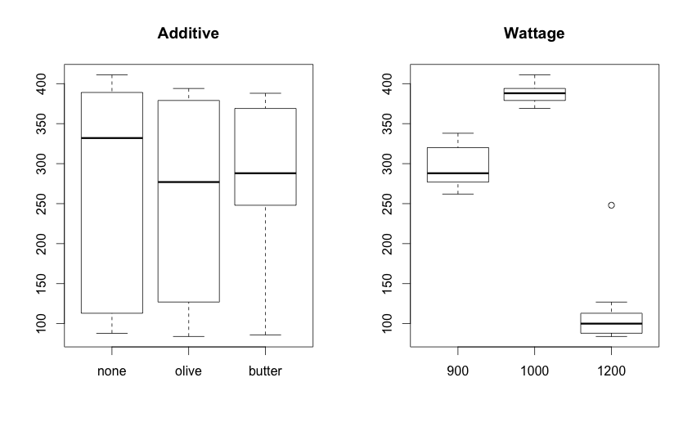

Slide 10
Conclusions
Fat didn’t make a difference (not expected)
MOAR POWR == MOAR KORN (expected)
Extremely large differences in microwaves

Slide 11
Recommendations
¼ cup kernels
paper bag
1 tbsp fat for flavor* (optional), salt
~1.5 minutes on high (until popping stops)
* be careful not to burn butter

