Slide 1


GUEss me
領先創新·超越自我
2019 Synopsys ARC AIoT Design Contest
蕭可宣 楊佳迎

Slide 2
AGENDA
Idea --------------------------------------------- 1 - 3
Implementation ----------------------------- 4 - 7
Difficulties and Innovative ---------------- 8 - 9
Summary -------------------------------------- 10

Slide 3
WHY THIS IDEA?
Tried to dry cloth but it remains damp after some period?
Tried to find a cloth or hanger but couldn't found?
Forget to collect your clothes and let outside for days?
Have You Ever ?!

Slide 4
BIG CONCEPT
Adjust the cloth to ensure the largest exposed surface area of the cloth to the sunlight.
The fastest way to figure out the location of the cloth or hanger.
Time to record the drying time of the cloth.
Reminder to collect the cloth.

Slide 5




technology
Smart Product
Database
Eco-Friendly
Simplicity

Slide 6
REQUIRED HARDWARE
ARC IOTDK
Buzzer
Light Sensor
Galvanized Wire
GPS Module
Humidity Sensor
Reed Switch and Magnet
Stepper Motor and Driver
Wifi Module

Slide 7
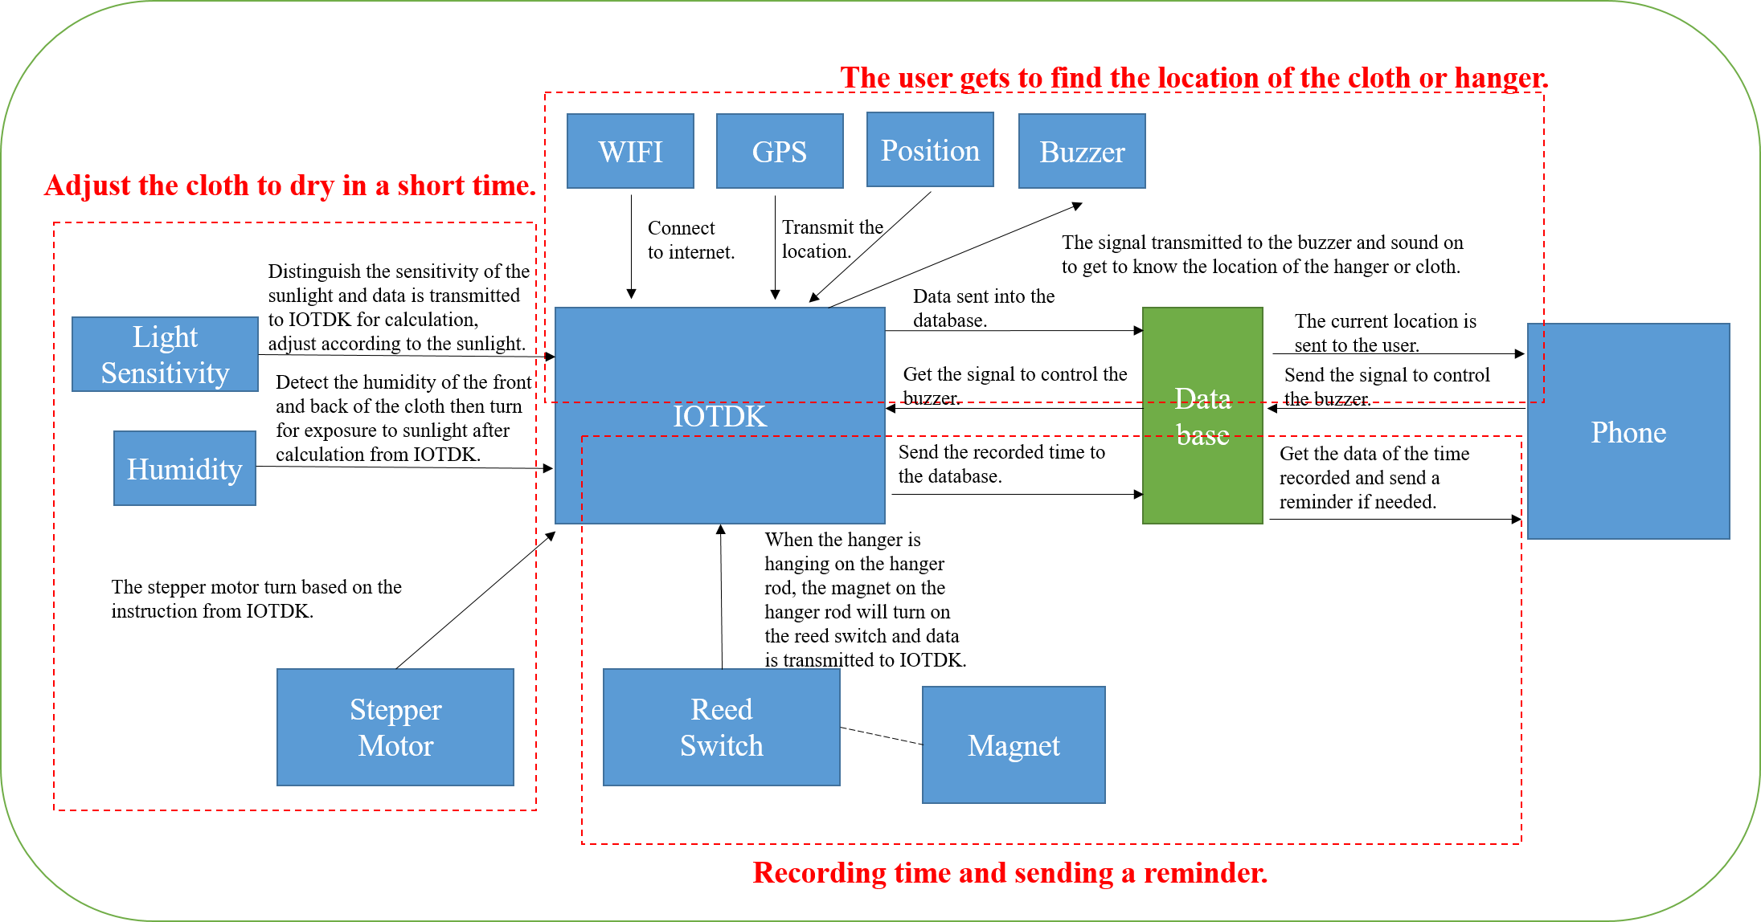
SYSTEM ARCHITECTURE

Slide 8
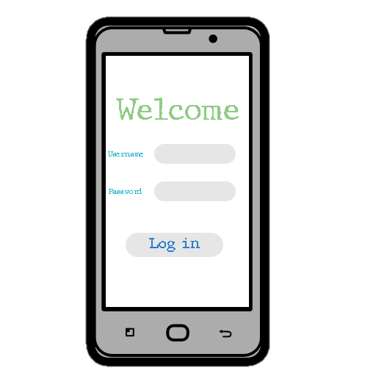
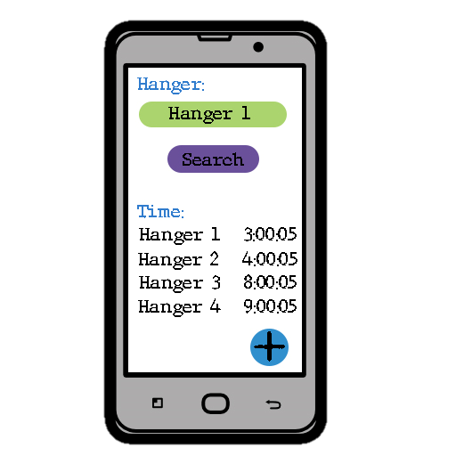
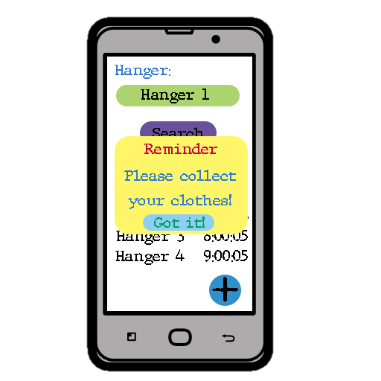
Software IMPLEMENTATION

Slide 9
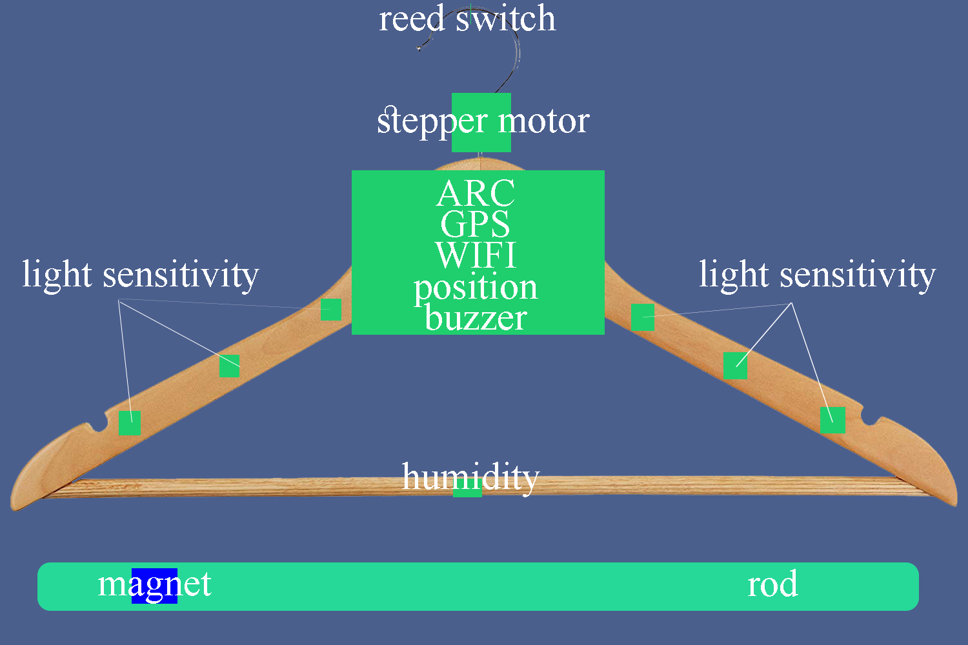
Basic implementation Diagram

Slide 10
DIFFICULTIES
Searching information on ARC IOTDK Board.
- The information on the internet for the board is insufficient.
Data collections.
- The data collected by the sensors and modules are affected by the environment causes the data inaccurate.
Direction of the hanger.
- The direction of the hanger is difficult to determine.

Slide 11
FUNCTION & INNOVATIVE
Turning hanger according to sunlight
To ensure the cloth expose to the largest surface area under sunlight.
Location of hanger or cloth
To get the current location of hanger or cloth using phone apps.
Time recorded and reminder
User can view the time recorder for the drying cloth through phone apps and get a reminder once it's more than some period of time.

Slide 12
SUMMARY & IN FUTURE
Location of hanger or cloth
Adjustment of hanger
User friendly – phone app
Machine learning
Data collection from the internet
Improve accuracy

Slide 13
Thank You!

