Slide 1
COURSE: CSE0613121 OBJECT ORIENTED PROGRAMMING
Instructors :
→ Safayet Hossain
→ Rafat Ara
Team Swans :
→ Kazi Rabit Jahir (1006)
→ Jahid Hasan (1005)
→ Fozlay Elahi Nayeem (1028)
→ Section: 2A
Presentation topic :
Bank Management System

Slide 2
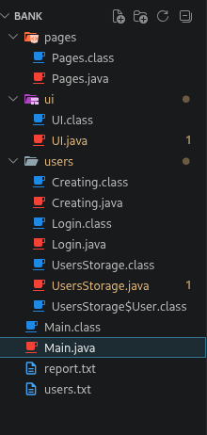
Bank Project - Comprehensive Analysis Report
A Java-based Banking System

Slide 3

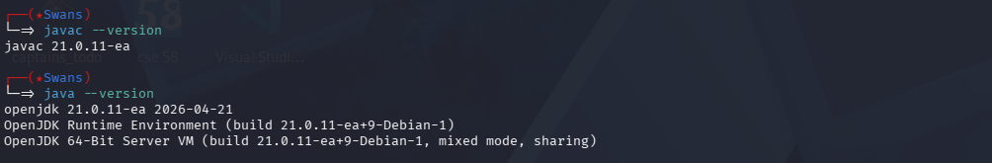

Project Overview
A Java-based banking system that allows users to create accounts, login, and manage their finances including deposits, withdrawals, loans, and account details.

Slide 4

Packages Used
Core Java Packages
Custom Packages
java.text.NumberFormat
java.util.Locale
java.util.Scanner
java.util.HashMap
java.io.FileWriter
java.io.BufferedReader
java.io.FileReader
pages (Pages.java)
ui (UI.java)
users (Login.java, Creating.java, UsersStorage.java)

Slide 5
Project Architecture
LOGIN LOOP (Initial)
User selects Login/Create/Exit
Validates credentials
Loop breaks after successful login
Uses switch-case navigation
USER HUB LOOP (After Login)
Provides 8 operations
Runs until Exit selected
Uses switch-case routing
Data Persistence
Users stored in HashMap and persisted to users.txt
Format: username,password,accountType,mobile,balance,loan
Loads on startup
Saves after updates

Slide 6


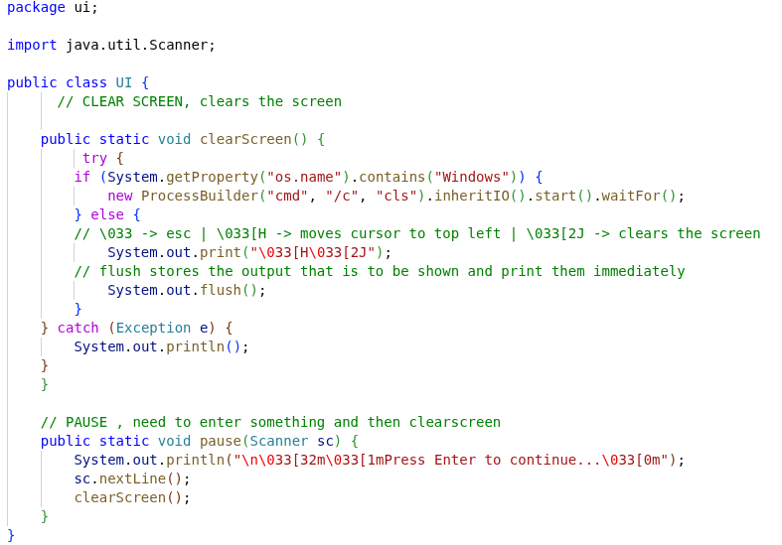
UI Utilities
clearScreen()
pause(Scanner sc)
Clears console for clean display, Platform-aware (Windows: cls, Linux/Mac: ANSI codes), Called before each menu.
Waits for Enter key, Auto-clears screen after pause, Used between menu transitions.
Color Formatting
ANSI codes are used for color formatting:
Green (success)
Red (error)
Blue (balance)
Bold (emphasis)

Slide 7
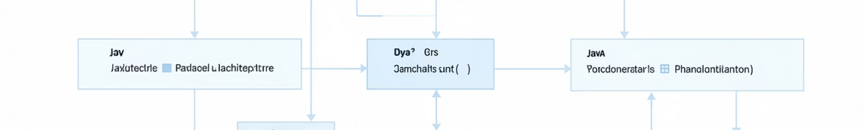

Core Classes Overview
This section provides a detailed look at the core Java classes that form the backbone of the banking system, outlining their primary responsibilities and method counts.
Main.java
Pages.java
Entry point, manages LOGIN and USER HUB loops. (1 method)
UI screen layouts. (5 methods)
UI.java
Login.java
Reusable utilities for display. (2 static methods)
Authentication logic for user sign-in. (1 method)
Creating.java
UsersStorage.java
Account creation functionality. (1 method)
Core data manager for user information and persistence. (10 methods)

Slide 8
UsersStorage.java - Core Data Management
1
2
INNER CLASS
MAIN CLASS
User
UsersStorage
Defines the structure for individual user accounts.
Manages user data, persistence, and core banking operations.
username: String
password: String
accountType: String
mobile: String
balance: Double
loan: Double
Field: HashMap (stores user data in memory)
Public Methods (9):
saveToFile(): Persists user data to a file.
loadFromFile(): Loads user data from a file.
login(): Authenticates user credentials.
balance(): Retrieves a user's account balance.
loan(): Manages a user's loan information.
updateBalance(): Adjusts a user's account balance.
updateLoan(): Modifies a user's loan status/amount.
getUser(): Retrieves a specific user's details.
createUser(): Registers a new user account.

Slide 9

File Persistence & Data Flow
FileWriter Usage
FileWriter is used in UsersStorage.saveToFile()
Utilizes try-with-resources for efficient resource management
Overwrites users.txt on each save
Iterates through HashMap to save all user data
Each user's data is stored in a comma-separated format
When saveToFile() is Called
After account creation
After taking loan
After repaying loan
After withdrawal
After deposit
Error Handling
Catches IOException during file operations
Displays success/error messages to the user
Data Loading
Uses BufferedReader and FileReader to read user data
Reads line-by-line from users.txt
Splits data by comma delimiter
Validates that each line contains 6 fields
Converts relevant fields to numeric types

Slide 10
Key Features & Constraints
Account Features
Transaction Features
Validations
✅ Multiple account types (personal, saving, rich, wealthy)
✅ Account details stored
✅ All data persisted to text file
Check Balance
Take Loan
Repay Loan
Withdraw
Deposit
View Details
Transfer
Username (unique, non-empty)
Password (non-empty)
Mobile (digits only)
Account Type (4 valid types)
Loan Amount ($100-$50,000)
Withdrawal (maintains $100 minimum)
Deposit/Repay (no negatives)

Slide 11
Project Strengths & Improvements
Strengths
Potential Improvements
Clear separation of concerns
Transaction history/logging
Interest calculation for loans
Database instead of text file
Password encryption
User session management
More robust error handling
Deposit/Withdrawal history tracking
Persistent data storage
Input validation with regex
User-friendly with colored output
Error handling for file I/O
Try-with-resources for resource management

Slide 12

Summary
This comprehensive analysis report details a Java-based banking system with robust architecture, clear separation of concerns, and persistent data management. The system successfully implements core banking operations with proper validation, error handling, and user-friendly interfaces. With 19 total methods across 6 classes, the project demonstrates solid software engineering principles and provides a strong foundation for future enhancements.
Thank you for reviewing our project. We believe this system provides a robust and scalable foundation for all banking operations.

