Slide 1
Packet Capture with Pingplotter

Slide 2
Preparation
Install Wireshark
Freeware from https://www.wireshark.org/
Install Pingplotter
Download a copy from www.bb.ustc.edu.cn
14 days trial
You can use it to perform traceroute, and configure things like packet size, transfer interval, etc.
Graphic output for network metrics

Slide 3
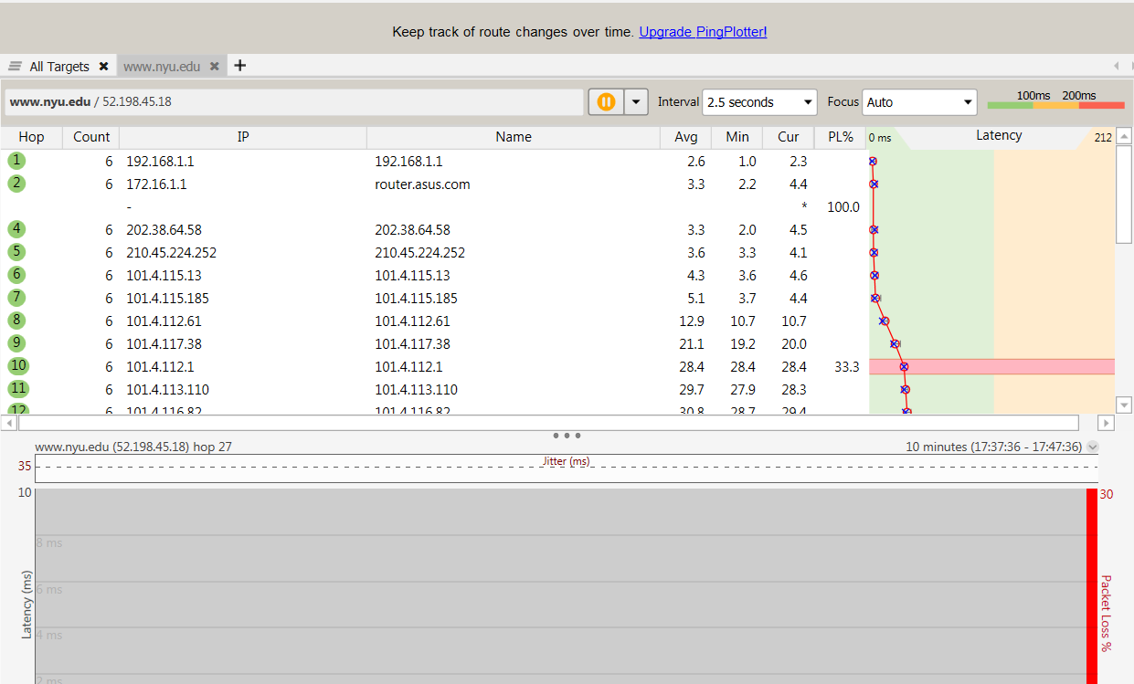
Preparation

Slide 4
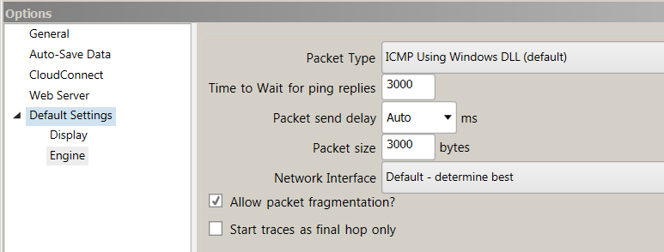
Packet Capture
Set packet size as 3000 bytes
Menu→edit→options
Keep “Allow packet fragmentation” checked

Slide 5
Packet Capture
Traceroute to gaia.cs.umass.edu, stop when the count is 3 or 4.
Meanwhile, capture the packets with wireshark

Slide 6
Questions
Find the first ICMP Echo Request packet that has TTL=1, is this packet being fragmented? If yes, how many fragments?
How the packed is fragmented and resembled? For each fragment, how to tell if it is the last fragment, and how many bytes are contained in each fragment? Print the packets and answer by highlighting the relevant fields.
What packet is returned from the router when TTL expires? What is contained in the payload of the packet?

Slide 7
Questions
Which link crosses the Pacific, give the router addresses at the two ends of the link. Explained your reason.
How long is the trans-Pacific link? (given that a bit transmits 2*10^8 m/s in fiber).

Slide 8
Submission
Submit to bb.ustc.edu.cn
The packet trace you have captured.
Your answers to the questions.

