Slide 1
Title: Comparison of Various Classification Algorithm on IRIS Dataset using WEKA Presented By: Md. Riasad Rahman (2014-2-60-045) Md. Golam Rabby (2014-2-60-059) Nazmul Hasan (2014-2-60-063)

Slide 2
WEKA
 Machine learning/data mining software written in Java (distributed under the GNU Public License)
 Java package - Collection of ML Algorithms
 Main features:
 Comprehensive set of data pre-processing tools, learning algorithms and evaluation methods
 Graphical user interfaces (incl. data visualization)
 Environment for comparing learning algorithms

Slide 3
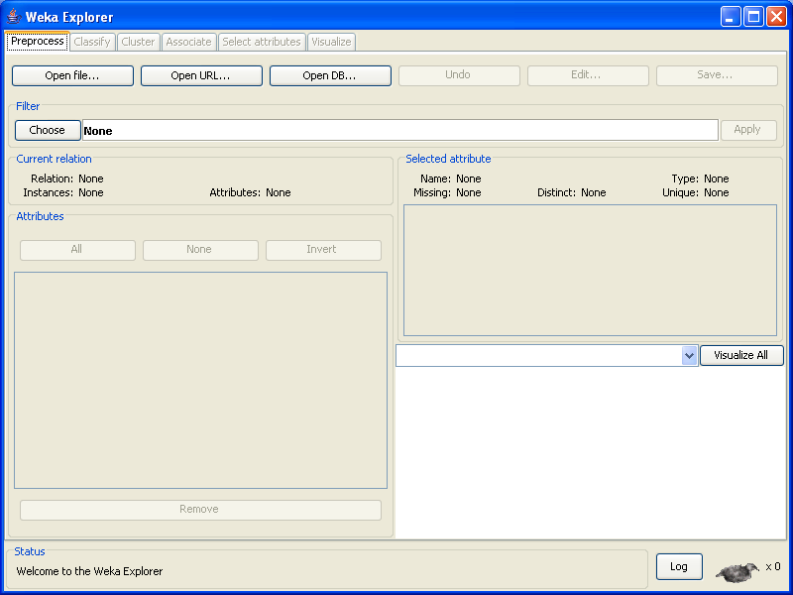
The Explorer
 Gives access to all facilities of Weka using menu selection and form filling
 Prepare the data, open the Explorer and load the data
 Flip back and forth between results, evaluate models built on different datasets and visualize graphically both and models and datasets, including classification errors

Slide 4
Preparing the data
--- Predicted attribute: class of iris plant.
--- This is an exceedingly simple domain.
Number of Instances: 150 (50 in each of three classes)
Number of Attributes: 4 numeric, predictive attributes and the class Attribute Information:
1. sepal length in cm
2. sepal width in cm
3. petal length in cm
4. petal width in cm
5. class:
-- Iris Setosa
-- Iris Versicolour
-- Iris Virginica
Missing Attribute Values: None

Slide 5
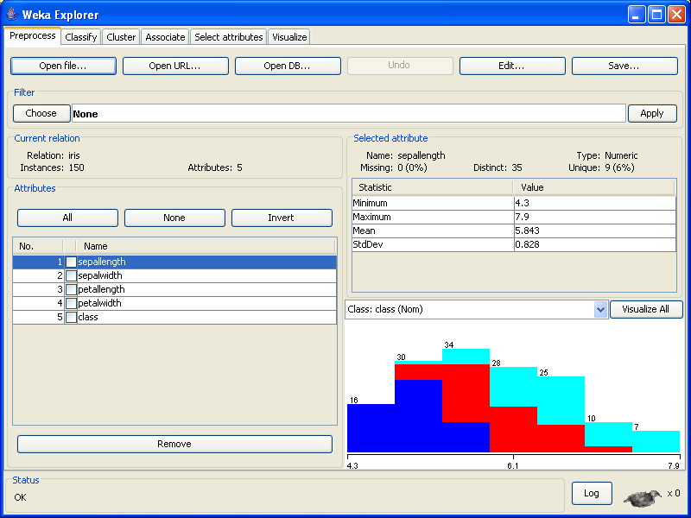
Loading the data
 For example, open the Iris data to find the following screen
 You'll notice that Weka now provides some information about the data, such as for example the number of instances, the number of attributes, and also some statistical information about the attributes one at a time
 The six tabs along the top are the basic operations that the Explorer supports

Slide 6
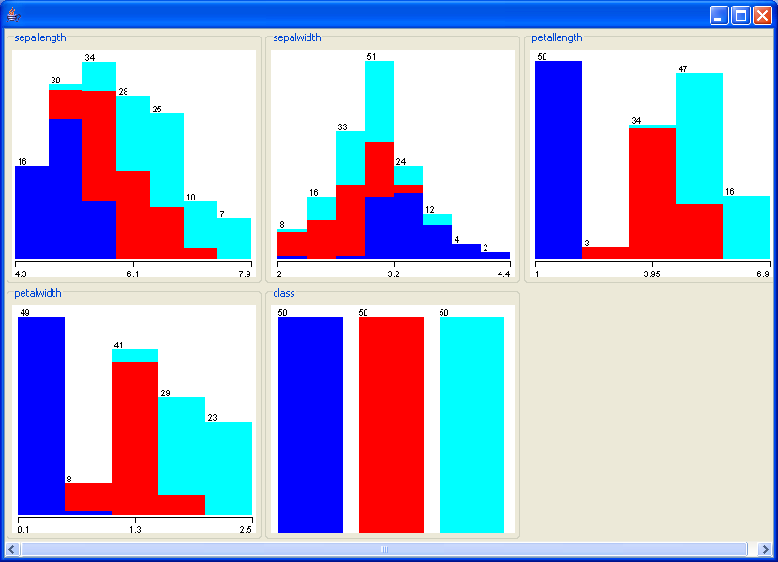
Visualizing the data
 The main GUI will show a
histogram for the attribute distributions for a single
selected attribute at a
time, by default this is the class attribute
 Note that the individual colors indicate the
individual classes (the Iris dataset has 3)
 If you move the mouse over the histogram, it will
show you the ranges and
how many samples fall in each range
 The button VISUALIZE ALL will let you bring up a
screen showing all
distributions at once as in the picture below

Slide 7
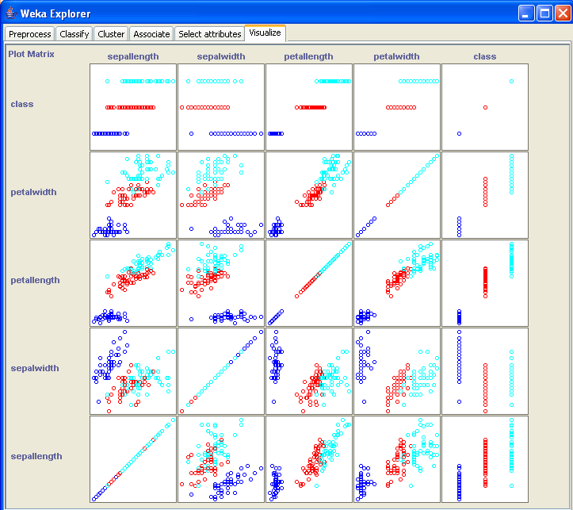
Visualizing the data (contd.)
 There is also a tab called called VISUALIZE which can be used to obtain the scatterplots for all attribute pairs
 In the picture we can see that in some examples the clusters and the different colors correspond to each other such as for example in the plots for class/(any attribute) pairs and the petalwidth/petallength attribute pair, whereas for other pairs (sepalwidth/sepallength for example) it's much hader to separate the clusters by color.

Slide 8
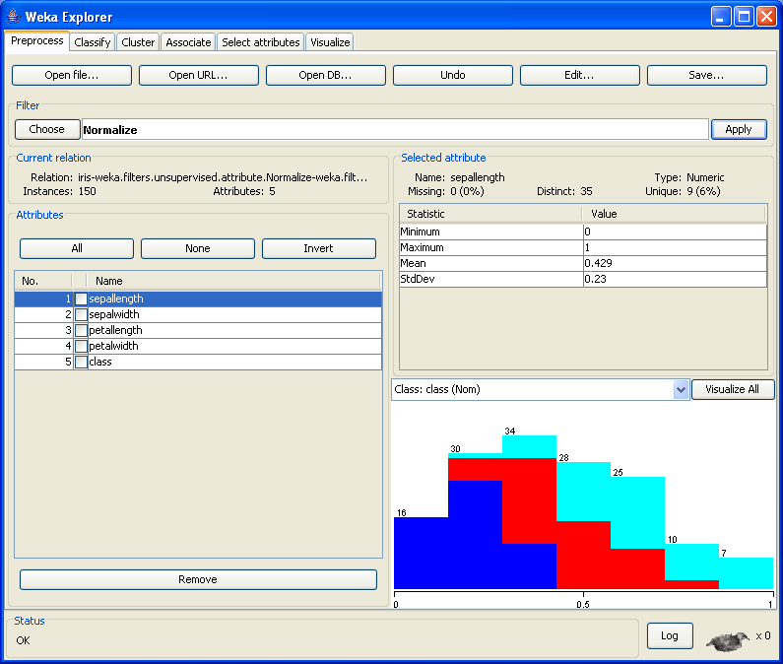
Filters
 Pre-processing tools in WEKA are called “filters”
 To apply a filter, you first
have to select which type of filter you'd like by
clicking on the CHOOSE button right underneath Filter
 WEKA contains filters for:
 Discretization
 Normalization
 Resampling
 Attribute selection
 Combining attributes
 Transforming, …

Slide 9
Classification
 Clicking on the classifier tab after loading a dataset into Weka and selecting the choose tab will bring up a menu with a number of choices for the classifier that is to be applied to the dataset
 Note that you have 4 options on how to test the model you're building: Using the training set, supplied test set (you will need to specify the location of the test set in this case), cross validation and a percentage
 The achieved accuracy of your model will vary, depending on the option you select. One pitfall to avoid is to select the training set as a test set, as that will result in an underestimate of the error rate
 The resulting model with a lot of additional information will be displayed after you click on start. What exactly is contained in the output can be determined under options.

Slide 10
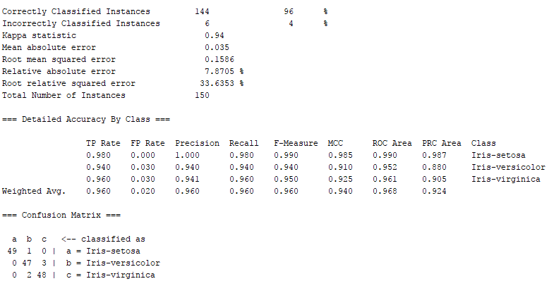
Classification (Decision tree)
 A sample output for applying the J48 decision tree algorithm to the Iris dataset is shown in the Figure
 The confusion matrix is displayed, as this gives a lot more information than just the prediction accuracy.

Slide 11
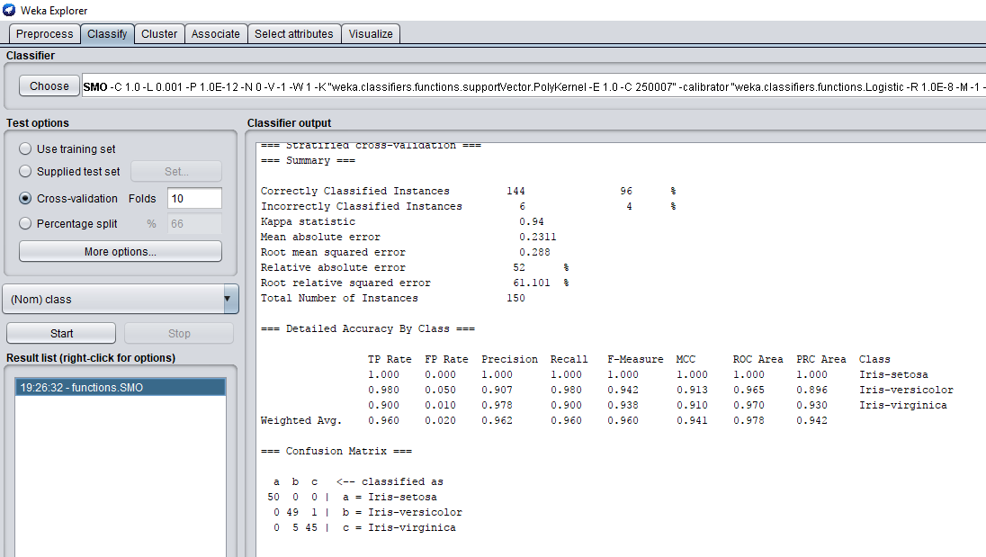
Classification (SVM)
A sample output for applying the SMO for SVM algorithm to the Iris dataset is shown in the Figure
 The confusion matrix is displayed, as this gives a lot more information than just the prediction accuracy.

Slide 12
Comparison between decision tree and SVM:
Error List | Decision tree | SVM
Kapa statistic | 0.94 | 0.94
Mean absolute error | 0.035 | 0.2311
Root mean squared error | 0.1586 | 0.288
Relative absolute error | 7.8705% | 52%
Root relative squared error | 33.6353% | 61.101%
Total number of instance | 150 | 150

Slide 13
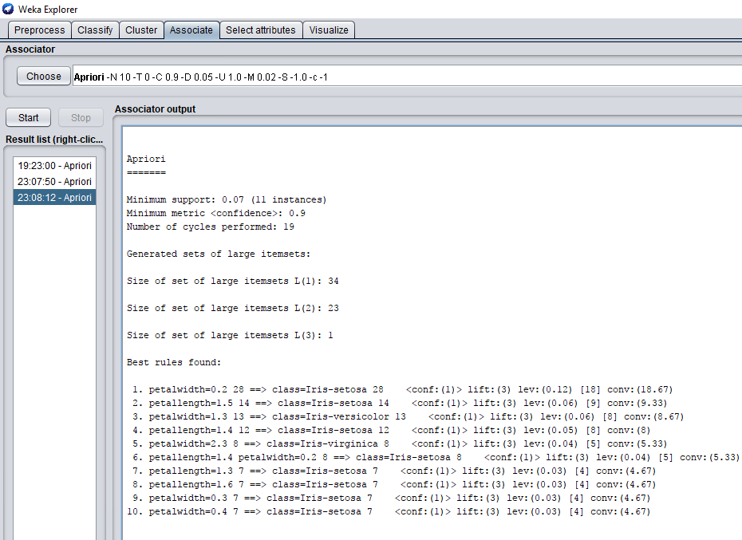
Association Rules for APRIORI
 Weka also provides algorithms to extract association rules from non- numerical data as shown in the picture

Slide 14

Machine Learning

