Slide 1
Workshop: Creating a bot
Rabeb Othmani

Slide 2
Welcome to the age of conversational interfaces
Desktop
Browser
Mobile

Slide 3
Welcome to the age of conversational interfaces
Click
Touch
Converse

Slide 4
Bots
Rapidly becoming an integral part of digital experiences
Essential to interact with a service or an application

Slide 5
What is a bot?
Application
Conversational interface
Contextual communication

Slide 6


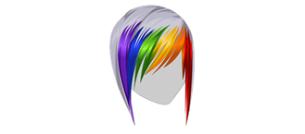
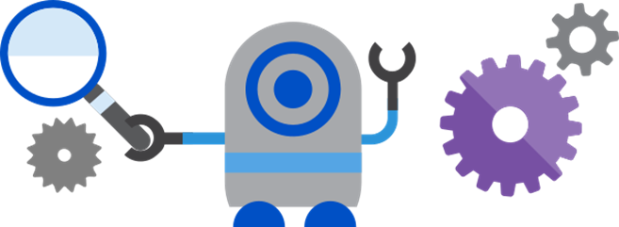
Microsoft Bot Framework
Channel (Cortana for example)
Conversations
Register
Users
Invoke
Developer
Build & Deploy
Bot

Slide 7
Concepts
Channel: the connection between the bot framework and communication apps such as slack, Messenger etc.
Bot connector: the service that connects the bot to one or more channels
Activity: Any communication going back and forth between the bot and the channel
Message: a type of activity, it could be a text or image etc
Dialog: helps organize the logic in your bot and manages conversation flow.

