Slide 1

Recommendation System for Amazon product co –purchasing network
SNA Project
Rabel Safina

Slide 2
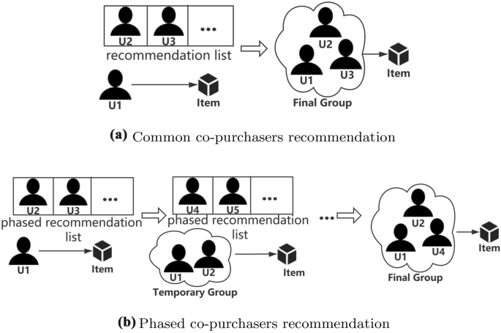
Recommend- -ations for item

Slide 3
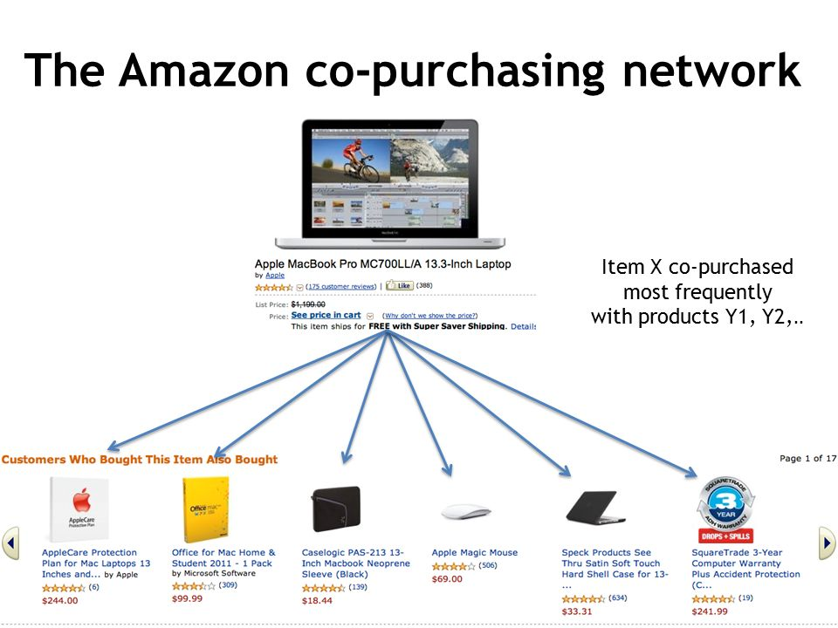
Amazon’s Network

Slide 4
Background: Viral Marketing
Viral marketing exploits existing social networks by encouraging customers to share product information with their friends.
It has been difficult to measure how influential person-to-person recommendations actually are over a wide range of products.
Although word-of-mouth can be a powerful factor influencing purchasing decisions, it can be tricky for advertisers to tap into.
It is human nature to be more interested in what a friend buys than what an anonymous person buys and to be more likely to trust their opinion and be more influenced by their actions. As one would expect, our friends are also acquainted with our needs and tastes and can make appropriate recommendations.

Slide 5
Recommendation Program
The recommendation dataset consists of 15,646,121 recommendations made among 3,943,084 distinct users. The data was collected from June 5, 2001, to May 16, 2003. In total, 548,523 products were recommended, 99% of them be-longing to 4 main product groups: books, DVDs, music and videos. In addition to recommendation data, we also crawled the retailer’s Web site to obtain product categories, reviews, and ratings for all products.

Slide 6
Dataset
Metadata
The data was collected by crawling Amazon website and contains product metadata and review information about 548,552 different products (Books, music CDs, DVDs and VHS video tapes).
Amazon product co-purchasing network
Network was collected by crawling Amazon website. It is based on Customers Who Bought This Item Also Bought feature of the Amazon website. If a product i is frequently co-purchased with product j, the graph contains a directed edge from i to j.

Slide 7
Metadata Dataset
Id: Product id (number 0, ..., 548551)
ASIN: Amazon Standard Identification Number
title: Name/title of the product
group: Product group (Book, DVD, Video or Music)
Sales rank: Amazon Salesrank
similar: ASINs of co-purchased products (people who buy X also buy Y)
categories: Location in product category hierarchy to which the product belongs (separated by |, category id in [])
reviews: Product review information: time, user id, rating, total number of votes on the review, total number of helpfulness votes (how many people found the review to be helpful)

Slide 8
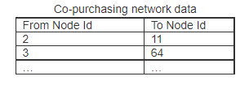
Co-Purchasing Dataset
Edges show co-purchasing links between products. Actually it is better to use arrow rather than straight line as co-purchasing network is directed. Customers who bought x also bought y.

Slide 9
Aims of My Project
To find Customers who bought x also bought y.
To recommend a customer to buy a particular product with another product.

Slide 10
Implementation Of Project
Language
I will use Python for coding and will do it in jupyter notebook
Libraries in Python I will use:
Networkx for constructing graphs of similar users
Pandas for data analysis
Matplotlib for visualizing the data.

Slide 11
Summary
In this project, I will built a product co purchasing recommendation system that makes recommendations given the product name as input.
The recommendation based on similar users who bought x and also y.
The products the one person has bought that other person have not bought yet can be recommended to him/her
My product co purchasing project work by suggesting products to the person based on metadata.
The similarity between the buyers are calculated in last and is used for recommendations.

Slide 12
Thanks

