Slide 1
Urdu Headlines Text Classification Using Logistic Regression
Rabel Safina
Aatiqa Batool

Slide 2
Introduction
Nowadays on the Internet there are a lot of sources that generate immense amounts of daily Urdu news. In addition, the demand for information by users has been growing continuously, so it is crucial that the news is classified to allow users to access the information of interest quickly and effectively.
This way, the machine learning model for automated news classification could be used to identify topics of untracked Urdu news and/or make individual suggestions based on the user’s prior interests.
Thus, our aim is to build models that take as input Urdu news headline and short description and output Urdu news category.

Slide 3
Our Dataset
Our corpus contains 111860 new words of 4 categories with (Business & Economics, sports, Entertainment, Science & Technology)
We downloaded our dataset from Mendeley website on Urdu news heading. After collecting our dataset, we pass it on preprocessing techniques to filter our data. Then finally we apply different machine learning algorithm to train our Urdu dataset.

Slide 4
Methodology
Our methodology contains a step-wise procedure; we started from the Urdu language corpus collection and then used some preprocessing techniques for features selection to apply actual classification algorithms.
We write multiple crawlers to collect data from different news websites, e.g., bbcurdu.com, arynews and urdupoint.com.
In total, we collected 141289 words, categories are as follow: Business & Economics, Entertainment, sports, Science & Technology.

Slide 5
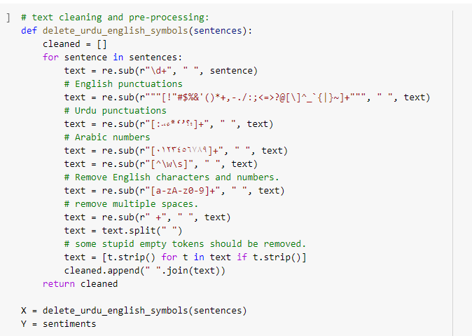
Preprocessing
Stop Words Removal:
The words which are either not useful for the proposed classification models or used as prepositions are included in the stop words list. In our case, we maintained a list of stop words to omit from our text to extract meaningful data for the classifiers.

Slide 6
Preprocessing
Feature Selection:
Feature selection is an important part of building machine learning models. We will be using the chi square test of independence to identify the important features.
After all preprocessing techniques, we then implement our dataset on machine learning algorithm. We divide our dataset into training 80% and testing 20%.

Slide 7

Results
Logistic regression was predicted as the best solution for this type of classification the output given by the model is stated below (Accuracy, precision, Recall, F1 score).
We found Logistic Regression is best algorithm for text classification that gives almost 93% accuracy to predict our class.

Slide 8
References
https://www.kaggle.com/adnanzaidi/ml-urdu-hindi-news-headline-classification
https://www.koreascience.or.kr/article/JAKO202121055546977.pdf
https://www.researchgate.net/publication/339029343_UrduHindi_News_Headline_Text_Classification_by_Using_Different_Machine_Learning_Algorithms
https://medium.com/analytics-vidhya/bbc-news-text-classification-a1b2a61af903

