Slide 1

SCHOOL OF COMPUTING AND INFORMATION TECHNOLOGY
Major Project Phase-I
Real-Time Cyber Threat Intelligence Platform for Indian Cyberspace
Under the Supervision
Prof. Vijayalaxmi C Handaragall
1
Presented By:
RABI RAHUL(R22EJ117)
T MUKESH (R22EJ143)
NEZIL NASAR (R22EJ170)
DATE: 11.10.2025

Slide 2
Overview
Introduction (Background)
Problem Statement (Motivation)
Objectives
Scope of the Project (Social / Environmental Impact)
Methodology (Approach)
Expected Outcomes (Deliverables)
Target Users
References
Q&A
Thank You

Slide 3
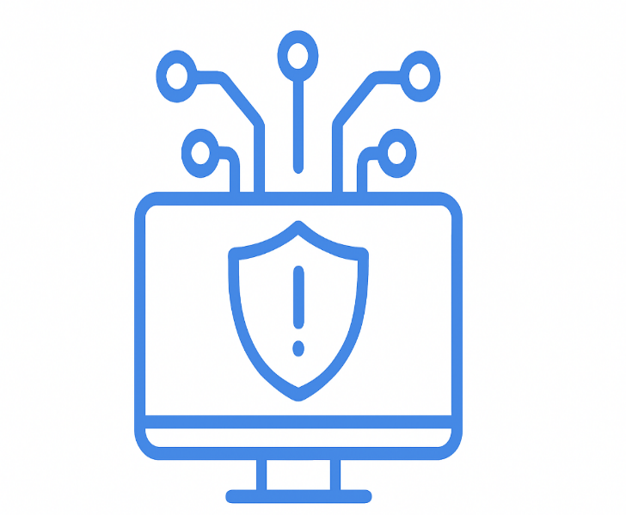

Introduction
India’s rapid digital growth in banking, healthcare, e-commerce, public services, and critical infrastructure increases exposure to cyber threats.
Rising attacks include ransomware, phishing, UPI frauds, data breaches, and exploitation of new vulnerabilities.
Many victims lack awareness of emerging threats due to delayed access to real-time information.
Agencies like CERT-In, NCIIPC, and I4C exist, but public and SMEs still lack a unified, real-time cyber threat platform.
This project builds a Real-Time Cyber Threat Intelligence Platform providing alerts, malicious link detection, and India-focused cybercrime updates.
02

Slide 4
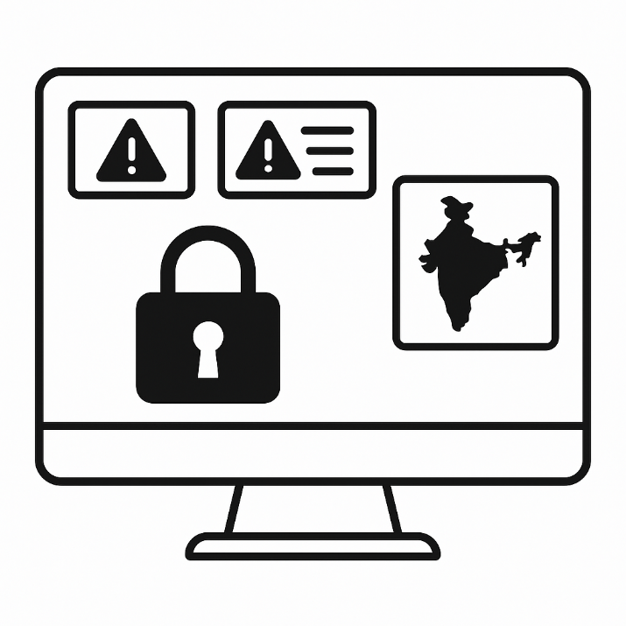
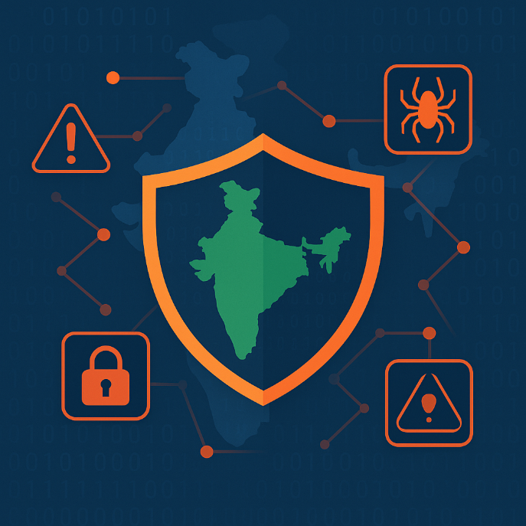
Problem Statement
The absence of a unified, publicly accessible platform that delivers real-time cyber threat alerts, vulnerability disclosures, malicious link detection, and India-specific cyber incident reporting results in delayed response measures and increased exposure to cyberattacks for individuals, organizations, and critical sectors.
02

Slide 5
Scope and Objectives
Primary Objective
To develop a unified real-time cyber threat intelligence platform that provides instant alerts on cyber incidents, vulnerabilities, and malicious activities affecting Indian cyberspace.
Secondary Objectives
Gather and classify threat information from trusted sources and show alerts, news, and trends in a single dashboard based on severity for Indian users.
Provide link-scanning and public reporting tools to detect scams and help users take early action against cyberattacks like data theft, ransomware, and fraud.
Social Impact
Promotes a safer digital environment by increasing public awareness of emerging cyber threats and vulnerabilities.
Supports individuals, small organizations, and critical sectors in preventing cyber frauds, data loss, and service disruptions through early alerts and informed action.
02

Slide 6
Methodology (Approach)
1. Data Collection
Connect to cyber-threat sources and Indian CERT feeds.
Gather incident data in real time.
2. Monitoring Pipeline
Continuously track and filter India-specific incidents.
Maintain a smooth real-time flow.
3. Incident Analysis
Classify incidents by type and severity.
Highlight high-priority alerts.
4. Dashboard
Display live incident updates and trends.
Provide a simple, clear interface.
5. Security
Protect data and follow Indian cyber guidelines.
Ensure safe and compliant operations.
02

Slide 7
Challenges / Risks
1. Data Reliability
Risk: Some feeds may be delayed or incomplete.
Mitigation: Use multiple trusted sources to cross-verify data
.
2. Real-Time Accuracy
Risk: System may detect false positives during high activity.
Mitigation: Add filtering rules and validation checks.
3. Security of the Tool
Risk: Processing cyber-incident data may attract attacks.
Mitigation: Encrypt data and use secure access controls.
4. Scalability
Risk: Large incident volume can slow performance.
Mitigation: Use scalable cloud or distributed processing.
02

Slide 8
Expected Outcomes (Deliverables)
Real-Time Threat Alerts
Instantly alerts users about ongoing cyber incidents and newly discovered vulnerabilities.
Helps organizations and citizens take preventive action before exploitation occurs.
2. Malicious Link Detection
Scans suspicious URLs shared through SMS, email, and social media for phishing and malware.
Reduces online fraud by identifying scam websites before users access them.
3. Unified Cyber Dashboard
Displays vulnerability advisories, cybercrime news, user-submitted threats, and analytics.
Serves as a one-stop platform for monitoring risks affecting Indian cyberspace.
4. Public Threat Reporting
Enables users to report fraud links, scam phone numbers, malicious apps, and phishing emails.
Supports law enforcement and cybersecurity agencies in tracking emerging threats.
5. Improved Security Readiness
Encourages timely patching, threat mitigation, and awareness-driven defense strategies.
Lowers risk of data breaches, ransomware attacks, and financial losses for users.
02

Slide 9
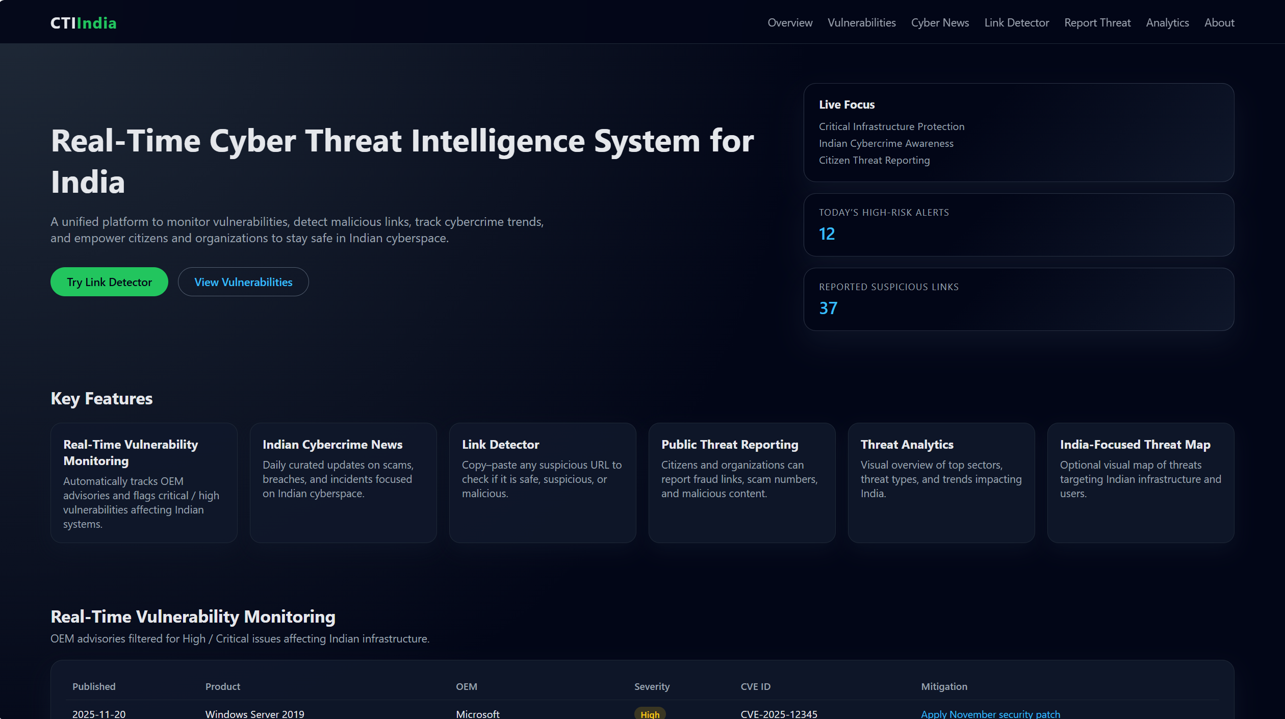

Slide 10
Target (End) User
1. Citizens
Can check suspicious links, avoid scams (UPI, job fraud, phishing), and report threats.
Improves cyber awareness and safe digital practices.
2. Small and Medium Enterprises (SMEs)
Receive timely vulnerability alerts without needing a dedicated security team.
Helps prevent data breaches and ransomware by early patching.
3. Critical Infrastructure Organizations
Sectors like banking, healthcare, power, telecom etc. get high-severity alerts.
Enables faster mitigation and reduces disruption of essential services.
4. Cyber Cells & Law Enforcement
Use reported data to detect scams, trace attacks, and raise public awareness.
Enhances investigation with real-time threat insights.
02

Slide 11
References
CERT-In (2024). Computer Emergency Response Team India – Advisories & Alerts. Ministry of Electronics and Information Technology, Government of India. Retrieved from https://www.cert-in.org.in
NCIIPC (2024). National Critical Information Infrastructure Protection Centre – Threat Reports & Guidance. Government of India. Retrieved from https://www.nciipc.gov.in
Indian Cybercrime Coordination Centre (I4C). (2024). National Cybercrime Reporting Portal. Ministry of Home Affairs, Government of India. Retrieved from https://cybercrime.gov.in
Cyber Swachhta Kendra. (2024). Botnet Cleaning and Malware Analysis Centre. Retrieved from https://www.cyberswachhtakendra.gov.in
National Vulnerability Database (NVD). (2024). Common Vulnerabilities and Exposures (CVE) Reports. Retrieved from https://nvd.nist.gov
Cyble Research. (2024). India Threat Landscape Report 2024. Retrieved from https://cyble.com/resources/research-reports/india-threat-landscape-report-2024
02

Slide 12
Questions?
02

Slide 13

Thank You

