Slide 1
Data Mining:
Concepts and Techniques
— Chapter 1 —
— Introduction —
Jiawei Han and Micheline Kamber
Department of Computer Science
University of Illinois at Urbana-Champaign
www.cs.uiuc.edu/~hanj
©2006 Jiawei Han and Micheline Kamber. All rights reserved.

Slide 2


Slide 3
Data and Information Systems
(DAIS:) Course Structures at CS/UIUC
Coverage: Database, data mining, text information systems and bioinformatics
Data mining
  Intro. to data warehousing and mining (CS412: Han—Fall)
  Data mining: Principles and algorithms (CS512: Han—Spring)
  Seminar: Advanced Topics in Data mining (CS591Han—Fall and Spring. 1 credit unit)
  Independent Study: only if you seriously plan to do your Ph.D. on data mining and try to demonstrate your ability
Database Systems:
  Database mgmt systems (CS411: Kevin Chang Fall and Spring)
  Advanced database systems (CS511: Kevin Chang Fall)
Text information systems
  Text information system (CS410 ChengXiang Zhai)
Bioinformatics
  Introduction to BioInformatics (Saurabh Sinha)
  CS591 Seminar on Bioinformatics (Sinha, Zhai, Han, Schatz, Zhong)

Slide 4
CS412 Coverage (Chapters 1-7 of This Book)
The book will be covered in two courses at CS, UIUC
  CS412: Introduction to data warehousing and data mining (Fall)
  CS512: Data mining: Principles and algorithms (Spring)
CS412 Coverage
  Introduction
  Data Preprocessing
  Data Warehouse and OLAP Technology: An Introduction
  Advanced Data Cube Technology and Data Generalization
  Mining Frequent Patterns, Association and Correlations
  Classification and Prediction
  Cluster Analysis

Slide 5
CS512 Coverage (Chapters 8-11 of This Book)
Mining data streams, time-series, and sequence data
Mining graphs, social networks and multi-relational data
Mining object, spatial, multimedia, text and Web data
  Mining complex data objects
  Spatial and spatiotemporal data mining
  Multimedia data mining
  Text mining
  Web mining
Applications and trends of data mining
  Mining business & biological data
  Visual data mining
  Data mining and society: Privacy-preserving data mining
Additional (often current) themes could be added to the course

Slide 6
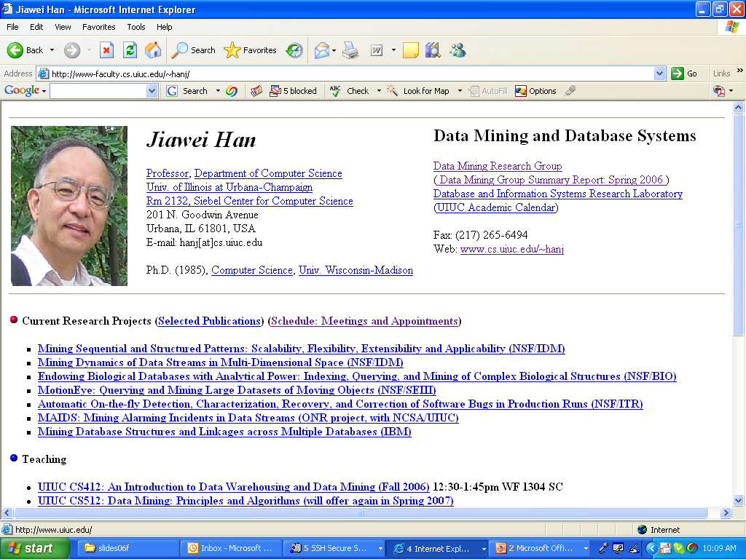

Slide 7
Chapter 1. Introduction
Motivation: Why data mining?
What is data mining?
Data Mining: On what kind of data?
Data mining functionality
Classification of data mining systems
Top-10 most popular data mining algorithms
Major issues in data mining
Overview of the course

Slide 8
Why Data Mining?
The Explosive Growth of Data: from terabytes to petabytes
  Data collection and data availability
    Automated data collection tools, database systems, Web, computerized society
  Major sources of abundant data
    Business: Web, e-commerce, transactions, stocks, …
    Science: Remote sensing, bioinformatics, scientific simulation, …
    Society and everyone: news, digital cameras, YouTube
We are drowning in data, but starving for knowledge!
“Necessity is the mother of invention”—Data mining—Automated analysis of massive data sets

Slide 9
Evolution of Sciences
Before 1600, empirical science
1600-1950s, theoretical science
  Each discipline has grown a theoretical component. Theoretical models often motivate experiments and generalize our understanding.
1950s-1990s, computational science
  Over the last 50 years, most disciplines have grown a third, computational branch (e.g. empirical, theoretical, and computational ecology, or physics, or linguistics.)
  Computational Science traditionally meant simulation. It grew out of our inability to find closed-form solutions for complex mathematical models.
1990-now, data science
  The flood of data from new scientific instruments and simulations
  The ability to economically store and manage petabytes of data online
  The Internet and computing Grid that makes all these archives universally accessible
  Scientific info. management, acquisition, organization, query, and visualization tasks scale almost linearly with data volumes. Data mining is a major new challenge!
Jim Gray and Alex Szalay, The World Wide Telescope: An Archetype for Online Science, Comm. ACM, 45(11): 50-54, Nov. 2002

Slide 10
Evolution of Database Technology
1960s:
  Data collection, database creation, IMS and network DBMS
1970s:
  Relational data model, relational DBMS implementation
1980s:
  RDBMS, advanced data models (extended-relational, OO, deductive, etc.)
  Application-oriented DBMS (spatial, scientific, engineering, etc.)
1990s:
  Data mining, data warehousing, multimedia databases, and Web databases
2000s
  Stream data management and mining
  Data mining and its applications
  Web technology (XML, data integration) and global information systems

Slide 11


What Is Data Mining?
Data mining (knowledge discovery from data)
  Extraction of interesting (non-trivial, implicit, previously unknown and potentially useful) patterns or knowledge from huge amount of data
  Data mining: a misnomer?
Alternative names
  Knowledge discovery (mining) in databases (KDD), knowledge extraction, data/pattern analysis, data archeology, data dredging, information harvesting, business intelligence, etc.
Watch out: Is everything “data mining”?
  Simple search and query processing
  (Deductive) expert systems

Slide 12
Knowledge Discovery (KDD) Process
Knowledge
  Data mining—core of knowledge discovery process
Pattern Evaluation
Data Mining
Task-relevant Data
Data Warehouse
Selection
Data Cleaning
Data Integration
Databases

Slide 13
Data Mining and Business Intelligence
Increasing potential
to support
business decisions
End User
Decision Making
Data Presentation
Business
Analyst
Visualization Techniques
Data Mining
Data
Analyst
Information Discovery
Data Exploration
Statistical Summary, Querying, and Reporting
Data Preprocessing/Integration, Data Warehouses
Data Sources
DBA
Paper, Files, Web documents, Scientific experiments, Database Systems

Slide 14
Data Mining: Confluence of Multiple Disciplines
Database
Technology
Statistics
Machine
Learning
Data Mining
Visualization
Pattern
Recognition
Other
Disciplines
Algorithm

Slide 15
Why Not Traditional Data Analysis?
Tremendous amount of data
  Algorithms must be highly scalable to handle such as tera-bytes of data
High-dimensionality of data
  Micro-array may have tens of thousands of dimensions
High complexity of data
  Data streams and sensor data
  Time-series data, temporal data, sequence data
  Structure data, graphs, social networks and multi-linked data
  Heterogeneous databases and legacy databases
  Spatial, spatiotemporal, multimedia, text and Web data
  Software programs, scientific simulations
New and sophisticated applications

Slide 16
Multi-Dimensional View of Data Mining
Data to be mined
  Relational, data warehouse, transactional, stream, object-oriented/relational, active, spatial, time-series, text, multi-media, heterogeneous, legacy, WWW
Knowledge to be mined
  Characterization, discrimination, association, classification, clustering, trend/deviation, outlier analysis, etc.
  Multiple/integrated functions and mining at multiple levels
Techniques utilized
  Database-oriented, data warehouse (OLAP), machine learning, statistics, visualization, etc.
Applications adapted
  Retail, telecommunication, banking, fraud analysis, bio-data mining, stock market analysis, text mining, Web mining, etc.

Slide 17
Data Mining: Classification Schemes
General functionality
  Descriptive data mining
  Predictive data mining
Different views lead to different classifications
  Data view: Kinds of data to be mined
  Knowledge view: Kinds of knowledge to be discovered
  Method view: Kinds of techniques utilized
  Application view: Kinds of applications adapted

Slide 18
Data Mining: On What Kinds of Data?
Database-oriented data sets and applications
  Relational database, data warehouse, transactional database
Advanced data sets and advanced applications
  Data streams and sensor data
  Time-series data, temporal data, sequence data (incl. bio-sequences)
  Structure data, graphs, social networks and multi-linked data
  Object-relational databases
  Heterogeneous databases and legacy databases
  Spatial data and spatiotemporal data
  Multimedia database
  Text databases
  The World-Wide Web

Slide 19
Data Mining Functionalities
Multidimensional concept description: Characterization and discrimination
  Generalize, summarize, and contrast data characteristics, e.g., dry vs. wet regions
Frequent patterns, association, correlation vs. causality
  Diaper → Beer [0.5%, 75%] (Correlation or causality?)
Classification and prediction
  Construct models (functions) that describe and distinguish classes or concepts for future prediction
    E.g., classify countries based on (climate), or classify cars based on (gas mileage)
  Predict some unknown or missing numerical values

Slide 20
Data Mining Functionalities (2)
Cluster analysis
  Class label is unknown: Group data to form new classes, e.g., cluster houses to find distribution patterns
  Maximizing intra-class similarity & minimizing interclass similarity
Outlier analysis
  Outlier: Data object that does not comply with the general behavior of the data
  Noise or exception? Useful in fraud detection, rare events analysis
Trend and evolution analysis
  Trend and deviation: e.g., regression analysis
  Sequential pattern mining: e.g., digital camera → large SD memory
  Periodicity analysis
  Similarity-based analysis
Other pattern-directed or statistical analyses

Slide 21
Top-10 Most Popular DM Algorithms:
18 Identified Candidates (I)
Classification
  #1. C4.5: Quinlan, J. R. C4.5: Programs for Machine Learning. Morgan Kaufmann., 1993.
  #2. CART: L. Breiman, J. Friedman, R. Olshen, and C. Stone. Classification and Regression Trees. Wadsworth, 1984.
  #3. K Nearest Neighbours (kNN): Hastie, T. and Tibshirani, R. 1996. Discriminant Adaptive Nearest Neighbor Classification. TPAMI. 18(6)
  #4. Naive Bayes Hand, D.J., Yu, K., 2001. Idiot's Bayes: Not So Stupid After All? Internat. Statist. Rev. 69, 385-398.
Statistical Learning
  #5. SVM: Vapnik, V. N. 1995. The Nature of Statistical Learning Theory. Springer-Verlag.
  #6. EM: McLachlan, G. and Peel, D. (2000). Finite Mixture Models. J. Wiley, New York. Association Analysis
  #7. Apriori: Rakesh Agrawal and Ramakrishnan Srikant. Fast Algorithms for Mining Association Rules. In VLDB '94.
  #8. FP-Tree: Han, J., Pei, J., and Yin, Y. 2000. Mining frequent patterns without candidate generation. In SIGMOD '00.

Slide 22
The 18 Identified Candidates (II)
Link Mining
  #9. PageRank: Brin, S. and Page, L. 1998. The anatomy of a large-scale hypertextual Web search engine. In WWW-7, 1998.
  #10. HITS: Kleinberg, J. M. 1998. Authoritative sources in a hyperlinked environment. SODA, 1998.
Clustering
  #11. K-Means: MacQueen, J. B., Some methods for classification and analysis of multivariate observations, in Proc. 5th Berkeley Symp. Mathematical Statistics and Probability, 1967.
  #12. BIRCH: Zhang, T., Ramakrishnan, R., and Livny, M. 1996. BIRCH: an efficient data clustering method for very large databases. In SIGMOD '96.
Bagging and Boosting
  #13. AdaBoost: Freund, Y. and Schapire, R. E. 1997. A decision-theoretic generalization of on-line learning and an application to boosting. J. Comput. Syst. Sci. 55, 1 (Aug. 1997), 119-139.

Slide 23
The 18 Identified Candidates (III)
Sequential Patterns
  #14. GSP: Srikant, R. and Agrawal, R. 1996. Mining Sequential Patterns: Generalizations and Performance Improvements. In Proceedings of the 5th International Conference on Extending Database Technology, 1996.
  #15. PrefixSpan: J. Pei, J. Han, B. Mortazavi-Asl, H. Pinto, Q. Chen, U. Dayal and M-C. Hsu. PrefixSpan: Mining Sequential Patterns Efficiently by Prefix-Projected Pattern Growth. In ICDE '01.
Integrated Mining
  #16. CBA: Liu, B., Hsu, W. and Ma, Y. M. Integrating classification and association rule mining. KDD-98.
Rough Sets
  #17. Finding reduct: Zdzislaw Pawlak, Rough Sets: Theoretical Aspects of Reasoning about Data, Kluwer Academic Publishers, Norwell, MA, 1992
Graph Mining
  #18. gSpan: Yan, X. and Han, J. 2002. gSpan: Graph-Based Substructure Pattern Mining. In ICDM '02.

Slide 24
Top-10 Algorithm Finally Selected at ICDM’06
#1: C4.5 (61 votes)
#2: K-Means (60 votes)
#3: SVM (58 votes)
#4: Apriori (52 votes)
#5: EM (48 votes)
#6: PageRank (46 votes)
#7: AdaBoost (45 votes)
#7: kNN (45 votes)
#7: Naive Bayes (45 votes)
#10: CART (34 votes)

Slide 25
Major Issues in Data Mining
Mining methodology
  Mining different kinds of knowledge from diverse data types, e.g., bio, stream, Web
  Performance: efficiency, effectiveness, and scalability
  Pattern evaluation: the interestingness problem
  Incorporation of background knowledge
  Handling noise and incomplete data
  Parallel, distributed and incremental mining methods
  Integration of the discovered knowledge with existing one: knowledge fusion
User interaction
  Data mining query languages and ad-hoc mining
  Expression and visualization of data mining results
  Interactive mining of knowledge at multiple levels of abstraction
Applications and social impacts
  Domain-specific data mining & invisible data mining
  Protection of data security, integrity, and privacy

Slide 26
A Brief History of Data Mining Society
1989 IJCAI Workshop on Knowledge Discovery in Databases
  Knowledge Discovery in Databases (G. Piatetsky-Shapiro and W. Frawley, 1991)
1991-1994 Workshops on Knowledge Discovery in Databases
  Advances in Knowledge Discovery and Data Mining (U. Fayyad, G. Piatetsky-Shapiro, P. Smyth, and R. Uthurusamy, 1996)
1995-1998 International Conferences on Knowledge Discovery in Databases and Data Mining (KDD’95-98)
  Journal of Data Mining and Knowledge Discovery (1997)
ACM SIGKDD conferences since 1998 and SIGKDD Explorations
More conferences on data mining
  PAKDD (1997), PKDD (1997), SIAM-Data Mining (2001), (IEEE) ICDM (2001), etc.
ACM Transactions on KDD starting in 2007

Slide 27
Conferences and Journals on Data Mining
KDD Conferences
  ACM SIGKDD Int. Conf. on Knowledge Discovery in Databases and Data Mining (KDD)
  SIAM Data Mining Conf. (SDM)
  (IEEE) Int. Conf. on Data Mining (ICDM)
  Conf. on Principles and practices of Knowledge Discovery and Data Mining (PKDD)
  Pacific-Asia Conf. on Knowledge Discovery and Data Mining (PAKDD)
Other related conferences
  ACM SIGMOD
  VLDB
  (IEEE) ICDE
  WWW, SIGIR
  ICML, CVPR, NIPS
Journals
  Data Mining and Knowledge Discovery (DAMI or DMKD)
  IEEE Trans. On Knowledge and Data Eng. (TKDE)
  KDD Explorations
  ACM Trans. on KDD

Slide 28
Where to Find References? DBLP, CiteSeer, Google
Data mining and KDD (SIGKDD: CDROM)
  Conferences: ACM-SIGKDD, IEEE-ICDM, SIAM-DM, PKDD, PAKDD, etc.
  Journal: Data Mining and Knowledge Discovery, KDD Explorations, ACM TKDD
Database systems (SIGMOD: ACM SIGMOD Anthology—CD ROM)
  Conferences: ACM-SIGMOD, ACM-PODS, VLDB, IEEE-ICDE, EDBT, ICDT, DASFAA
  Journals: IEEE-TKDE, ACM-TODS/TOIS, JIIS, J. ACM, VLDB J., Info. Sys., etc.
AI & Machine Learning
  Conferences: Machine learning (ML), AAAI, IJCAI, COLT (Learning Theory), CVPR, NIPS, etc.
  Journals: Machine Learning, Artificial Intelligence, Knowledge and Information Systems, IEEE-PAMI, etc.
Web and IR
  Conferences: SIGIR, WWW, CIKM, etc.
  Journals: WWW: Internet and Web Information Systems,
Statistics
  Conferences: Joint Stat. Meeting, etc.
  Journals: Annals of statistics, etc.
Visualization
  Conference proceedings: CHI, ACM-SIGGraph, etc.
  Journals: IEEE Trans. visualization and computer graphics, etc.

Slide 29
Recommended Reference Books
S. Chakrabarti. Mining the Web: Statistical Analysis of Hypertex and Semi-Structured Data. Morgan Kaufmann, 2002
R. O. Duda, P. E. Hart, and D. G. Stork, Pattern Classification, 2ed., Wiley-Interscience, 2000
T. Dasu and T. Johnson. Exploratory Data Mining and Data Cleaning. John Wiley & Sons, 2003
U. M. Fayyad, G. Piatetsky-Shapiro, P. Smyth, and R. Uthurusamy. Advances in Knowledge Discovery and Data Mining. AAAI/MIT Press, 1996
U. Fayyad, G. Grinstein, and A. Wierse, Information Visualization in Data Mining and Knowledge Discovery, Morgan Kaufmann, 2001
J. Han and M. Kamber. Data Mining: Concepts and Techniques. Morgan Kaufmann, 2nd ed., 2006
D. J. Hand, H. Mannila, and P. Smyth, Principles of Data Mining, MIT Press, 2001
T. Hastie, R. Tibshirani, and J. Friedman, The Elements of Statistical Learning: Data Mining, Inference, and Prediction, Springer-Verlag, 2001
B. Liu, Web Data Mining, Springer 2006.
T. M. Mitchell, Machine Learning, McGraw Hill, 1997
G. Piatetsky-Shapiro and W. J. Frawley. Knowledge Discovery in Databases. AAAI/MIT Press, 1991
P.-N. Tan, M. Steinbach and V. Kumar, Introduction to Data Mining, Wiley, 2005
S. M. Weiss and N. Indurkhya, Predictive Data Mining, Morgan Kaufmann, 1998
I. H. Witten and E. Frank, Data Mining: Practical Machine Learning Tools and Techniques with Java Implementations, Morgan Kaufmann, 2nd ed. 2005

Slide 30
Summary
Data mining: Discovering interesting patterns from large amounts of data
A natural evolution of database technology, in great demand, with wide applications
A KDD process includes data cleaning, data integration, data selection, transformation, data mining, pattern evaluation, and knowledge presentation
Mining can be performed in a variety of information repositories
Data mining functionalities: characterization, discrimination, association, classification, clustering, outlier and trend analysis, etc.
Data mining systems and architectures
Major issues in data mining

Slide 31


Slide 32
Supplementary Lecture Slides
Note: The slides following the end of chapter summary are supplementary slides that could be useful for supplementary readings or teaching
These slides may have its corresponding text contents in the book chapters, but were omitted due to limited time in author’s own course lecture
The slides in other chapters have similar convention and treatment

Slide 33
Why Data Mining?—Potential Applications
Data analysis and decision support
  Market analysis and management
    Target marketing, customer relationship management (CRM), market basket analysis, cross selling, market segmentation
  Risk analysis and management
    Forecasting, customer retention, improved underwriting, quality control, competitive analysis
  Fraud detection and detection of unusual patterns (outliers)
Other Applications
  Text mining (news group, email, documents) and Web mining
  Stream data mining
  Bioinformatics and bio-data analysis

Slide 34
Ex. 1: Market Analysis and Management
Where does the data come from?—Credit card transactions, loyalty cards, discount coupons, customer complaint calls, plus (public) lifestyle studies
Target marketing
  Find clusters of “model” customers who share the same characteristics: interest, income level, spending habits, etc.
  Determine customer purchasing patterns over time
Cross-market analysis—Find associations/co-relations between product sales, & predict based on such association
Customer profiling—What types of customers buy what products (clustering or classification)
Customer requirement analysis
  Identify the best products for different groups of customers
  Predict what factors will attract new customers
Provision of summary information
  Multidimensional summary reports
  Statistical summary information (data central tendency and variation)

Slide 35
Ex. 2: Corporate Analysis & Risk Management
Finance planning and asset evaluation
  cash flow analysis and prediction
  contingent claim analysis to evaluate assets
  cross-sectional and time series analysis (financial-ratio, trend analysis, etc.)
Resource planning
  summarize and compare the resources and spending
Competition
  monitor competitors and market directions
  group customers into classes and a class-based pricing procedure
  set pricing strategy in a highly competitive market

Slide 36
Ex. 3: Fraud Detection & Mining Unusual Patterns
Approaches: Clustering & model construction for frauds, outlier analysis
Applications: Health care, retail, credit card service, telecomm.
  Auto insurance: ring of collisions
  Money laundering: suspicious monetary transactions
  Medical insurance
    Professional patients, ring of doctors, and ring of references
    Unnecessary or correlated screening tests
  Telecommunications: phone-call fraud
    Phone call model: destination of the call, duration, time of day or week. Analyze patterns that deviate from an expected norm
  Retail industry
    Analysts estimate that 38% of retail shrink is due to dishonest employees
  Anti-terrorism

Slide 37
KDD Process: Several Key Steps
Learning the application domain
  relevant prior knowledge and goals of application
Creating a target data set: data selection
Data cleaning and preprocessing: (may take 60% of effort!)
Data reduction and transformation
  Find useful features, dimensionality/variable reduction, invariant representation
Choosing functions of data mining
  summarization, classification, regression, association, clustering
Choosing the mining algorithm(s)
Data mining: search for patterns of interest
Pattern evaluation and knowledge presentation
  visualization, transformation, removing redundant patterns, etc.
Use of discovered knowledge

Slide 38
Are All the “Discovered” Patterns Interesting?
Data mining may generate thousands of patterns: Not all of them are interesting
  Suggested approach: Human-centered, query-based, focused mining
Interestingness measures
  A pattern is interesting if it is easily understood by humans, valid on new or test data with some degree of certainty, potentially useful, novel, or validates some hypothesis that a user seeks to confirm
Objective vs. subjective interestingness measures
  Objective: based on statistics and structures of patterns, e.g., support, confidence, etc.
  Subjective: based on user’s belief in the data, e.g., unexpectedness, novelty, actionability, etc.

Slide 39
Find All and Only Interesting Patterns?
Find all the interesting patterns: Completeness
  Can a data mining system find all the interesting patterns? Do we need to find all of the interesting patterns?
  Heuristic vs. exhaustive search
  Association vs. classification vs. clustering
Search for only interesting patterns: An optimization problem
  Can a data mining system find only the interesting patterns?
  Approaches
    First general all the patterns and then filter out the uninteresting ones
    Generate only the interesting patterns—mining query optimization

Slide 40
Other Pattern Mining Issues
Precise patterns vs. approximate patterns
  Association and correlation mining: possible find sets of precise patterns
    But approximate patterns can be more compact and sufficient
    How to find high quality approximate patterns??
  Gene sequence mining: approximate patterns are inherent
    How to derive efficient approximate pattern mining algorithms??
Constrained vs. non-constrained patterns
  Why constraint-based mining?
  What are the possible kinds of constraints? How to push constraints into the mining process?

Slide 41
A Few Announcements (Sept. 1)
A new section CS412ADD: CRN 48711 and its rules/arrangements
4th Unit for I2CS students
  Survey report for mining new types of data
4th Unit for in-campus students
  High quality implementation of one selected (to be discussed with TA/Instructor) data mining algorithm in the textbook
  Or, a research report if you plan to devote your future research thesis on data mining

Slide 42
Why Data Mining Query Language?
Automated vs. query-driven?
  Finding all the patterns autonomously in a database?—unrealistic because the patterns could be too many but uninteresting
Data mining should be an interactive process
  User directs what to be mined
Users must be provided with a set of primitives to be used to communicate with the data mining system
Incorporating these primitives in a data mining query language
  More flexible user interaction
  Foundation for design of graphical user interface
  Standardization of data mining industry and practice

Slide 43
Primitives that Define a Data Mining Task
Task-relevant data
  Database or data warehouse name
  Database tables or data warehouse cubes
  Condition for data selection
  Relevant attributes or dimensions
  Data grouping criteria
Type of knowledge to be mined
  Characterization, discrimination, association, classification, prediction, clustering, outlier analysis, other data mining tasks
Background knowledge
Pattern interestingness measurements
Visualization/presentation of discovered patterns

Slide 44
Primitive 3: Background Knowledge
A typical kind of background knowledge: Concept hierarchies
Schema hierarchy
  E.g., street < city < province_or_state < country
Set-grouping hierarchy
  E.g., {20-39} = young, {40-59} = middle_aged
Operation-derived hierarchy
  email address: hagonzal@cs.uiuc.edu
    login-name < department < university < country
Rule-based hierarchy
  low_profit_margin (X) <= price(X, P₁) and cost (X, P₂) and (P₁ - P₂) < $50

Slide 45
Primitive 4: Pattern Interestingness Measure
Simplicity
  e.g., (association) rule length, (decision) tree size
Certainty
  e.g., confidence, P(A|B) = #(A and B)/ #(B), classification reliability or accuracy, certainty factor, rule strength, rule quality, discriminating weight, etc.
Utility
  potential usefulness, e.g., support (association), noise threshold (description)
Novelty
  not previously known, surprising (used to remove redundant rules, e.g., Illinois vs. Champaign rule implication support ratio)

Slide 46
Primitive 5: Presentation of Discovered Patterns
Different backgrounds/usages may require different forms of representation
  E.g., rules, tables, crosstabs, pie/bar chart, etc.
Concept hierarchy is also important
  Discovered knowledge might be more understandable when represented at high level of abstraction
  Interactive drill up/down, pivoting, slicing and dicing provide different perspectives to data
Different kinds of knowledge require different representation: association, classification, clustering, etc.

Slide 47
DMQL—A Data Mining Query Language
Motivation
  A DMQL can provide the ability to support ad-hoc and interactive data mining
  By providing a standardized language like SQL
    Hope to achieve a similar effect like that SQL has on relational database
    Foundation for system development and evolution
    Facilitate information exchange, technology transfer, commercialization and wide acceptance
Design
  DMQL is designed with the primitives described earlier

Slide 48
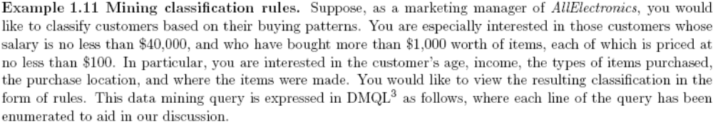
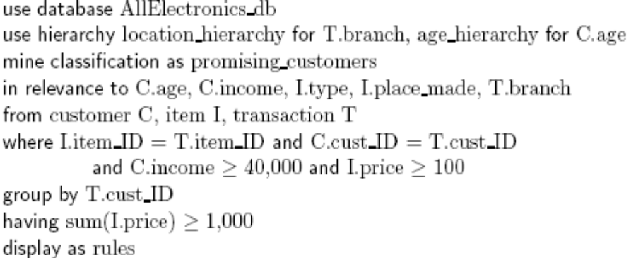
An Example Query in DMQL

Slide 49
Other Data Mining Languages & Standardization Efforts
Association rule language specifications
  MSQL (Imielinski & Virmani’99)
  MineRule (Meo Psaila and Ceri’96)
  Query flocks based on Datalog syntax (Tsur et al’98)
OLEDB for DM (Microsoft’2000) and recently DMX (Microsoft SQLServer 2005)
  Based on OLE, OLE DB, OLE DB for OLAP, C#
  Integrating DBMS, data warehouse and data mining
DMML (Data Mining Mark-up Language) by DMG (www.dmg.org)
  Providing a platform and process structure for effective data mining
  Emphasizing on deploying data mining technology to solve business problems

Slide 50
Integration of Data Mining and Data Warehousing
Data mining systems, DBMS, Data warehouse systems coupling
  No coupling, loose-coupling, semi-tight-coupling, tight-coupling
On-line analytical mining data
  integration of mining and OLAP technologies
Interactive mining multi-level knowledge
  Necessity of mining knowledge and patterns at different levels of abstraction by drilling/rolling, pivoting, slicing/dicing, etc.
Integration of multiple mining functions
  Characterized classification, first clustering and then association

Slide 51
Coupling Data Mining with DB/DW Systems
No coupling—flat file processing, not recommended
Loose coupling
  Fetching data from DB/DW
Semi-tight coupling—enhanced DM performance
  Provide efficient implement a few data mining primitives in a DB/DW system, e.g., sorting, indexing, aggregation, histogram analysis, multiway join, precomputation of some stat functions
Tight coupling—A uniform information processing environment
  DM is smoothly integrated into a DB/DW system, mining query is optimized based on mining query, indexing, query processing methods, etc.

Slide 52
Architecture: Typical Data Mining System
Graphical User Interface
Pattern Evaluation
Knowledge-Base
Data Mining Engine
Database or Data Warehouse Server
data cleaning, integration, and selection
Data
Warehouse
World-Wide
Web
Other Info
Repositories
Database

