Slide 1
CS536
Data Mining

Slide 2
Information Retrieval
Information Retrieval (IR) is finding material (usually documents) of an unstructured nature (usually text) that satisfies an information need from within large collections (usually stored on computers).

Slide 3
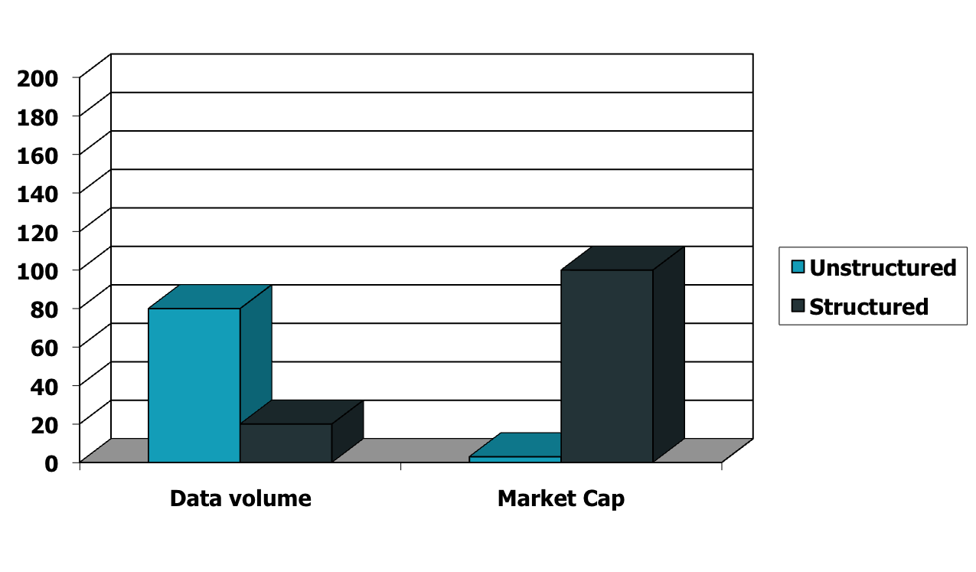
Unstructured (text) vs. structured (database) data in 1996

Slide 4

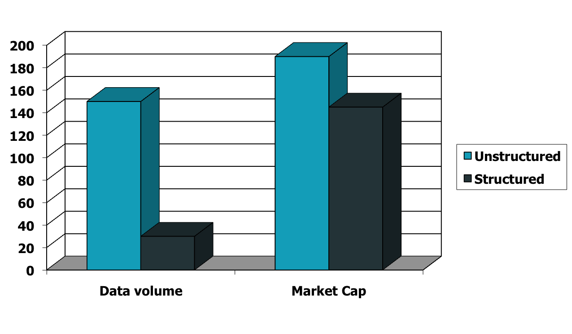



Unstructured (text) vs. structured (database) data in 2009

Slide 5
IR Vs Data Retrieval
 | Data Retrieval | Info Retrieval
Matching | Exact match | Partial match, best match
Inference | Deduction | Induction
Model | Deterministic | Probabilistic
Classification | Monothetic | Polythetic
Query language | Artificial | Natural
Query specification | Complete | Incomplete
Items wanted | Matching | Relevant
Error response | Sensitive | Insensitive

Slide 6
Basic assumptions of Information Retrieval
Sec. 1.1
Collection: Fixed set of documents
Goal: Retrieve documents with information that is relevant to the user’s information need and helps the user complete a task

Slide 7
How good are the retrieved docs?
Sec. 1.1
Precision : The number of relevant documents retrieved by a search divided by the total number of documents retrieved
Recall : Number of relevant documents retrieved by a search divided by the total number of existing relevant documents

Slide 8
Clustering, Classification and Ranking
Clustering: Given a set of docs, group them into clusters based on their contents.
Classification: Given a set of topics, plus a new doc D, decide which topic(s) D belongs to.
Ranking: Can we learn how to best order a set of documents, e.g., a set of search results

Slide 9
The web and its challenges
Unusual and diverse documents
Unusual and diverse users, queries, information needs
Beyond terms, exploit ideas from social networks
  link analysis, clickstreams ...
How do search engines work? And how can we make them better?

Slide 10
More sophisticated information retrieval
Cross-language information retrieval
Question answering
Summarization
Text mining
Text Entailment

Slide 11
Text Processing
Sec. 2.2.1

Slide 12
Tokenization
Sec. 2.2.1
Input: “Friends, Romans and Countrymen”
Output: Tokens
  Friends
  Romans
  Countrymen
A token is an instance of a sequence of characters
Each such token is now a candidate for an index entry, after further processing
  Described below
But what are valid tokens to emit?

Slide 13
Tokenization
Sec. 2.2.1
Issues in tokenization:
  Finland’s capital →
  Finland? Finlands? Finland’s?
  Hewlett-Packard → Hewlett and Packard as two tokens?
    state-of-the-art: break up hyphenated sequence.
    co-education
    lowercase, lower-case, lower case ?
    It can be effective to get the user to put in possible hyphens
  San Francisco: one token or two?
    How do you decide it is one token?

Slide 14
Stop words
Sec. 2.2.2
With a stop list, you exclude from the dictionary entirely the commonest words. Intuition:
  They have little semantic content: the, a, and, to, be
  There are a lot of them: ~30% of postings for top 30 words
But the trend is away from doing this:
  Good compression techniques means the space for including stop words in a system is very small
  Good query optimization techniques mean you pay little at query time for including stop words.
  You need them for:
    Phrase queries: “King of Denmark”
    Various song titles, etc.: “Let it be”, “To be or not to be”
    “Relational” queries: “flights to London”
Notes:
Nevertheless: “Google ignores common words and characters such as where, the, how, and other digits and letters which slow down your search without improving the results.” (Though you can explicitly ask for them to remain.)

Slide 15
Normalization to terms
Sec. 2.2.3
We need to “normalize” words in indexed text as well as query words into the same form
  We want to match U.S.A. and USA
Result is terms: a term is a (normalized) word type, which is an entry in our IR system dictionary
We most commonly implicitly define equivalence classes of terms by, e.g.,
  deleting periods to form a term
    U.S.A., USA ⎝ USA
  deleting hyphens to form a term
    anti-discriminatory, antidiscriminatory ⎝ antidiscriminatory

Slide 16
Case folding
Sec. 2.2.3
Reduce all letters to lower case
  exception: upper case in mid-sentence?
    e.g., General Motors
    Fed vs. fed
    SAIL vs. sail
  Often best to lower case everything, since users will use lowercase regardless of ‘correct’ capitalization…
Google example:
  Query C.A.T.
  #1 result is for “cat” not Caterpillar Inc.

Slide 17
Normalization to terms
Sec. 2.2.3
An alternative to equivalence classing is to do asymmetric expansion
An example of where this may be useful
  Enter: window Search: window, windows
  Enter: windows Search: Windows, windows, window
  Enter: Windows Search: Windows
Potentially more powerful, but less efficient
Notes:
Why not the reverse?

Slide 18
Lemmatization
Sec. 2.2.4
Reduce inflectional/variant forms to base form
E.g.,
  am, are, is → be
  car, cars, car's, cars' → car
the boy's cars are different colors → the boy car be different color
Lemmatization implies doing “proper” reduction to dictionary headword form

Slide 19
Stemming
Sec. 2.2.4
Reduce terms to their “roots” before indexing
“Stemming” suggest crude affix chopping
  language dependent
  e.g., automate(s), automatic, automation all reduced to automat.
for example compressed
and compression are both
accepted as equivalent to
compress.
for exampl compress and
compress ar both accept
as equival to compress

Slide 20
Porter’s algorithm
Sec. 2.2.4
Commonest algorithm for stemming English
  Results suggest it’s at least as good as other stemming options
Conventions + 5 phases of reductions
  phases applied sequentially
  each phase consists of a set of commands
  sample convention: Of the rules in a compound command, select the one that applies to the longest suffix.

Slide 21
Typical rules in Porter
Sec. 2.2.4
sses → ss
ies → i
ational → ate
tional → tion
Weight of word sensitive rules
(m>1) EMENT →
    replacement → replac
    cement → cement

Slide 22
IR Models
Sec. 2.2.1

Slide 23
Bag of words model
Vector representation doesn’t consider the ordering of words in a document
John is quicker than Mary and Mary is quicker than John have the same vectors
This is called the bag of words model.

Slide 24

Term frequency tf
The term frequency tf_{t,d} of term t in document d is defined as the number of times that t occurs in d.

Slide 25

Inverse document frequency idf
A measure of the general importance of the term (obtained by dividing the total number of documents by the number of documents containing the term, and then taking the logarithm of that quotient)

Slide 26
tf-idf
A measure of the general importance of the term (obtained by dividing the total number of documents by the number of documents containing the term, and then taking the logarithm of that quotient)

Slide 27
Semantics
Rely on pre-existing knowledge resources
- Thesauri
- semantic networks
- taxnomies
- encyclopedias
Examples; WordNet, Wikipedia etc

Slide 28
WordNet
WordNet is a lexical database of English, which groups nouns, verbs, adjectives and adverbs into sets of synonyms (synsets)
Synsets are interlinked with conceptual semantic and lexical relations including hypernymy, meronymy, causality etc

Slide 29
The END ☺

