Slide 1
DATA MINING
Introductory and Advanced Topics
Part I
Margaret H. Dunham
Department of Computer Science and Engineering
Southern Methodist University
Companion slides for the text by Dr. M.H.Dunham, Data Mining, Introductory and Advanced Topics, Prentice Hall, 2002.

Slide 2
Data Mining Outline
PART I
  Introduction
  Related Concepts
  Data Mining Techniques
PART II
  Classification
  Clustering
  Association Rules
PART III
  Web Mining
  Spatial Mining
  Temporal Mining

Slide 3
Introduction Outline
Goal: Provide an overview of data mining.
Define data mining
Data mining vs. databases
Basic data mining tasks
Data mining development
Data mining issues

Slide 4
Introduction
Data is growing at a phenomenal rate
Users expect more sophisticated information
How?
UNCOVER HIDDEN INFORMATION
DATA MINING

Slide 5
Data Mining Definition
Finding hidden information in a database
Fit data to a model
Similar terms
  Exploratory data analysis
  Data driven discovery
  Deductive learning

Slide 6
Data Mining Algorithm
Objective: Fit Data to a Model
  Descriptive
  Predictive
Preference – Technique to choose the best model
Search – Technique to search the data
  “Query”

Slide 7
Database Processing vs. Data Mining Processing
Query
  Well defined
  SQL
Query
  Poorly defined
  No precise query language
Data
  Operational data
Data
  Not operational data
Output
  Precise
  Subset of database
Output
  Fuzzy
  Not a subset of database

Slide 8
Query Examples
Database
Data Mining
Find all credit applicants with last name of Smith.
  Identify customers who have purchased more than $10,000 in the last month.
        Find all customers who have purchased milk
  Find all credit applicants who are poor credit risks. (classification)
        Identify customers with similar buying habits. (Clustering)
        Find all items which are frequently purchased with milk. (association rules)

Slide 9
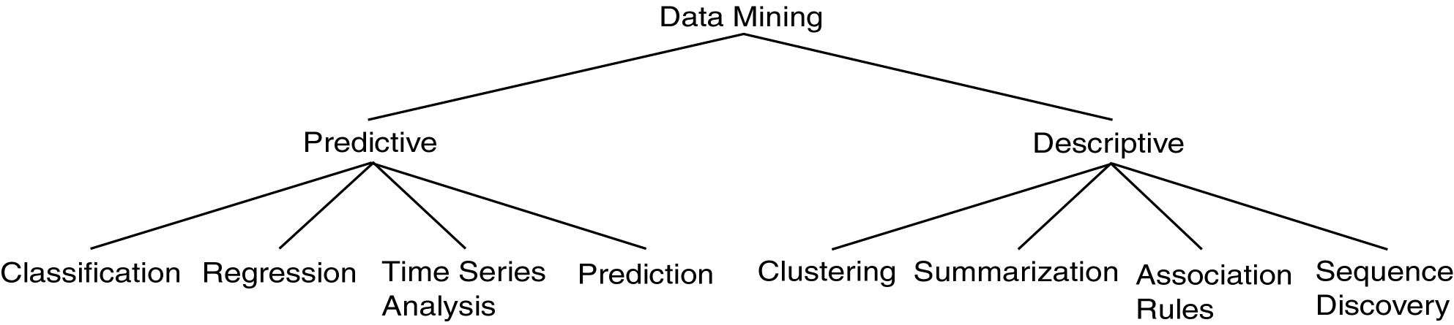
Data Mining Models and Tasks

Slide 10
Basic Data Mining Tasks
Classification maps data into predefined groups or classes
  Supervised learning
  Pattern recognition
  Prediction
Regression is used to map a data item to a real valued prediction variable.
Clustering groups similar data together into clusters.
  Unsupervised learning
  Segmentation
  Partitioning

Slide 11
Basic Data Mining Tasks (cont’d)
Summarization maps data into subsets with associated simple descriptions.
  Characterization
  Generalization
Link Analysis uncovers relationships among data.
  Affinity Analysis
  Association Rules
  Sequential Analysis determines sequential patterns.

Slide 12
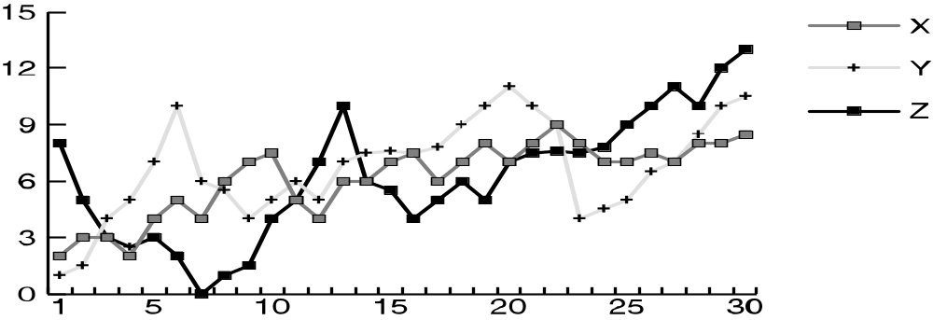
Ex: Time Series Analysis
Example: Stock Market
Predict future values
Determine similar patterns over time
Classify behavior

Slide 13
Data Mining vs. KDD
Knowledge Discovery in Databases (KDD): process of finding useful information and patterns in data.
Data Mining: Use of algorithms to extract the information and patterns derived by the KDD process.

Slide 14
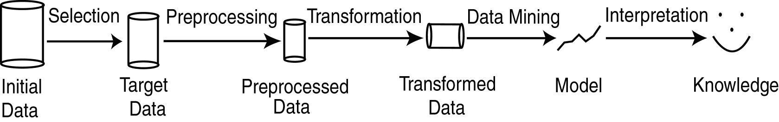
KDD Process
Modified from [FPSS96C]
Selection: Obtain data from various sources.
Preprocessing: Cleanse data.
Transformation: Convert to common format. Transform to new format.
Data Mining: Obtain desired results.
Interpretation/Evaluation: Present results to user in meaningful manner.

Slide 15
KDD Process Ex: Web Log
Selection:
  Select log data (dates and locations) to use
Preprocessing:
  Remove identifying URLs
  Remove error logs
Transformation:
  Sessionize (sort and group)
Data Mining:
  Identify and count patterns
  Construct data structure
Interpretation/Evaluation:
  Identify and display frequently accessed sequences.
Potential User Applications:
  Cache prediction
  Personalization

Slide 16
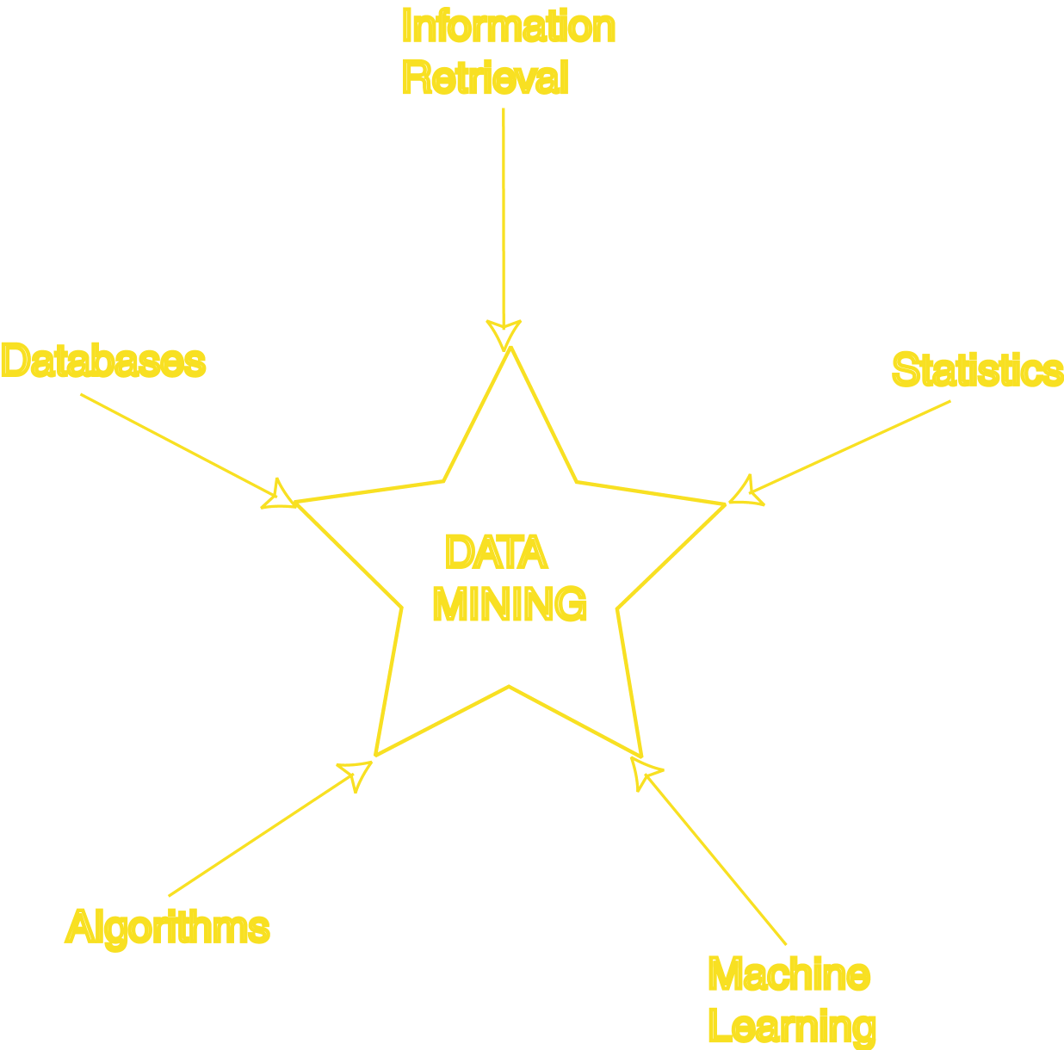
Data Mining Development
Similarity Measures
Hierarchical Clustering
IR Systems
Imprecise Queries
Textual Data
Web Search Engines
Relational Data Model
SQL
Association Rule Algorithms
Data Warehousing
Scalability Techniques
Bayes Theorem
Regression Analysis
EM Algorithm
K-Means Clustering
Time Series Analysis
Algorithm Design Techniques
Algorithm Analysis
Data Structures
Neural Networks
Decision Tree Algorithms

Slide 17
KDD Issues
Human Interaction
Overfitting
Outliers
Interpretation
Visualization
Large Datasets
High Dimensionality

Slide 18
KDD Issues (cont’d)
Multimedia Data
Missing Data
Irrelevant Data
Noisy Data
Changing Data
Integration
Application

Slide 19
Social Implications of DM
Privacy
Profiling
Unauthorized use

Slide 20
Data Mining Metrics
Usefulness
Return on Investment (ROI)
Accuracy
Space/Time

Slide 21
Database Perspective on Data Mining
Scalability
Real World Data
Updates
Ease of Use

Slide 22
Visualization Techniques
Graphical
Geometric
Icon-based
Pixel-based
Hierarchical
Hybrid

Slide 23
Related Concepts Outline
Goal: Examine some areas which are related to data mining.
Database/OLTP Systems
Fuzzy Sets and Logic
Information Retrieval(Web Search Engines)
Dimensional Modeling
Data Warehousing
OLAP/DSS
Statistics
Machine Learning
Pattern Matching

Slide 24
DB & OLTP Systems
Schema
  (ID,Name,Address,Salary,JobNo)
Data Model
  ER
  Relational
Transaction
Query:
    SELECT Name
    FROM T
    WHERE Salary > 100000
DM: Only imprecise queries

Slide 25
Fuzzy Sets and Logic
Fuzzy Set: Set membership function is a real valued function with output in the range [0,1].
f(x): Probability x is in F.
1-f(x): Probability x is not in F.
EX:
  T = {x | x is a person and x is tall}
  Let f(x) be the probability that x is tall
  Here f is the membership function
DM: Prediction and classification are fuzzy.

Slide 26
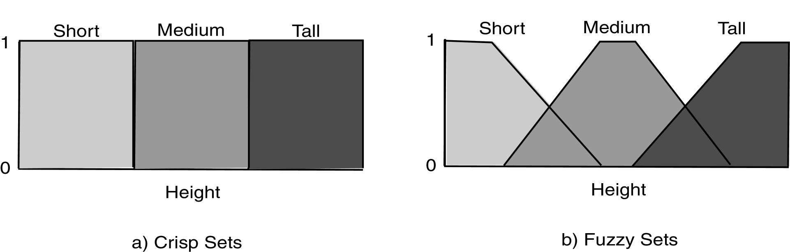
Fuzzy Sets

Slide 27
Classification/Prediction is Fuzzy
Loan
Amnt
Reject
Reject
Accept
Accept
Simple
Fuzzy

Slide 28
Information Retrieval
Information Retrieval (IR): retrieving desired information from textual data.
Library Science
Digital Libraries
Web Search Engines
Traditionally keyword based
Sample query:
  Find all documents about “data mining”.
DM: Similarity measures;
Mine text/Web data.

Slide 29
Information Retrieval (cont’d)
Similarity: measure of how close a query is to a document.
Documents which are “close enough” are retrieved.
Metrics:
  Precision = |Relevant and Retrieved|
  |Retrieved|
  Recall = |Relevant and Retrieved|
  |Relevant|

Slide 30
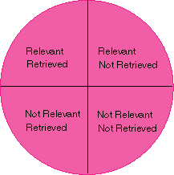
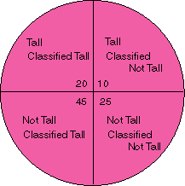
IR Query Result Measures and Classification
IR
Classification

Slide 31
Dimensional Modeling
View data in a hierarchical manner more as business executives might
Useful in decision support systems and mining
Dimension: collection of logically related attributes; axis for modeling data.
Facts: data stored
Ex: Dimensions – products, locations, date
Facts – quantity, unit price
DM: May view data as dimensional.

Slide 32
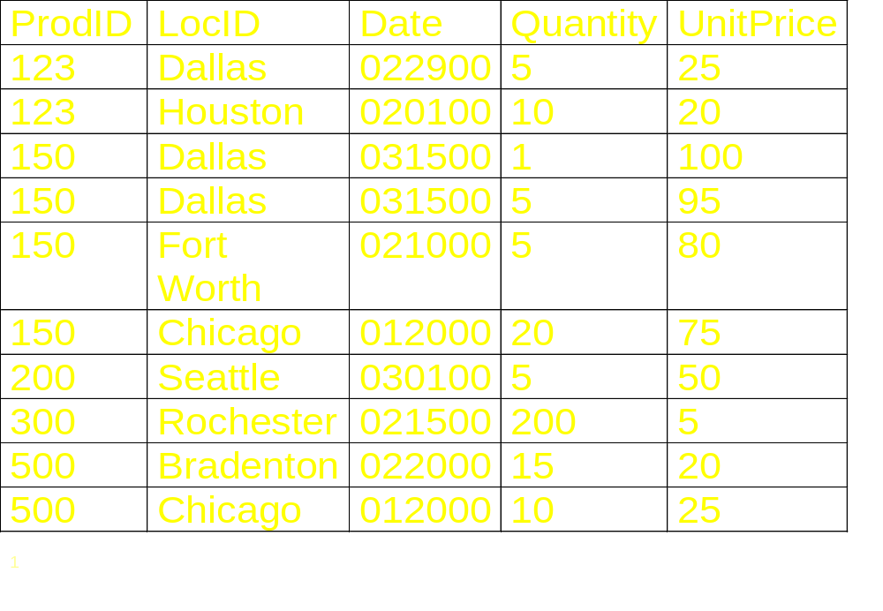
Relational View of Data

Slide 33
Dimensional Modeling Queries
Roll Up: more general dimension
Drill Down: more specific dimension
Dimension (Aggregation) Hierarchy
SQL uses aggregation
Decision Support Systems (DSS): Computer systems and tools to assist managers in making decisions and solving problems.

Slide 34
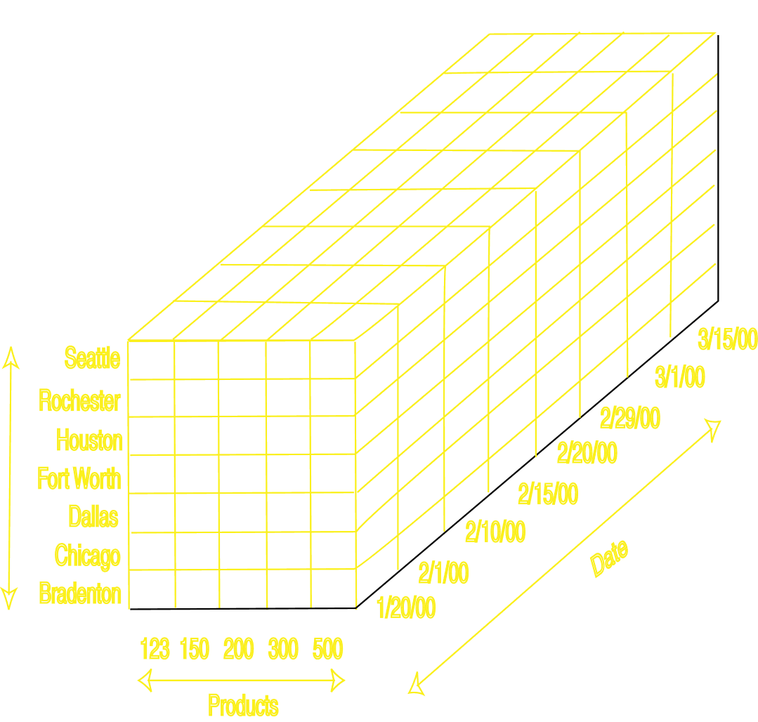
Cube view of Data

Slide 35
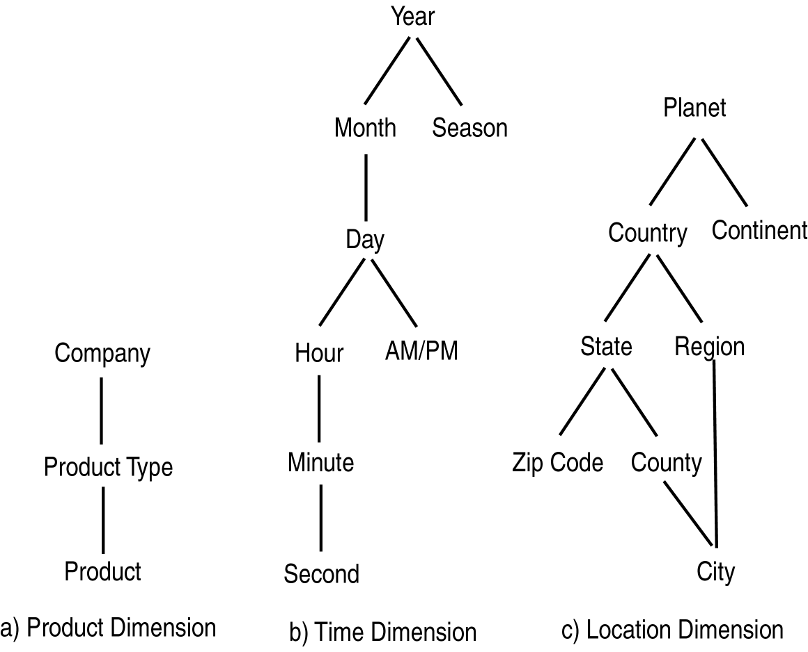
Aggregation Hierarchies

Slide 36
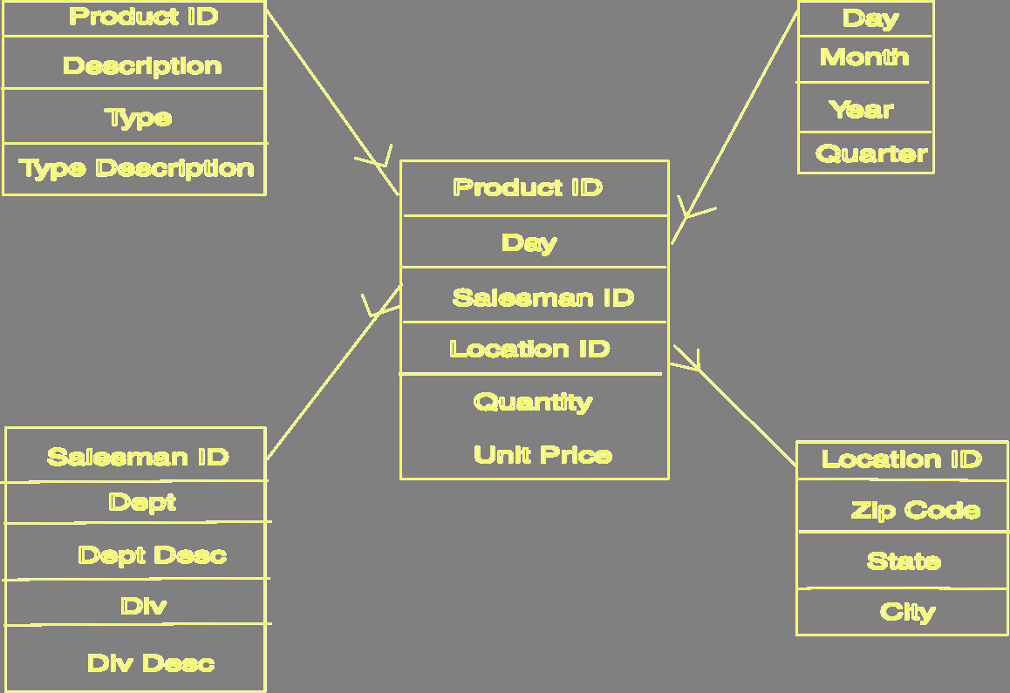
Star Schema

Slide 37
Data Warehousing
“Subject-oriented, integrated, time-variant, nonvolatile” William Inmon
Operational Data: Data used in day to day needs of company.
Informational Data: Supports other functions such as planning and forecasting.
Data mining tools often access data warehouses rather than operational data.
DM: May access data in warehouse.

Slide 38
Operational vs. Informational
Operational Data
Data Warehouse
Application
OLTP
OLAP
Use
Precise Queries
Ad Hoc
Temporal
Snapshot
Historical
Modification
Dynamic
Static
Orientation
Application
Business
Data
Operational Values
Integrated
Size
Gigabits
Terabits
Level
Detailed
Summarized
Access
Often
Less Often
Response
Few Seconds
Minutes
Data Schema
Relational
Star/Snowflake

Slide 39
OLAP
Online Analytic Processing (OLAP): provides more complex queries than OLTP.
OnLine Transaction Processing (OLTP): traditional database/transaction processing.
Dimensional data; cube view
Visualization of operations:
  Slice: examine sub-cube.
  Dice: rotate cube to look at another dimension.
  Roll Up/Drill Down
  DM: May use OLAP queries.

Slide 40
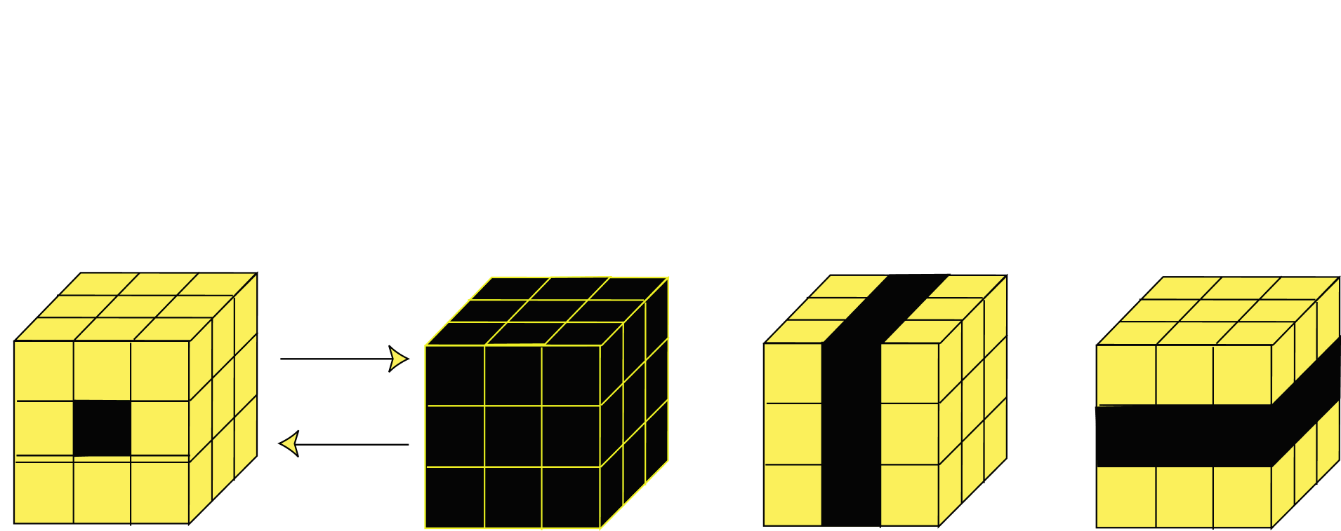
OLAP Operations
Roll Up
Drill Down
Single Cell
Multiple Cells
Slice
Dice

Slide 41
Statistics
Simple descriptive models
Statistical inference: generalizing a model created from a sample of the data to the entire dataset.
Exploratory Data Analysis:
  Data can actually drive the creation of the model
  Opposite of traditional statistical view.
Data mining targeted to business user
DM: Many data mining methods come from statistical techniques.

Slide 42
Machine Learning
Machine Learning: area of AI that examines how to write programs that can learn.
Often used in classification and prediction
Supervised Learning: learns by example.
Unsupervised Learning: learns without knowledge of correct answers.
Machine learning often deals with small static datasets.
DM: Uses many machine learning techniques.

Slide 43
Pattern Matching (Recognition)
Pattern Matching: finds occurrences of a predefined pattern in the data.
Applications include speech recognition, information retrieval, time series analysis.
DM: Type of classification.

Slide 44
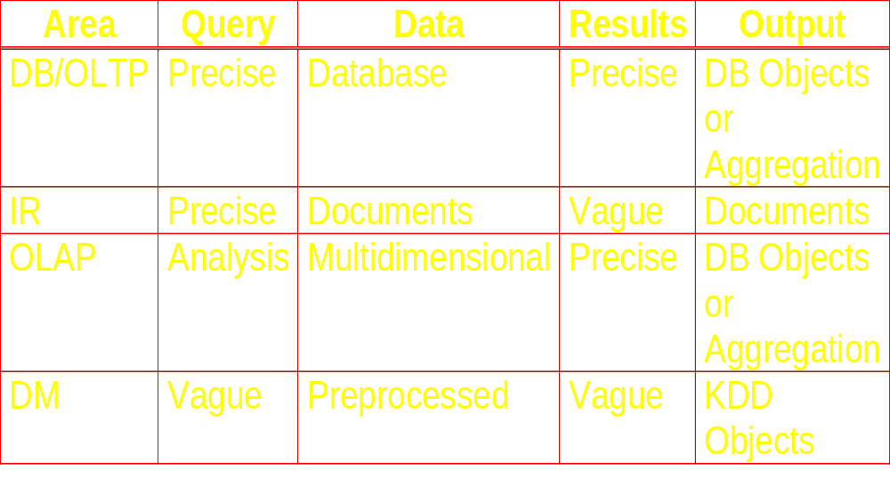
DM vs. Related Topics

Slide 45
Data Mining Techniques Outline
Goal: Provide an overview of basic data mining techniques
Statistical
  Point Estimation
  Models Based on Summarization
  Bayes Theorem
  Hypothesis Testing
  Regression and Correlation
Similarity Measures
Decision Trees
Neural Networks
  Activation Functions
Genetic Algorithms

Slide 46
Point Estimation
Point Estimate: estimate a population parameter.
May be made by calculating the parameter for a sample.
May be used to predict value for missing data.
Ex:
  R contains 100 employees
  99 have salary information
  Mean salary of these is $50,000
  Use $50,000 as value of remaining employee’s salary.
  Is this a good idea?

Slide 47

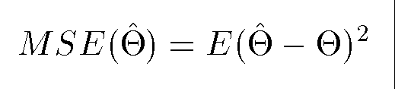
Estimation Error
Bias: Difference between expected value and actual value.
Mean Squared Error (MSE): expected value of the squared difference between the estimate and the actual value:
Why square?
Root Mean Square Error (RMSE)

Slide 48
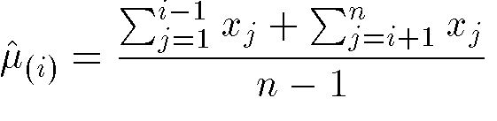
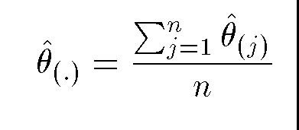
Jackknife Estimate
Jackknife Estimate: estimate of parameter is obtained by omitting one value from the set of observed values.
Ex: estimate of mean for X={x₁, … , x_{n}}

Slide 49
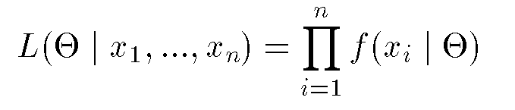
Maximum Likelihood Estimate (MLE)
Obtain parameter estimates that maximize the probability that the sample data occurs for the specific model.
Joint probability for observing the sample data by multiplying the individual probabilities. Likelihood function:
Maximize L.

Slide 50
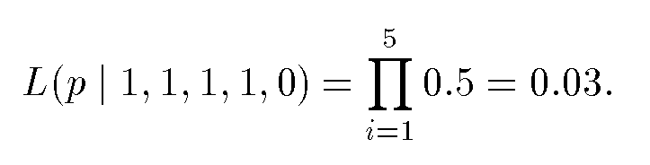
MLE Example
Coin toss five times: {H,H,H,H,T}
Assuming a perfect coin with H and T equally likely, the likelihood of this sequence is:
However if the probability of a H is 0.8 then:

Slide 51
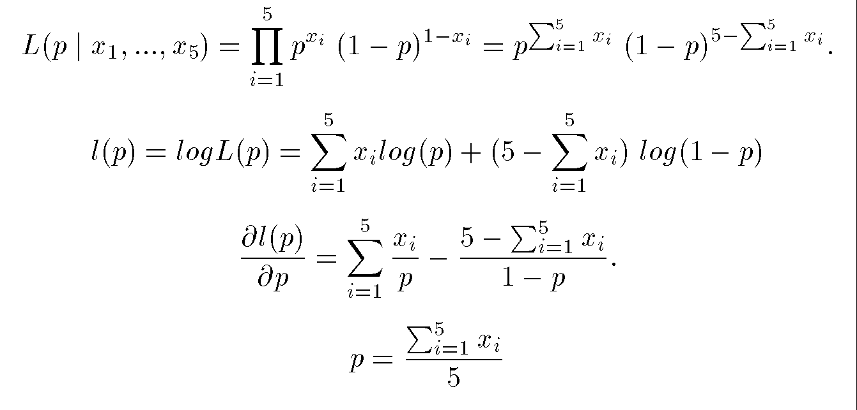
MLE Example (cont’d)
General likelihood formula:
Estimate for p is then 4/5 = 0.8

Slide 52
Expectation-Maximization (EM)
Solves estimation with incomplete data.
Obtain initial estimates for parameters.
Iteratively use estimates for missing data and continue until convergence.

Slide 53
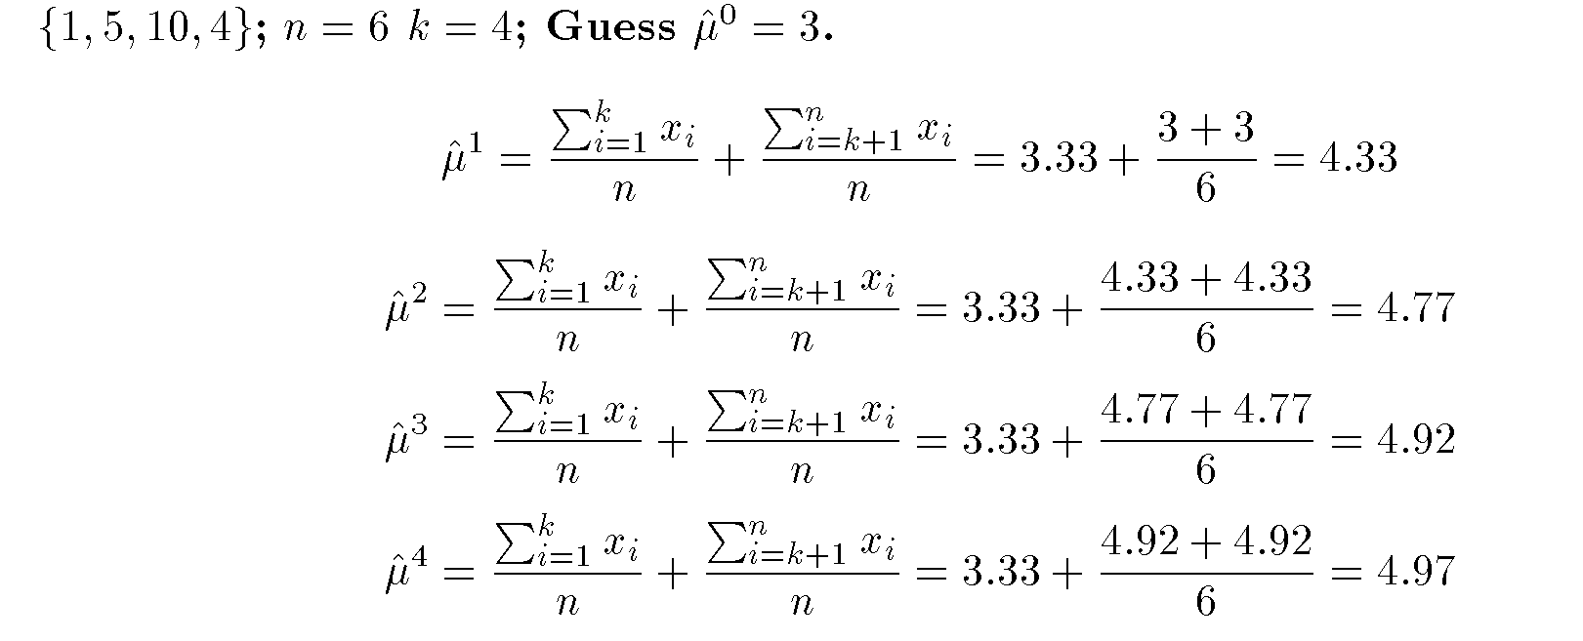
EM Example

Slide 54
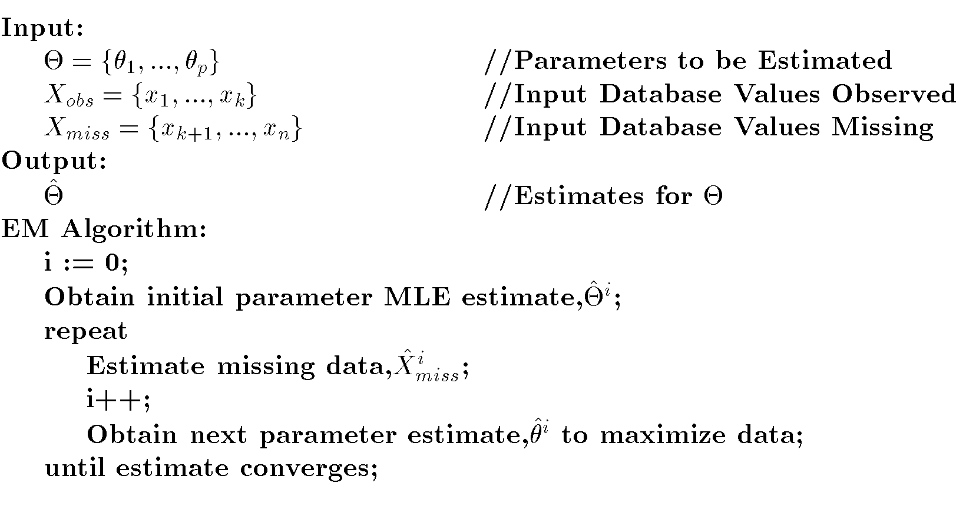
EM Algorithm

Slide 55
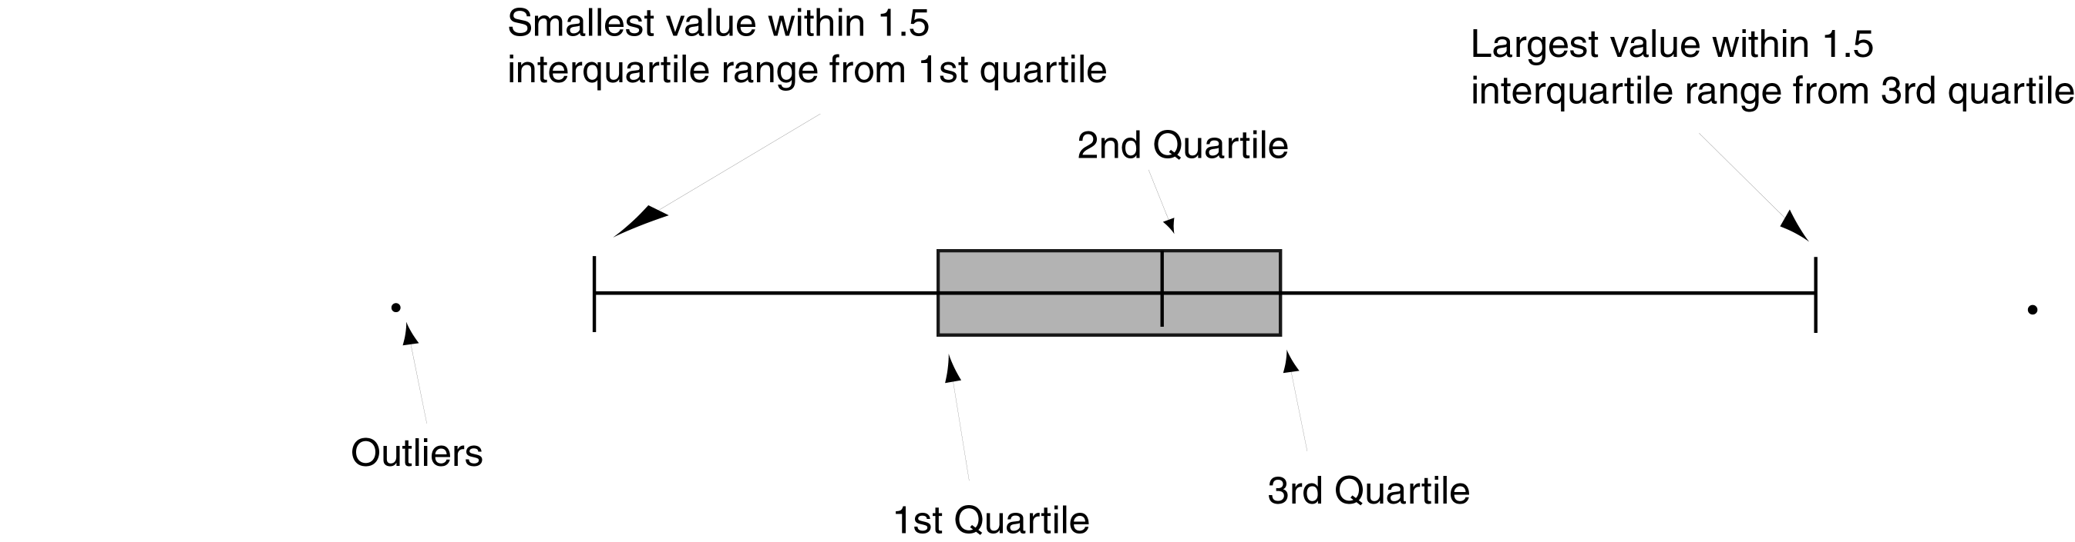
Models Based on Summarization
Visualization: Frequency distribution, mean, variance, median, mode, etc.
Box Plot:

Slide 56
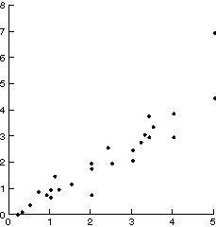
Scatter Diagram

Slide 57
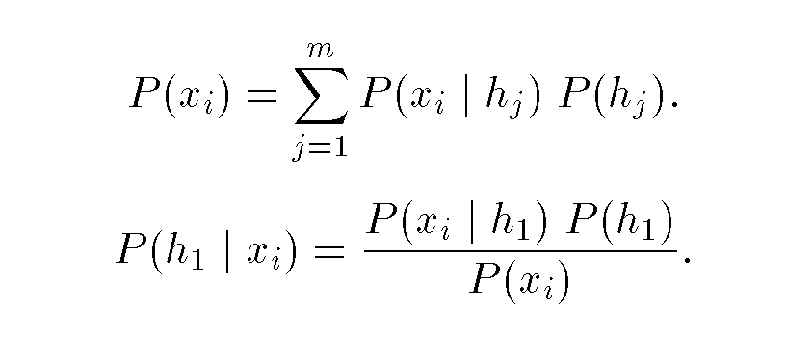
Bayes Theorem
Posterior Probability: P(h₁|x_{i})
Prior Probability: P(h₁)
Bayes Theorem:
Assign probabilities of hypotheses given a data value.

Slide 58

Bayes Theorem Example
Credit authorizations (hypotheses): h₁=authorize purchase, h₂ = authorize after further identification, h₃=do not authorize, h₄= do not authorize but contact police
Assign twelve data values for all combinations of credit and income:
From training data: P(h₁) = 60%; P(h₂)=20%; P(h₃)=10%; P(h₄)=10%.

Slide 59
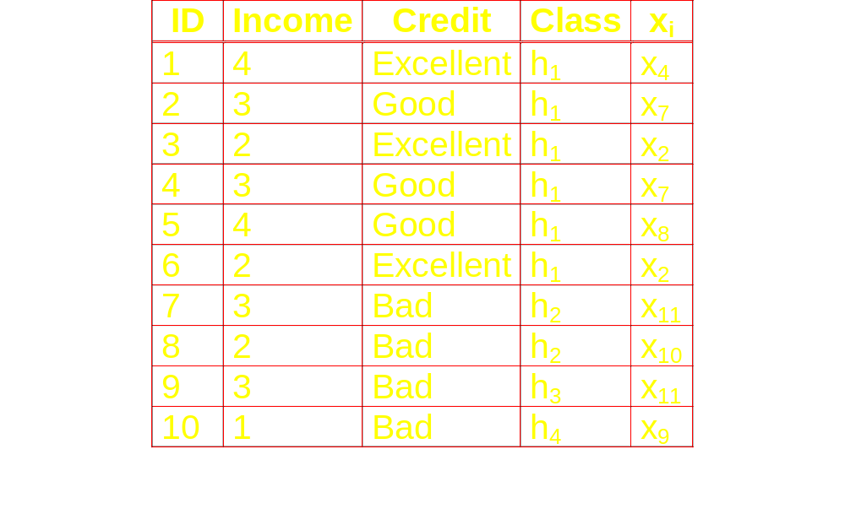
Bayes Example(cont’d)
Training Data:

Slide 60
Bayes Example(cont’d)
Calculate P(x_{i}|h_{j}) and P(x_{i})
Ex: P(x₇|h₁)=2/6; P(x₄|h₁)=1/6; P(x₂|h₁)=2/6; P(x₈|h₁)=1/6; P(x_{i}|h₁)=0 for all other x_{i}.
Predict the class for x₄:
  Calculate P(h_{j}|x₄) for all h_{j}.
  Place x₄ in class with largest value.
  Ex:
    P(h₁|x₄)=(P(x₄|h₁)(P(h₁))/P(x₄)
    =(1/6)(0.6)/0.1=1.
    x₄ in class h₁.

Slide 61
Hypothesis Testing
Find model to explain behavior by creating and then testing a hypothesis about the data.
Exact opposite of usual DM approach.
H₀ – Null hypothesis; Hypothesis to be tested.
H₁ – Alternative hypothesis

Slide 62
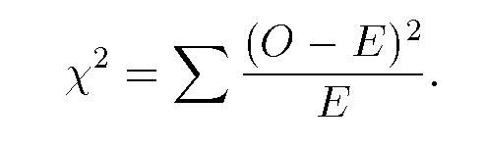
Chi Squared Statistic
O – observed value
E – Expected value based on hypothesis.
Ex:
  O={50,93,67,78,87}
  E=75
  χ²=15.55 and therefore significant

Slide 63
Regression
Predict future values based on past values
Linear Regression assumes linear relationship exists.
y = c₀ + c₁ x₁ + … + c_{n} x_{n}
Find values to best fit the data

Slide 64
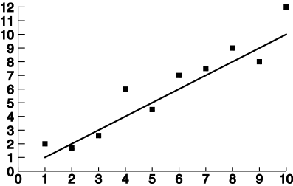
Linear Regression

Slide 65
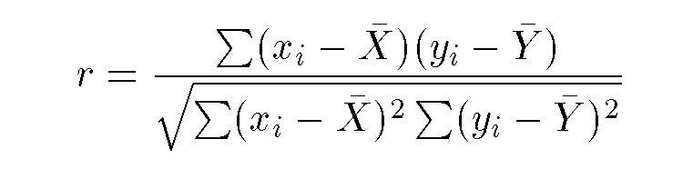
Correlation
Examine the degree to which the values for two variables behave similarly.
Correlation coefficient r:
  1 = perfect correlation
  -1 = perfect but opposite correlation
  0 = no correlation

Slide 66
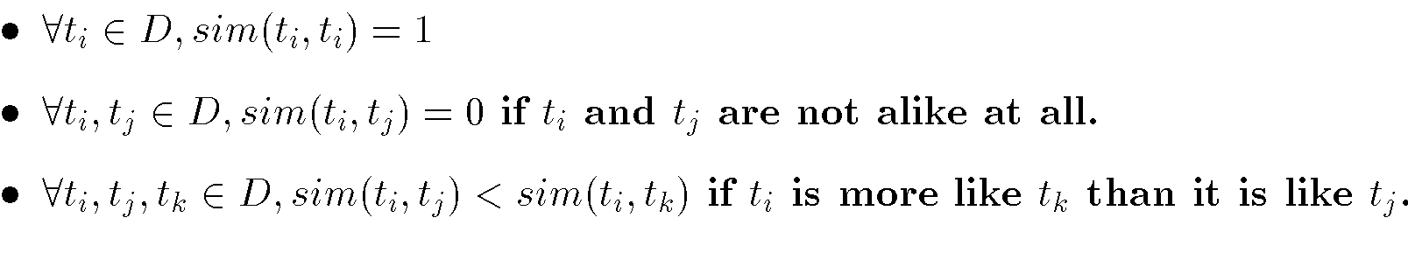
Similarity Measures
Determine similarity between two objects.
Similarity characteristics:
Alternatively, distance measure measure how unlike or dissimilar objects are.

Slide 67
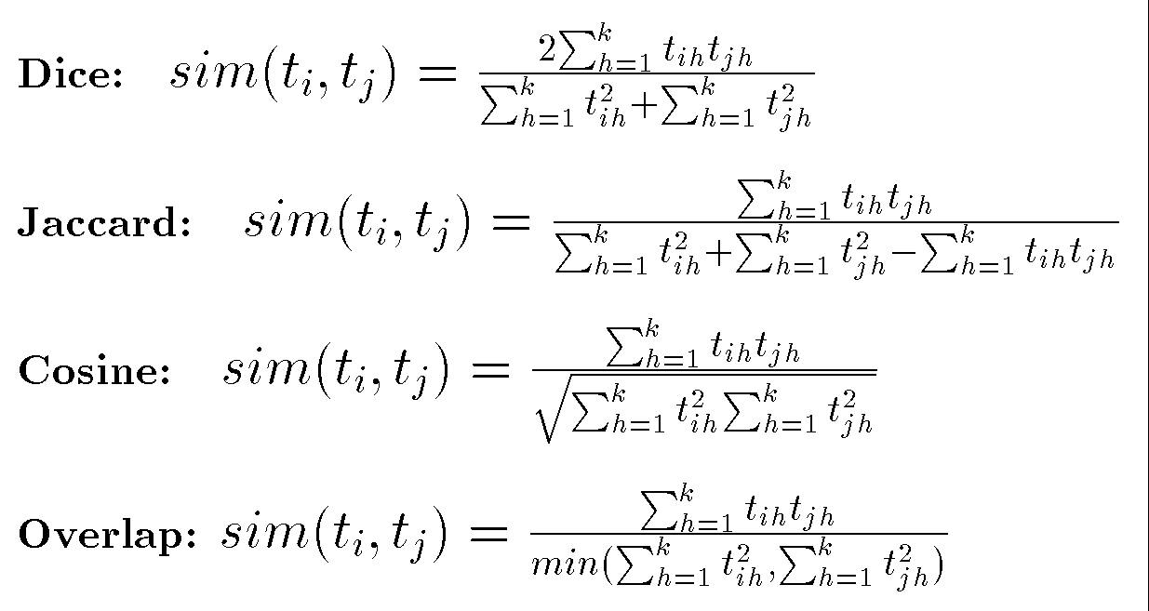
Similarity Measures

Slide 68
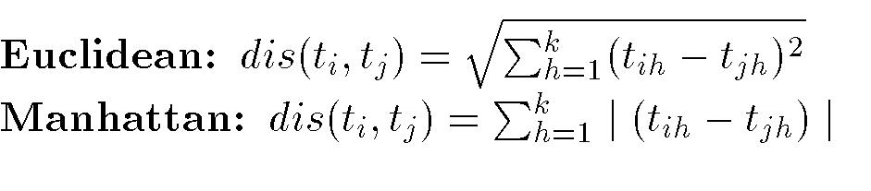
Distance Measures
Measure dissimilarity between objects

Slide 69
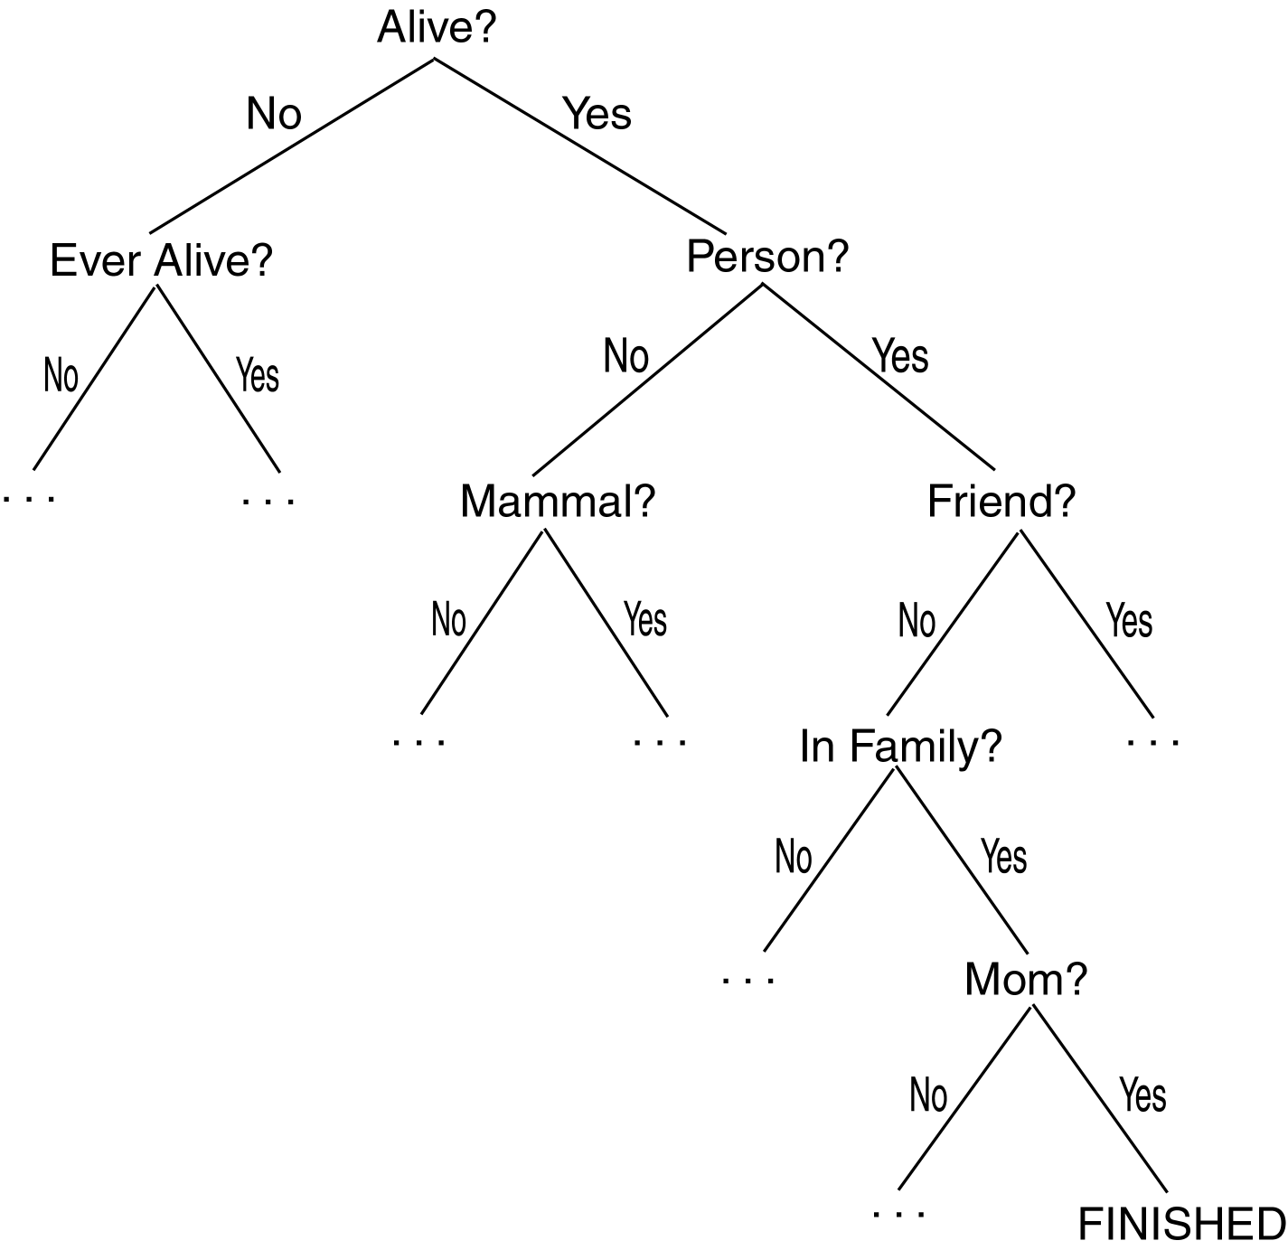
Twenty Questions Game

Slide 70
Decision Trees
Decision Tree (DT):
  Tree where the root and each internal node is labeled with a question.
  The arcs represent each possible answer to the associated question.
  Each leaf node represents a prediction of a solution to the problem.
Popular technique for classification; Leaf node indicates class to which the corresponding tuple belongs.

Slide 71
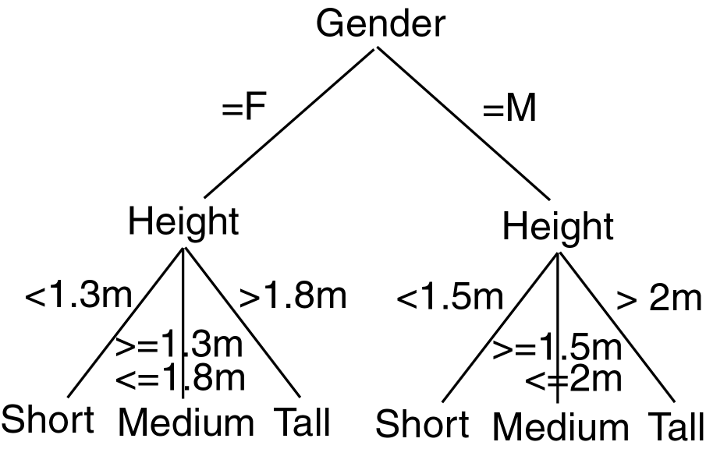
Decision Tree Example

Slide 72
Decision Trees
A Decision Tree Model is a computational model consisting of three parts:
  Decision Tree
  Algorithm to create the tree
  Algorithm that applies the tree to data
Creation of the tree is the most difficult part.
Processing is basically a search similar to that in a binary search tree (although DT may not be binary).

Slide 73
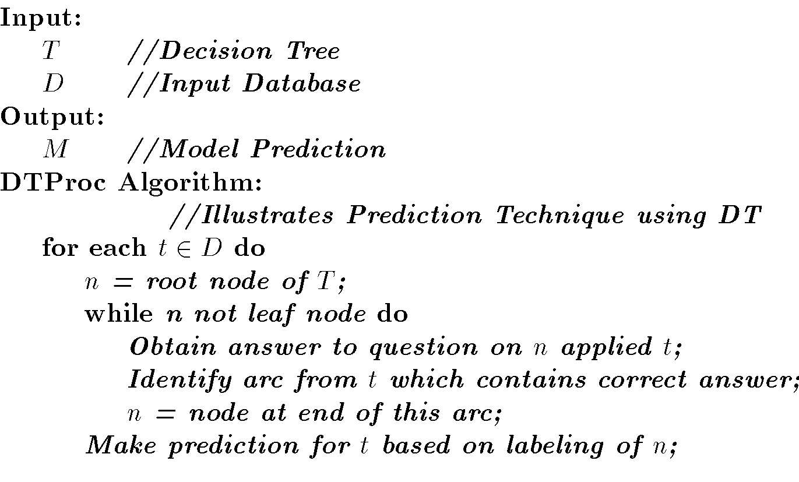
Decision Tree Algorithm

Slide 74
DT Advantages/Disadvantages
Advantages:
  Easy to understand.
  Easy to generate rules
Disadvantages:
  May suffer from overfitting.
  Classifies by rectangular partitioning.
  Does not easily handle nonnumeric data.
  Can be quite large – pruning is necessary.

Slide 75
Neural Networks
Based on observed functioning of human brain.
(Artificial Neural Networks (ANN)
Our view of neural networks is very simplistic.
We view a neural network (NN) from a graphical viewpoint.
Alternatively, a NN may be viewed from the perspective of matrices.
Used in pattern recognition, speech recognition, computer vision, and classification.

Slide 76
Neural Networks
Neural Network (NN) is a directed graph F=<V,A> with vertices V={1,2,…,n} and arcs A={<i,j>|1<=i,j<=n}, with the following restrictions:
  V is partitioned into a set of input nodes, V_{I}, hidden nodes, V_{H}, and output nodes, V_{O}.
  The vertices are also partitioned into layers
  Any arc <i,j> must have node i in layer h-1 and node j in layer h.
  Arc <i,j> is labeled with a numeric value w_{ij}.
  Node i is labeled with a function f_{i}.

Slide 77
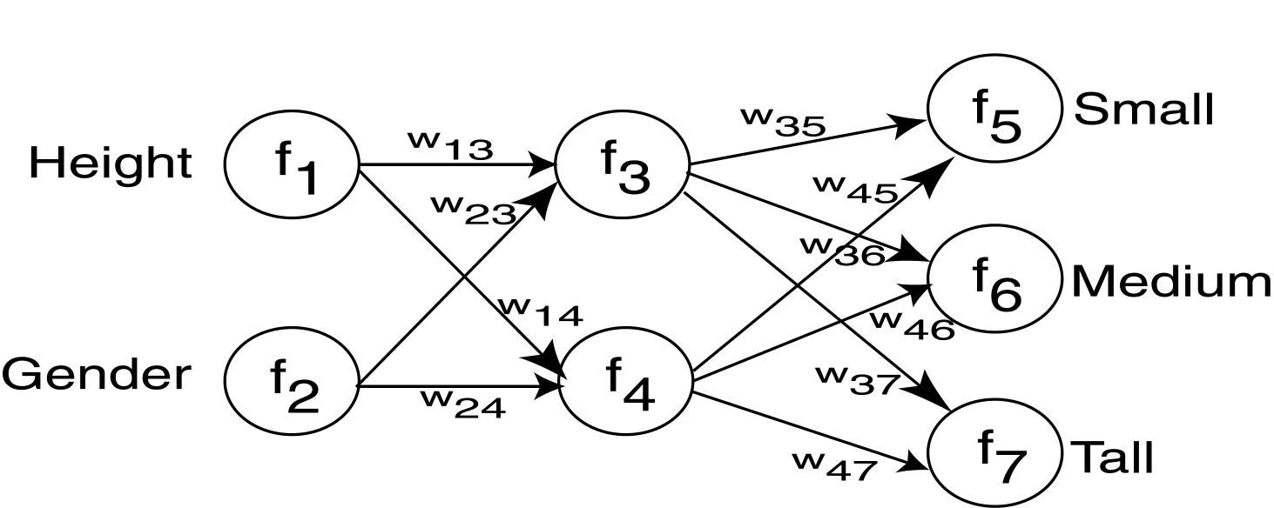
Neural Network Example

Slide 78
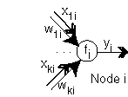
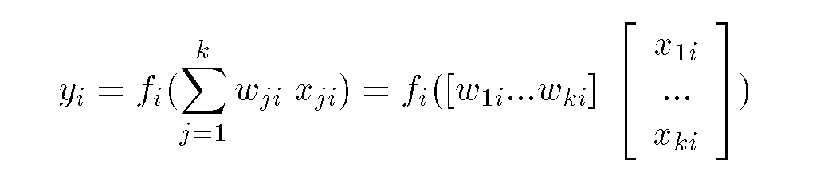
NN Node

Slide 79
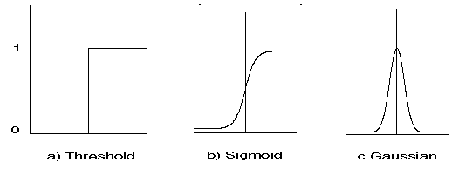
NN Activation Functions
Functions associated with nodes in graph.
Output may be in range [-1,1] or [0,1]

Slide 80
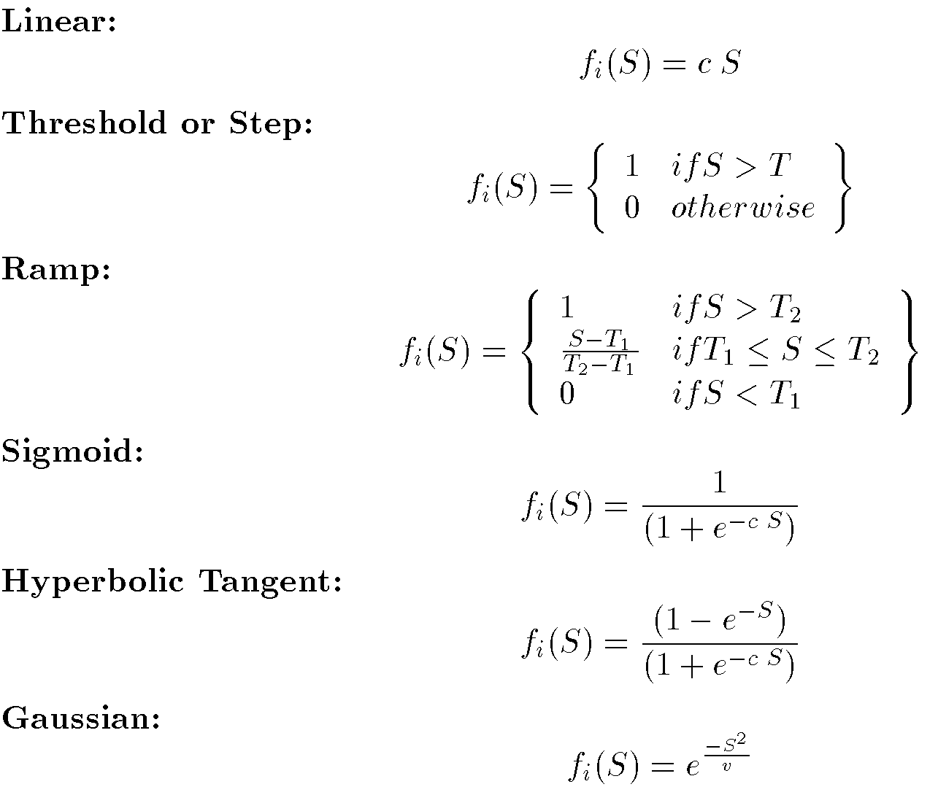
NN Activation Functions

Slide 81
NN Learning
Propagate input values through graph.
Compare output to desired output.
Adjust weights in graph accordingly.

Slide 82
Neural Networks
A Neural Network Model is a computational model consisting of three parts:
  Neural Network graph
  Learning algorithm that indicates how learning takes place.
  Recall techniques that determine hew information is obtained from the network.
We will look at propagation as the recall technique.

Slide 83
NN Advantages
Learning
Can continue learning even after training set has been applied.
Easy parallelization
Solves many problems

Slide 84
NN Disadvantages
Difficult to understand
May suffer from overfitting
Structure of graph must be determined a priori.
Input values must be numeric.
Verification difficult.

Slide 85
Genetic Algorithms
Optimization search type algorithms.
Creates an initial feasible solution and iteratively creates new “better” solutions.
Based on human evolution and survival of the fittest.
Must represent a solution as an individual.
Individual: string I=I₁,I₂,…,I_{n} where I_{j} is in given alphabet A.
Each character I_{j} is called a gene.
Population: set of individuals.

Slide 86
Genetic Algorithms
A Genetic Algorithm (GA) is a computational model consisting of five parts:
  A starting set of individuals, P.
  Crossover: technique to combine two parents to create offspring.
  Mutation: randomly change an individual.
  Fitness: determine the best individuals.
  Algorithm which applies the crossover and mutation techniques to P iteratively using the fitness function to determine the best individuals in P to keep.

Slide 87
Crossover Examples

Slide 88
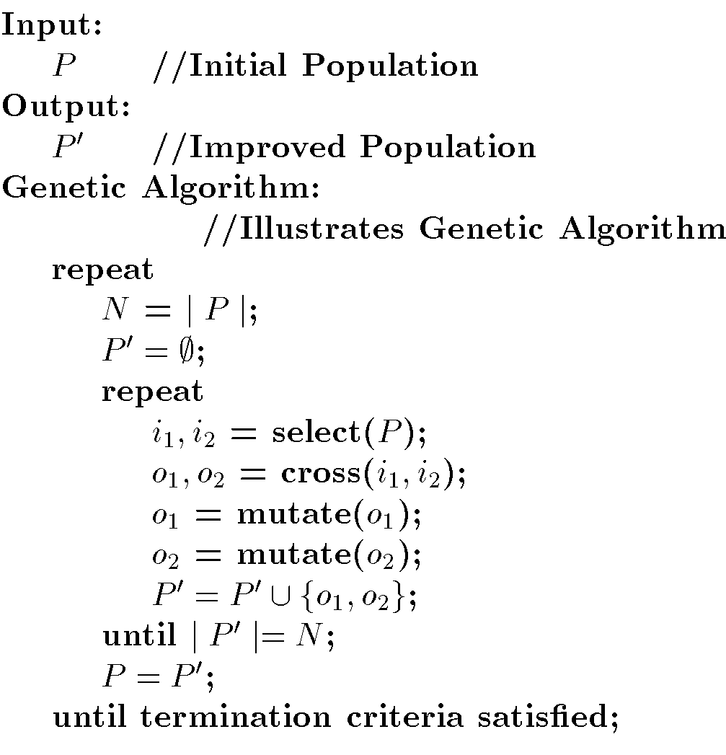
Genetic Algorithm

Slide 89
GA Advantages/Disadvantages
Advantages
  Easily parallelized
Disadvantages
  Difficult to understand and explain to end users.
  Abstraction of the problem and method to represent individuals is quite difficult.
  Determining fitness function is difficult.
  Determining how to perform crossover and mutation is difficult.

