Slide 1
Motion Estimation

Slide 2
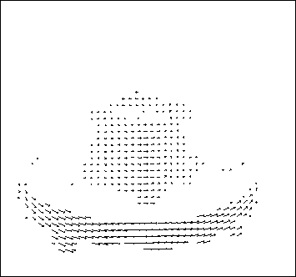
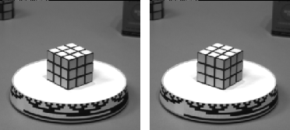
Optical flow
Measurement of motion at every pixel

Slide 3


Problem definition: optical flow
How to estimate pixel motion from image H to image I?
  Solve pixel correspondence problem
    given a pixel in H, look for nearby pixels of the same color in I
Key assumptions
  color constancy: a point in H looks the same in I
    For grayscale images, this is brightness constancy
  small motion: points do not move very far
This is called the optical flow problem

Slide 4

Optical flow equation
Notes:
A: u and v are unknown, 1 equation

Slide 5







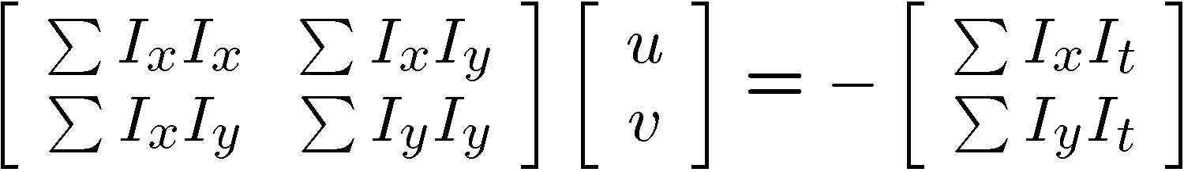


Lukas-Kanade flow
Prob: we have more equations than unknowns
Solution: solve least squares problem
  minimum least squares solution given by solution (in d) of:
  The summations are over all pixels in the K x K window
  This technique was first proposed by Lukas & Kanade (1981)
    described in Trucco & Verri reading

Slide 6
Iterative Refinement
Iterative Lukas-Kanade Algorithm
  Estimate velocity at each pixel by solving Lucas-Kanade equations
  Warp H towards I using the estimated flow field
    - use image warping techniques
  Repeat until convergence

Slide 7
Coarse-to-fine optical flow estimation
u=1.25 pixels
u=2.5 pixels
u=5 pixels
image H
u=10 pixels
image H
image I
image I
Gaussian pyramid of image H
Gaussian pyramid of image I

Slide 8
Coarse-to-fine optical flow estimation
run iterative L-K
warp & upsample
run iterative L-K
.
.
.
image J
image H
image I
image I
Gaussian pyramid of image H
Gaussian pyramid of image I

Slide 9
Multi-resolution Lucas Kanade Algorithm
Compute Iterative LK at highest level
For Each Level i
  Take flow u(i-1), v(i-1) from level i-1
  Upsample the flow to create u*(i), v*(i)
  matrices of twice resolution for level i.
  Multiply u*(i), v*(i) by 2
  Compute I_{t} from a block displaced by
  u*(i), v*(i)
  Apply LK to get u’(i), v’(i) (the correction
  in flow)
  Add corrections u’(i), v’(i) to obtain the
  flow u(i), v(i) at i^{th} level, i.e.,
  u(i)=u*(i)+u’(i), v(i)=v*(i)+v’(i)

Slide 10
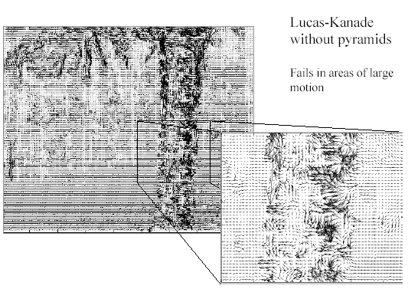
Optical Flow Results

Slide 11
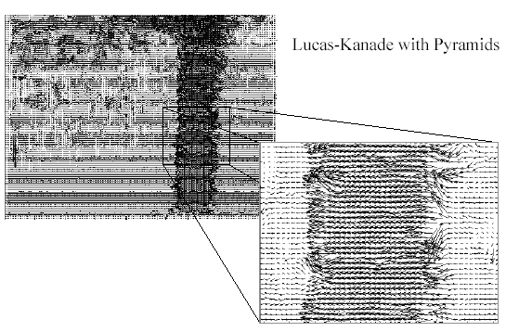
Optical Flow Results

Slide 12
Optical flow Results

Slide 13
Global Flow

Slide 14
Global Flow
Dominant Motion in the image
  Motion of all points in the scene
  Motion of most of the points in the scene
  A Component of motion of all points in the scene
Global Motion is caused by
  Motion of sensor (Ego Motion)
  Motion of a rigid scene
Estimation of Global Motion can be used to
  Video Mosaics
  Image Alignment (Registration)
  Removing Camera Jitter
  Tracking (By neglecting camera motion)
  Video Segmentation etc.

Slide 15
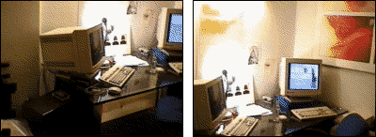
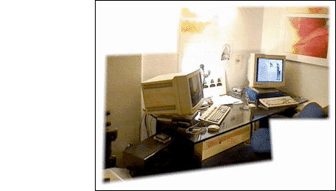
Global Flow
Application: Image Alignment

Slide 16
Global Flow
Special Case of General Optical Flow Problem
Can be solved by using Lucas Kanade algorithm.
Specialized algorithms exist that perform better by further constraining the problem.

Slide 17
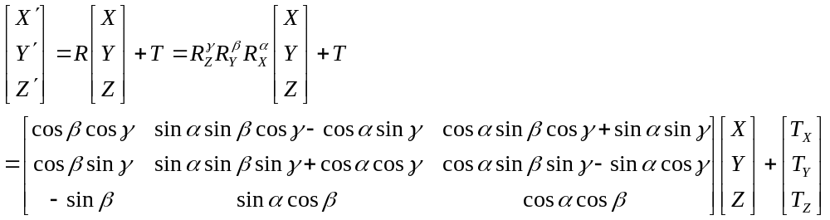
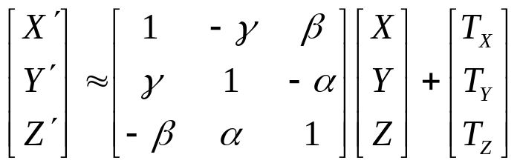
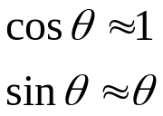
Motion Models
First we look for a parametric form of global flow vector.
Global Flow occurs because of 3D rigid motion of either the
sensor or the scene.
3D Rigid Motion
(If θ is small)
Also neglecting the higher order terms

Slide 18
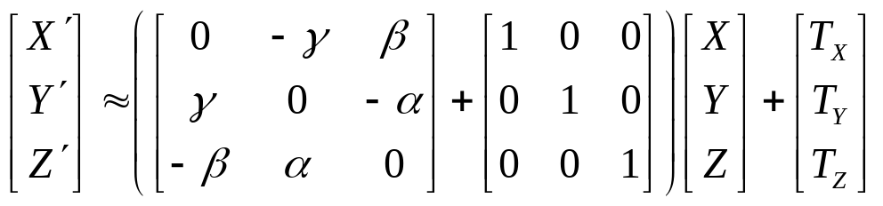
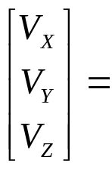
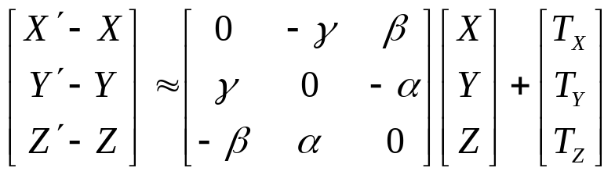
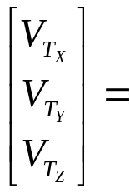
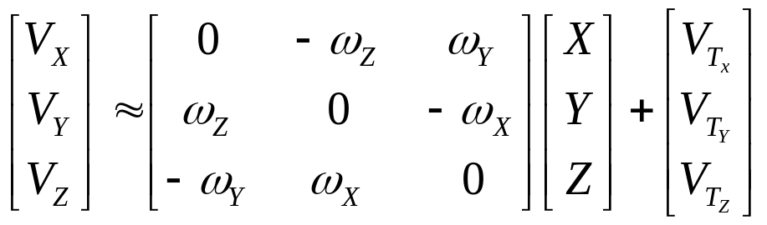
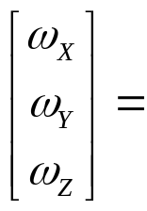
Motion Models
3D Rigid Motion
Velocity Vector
Translational
Component of Velocity
Angular Velocity

Slide 19
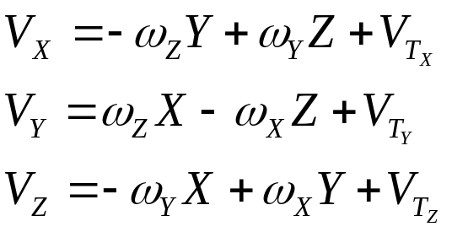
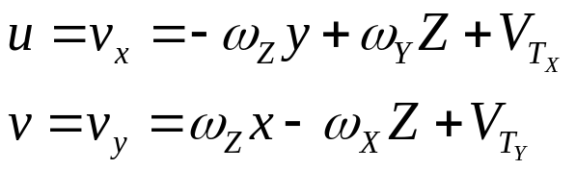
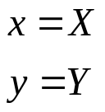
Motion Models
Orthographic Projection
(Orthographic Projection)

Slide 20
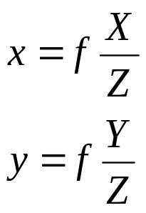
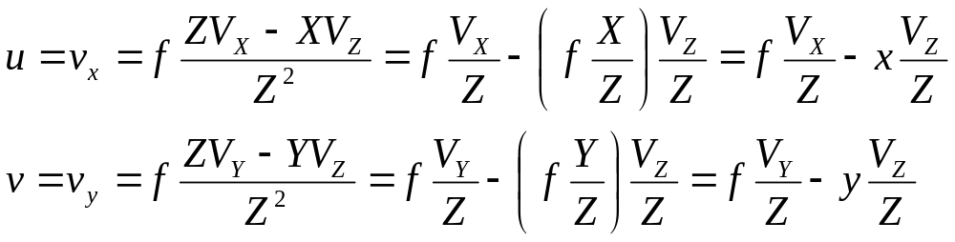
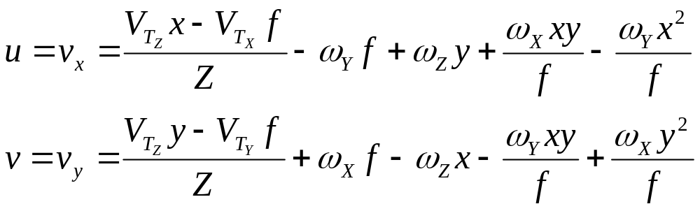
Motion Models
Perspective Projection (Arbitrary Flow)
Basic Equations of the Motion Field

Slide 21

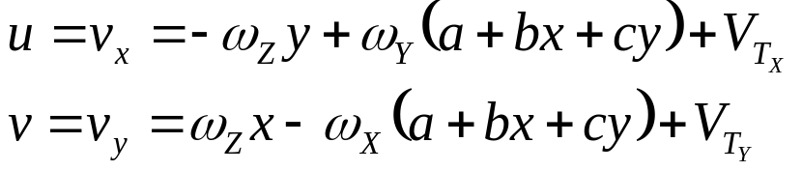
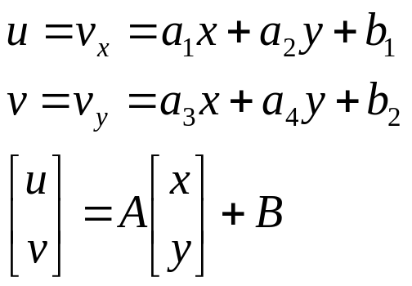
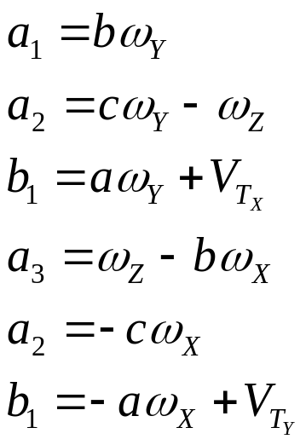
Motion Models
Planar Scene + Orthographic Projection (Affine Flow)
(Orthographic Projection +3D Rigid Motion)
(Equation of Plane)

Slide 22
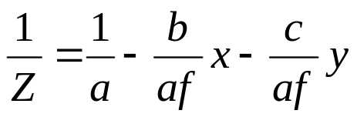
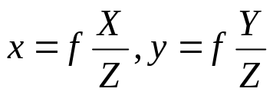
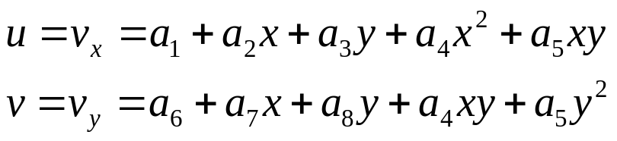
Motion Models
Planar Scene + Perspective Projection (Pseudo-Perspective)
(Perspective Flow)
(Equation of Plane)

Slide 23
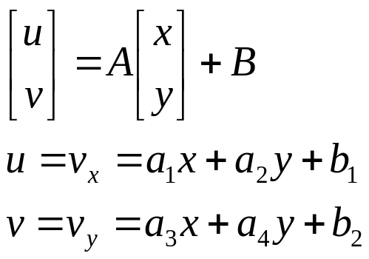
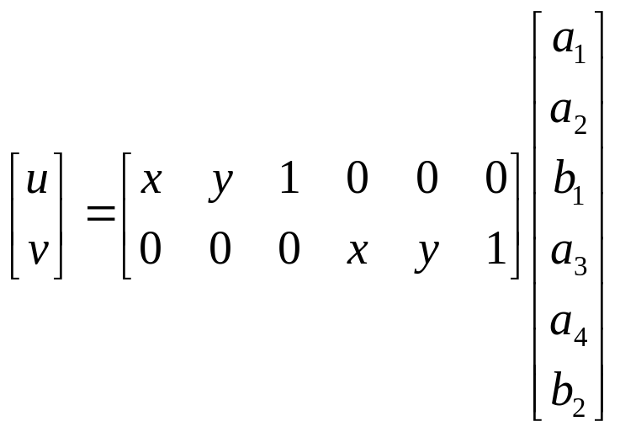

Estimation of Global Flow
Assume Affine Flow:
James R. Bergen, P. Anandan, Keith J. Hanna, Rajesh Hingorani: “Hierarchical Model-Based
Motion Estimation," ECCV 1992: 237-252

Slide 24
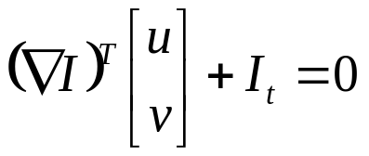

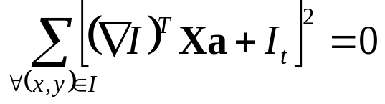
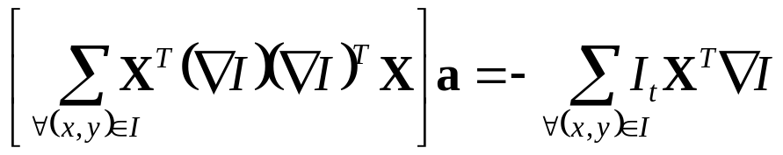
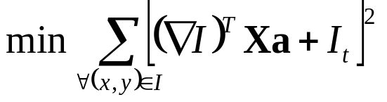

Estimation of Global Flow
(Optical Flow Constraint Equation)

Slide 25
Iterative Refinement
Iterative Algorithm
  Estimate global flow by solving linear system Aa=B
  Warp H towards I using the estimated flow
    - use image warping techniques (to be covered later)
  Repeat until convergence or a fixed number of iterations

Slide 26
Coarse-to-fine global flow estimation
u=1.25 pixels
u=2.5 pixels
u=5 pixels
image H
u=10 pixels
image H
image I
image I
Gaussian pyramid of image H
Gaussian pyramid of image I

Slide 27
Coarse-to-fine global flow estimation
Compute Flow Iteratively
warp & upsample
Compute Flow Iteratively
.
.
.
image J
image H
image I
image I
Gaussian pyramid of image H
Gaussian pyramid of image I

Slide 28
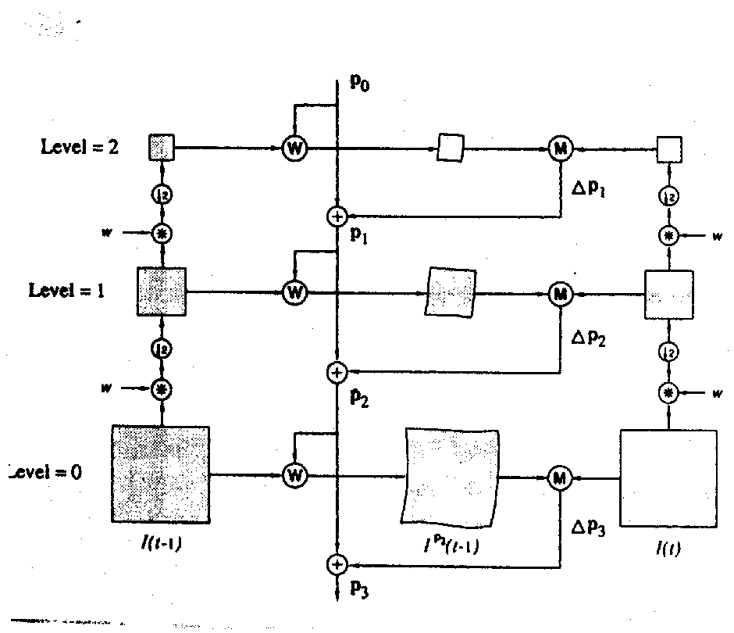
Coarse-to-fine global motion estimation

Slide 29
Basic Components
Pyramid Construction
Motion Estimation
Image Warping
Coarse to Fine Refinement

Slide 30
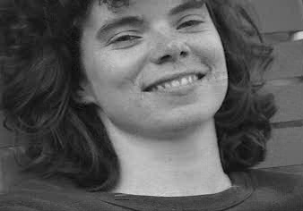
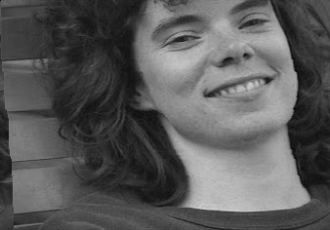
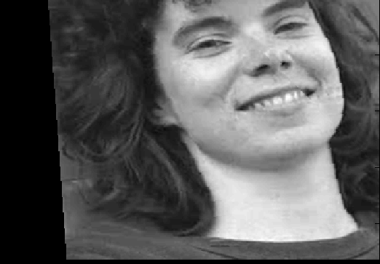
Result of Global Motion Estimation
Image ‘t’
Image ‘t+1’
Affine Model
output
4 Pyramids Level
5 Iterations/Pyramid Level

Slide 31
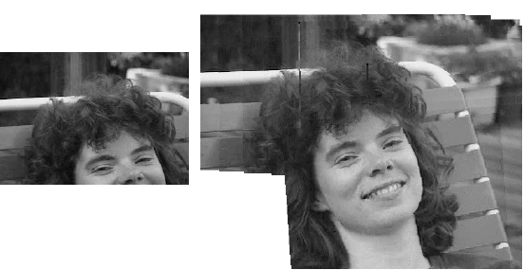
Video Mosaic

Slide 32
Suggested Readings
Chapter 8, Emanuele Trucco, Alessandro Verri, “Introductory Techniques for 3-D Computer Vision”
James R. Bergen, P. Anandan, Keith J. Hanna, Rajesh Hingorani: “Hierarchical Model-Based Motion Estimation," ECCV 1992: 237-252

