Slide 1
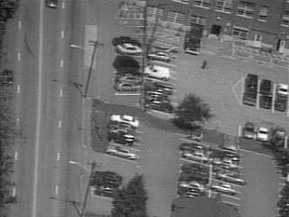
Motion Estimation I
What affects the induced image motion?
Camera motion
Object motion
Scene structure

Slide 2
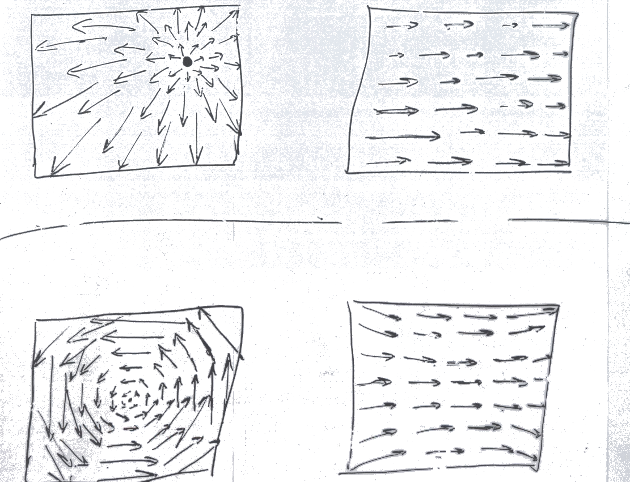
Example Flow Fields
This lesson – estimation of general flow-fields
Next lesson – constrained by global parametric transformations

Slide 3



The Aperture Problem
So how much information is there locally…?
Notes:
So what does it mean “motion consistency of small patches”?
Consider for example the following 4 patches.
They all have different patterns of intensities (and seem to have different motions).
Yet, they have been induced by the same global motion.
Therefore, we would like our measure to capture that they are motion consistent.
While these 4 intensity patterns cannot result from the same motion,
therefore we would like our measure to tell us they are inconsistent.
Once again, we want to do than purely based on the intensities of those patches, without estimating their motions.

Slide 4
The Aperture Problem
Not enough info in local regions
Copyright, 1996 © Dale Carnegie & Associates, Inc.

Slide 5
The Aperture Problem
Not enough info in local regions
Copyright, 1996 © Dale Carnegie & Associates, Inc.

Slide 6
The Aperture Problem
Copyright, 1996 © Dale Carnegie & Associates, Inc.

Slide 7
The Aperture Problem
Information is propagated from regions with high certainty (e.g., corners) to regions with low certainty.
Copyright, 1996 © Dale Carnegie & Associates, Inc.

Slide 8
Such info propagation can cause optical illusions…
Illusory corners
Notes:
So what does it mean “motion consistency of small patches”?
Consider for example the following 4 patches.
They all have different patterns of intensities (and seem to have different motions).
Yet, they have been induced by the same global motion.
Therefore, we would like our measure to capture that they are motion consistent.
While these 4 intensity patterns cannot result from the same motion,
therefore we would like our measure to tell us they are inconsistent.
Once again, we want to do than purely based on the intensities of those patches, without estimating their motions.

Slide 9
1. Gradient based methods
(Horn &Schunk, Lucase & Kanade)
2. Region based methods
(Correlation, SSD, Normalized correlation)
Direct (intensity-based) Methods
Feature-based Methods

Slide 10
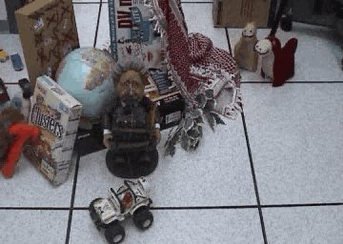
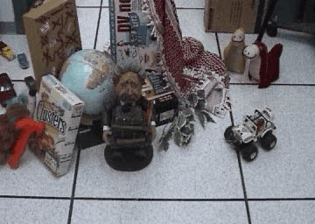

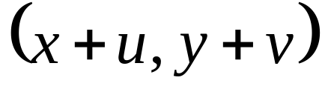
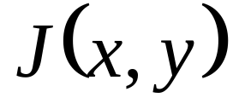
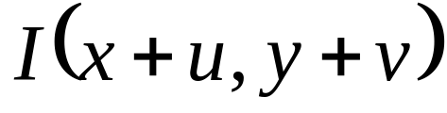

Brightness Constancy Assumption
Image I
(taken at time t+1)
Image J
(taken at time t)

Slide 11
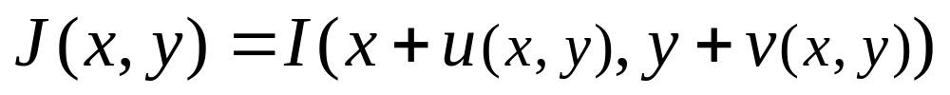
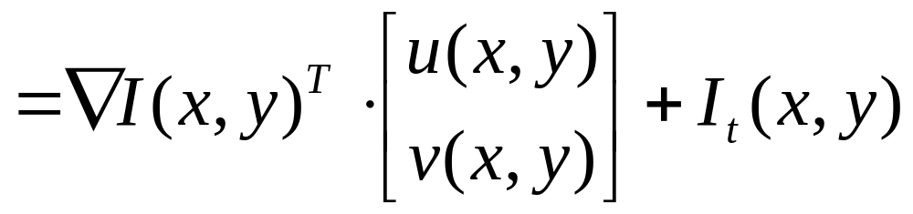
The Brightness Constancy Constraint
Brightness Constancy Equation:
Linearizing (assuming small (u,v)):

Slide 12
Observations:
* One equation, 2 unknowns
* A line constraint in (u,v) space.
* Can recover Normal Flow.
Need additional constraints…

Slide 13
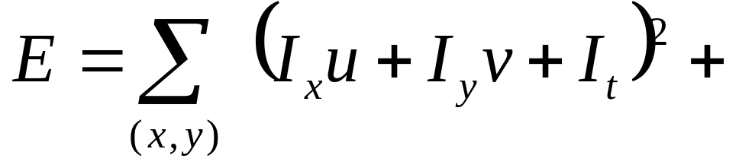
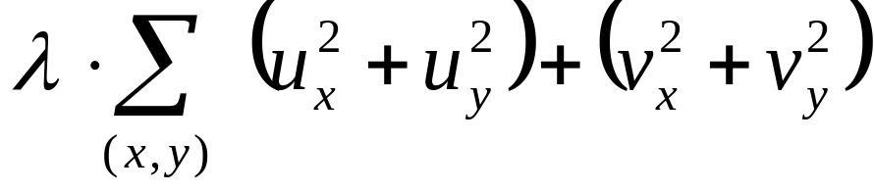
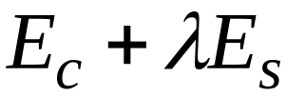
Horn and Schunk (1981)
Add global smoothness term
Error in brightness constancy equation
Smoothness error
Minimize:
Solve by calculus of variations

Slide 14
Horn and Schunk (1981)
Problems…
* Smoothness assumption wrong at motion/depth discontinuities
➔ over-smoothing of the flow field.
* How is Lambda determined…?

Slide 15
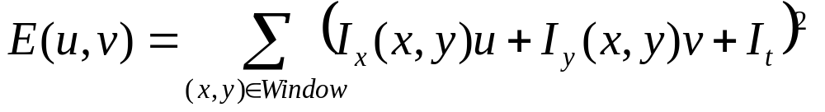
Lucas-Kanade (1984)
Assume a single displacement (u,v) for all pixels within a small window
Geometrically -- Intersection of multiple line constraints
Algebraically --
Minimize E(u,v):

Slide 16
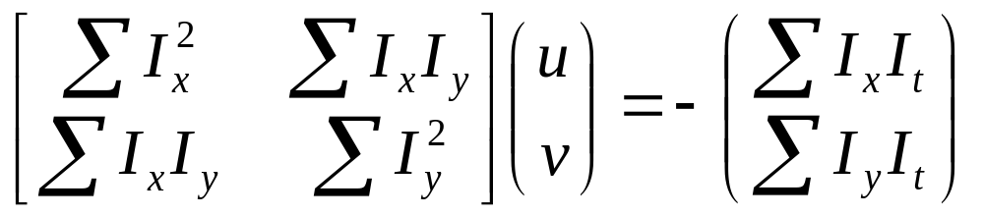
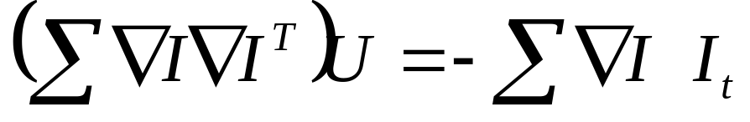
Lucas-Kanade (1984)
Minimize E(u,v):
Differentiating w.r.t u and v and equating to 0 ➔
Solve for (u,v)
[ Repeat this process for each and every pixel in the image ]

Slide 17
Lucas-Kanade (1984)
Problems…
* Singularities (partially solved by coarse-to-fine)
* Still smoothes at motion discontinuities (but unlike Horn & Schunk, does not propagate error across entire image)

Slide 18
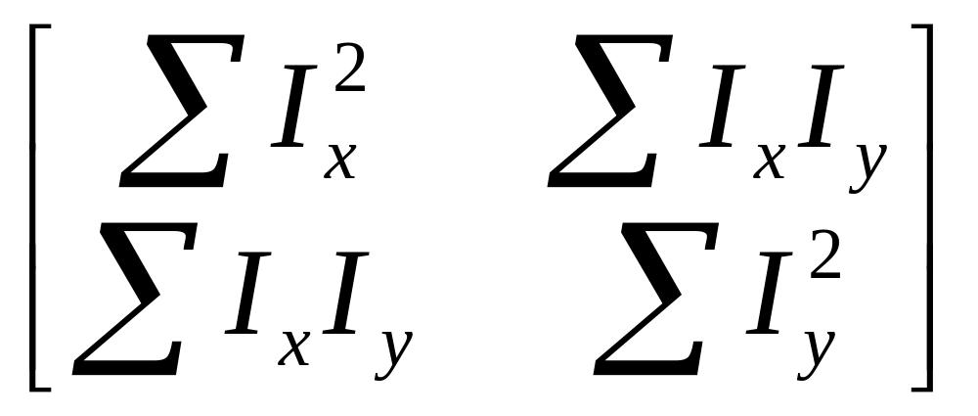
Singularites
We want this matrix to be invertible.
i.e., no zero eigenvalues

Slide 19
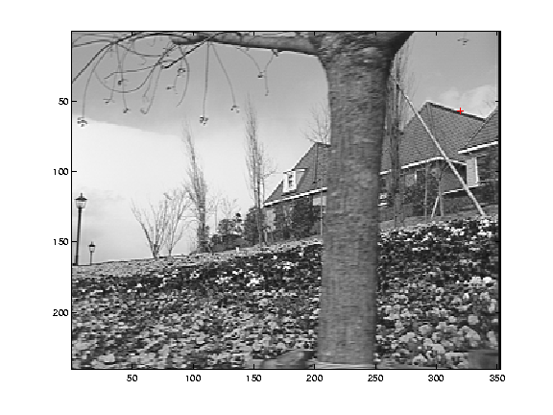
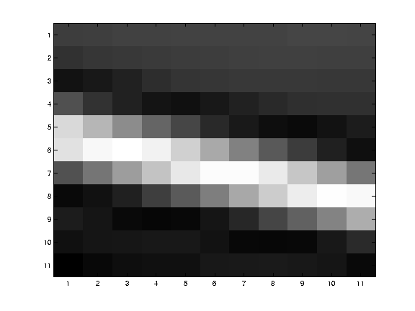
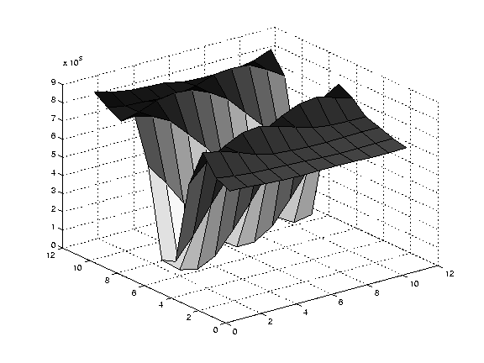
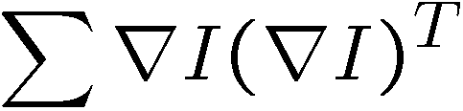
Edge
large gradients, all the same
large λ₁, small λ₂

Slide 20
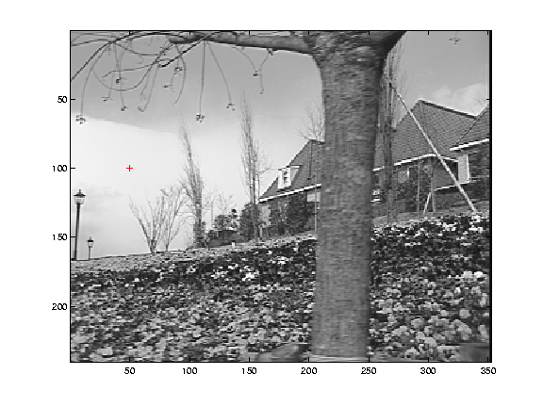
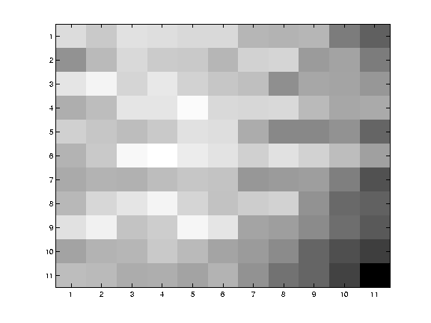
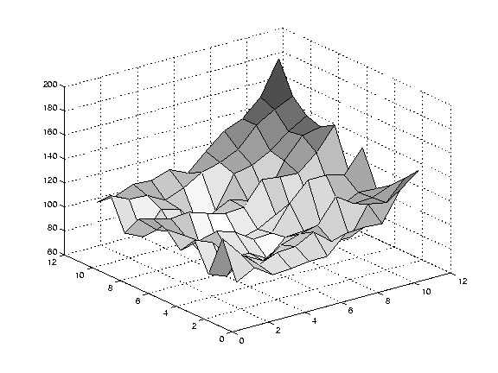
Low texture region
gradients have small magnitude
small λ₁, small λ₂

Slide 21
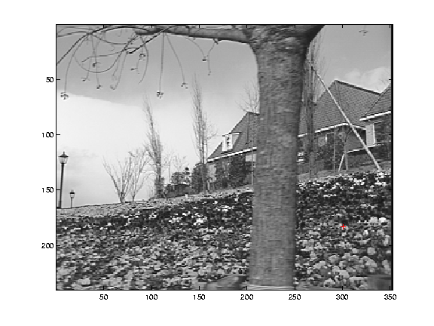
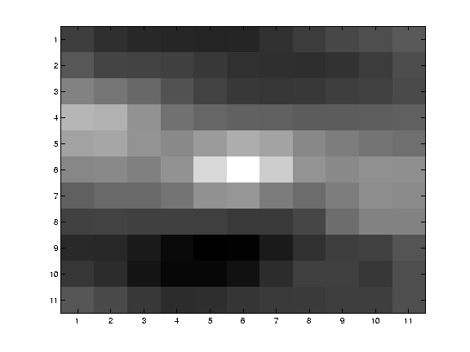
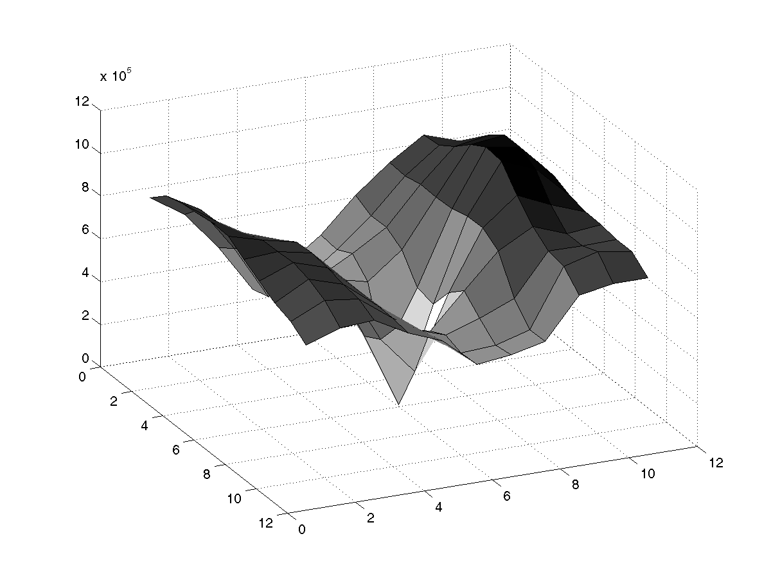
High textured region
gradients are different, large magnitudes
large λ₁, large λ₂

Slide 22
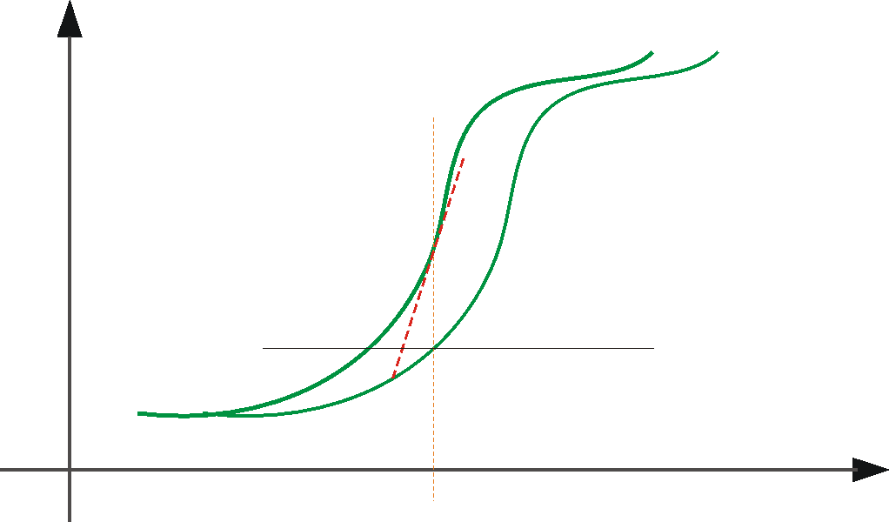
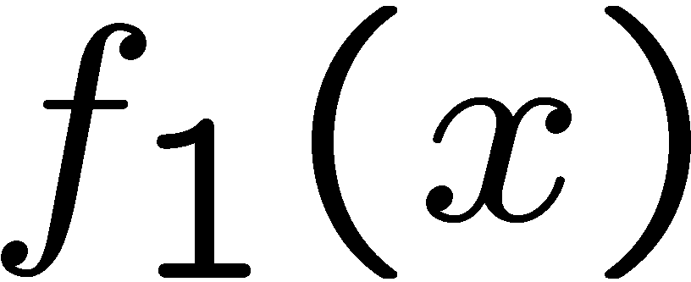
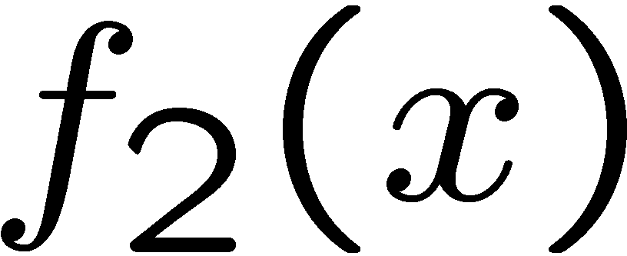

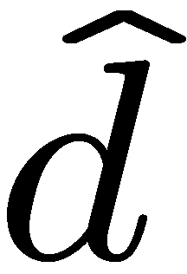
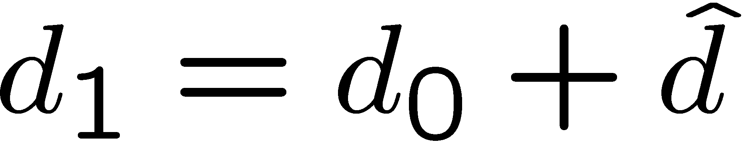
Linearization approximation
➔ iterate & warp
estimate update
Initial guess:
Estimate:
x₀
x

Slide 23
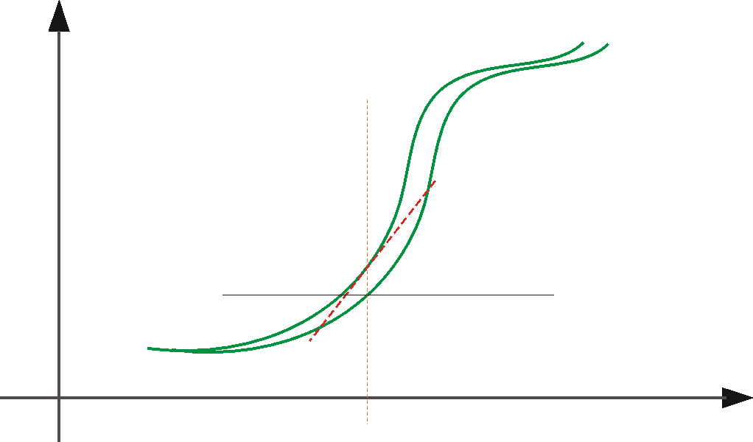
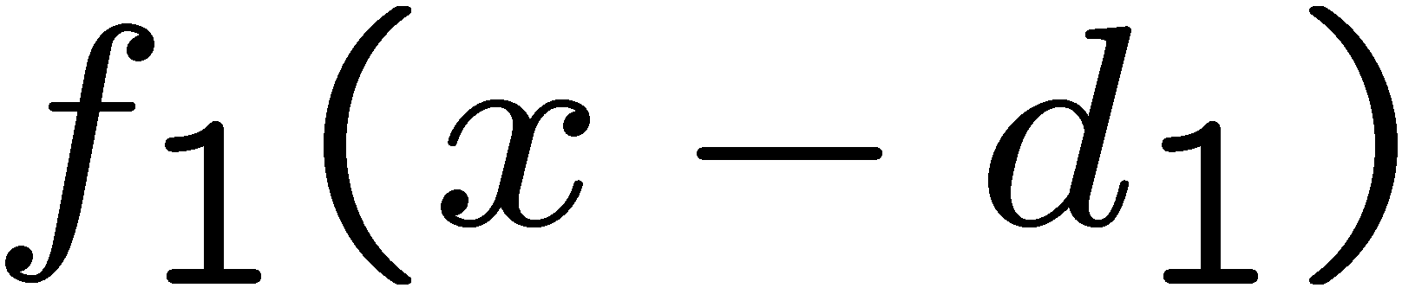
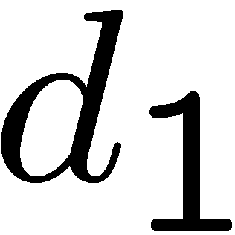
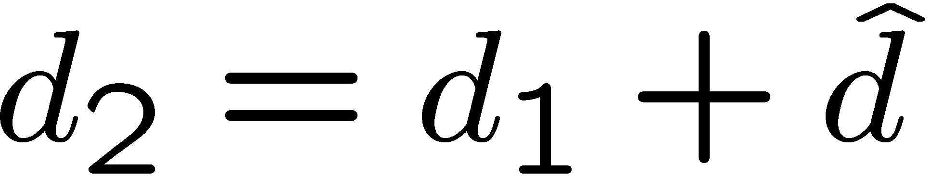
Linearization approximation
➔ iterate & warp
estimate update
Initial guess:
Estimate:
x₀
x

Slide 24
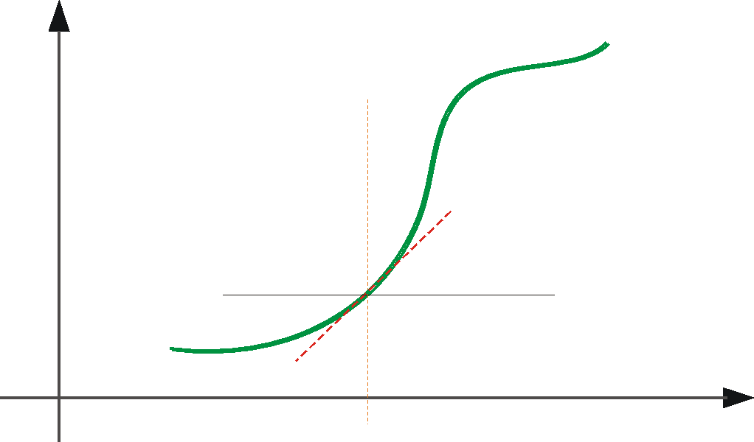
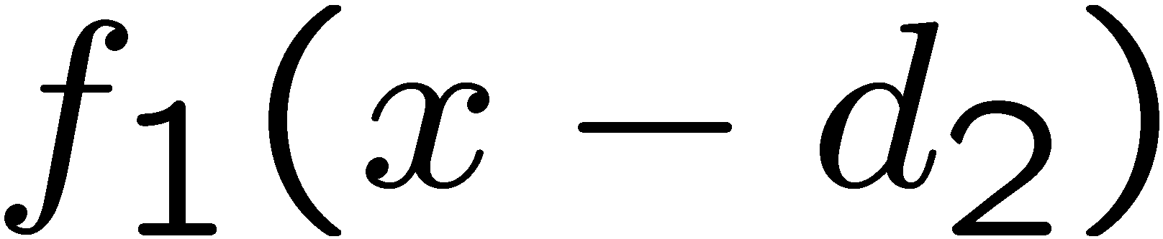
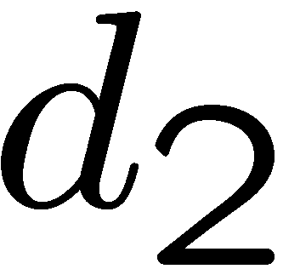
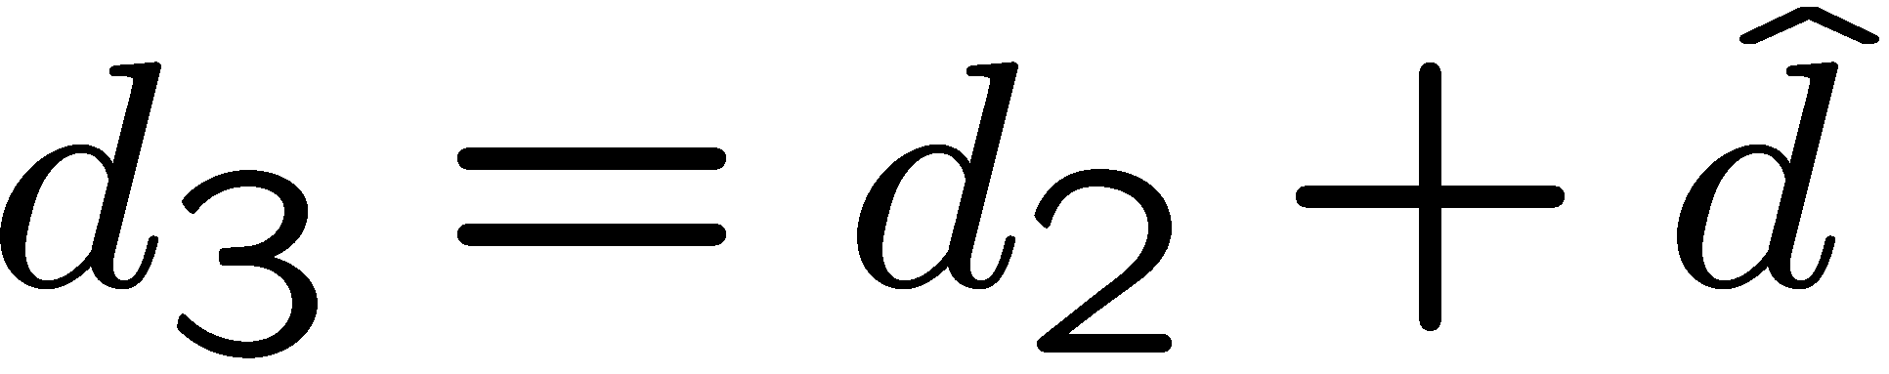
Linearization approximation
➔ iterate & warp
estimate update
Initial guess:
Estimate:
Initial guess:
Estimate:
x₀
x

Slide 25
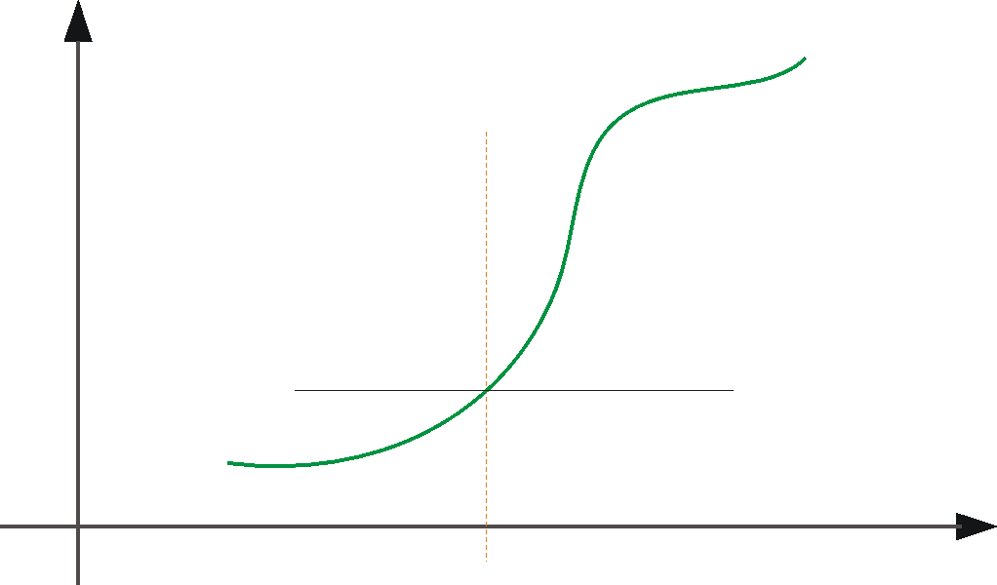
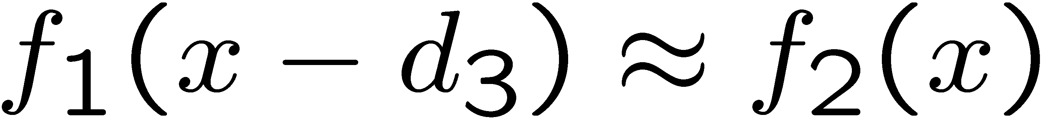
Linearization approximation
➔ iterate & warp
x₀
x

Slide 26
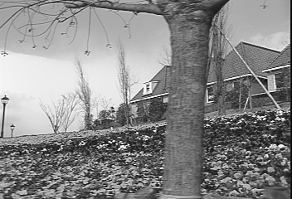
Revisiting the small motion assumption
Is this motion small enough?
  Probably not—it’s much larger than one pixel (2nd order terms dominate)
  How might we solve this problem?

Slide 27



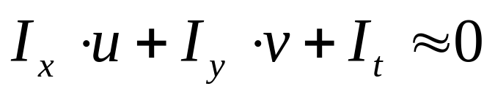
Coarse-to-Fine Estimation
Advantages: (i) Larger displacements. (ii) Speedup.
(iii) Information from multiple window sizes.
refine
iterate
u=1.25 pixels
+
u=2.5 pixels
==> small u and v ...
u=5 pixels
image J
u=10 pixels
image J
image I
image I
Pyramid of image J
Pyramid of image I

Slide 28
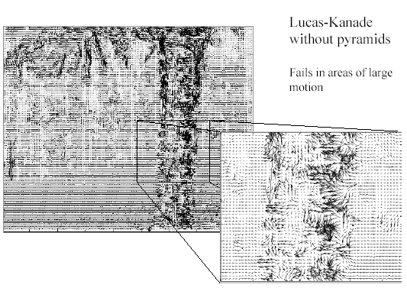
Optical Flow Results

Slide 29
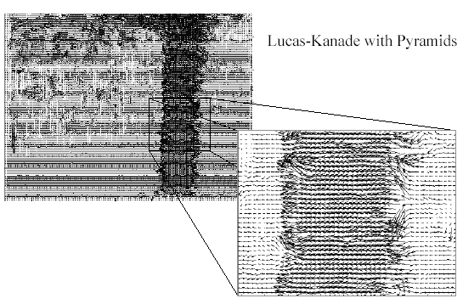
Optical Flow Results

Slide 30
1. Gradient based methods
(Horn &Schunk, Lucase & Kanade, …)
2. Region based methods
(Correlation, SSD, Normalized correlation)
➔ on the blackboard…
But… (despite coarse-to-fine estimation)
  rely on B.C.
  cannot handle very large motions
  small object moving fast…?
Copyright, 1996 © Dale Carnegie & Associates, Inc.

Slide 31
Region-Based Methods
* Define a small area around a pixel as the region
* Match the region against each pixel within a search area in next image.
* Use a match measure (e.g., sum of-squares difference, correlation, normalized correlation)
* Choose the maximum (or minimum) as the match

Slide 32
SSD Surface – Textured area

Slide 33
SSD Surface -- Edge

Slide 34
SSD – homogeneous area

Slide 35
B.C. + Additional constraints:
Spatial smoothness: [e.g., Horn & Schunk:81, Anandan:89]
    Violated at depth/motion discontinuities
Increase aperture: [e.g., Lucas & Kanade]
    Local singularities at degenerate image regions.
Increase analysis window to large image regions
=> Global model constraints:
    Numerically stable, but requires prior model selection:
      Planar (2D) world model
        [e.g., Bergen-et-al:92, Irani-et-al:92+94, Black-et-al]
      3D world model
      [e.g., Hanna-et-al:91+93, Stein & Shashua:97, Irani-et-al:1999]
Copyright, 1996 © Dale Carnegie & Associates, Inc.

