Slide 1
Optical Flow
Donald Tanguay
June 12, 2002

Slide 2
Outline
Description of optical flow
General techniques
Specific methods
  Horn and Schunck (regularization)
  Lucas and Kanade (least squares)
  Anandan (correlation)
  Fleet and Jepson (phase)
Performance results

Slide 3
Optical Flow
Motion field – projection of 3-D velocity field onto image plane
Optical flow – estimation of motion field
Causes for discrepancy:
  aperture problem: locally degenerate texture
  single motion assumption
  temporal aliasing: low frame rate, large motion
  spatial aliasing: camera sensor
  image noise

Slide 4


Brightness Constancy
Image intensity is roughly constant over short intervals:
Taylor series expansion:
Optical flow constraint equation:
(a.k.a. BCCE: brightness constancy constraint equation)
(a.k.a. image brightness constancy equation)
(a.k.a. intensity flow equation)

Slide 5
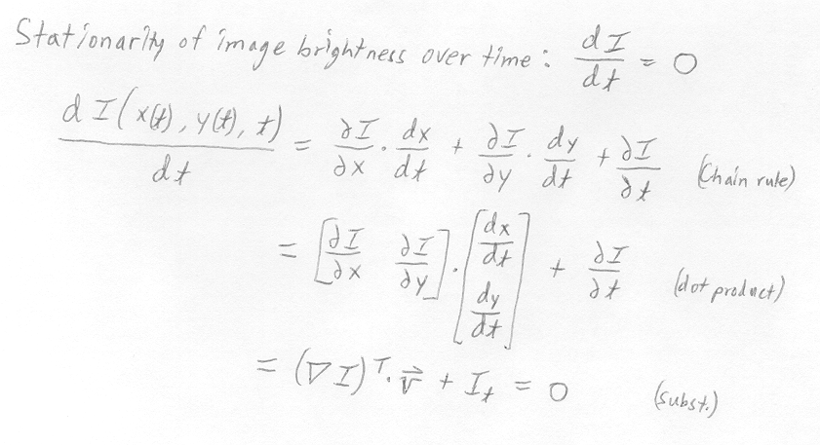
Brightness Constancy

Slide 6
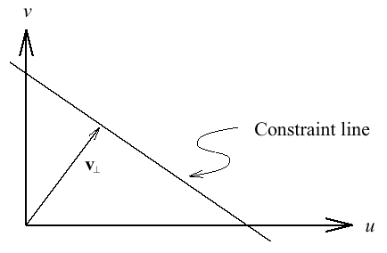
Aperture Problem
One equation in two unknowns => a line of solutions

Slide 7
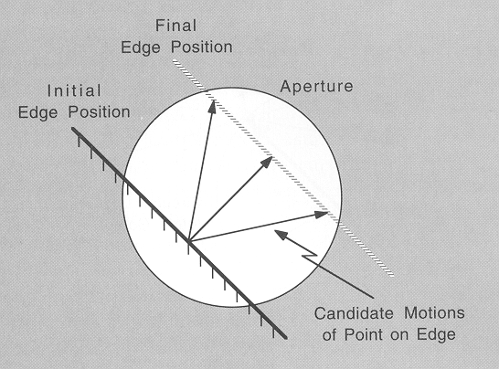
Aperture Problem
In degenerate local regions, only the normal velocity is measurable.

Slide 8
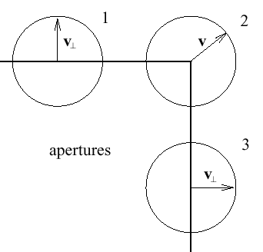
Aperture Problem

Slide 9
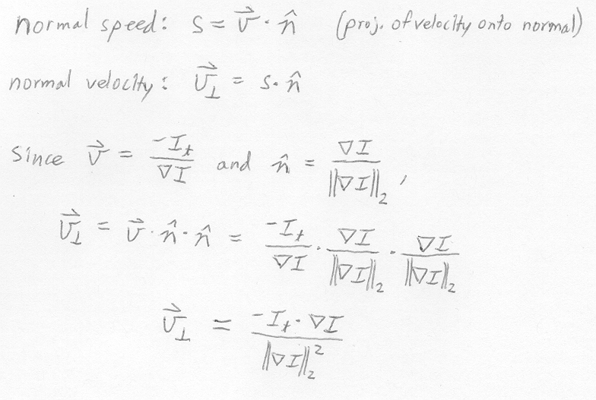
Normal Flow

Slide 10
General Techniques
Multiconstraint
Hierarchical
Multiple motions
Temporal refinement
Confidence measures

Slide 11
General Techniques
Multiconstraint
  over-constrained system of linear equations for the velocity at a single image point
  least squares, total least squares solutions
Hierarchical
  coarse to fine
  help deal with large motions, sampling problems
  image warping helps registration at diff. scales

Slide 12
Multiple Motions
Typically caused by occlusion
Motion discontinuity violates smoothness, differentiability assumptions
Approaches
  line processes to model motion discontinuities
  “oriented smoothness” constraint
  mixed velocity distributions

Slide 13
Temporal Refinement
Benefits:
  accuracy improved by temporal integration
  efficient incremental update methods
  ability to adapt to discontinuous optical flow
Approaches:
  temporal continuity to predict velocities
  Kalman filter to reduce uncertainty of estimates
  low-pass recursive filters

Slide 14
Confidence Measures
Determine unreliable velocity estimates
Yield sparser velocity field
Examples:
  condition number
  Gaussian curvature (determinant of Hessian)
  magnitude of local image gradient

Slide 15
Specific Methods
Intensity-based differential
  Horn and Schunck
  Lucas and Kanade
Region-based matching (stereo-like)
  Anandan
Frequency-based
  Fleet and Jepson

Slide 16

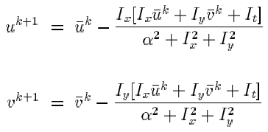
Horn and Schunck
Minimize the error functional over domain D:
BCCE
smoothness
term
smoothness
influence
parameter
Solve for velocity by iterating over Gauss-Seidel equations:

Slide 17
Horn and Schunck
Assumptions
  brightness constancy
  neighboring velocities are nearly identical
Properties
  + incorporates global information
  + image first derivatives only
  iterative
  smoothes across motion boundaries

Slide 18

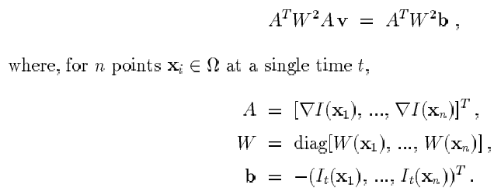
Lucas and Kanade
Minimize error via weighted least squares:
which has a solution of the form:

Slide 19
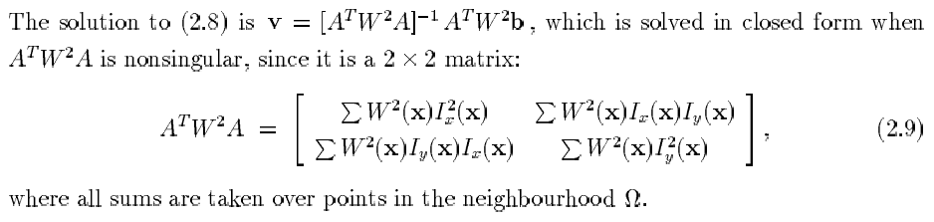
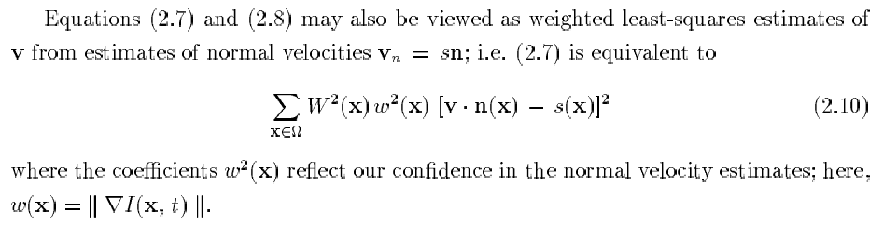
Lucas and Kanade

Slide 20
Lucas and Kanade
Assumptions
  locally constant velocity
Properties
  + closed form solution
  - estimation across motion boundaries

Slide 21
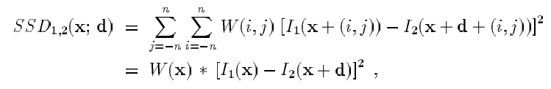
Anandan
Laplacian pyramid – allows large displacements, enhances edges
Coarse-to-fine SSD matching strategy

Slide 22
Anandan
Assumptions
  displacements are integer values
Properties
  + hierarchical
  + no need to calculate derivatives
  gross errors arise from aliasing
  - inability to handle subpixel motion

Slide 23



Fleet and Jepson
A phase-based differential technique.
Complex-valued band-pass filters:
Velocity normal to level phase contours:
Phase derivatives:

Slide 24
Fleet and Jepson
Properties:
  + single scale gives good results
  - instabilities at phase singularities must be detected

Slide 25
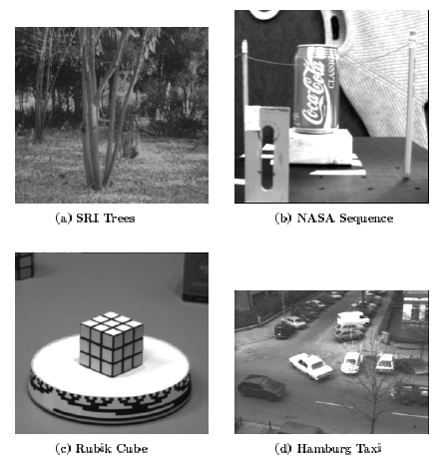
Image Data Sets

Slide 26
Image Data Sets
SRI sequence: Camera translates to the right; large amount of occlusion; image velocities as large as 2 pixels/frame.
NASA sequence: Camera moves towards Coke can; image velocities are typically less than one pixel/frame.
Rotating Rubik cube: Cube rotates counter-clockwise on turntable; velocities from 0.2 to 2.0 pixels/frame.
Hamburg taxi: Four moving objects – taxi, car, van, and pedestrian at 1.0, 3.0, 3.0, 0.3 pixels/frame

Slide 27
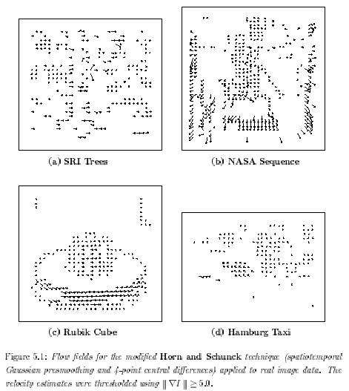
Results: Horn-Schunck

Slide 28
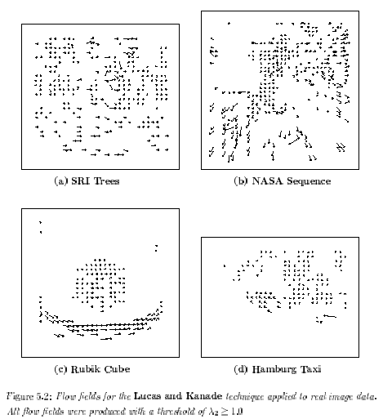
Results: Lucas-Kanade

Slide 29
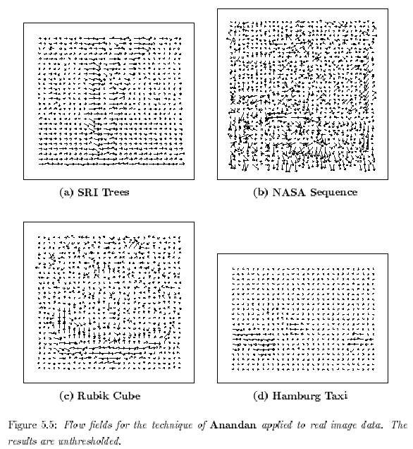
Results: Anandan

Slide 30
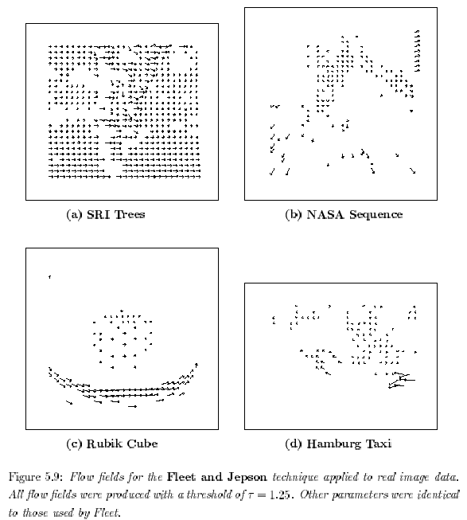
Results: Fleet-Jepson

Slide 31
References
Anandan, “A computational framework and an algorithm for the measurement of visual motion,” IJCV vol. 2, pp. 283-310, 1989.
Barron, Fleet, and Beauchemin, “Performance of Optical Flow Techniques,” IJCV 12:1, pp. 43-77, 1994.
Beauchemin and Barron, “The Computation of Optical Flow,” ACM Computing Surveys, 27:3, pp. 433-467, 1995.
Fleet and Jepson, “Computation of component image velocity from local phase information,” IJCV, vol. 5, pp. 77-104, 1990.

Slide 32
References
Heeger, “Optical flow using spatiotemporal filters,” IJCV, vol. 1, pp. 279-302, 1988.
Horn and Schunck, “Determining Optical Flow,” Artificial Intelligence, vol. 17, pp. 185-204, 1981.
Lucas and Kanade, “An iterative image registration technique with an application to stereo vision,” Proc. DARPA Image Understanding Workshop, pp. 121-130, 1981.
Singh, “An estimation-theoretic framework for image-flow computation,” Proc. IEEE ICCV, pp. 168-177, 1990.

