Slide 1
YOLO-World: Real-Time Open-Vocabulary Object Detection
CVPR 2024
Rabia Şevval Aydın - 504251520
Notes:
Paper
Main idea of the paper
Method used by the authors
Your own contribution and effort to improve or extend the work
duration,-> 20 min presentation, 2-3m q&a
Evaluation-> slides, presentation performance, content and material

Slide 2
Core Problem
Traditional YOLO can only detect objects from predefined categories that they’re trained on (e.g. 80 categories from COCO dataset). This limits their application range in real-world scenarios.
Authors aimed to give YOLO ‘open-vocabulary’ capabilities which is the ability to detect any object described in words, not just pre-trained categories.
Notes:
The core problem yolo world addresses is that yolo can only detect objects from predefined categories that they’re trained on beforehand. Since this limits their application range in real world scenarios, the
Authors aimed to give YOLO ‘open-vocabulary’ capabilities which means the model would have the ability to detect any object not just pre-trained categories.

Slide 3
Existing Open-Vocabulary Detectors
GLIP, Grounding-DINO, DetCLIP etc.
  Use vision-language models
  Often rely on large transformers (Swin-L, ViT-L)
  Perform online text encoding during inference
Result:
  Very slow
  Hard to deploy on real time systems
Key Idea of YOLO-World:
Can we turn YOLO into vision-language detector without losing real time performance?
Notes:
There are already object detectors with Open Vocabulary capabilities but their main problem they are very slow and hard to deploy on real time systems because usually they rely on large transformers and perform online text encoding during inference which increases the processing time.

Slide 4
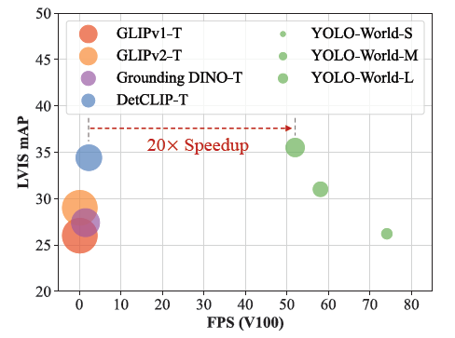
Figure 1. Speed-and-Accuracy Curve. Comparing YOLOWorld with recent open-vocabulary methods in terms of speed and accuracy. All models are evaluated on the LVIS minival and inference speeds are measured on one NVIDIA V100 w/o TensorRT. The size of the circle represents the model’s size.
Notes:
The answer to the previous question is yes they did achiece results that have significant faster performance result compared to existing open-vocabulary methods. Also in addition to speed they achieved this with smaller model’s size, decreasing the computational load.

Slide 5
Traditional YOLO will look for:
  Is this a dog, car, or a person?
YOLO-World looks for:
  Does this region match the meaning of the ‘golden dog’?
So, the detector no longer predict categories. It predicts:
  Bounding boxes
  Embeddings that live in the same space as text embeddings.
Detection becomes matching, not classification.
Notes:
Image regions and words are embedded into the same semantic space, and detection is similarity matching.

Slide 6
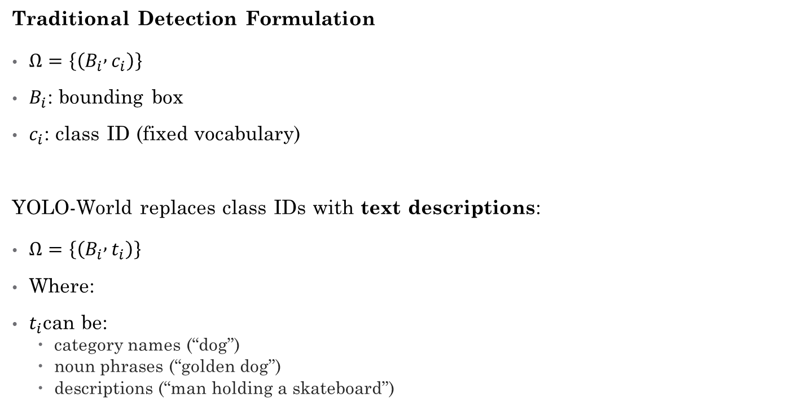
Reformulating Detection as Region–Text Matching
Traditional Detection Formulation
$Ω=\left\{\left(B_{i} , c_{i}\right)\right\}$
$B_{i}$: bounding box
$c_{i}$: class ID (fixed vocabulary)
YOLO-World replaces class IDs with text descriptions:
$Ω=\left\{\left(B_{i} , t_{i}\right)\right\}$
Where:
$t_{i}$can be:
  category names (“dog”)
  noun phrases (“golden dog”)
  descriptions (“man holding a skateboard”)
Notes:
Detection datasets
Grounding datasets
Image-text datasets
All become region–text pairs

Slide 7
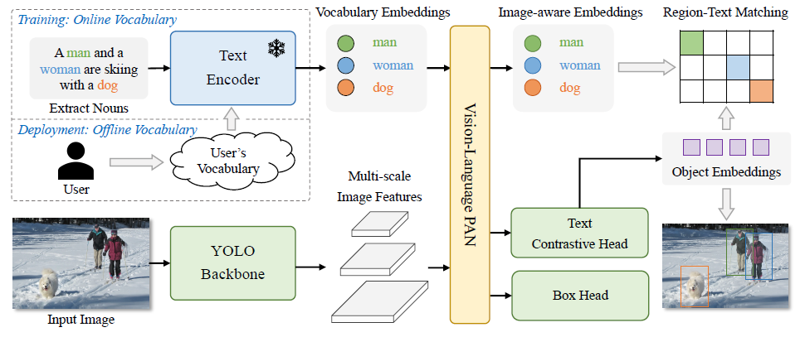
Figure 3. Overall Architecture of YOLO-World. Compared to traditional YOLO detectors, YOLO-World as an open-vocabulary detector adopts text as input. The Text Encoder first encodes the input text input text embeddings. Then the Image Encoder encodes the input image into multi-scale image features, and the proposed RepVL-PAN exploits the multi-level cross-modality fusion for both image and text features. Finally, YOLO-World predicts the regressed bounding boxes and the object embeddings for matching the categories or nouns that appeared in the input text.
Notes:
The system has four components:
1.YOLO Image Backbone
Standard YOLOv8 CNN
Produces multi-scale features $C3,C4,C5$
2.CLIP Text Encoder
Pretrained CLIP transformer
Converts text prompts → semantic embeddings
Frozen during training (important!)
3.RepVL-PAN (New Contribution)
Vision–language fusion inside the feature pyramid
4.Text-Contrastive Detection Head
Outputs:
bounding boxes
object embeddings (not class logits)
Input Image ──▶ YOLO Backbone ──▶ Multi-scale Features
│
Input Text ──▶ CLIP Text Encoder ──▶ Text Embeddings
│
RepVL-PAN (fusion)
│
Detection Head (boxes + embeddings)

Slide 8
1. YOLO Backbone
Standard YOLOv8 architecture.
Takes an image
Produces multi-scale feature maps:
C3 (small objects) [H/8 × W/8 × D]
C4 (medium objects) [H/16 × W/16 × D]
C5 (large objects) [H/32 × W/32 × D]

Slide 9
2. Text Encoder (CLIP)
Gets input text in the following formats:
  [‘man’, ‘woman’, ‘dog’]
  [‘golden dog’, ‘black dog’]
  [‘person holding a cup’]
CLIP converts each phrase into D-dimensional embedding.
CLIP is frozen.
It already knows visual semantics from image-text pretraining.

Slide 10
3. RepVL-PAN (Vision–Language Fusion)
RepVL-PAN modifies YOLO’s Path Aggregation Network (PAN).
Standard PAN:
Combines C3, C4, C5 top-down and bottom-up
Helps multi-scale detection
YOLO-World adds two lightweight language interactions:
Text-Guided CSP Layer (Text → Image)
Image-Pooling Attention (Image → Text)
Notes:
YOLO-World extends PAN into a vision-language PAN.
At this point we have:
Image features: spatial + visual
Text features: embeddings but no connection to location.
Question: how do we make the image regions aware of text meaning, without worsening YOLO’s speed? -> RepVL-PAN

Slide 11
3.1 Text-Guided CSP Layer
(Text → Image)
“Which words are relevant to this image location?”
For each spatial location in the feature map:
Compare that feature vector with all text embeddings
Find the most relevant word
Use it as an attention gate
Notes:
So if a region looks like a dog, and the vocabulary contains the Word dog then that region get boosted, and irrelevant regions get suppressed.
Enhances regions relevant to the vocabulary

Slide 12
3.2 Image-Pooling Attention
(Image → Text)
“Given this image, what do these words mean in this context?”
Instead of heavy attention over all pixels:
Pools image features into 27 representative tokens. (3 levels × 9 regions)
Runs multi-head attention:
  Query: text embeddings
  Key/Values: pooled image features
  W' = W + MultiHead-Attention(W, X̃, X̃)
Result: image-aware text representations
Notes:
For example if the word bat is near a baseball fi
Instead of using full image features (expensive), use compact 3×3 representations
Text embeddings attend to these image regions Updated text embeddings become "image-aware" Helps text representations understand visual context
In the end instead of a classification problem we achieve matching.
eld, then it is taken into account as sports bat not the animal.

Slide 13
Online vs. Offline Vocabulary
Vocabulary = set of words/phrases model is allowed to detect
During training, YOLO-World uses online vocabulary.
Each training batch has different words that comes from category names, noun phrases, captions.
Text encoder runs every batch.
So, the vocabulary changes dynamically which is good for open-vocabulary generalization and aligning regions with words.

Slide 14
Why online vocabulary is bad for inference?
For every image:
Run text encoder
Encode all prompts
Match regions to text
This is what models like Grounding-DINO/GLIP do. They run text encoding for every image.
Notes:
This cause problems:
Slow runtime
Gpu-heavy
Hard to deploy
Against yolo’s princible.

Slide 15
What is offline vocabulary?
You encode the text once, ahead of time, and never run the text encoder during inference.
Before inference, user chooses what they want to detect. This can be categories, phrases or descriptions.
You run the CLIP text encoder once to get embeddings. This happens once per vocabulary not per image.
YOLO-World absorbs the text embedding into network weights. (Re-parameterization)
After is text encoder is no longer needed, embeddings are no longer inputs. The detector becomes pure CNN again. (prompt-then-detect)
Notes:
1. So you determine the vocabulary before hand.
2. So the text encoder runs offline.
(!) So text embeddings are merged into convolution kernels, linear layers, normalization parameters.
This is called prompt-then-detect approach

Slide 16
prompt-then-detect
Traditional open-vocabulary detectors:
Prompt + Image → Detection (every single time)
YOLO-World:
Prompt → Compile → Detect many images
Notes:
This is called prompt-then-detect

Slide 17
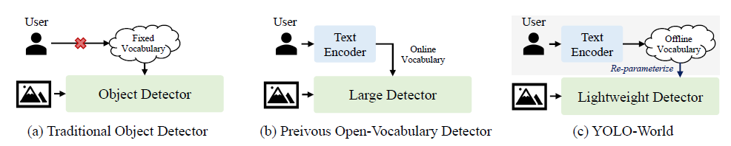
Figure 3. Comparison with Detection Paradigms. (a) Traditional Object Detector: These object detectors can only detect objects within the fixed vocabulary pre-defined by the training datasets, e.g., 80 categories of COCO dataset [26]. The fixed vocabulary limits the extension for open scenes. (b) Previous Open-Vocabulary Detectors: Previous methods tend to develop large and heavy detectors for open-vocabulary detection which intuitively have strong capacity. In addition, these detectors simultaneously encode images and texts as input for prediction, which is time-consuming for practical applications. (c) YOLO-World: We demonstrate the strong open-vocabulary performance of lightweight detectors, e.g., YOLO detectors [20, 42], which is of great significance for real-world applications. Rather than using online vocabulary, we present a prompt-then-detect paradigm for efficient inference, in which the user generates a series of prompts according to the need and the prompts will be encoded into an offline vocabulary. Then it can be re-parameterized as the model weights for deployment and further acceleration.
Notes:
Figure 2. Comparison with Detection Paradigms. (a) Traditional Object Detector: These object detectors can only detect objects within the fixed vocabulary pre-defined by the training datasets, e.g., 80 categories of COCO dataset [26]. The fixed vocabulary limits the extension for open scenes. (b) Previous Open-Vocabulary Detectors: Previous methods tend to develop large and heavy detectors for open-vocabulary detection which intuitively have strong capacity. In addition, these detectors simultaneously encode images and texts as input for prediction, which is time-consuming for practical applications. (c) YOLO-World: We demonstrate the strong open-vocabulary performance of lightweight detectors, e.g., YOLO detectors [20, 42], which is of great significance for real-world applications. Rather than using online vocabulary, we present a prompt-then-detect paradigm for efficient inference, in which the user generates a series of prompts according to the need and the prompts will be encoded into an offline vocabulary. Then it can be re-parameterized as the model weights for deployment and further acceleration.
In summary:
Offline vocabulary = compiling language into weights.
Language is no longer an input, it becomes part of the detector.

Slide 18
Trade-off of offline vocabulary
It can only detect that predetermined vocabulary.
To change vocabulary:
  Re-encode text
  Re-parameterize
  Redeploy
But doing this is cheap, fast and acceptable in real scenarios.
A traffic camera system, an autonomous vehicle.
Notes:
They don’t need infinite vocabulary per frame so you can use them

Slide 19
Training Details
Optimizer: Adam W
Learning rate: 0.002
Weight decay: 0.05
Batch size: 512 (32 V100 GPUs)
100 epochs
Data augmentation: color jittering, random affine transformations, random horizontal flip, mosaic augmentation.

Slide 20
YOLO-World is pre-trained on large-scale datasets, including detection, grounding, and image-text datasets.
Objects365 (365 categories)
LVIS (1000+ categories)
Mixed Grounding Datasets (Flickr30k, GQA, COCO)

Slide 21
Importance of Text Quality
GQA dataset provides biggest improvement because:
Rich noun phrases vs. simple category names
Diverse linguistic descriptions
Better visual-semantic alignment

Slide 22
Prompt/vocabulary improvements
A1) Better prompt templates
Instead of raw category names:
"dog" → "a photo of a dog" / "a clear photo of a dog"
Add synonyms: "sofa, couch" (treat as multiple entries, merge results)
Why it can help: text embeddings shift a lot based on phrasing in CLIP-like models.
How to measure: LVIS Fixed AP / custom-vocab AP + false positives (see metrics below)
A2) Vocabulary design: reduce confusion
If you include very similar terms, you increase misclassification:
["dog", "puppy", "golden dog"] might steal matches from each other.
Notes:
Changed the base COCO class raw label’s to descriptive prompts.
e.g. ‘‘bus’’ -> ‘’a photo of a bus’’

Slide 23
YOLO-World-S: 7.9M params
YOLO-World-M: 20.1M params
YOLO-World-L: 37.1M params
Evaluation dataset → COCO val 2017 (5000 images)

Slide 24
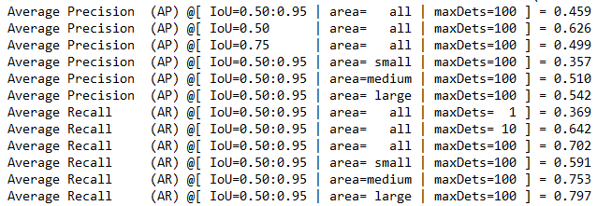
Evaluation Results of Base Model – Raw Labels
Notes:
Evaluation dataset → COCO val 2017 (5000 images)

Slide 25
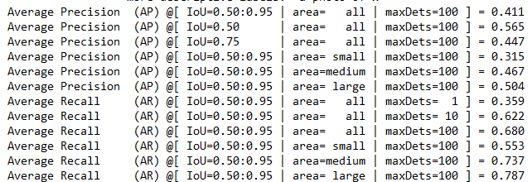
Evaluation Results of Using Descriptive Class Labels

Slide 26
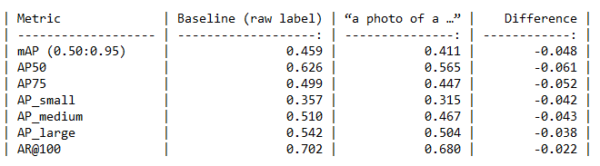
Comparison Table Between Raw and Descriptive Class Labels
Notes:
Measures how well a predicted bounding box overlaps the ground-tru
AP measures detection quality box primary COCO metric. Model must both classify correctly and localize precisely
Penalizes loose boxes
Metric->Object size
AP_s -> Small AP_m ->Medium AP_l -> Large

Slide 27
Multi-prompt
For every class create 3 similar prompts and take their mean.
Texts = [[p1,p2,p3], [p1,p2,p3], …]
Encode all prompts
Normalize every embedding
For every category take the mean of the embeddings to produce singular representation.
Still working on it...

Slide 28
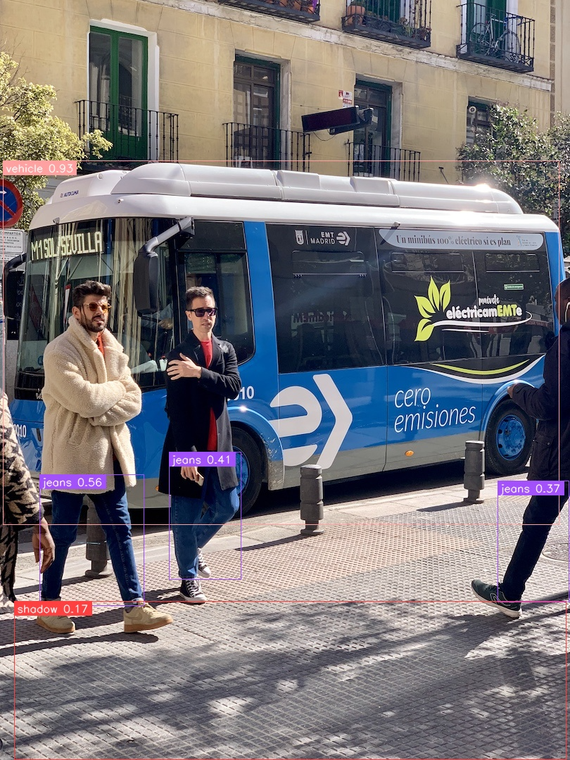

Slide 29
Thank you for listening

Slide 30
Text Encoder Comparison
BERT (frozen): 14.6 AP, 3.4 APᵣ
BERT (fine-tuned): 18.3 AP, 6.6 APᵣ
CLIP (frozen): 22.4 AP, 14.5 APᵣ
CLIP (fine-tuned): 19.3 AP (degrades - loses generalization)
Notes:
????????????

