Slide 1
What is IoT
Connecting the physical world to the internet.
Data Collection
Transmission
Analytics
Decision

Slide 2
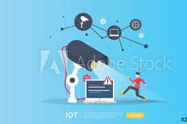
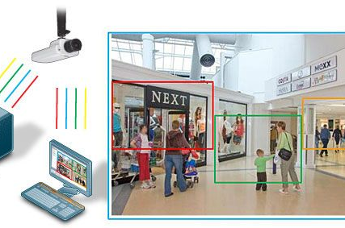
SEE! Basic Vs Sophisticated

Slide 3
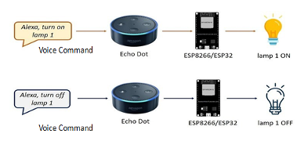
Hear! ALEXAAAA!

Slide 4
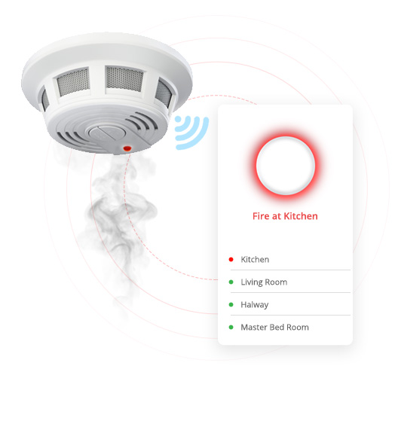
SMELL!

Slide 5
Different paradigms
Data Collection
Transmission
(data and more)
Analytics

Slide 6
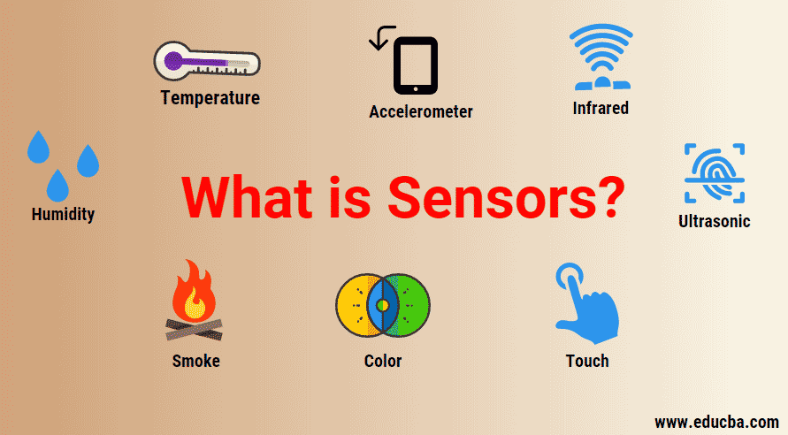
Data Collection – Edge
Sensors and more!
Virtual sensors, real sensors
Python package: CounterFit
Notes:
https://github.com/CounterFit-IoT/CounterFit/tree/main/counterfit-app

Slide 7
Analytics
Data Collection
Transmission
Analytics

Slide 8

Different paradigms to choose for your project

Slide 9
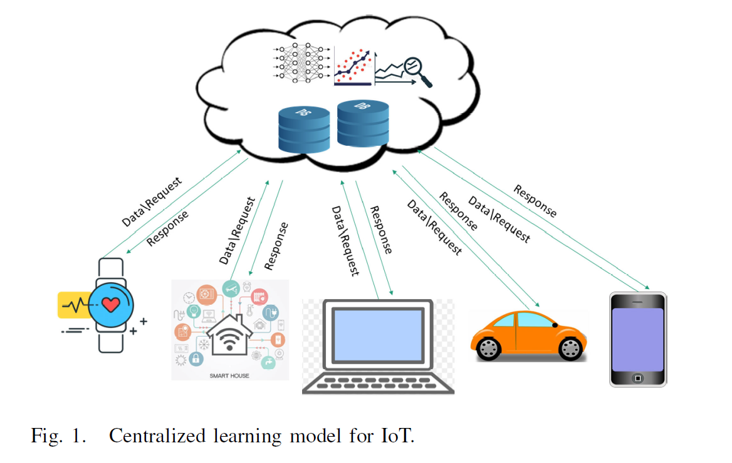
Implementation:
AWS
Microsoft Azure

Slide 10
Centralized learning
+ cloud offers a huge repository so that stores huge volumes of data.
+ equipped with high-performance servers.
+ cloud services are best protected by service providers for any security breaches or attacks.
But! data travels to the server!! Concerns about personal and medical data

Slide 11
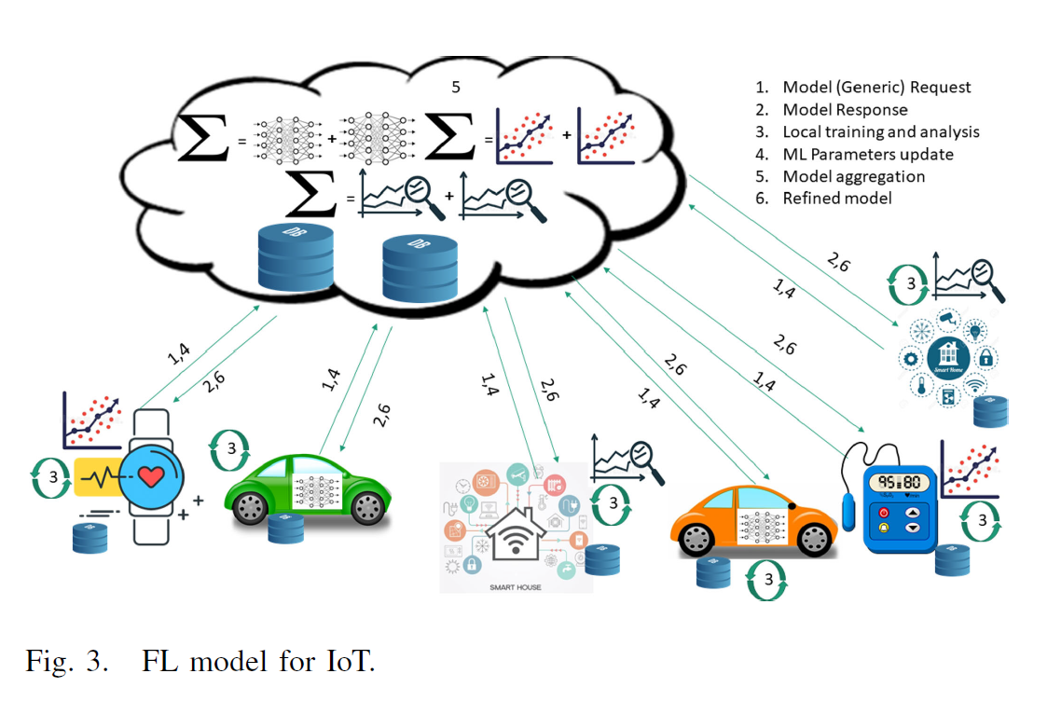

Slide 12
Federated Learning
Privacy preserving paradigm
Libraries:
Flower framework
Tensorflow_federated

Slide 13
Edge Implementation considerations: Data Collection + Training
Limited memory:
High batch size and memory-consuming NN, no TL
Vulnerable:
not always up to date in protection against attacks!
Limited battery power: complex models
Accuracy

Slide 14
References
Recent Advances on Federated Learning for Cybersecurity and Cybersecurity for Federated Learning for Internet of Things (IEEE journal of IoT, IF 9.9)

Slide 15
EDA
What Does EDA stand for?
is understanding the data sets by summarizing their main characteristics often plotting them visually
Observations about the dataset
Informed decisions before sending the dataset to a neural network for training

Slide 16

Log Files

Slide 17
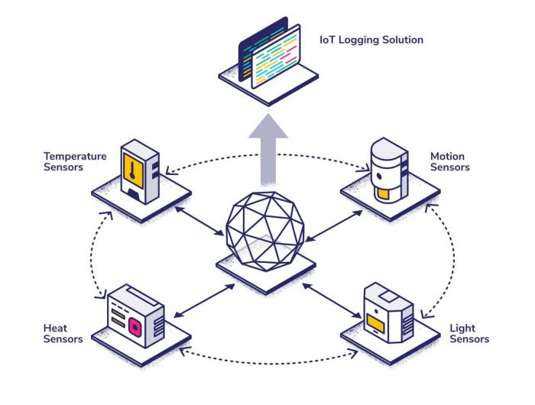

Slide 18
Log Types
Status Log
Error Log
Authentication Log
Configuration Log
Notes:
-Status ON/OFF : periodically
-Error Log: Exception handling , down time ,
when occurred ,
and if possible why it occurred (which line of code), WHO WAS SIGNED IN Only sent when happens (not periodic),
-Authentication Log: upon logging in , Sometimes only login failure , or always (NO Periodic)
-Configuration Log: SW updates (NOT PERIODIC)
EVENT LOG!(project) +
LOGGING LIBRARY

Slide 19

Where are log files saved?
On-Device Storage
Cloud Storage
Considerations:
Scale
Real-time insights
Notes:
TIMESTAMP , IP, Logtype, credentials
What would you choose?
1- high scale : cloud is too much traffic
2- but if insights needed in real-time

Slide 20

What can we do with log files?

Slide 21
Why it is important to analyze log files?
Traffic monitoring
Delay in service detection
Debug and track user complaints
Security

