Slide 1



Sales
View in Power BI
Last data refresh:
3/5/2025 9:01:45 AM UTC
Downloaded at:
3/5/2025 9:04:15 AM UTC

Slide 2
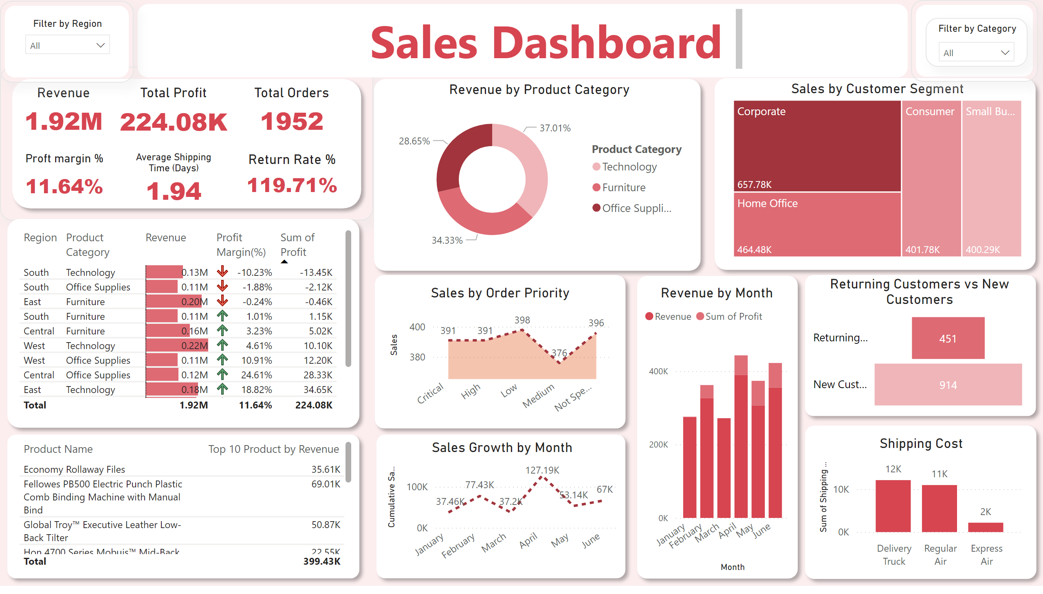
Page 2
Notes:
Filter by Region
No alt text provided
Filter
No alt text provided
Revenue
No alt text provided
Total Profit
No alt text provided
Total Orders
No alt text provided
Proft margin %
No alt text provided
Average Shipping Time (Days)
No alt text provided
Return Rate %
No alt text provided
Filter
No alt text provided
Revenue by Product Category
No alt text provided
shape
No alt text provided
Sales by Customer Segment
No alt text provided
shape
No alt text provided
tableEx
No alt text provided
shape
No alt text provided
Sales by Order Priority
No alt text provided
shape
No alt text provided
Returning Customers vs New Customers
No alt text provided
shape
No alt text provided
shape
No alt text provided
textbox
No alt text provided
Filter by Category
No alt text provided
Filter
No alt text provided
Revenue by Month
No alt text provided
shape
No alt text provided
Shipping Cost
No alt text provided
shape
No alt text provided
tableEx
No alt text provided
shape
No alt text provided
Sales Growth by Month
No alt text provided
shape
No alt text provided

